Slide 1
Sunday March 6th
09h02: Ramp started. 1 nominal bunch per beam.
  Reference orbit established at 3.5 TeV.
  Emittance 1.5 / 1.0 μm (b1)
  1.7 / 1.2 μm (b2)
  Beam lifetime > 1,000 hours in both beams
10h40: Start collimation setup at 3.5 TeV.
16h04: Dump b1. LBDS self trigger:
  BETS tracking error. Supply problem start at 14h00.
  Later access required: change the HV power supply.
17h56: Beam 2 dumped: losses from collimation setup.
  B1: 13 H collimators completed.
  B2: 21 H collimators completed.
  Impedance observations in parallel.
18h51: Access for beam dump.

Slide 2
Sunday/Monday March 6th/7th
RQT13.R7B2 tripped, EPC piquet could fix it remotely, hardware will be changed at the next occasion.
Quench heater power supply is discharged for RB.A56. QPS_OK is masked in SIS.
21h07: Injection.
21h53: Machine protection and other tests.
  Switch off power converters to check SIS. OK.
  Check RF frequency interlocks. OK.
  Check automatic correction ALICE/LHCb spectrometer bump non-closure. OK.
00h09: Start of transverse damper studies.
04h00: Loss maps.
06h00: Ramp without tune feedback but with radial mod.
08h00: Start injection and dump setup at 450 GeV.

Slide 3
Week Summary
Rocky week. Plenty of access up to start of weekend.
  Up to 11h access per day.
  Many problems (see daily slides).
  Major impact: Feedback software and control. OK presently.
  Major impact: Beam dump problems. Many accesses. Rollback of software. More or less OK (still 1 problem per day). Brennan at LMC.
Very smooth and efficient weekend (we need more weekends and less weekdays).

Slide 4
Where are we for 450 GeV?
Injection optics and orbit OK.
Aperture OK and measured.
  Measure DS aperture and response.
RF system OK.
Transverse damper OK.
Feedbacks OK.
Emittance small but not controlled.
Injection ring collimation OK.
  Repeat loss maps once preliminary data is analyzed. ~4h.
Machine protection OK.
  Some final adjustments to be done.
Injection transfer line collimation OK.
  Checks to be completed for TI8.
Then move to multi-bunch injection.

Slide 5
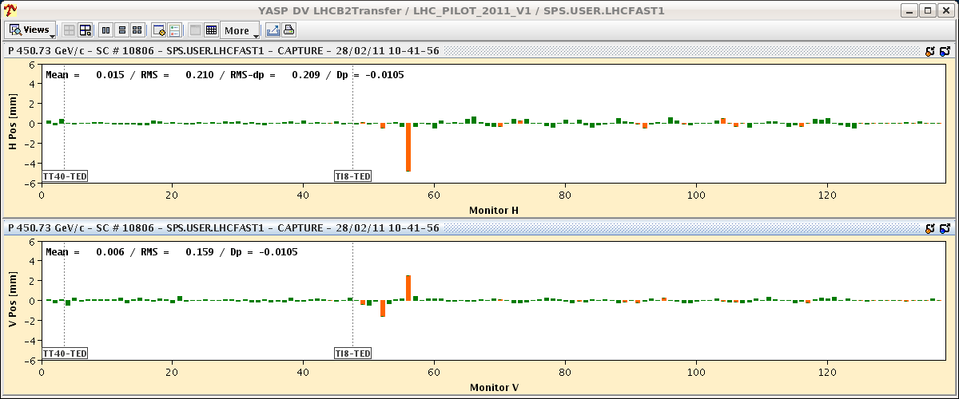
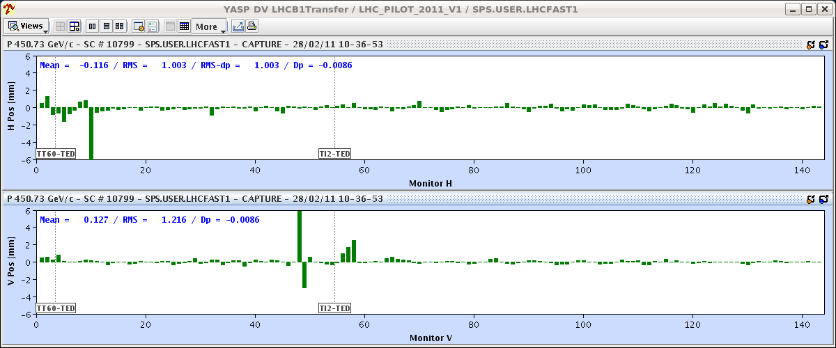
Transfer Line Trajectories
Injection team

Slide 6
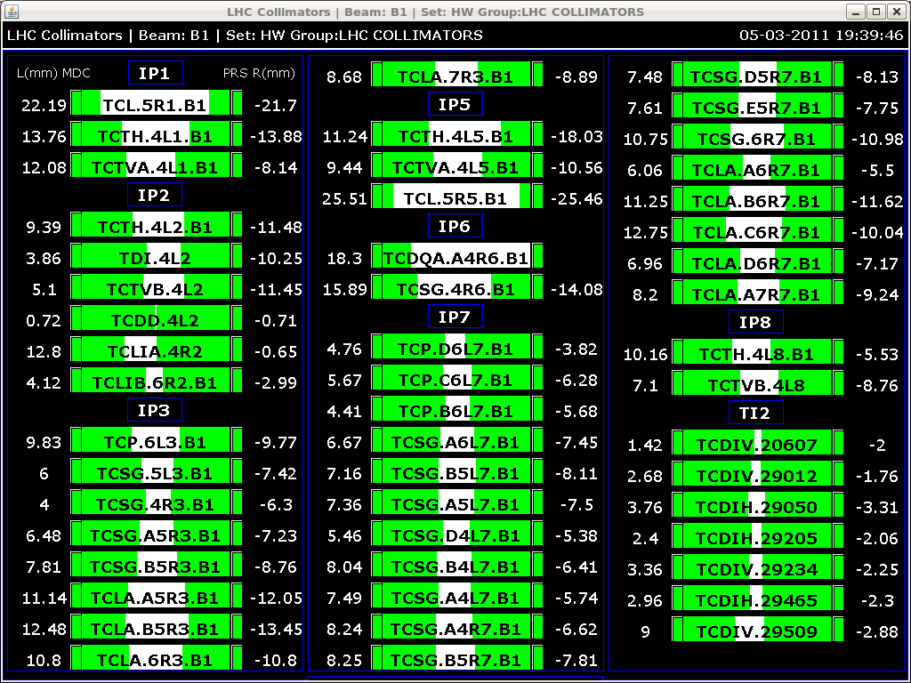
Full collimator + protection settings B1

Slide 7
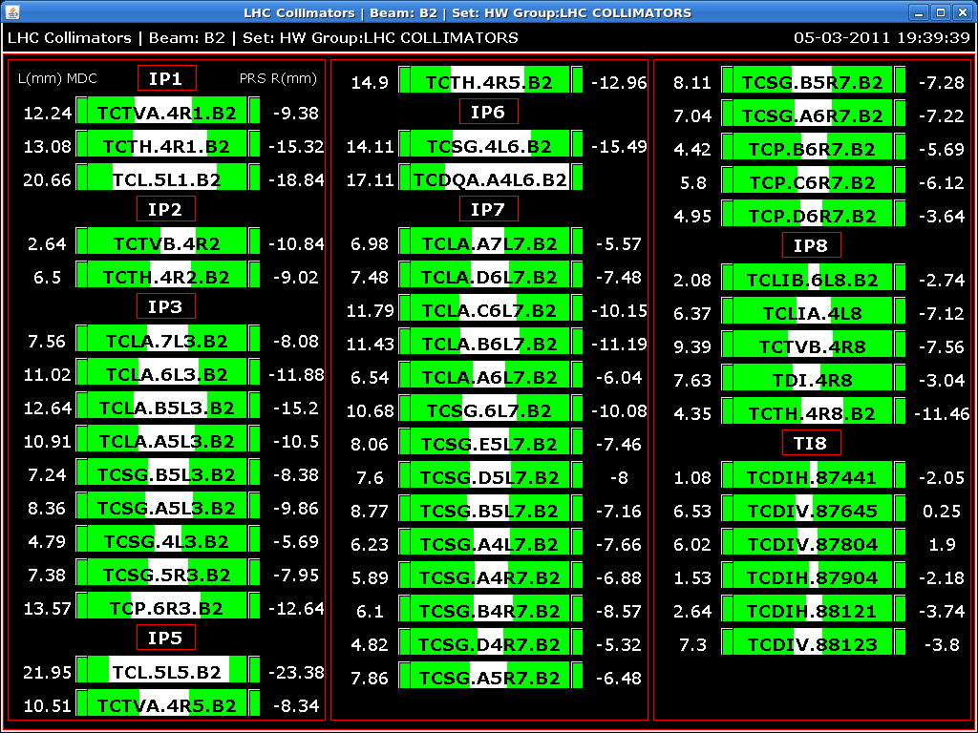
Full collimator + protection settings B2

Slide 8
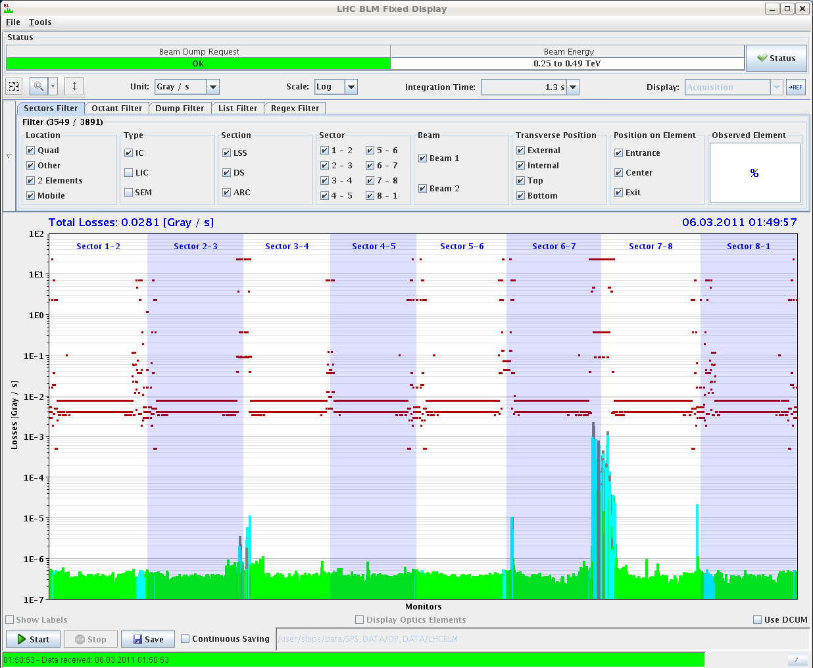
Loss map example

Slide 9
Where are we for the ramp?
Pilot and nominal bunch. OK.
Chromaticity, tune, orbit OK.
  Still require
RF blowup. OK.
  Some minor optimizations still ongoing. Philippe.
Feedbacks OK.
Transmission and lifetimes OK.
Collimator ramp:
  To be done once endpoint is known (3.5 TeV setup)

Slide 10
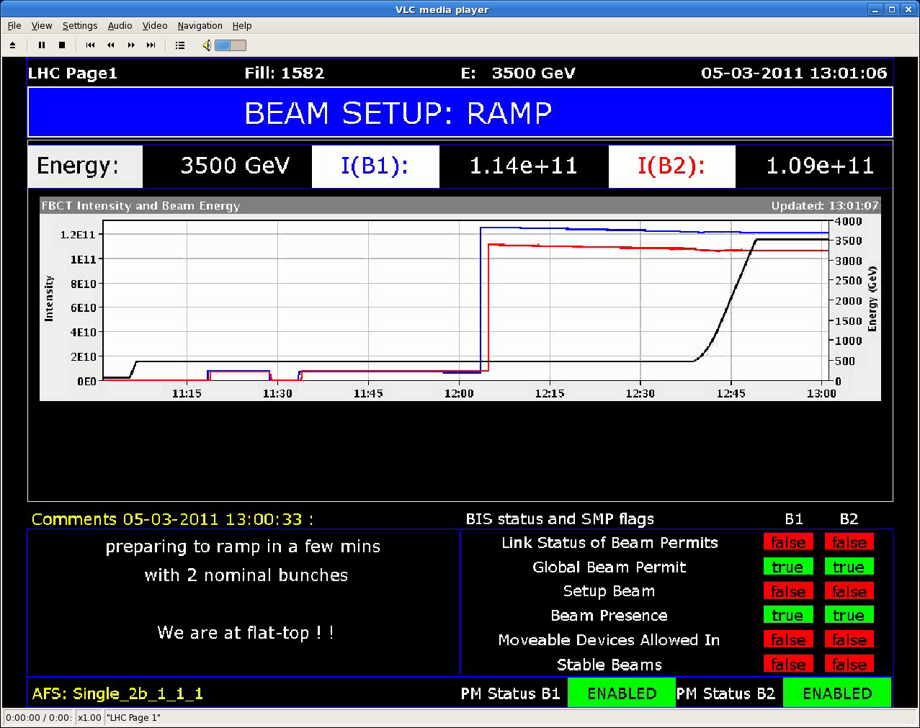
Fine ramp with nominal bunch…

Slide 11
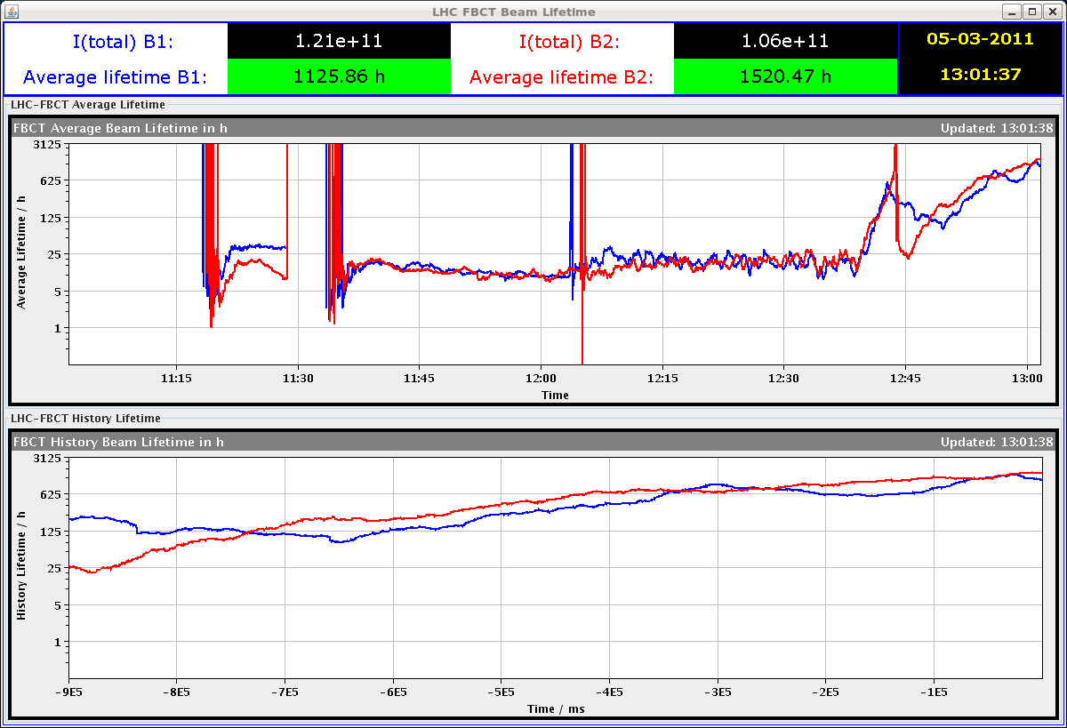
Lifetimes…

Slide 12
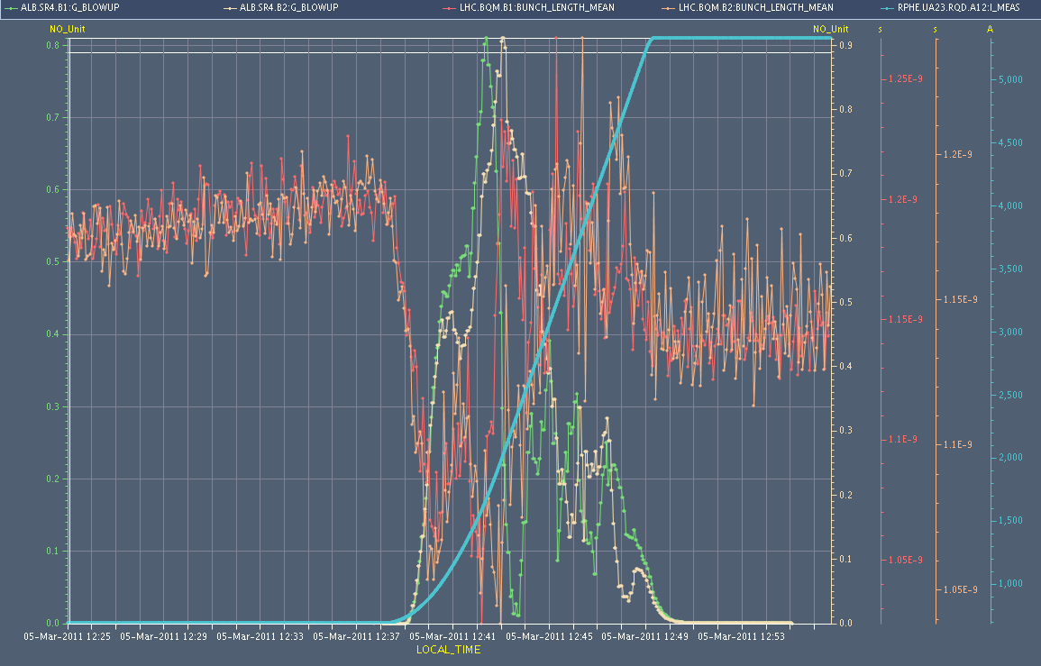
RF blowup and bunch length
Philippe et al

Slide 13
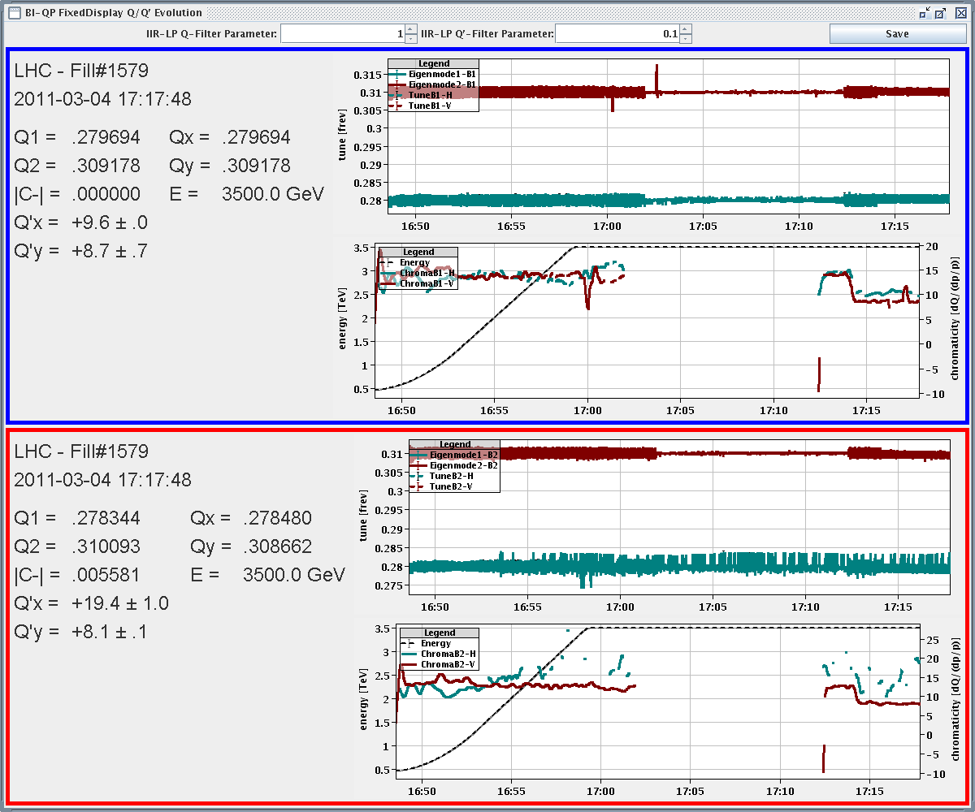
Tune feedback and chroma

Slide 14
Where are we for 3.5 TeV?
Chromaticity and tunes OK.
Beta beat and coupling through squeeze OK.
  Beta* correction to be done with k-modulation.
Squeeze with dynamic orbit reference OK.
Sequence with feedbacks OK.
Pilot collisions and vernier scans OK.
Final 3.5 TeV reference orbit defined (nominal bunch).
30 – 40% of collimators calibrated for flat top.
  To be completed.
Dump protection setup and check.
  To be done.

Slide 15
B1 beta beat
Rogelio, Glenn, Ryoichi, Masamitsu, Rama

Slide 16
B2 beta beat
Rogelio, Glenn, Ryoichi, Masamitsu, Rama

Slide 17
B2 coupling
Rogelio, Glenn, Ryoichi, Masamitsu, Rama

Slide 18
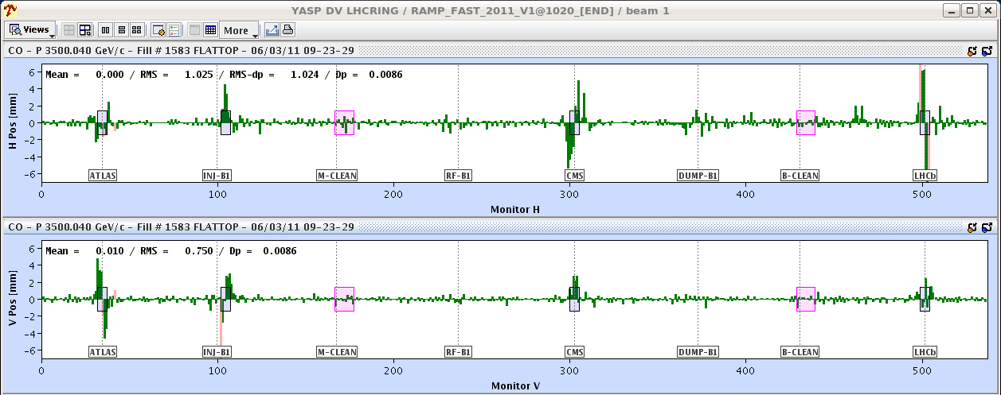
3.5 TeV Orbit High Intensity B1

Slide 19
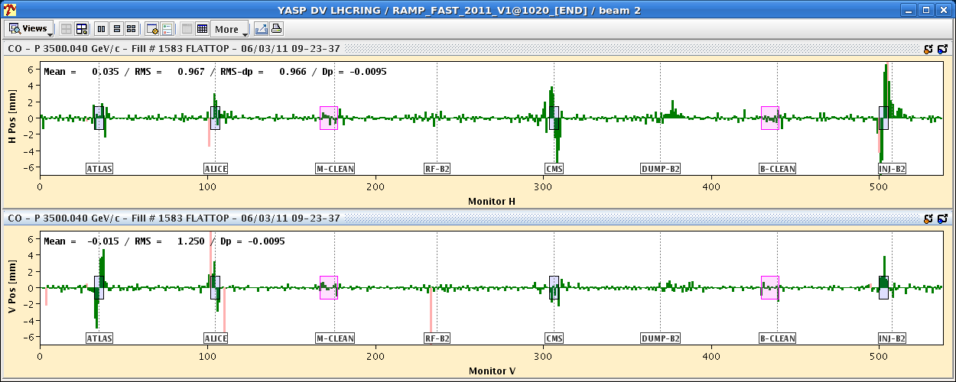
3.5 TeV Orbit High Intensity B2

Slide 20
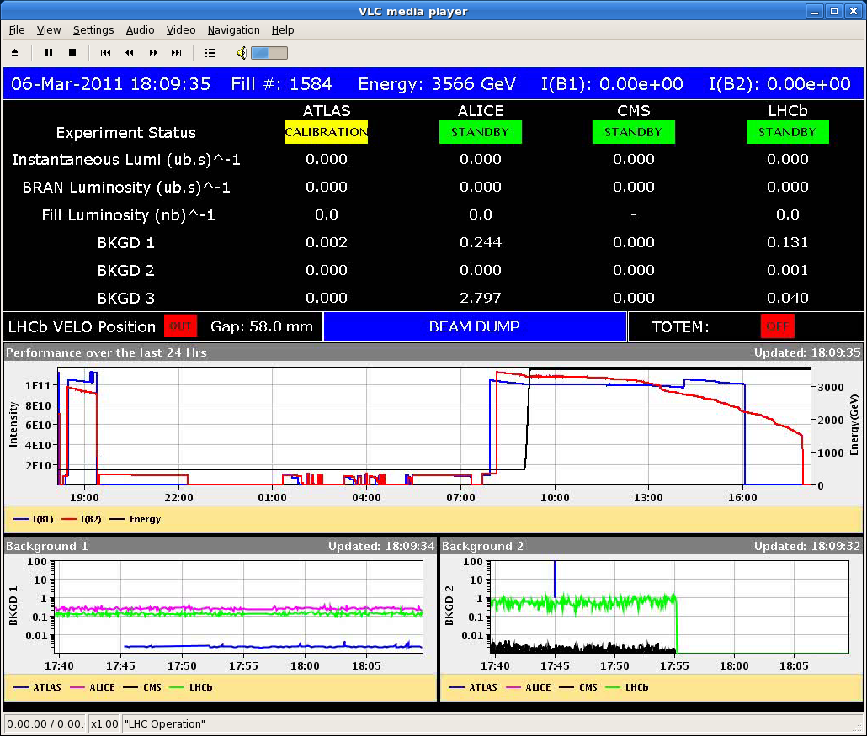
Shaving of Beam During Collimator Setup
Coll team

Slide 21
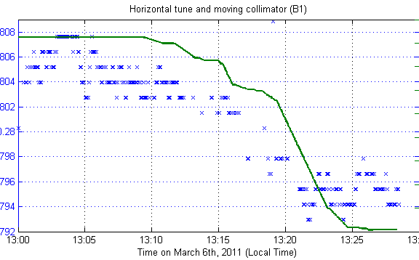
Tune Shift from Single Collimator?
B. Salvant and N. Mounet

Slide 22
IP beta values (Glenn Vanbavinckhove et al)
Beam1 (after local and global correction):
IP β*_{x} (ex) β*_{y}(ey)
IP1 1.68 (0.08) 1.62 (0.20)
IP5 1.53 (0.18) 1.45 (0.72)
Beam2 (after local correction, no global correction):
IP β*_{x} (ex) β*_{y}(ey)
IP1 1.43 (0.06) 1.62 (0.06)
IP5 1.64 (0.16) 1.48 (0.03)
11.7% imbalance
9.5% imbalance

Slide 23
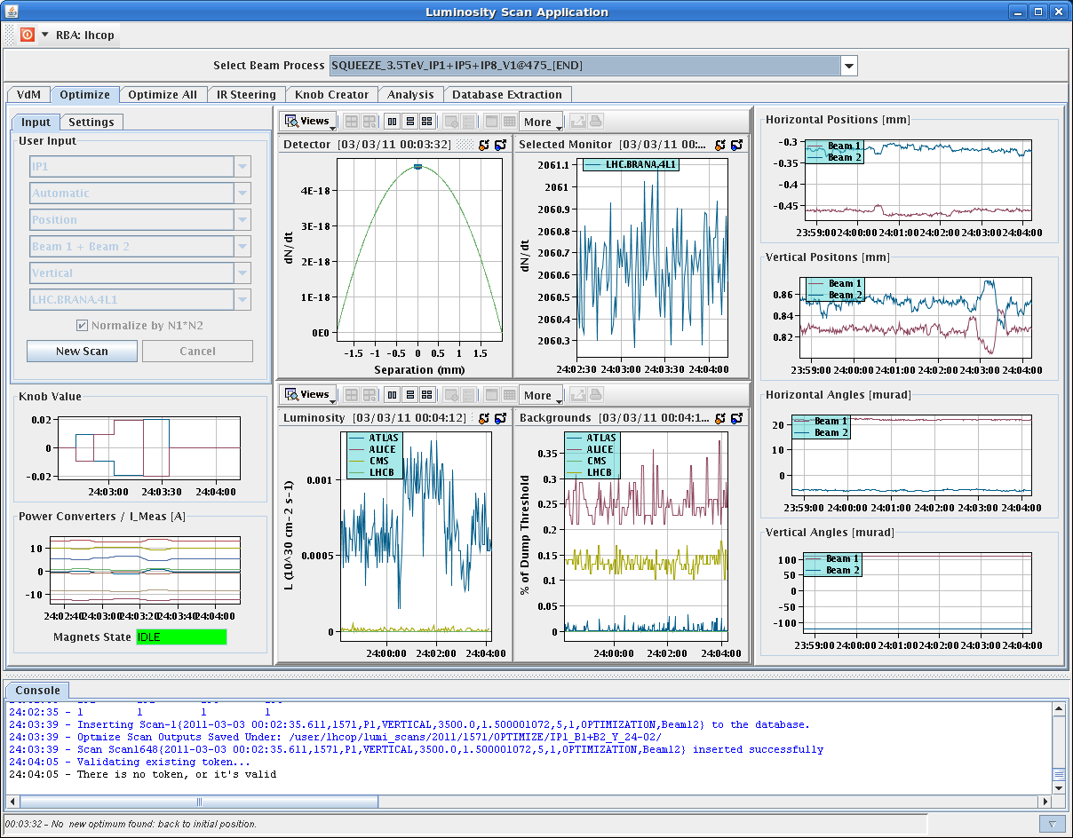
Beam-beam scan

Slide 24
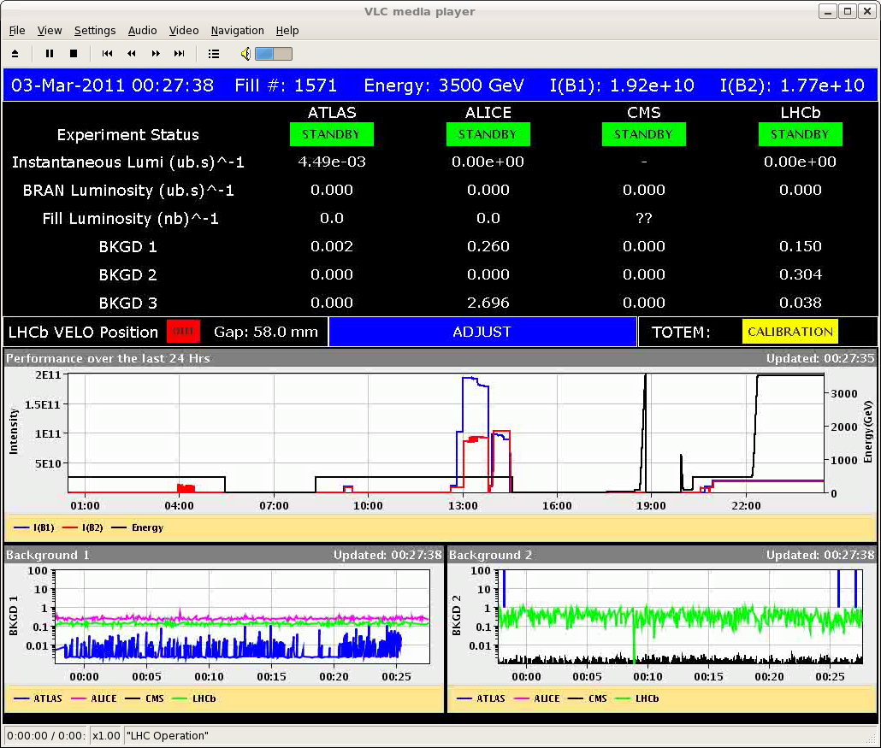
Tiny but First Luminosity…

Slide 25
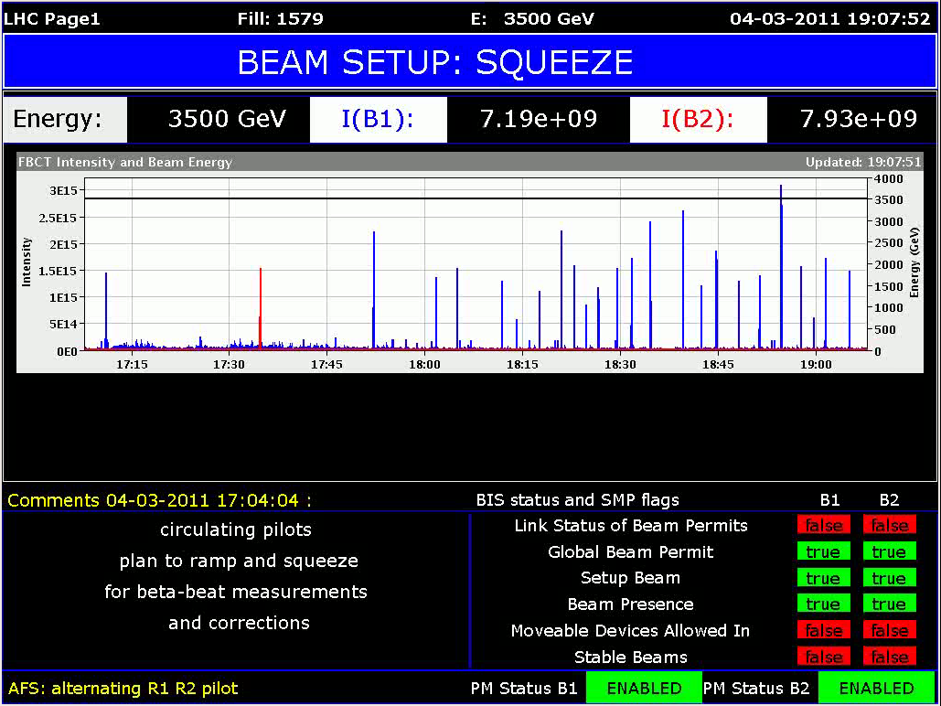
3e15 protons in?
Not yet…

Slide 26
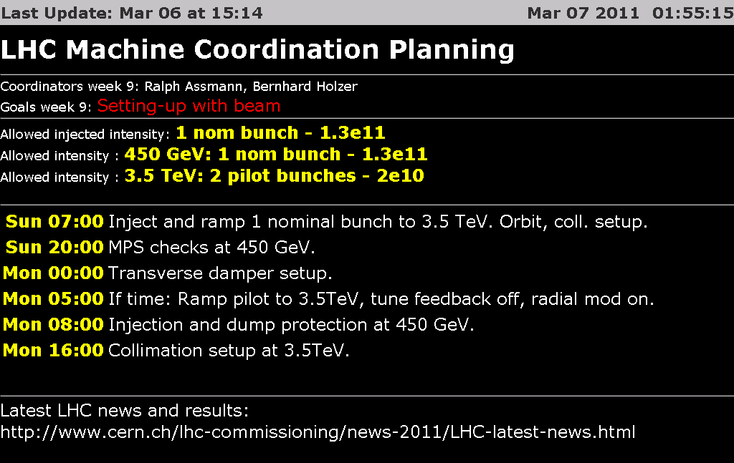
Ahead

