Slide 1
Friday March 4th
the short story:
from a global point of view ...
... we had basically only one access !!!

Slide 2
Ahead
 | Day | Shift | Time (h) | Activity
3 | THU | 7:45 | 7 | Prepare access.
3 | THU | 15:00 | 5 | Ramp to 3.5 TeV with pilot bunch.
3 | THU | 20:00 | 4 | Transverse damper for multi-bunch
4 | FRI | 0:00 | 8 | Beta beat, coupling, beta* correction at 3.5 TeV, pilot bunch
4 | FRI | 8:00 | 1 | BLM tests of new software
4 | FRI | 9:00 | 8 | Trial ramp to 3.5 TeV with 1 nominal bunch (RF blowup, orbit, emittance, damper, ...)
4 | FRI | 17:00 | 8 | Collimation setup 3.5 TeV before squeeze, 1 nominal bunch
4 | SAT | 1:00 | 6 | Qualification dump protection, injection protection, collimation
4 | SAT | 7:00 | 8 | Injection and dump setup (higher intensity, MP, …)
4 | SAT | 15:00 | 8 | Collimation setup 3.5 TeV before squeeze, 1 nominal bunch
4 | SAT | 23:00 | 8 | tbd
5 | SUN | 7:00 | 8 | Collimation setup 3.5 TeV before squeeze, 1 nominal bunch
5 | SUN | 15:00 | 8 | tbd
11 hours access in last 24h and more to come…

Slide 3
Friday March 4th
a bit more in detail:
Thu 7:00h Access LBDS problem (blocking injection)
Access started in pt 2 and 8.
Mr Grawer in point 2
Giorgio d'Angelo and RP piquet in point 8
Etienne entering pt 6.
QPS RBAC token given to Zinur until 12:00.
... in addition gong through the complete access list on the white board.
(it’s white now.)

Slide 4
Friday March 4th
Thu 12:00h LBDS problem (blocking injection)
Etienne and colleagues are here in the CCC.
They reverted to the 2010 version of the code for the
detection of the frequencies.
in the background:
updated the sequences to drive the squeeze (both in one step of in several steps):
the PREPARE TUNE FB FOR SQUEEZE has been removed and replaced
by a combined task with the sent timing event and the load dynamic ref orbit
change. Now, no need to switch OFF tune Feedbacks at the beginning of the
squeeze, the change of tune ref and windows will be triggered at the same time
as the timing event . ... to be checked.

Slide 5
Friday March 4th
Thu 13:21 We can try and close the LHC again.
All PCs are fault-less now and prepared for powering,
apart from the RD34s
and now the story starts:
Preparing to precycle, a couple of trips on the way to standby:
RSD1.A67B1
RCBCH7.R8B2 For these we call the PO piquet.
RQT5.R3
RCBWH5.L8B1 These two we reset and restart as they are warm magnets.

Slide 6
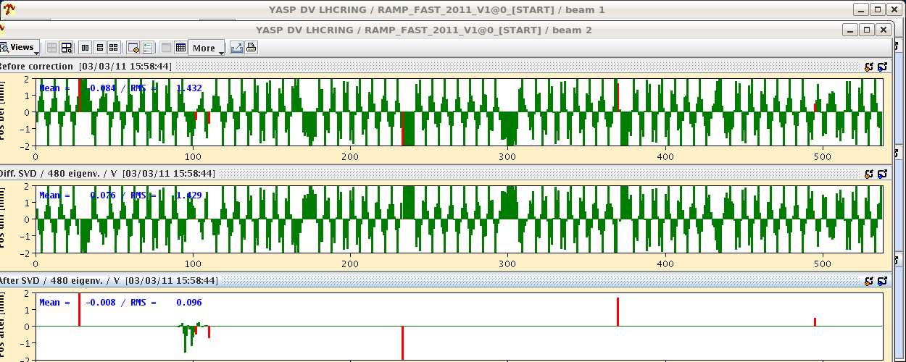
Friday March 4th
Thu 13:56 RCD.A12B2 tripped also
Piquet role given to B. Dubois (piquet EPC)
14:03 RCBXV2.L8 tripped also
14:04 RCBCV7.L2B2 tripped also.
That makes 5 cold and 2 warm.
... just for the fun of it:
Effect of ignoring the tripped corrector RCBV.7L2.B2.

Slide 7
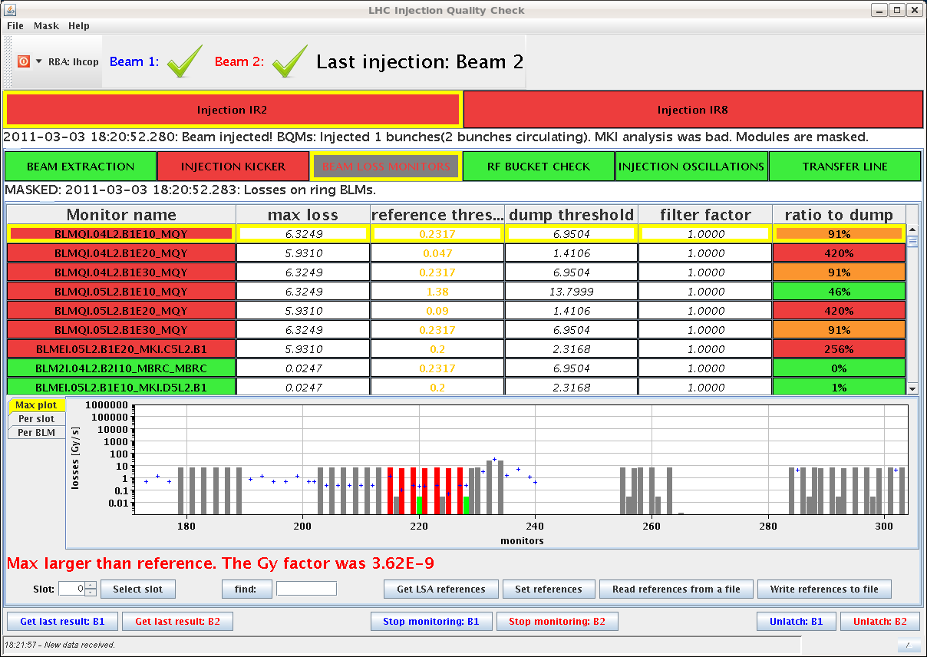
Friday March 4th
Thu 17:26 LHC SEQ: inj handshake status: experiments and LHC ready for injection
18:22 Both beams injected ok (1 pilot bunch)
but: IQC on the injection of the second pilot bunches
19:00 BEAM MODE > Ramp
BEAM MODE > flat top
BEAM MODE > squeeze

Slide 8
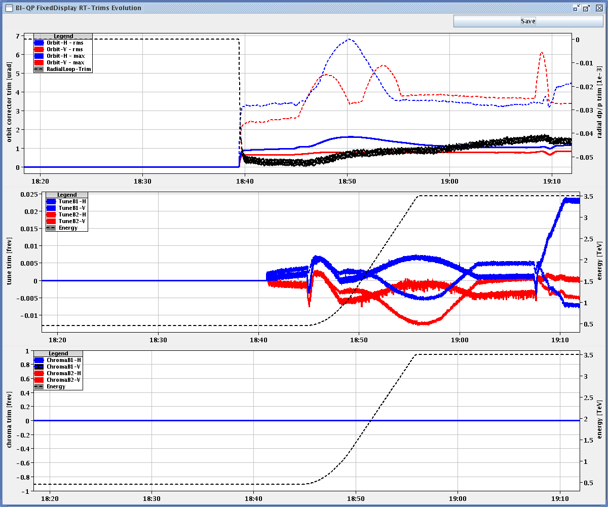
Friday March 4th
Thu 19:00 BEAM MODE > Ramp
BEAM MODE > flat top
BEAM MODE > squeeze
Q and Q' during ramp and first step of the squeeze with dynamic reference for the Q feedback
... and it works !!!

Slide 9
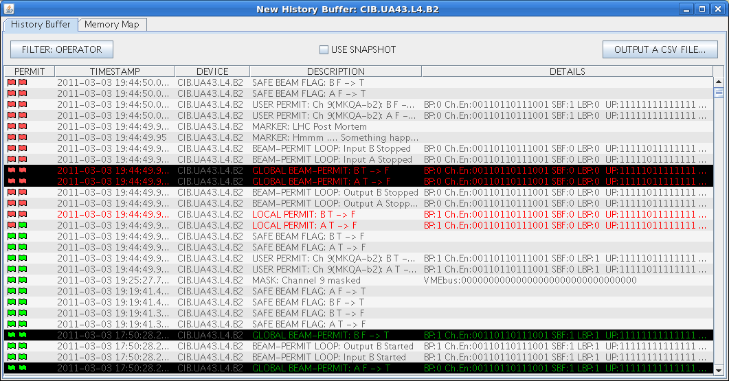
Friday March 4th
Thu 19:47
Lost B2. First channel was the MKQA (which was masked, and still is).
It looks like a glitch of the SBF
Thu 20:36
Thu 21:50
Kicker b1 tripped during the softstrart. We call the BT piquet.
Injection & Ramp,
Beam dump on top of the ramp. Was due to the loss of a corrector circuit (RQTF.A23B2)

Slide 10
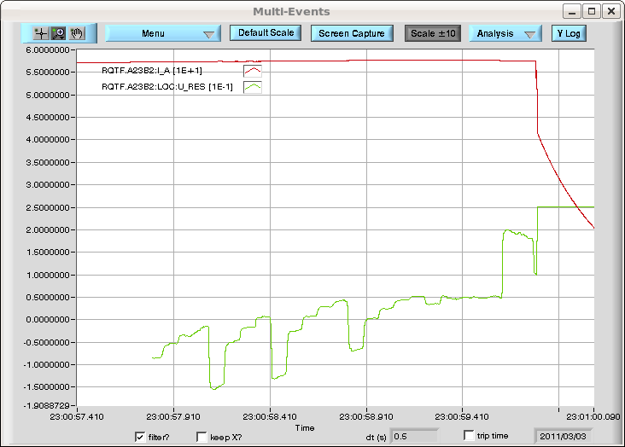
Friday March 4th
Thu 21:50
Beam dump on top of the ramp. Was due to the loss of a corrector circuit (RQTF.A23B2)
ref_rate limit apparently exceeded.
BEAM MODE > Injection Probe Beam
Beam2 dumped by self-triggering of the LBDS. Experts investigating.
According to FRANCESCO CASTRONUOVO we did an asynchronous dump, so the specialists want to check-we are preparing for
access at 2h00
Thu 23:54
23:55
02:00

Slide 11
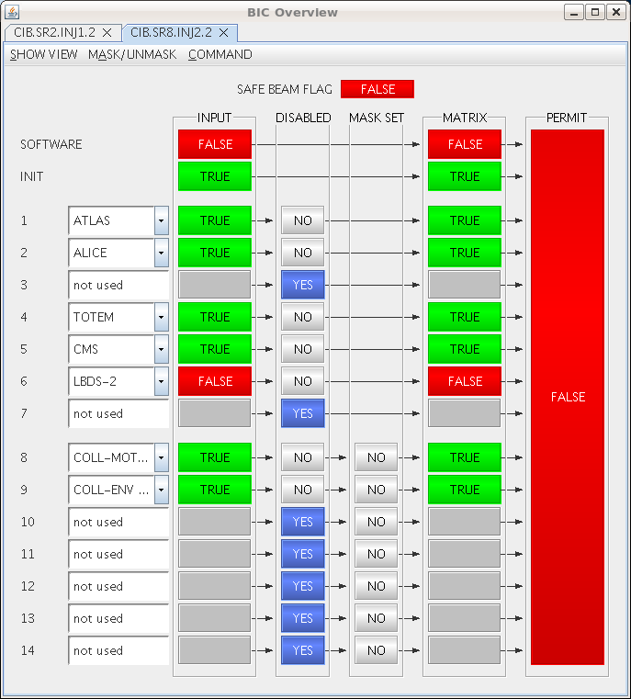
Friday March 4th
Fri 04:05
... never give up:
LHC RUN CTRL: BEAM MODE changed to INJECTION PROBE BEAM
Channel number 6 of injection BIC is not ok for both beams.
it is again the LBDS
According to Alain Antoine, the LBDS is not receiving the power permit.
Following the suggestion of Alain, we called Etienne Carlier, who thinks that the problem is on the software side.
Fri 07:00 ... guess what ...
preparing access

Slide 12
Proposal
 | Day | Shift | Time (h) | Activity
4 | Fri | 7:45 | 7 | Prepare access.
4 | Fri | 15:00 | 5 | Ramp to 3.5 TeV with pilot bunch.
4 | Fri | 20:00 | 4 | Transverse damper for multi-bunch
5 | Sa | 0:00 | 8 | Beta beat, coupling, beta* correction at 3.5 TeV, pilot bunch
5 | Sa | 8:00 | 1 | BLM tests of new software
5 | Sa | 9:00 | 8 | Trial ramp to 3.5 TeV with 1 nominal bunch (RF blowup, orbit, emittance, damper, ...)
 |  |  | 8 | Collimation setup 3.5 TeV before squeeze, 1 nominal bunch
 |  |  | 6 | Qualification dump protection, injection protection, collimation
 |  |  | 8 | Injection and dump setup (higher intensity, MP, …)
 |  |  | 8 | Collimation setup 3.5 TeV before squeeze, 1 nominal bunch
 |  |  | 8 | tbd
 |  |  | 8 | Collimation setup 3.5 TeV before squeeze, 1 nominal bunch
 |  |  | 8 | tbd
11 hours access in last 24h and more to come…

