Slide 1
Wednesday March 2nd
04h36: Cryo problem in arc 81. Access.
09h14: Injection.
TI8 injection collimator setup.
Testing new sequence.
New version of vacuum application (S. Blanchard).
Updates and modifications of orbit and tune feedbacks.
14h34: Access…
In PT 2 and 8 for power converters: changed modules.
ATLAS access in shadow.
15h58: Access over.

Slide 2
Summary of injection studies
(Wolfgang, Malika, Verena)
TCDI set up:
Set up of TCDI collimators with probe beam in TI2 and TI8 finished
new settings trimmed in with thresholds updated (1 sigma!!) to be changed to 0.25 sigma
new settings in entry of 12:16
Checked the new settings with nominal bunch, trajectories not clean, maybe energy error from SPS, to be confirmed
Losses in TL below 3 mGray at collimators with high Dispersion
Losses on LHC BLMs below warning level
TDI angular scan:
worked only on B1
measured beam size at TDI with + 1mrad TDI tilt for different TCP settings (beam edge defined by TCP)
has to be done also for -1 mrad tilt before conclusion

Slide 3
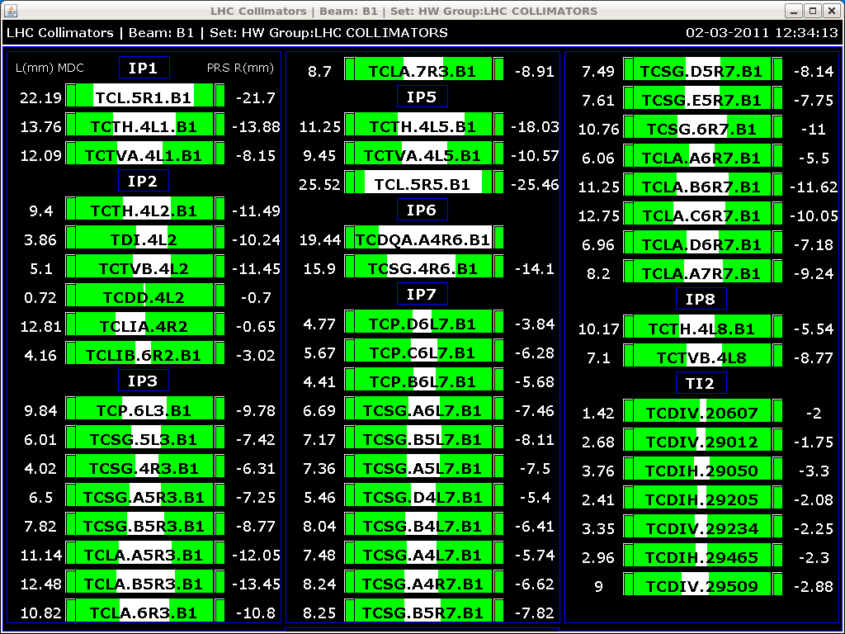
Settings B1

Slide 4
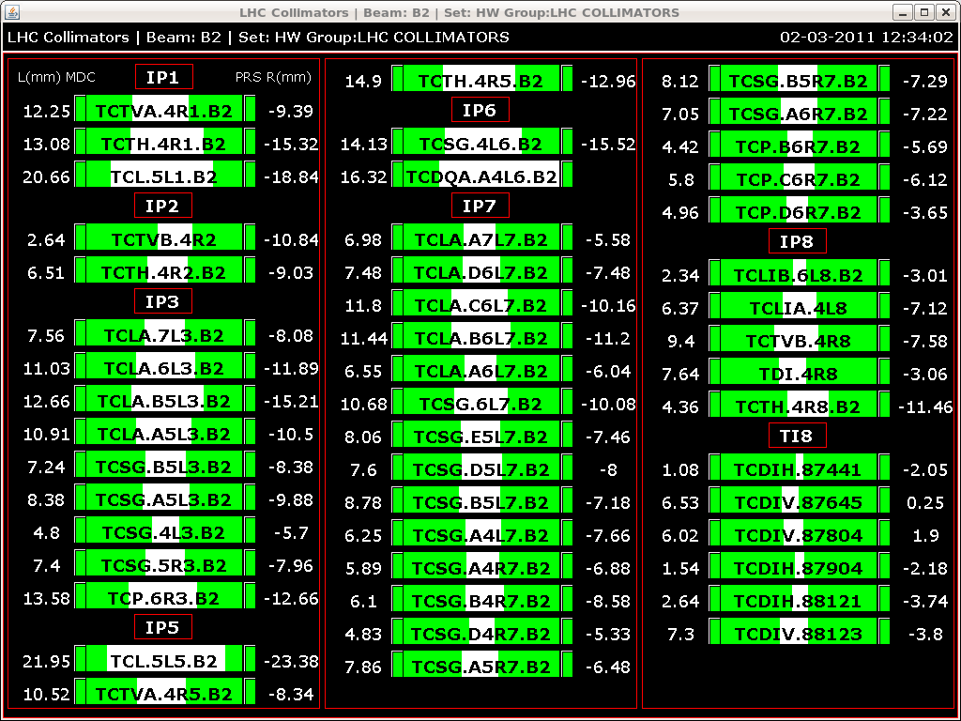
Settings B2

Slide 5
Summary of Feedback updates and mods:
OFC: changed orbit reference scaling to linear (was cubic/'parabolic->linear->parabolic')
OFC: changed default settings for the synchronous orbit acquisition mode for IR BPMs
OFC: added a new refined Q' demodulation estimate.
OFC & OFSU: modified and resynchronized the communication library.
OFSU: restructured and de-synchronized reference orbit handling. Fixed the "Disco effect“.
Checked with beam and sequence. Works OK.
(Ralph St., Maxim)

Slide 6
Wednesday March 2nd
15h58: Access over. And another access required → use opportunity to clean out access list…
RB.A81 lost QPS OK when preparing for precycle. Access required. QPS problem due to loss of communication from beam losses at injection. New software.
RQTL111.L3B2 and RCBXH3.R1 tripped, idle at standby. Reset.
Access for damper problem in the SPS (3h).
LHC-b and CMS accesses in shadow.
LBDS access in shadow.

Slide 7
Wednesday March 2nd
18h37: Access over. Pre-cycle.
Lost power permit for S67, S78 and S81. Likely from switching off access during pre-cycle (known problem?).
19h34: RSD2.A78B1 tripped during pre cycle.
One Roman Pot not completed out → interlock. Moved out by TOTEM.
20h43: Beams back. 2 pilot bunches per beam.
21h34: Incorporation problems before ramp. Reference mis-match.
22h10: Start ramp. Then squeeze.

Slide 8
Thursday March 3rd
00h00: Collisions first time 2011. Lumi scan tried.
01h05: Orbit feedback tests completed. Kick response for arc and IR corrector. Different eigenvalues tried.
01h06: MPS test : switch off RD1.LR5 @ beta* = 1.5 m. Test successful, no orbit change at time of FMCM dump trigger corresponding to 0.19 A / 335 A, ~ 5E-4.
01h14: Ramp down and precycle.
02h21: LBDS problem for B1. Called Etienne.
02h50: CIBG beam permit loop not ok. Called Bruno.
02h55: Injection B2 only.
03h23: Lost cryo OK for 81 (same as Wed morning).
05h10: Ramp B2.
05h52: Beam dump by EIC. Tune feedback problem. Unclear instructions for feedback operation.

Slide 9
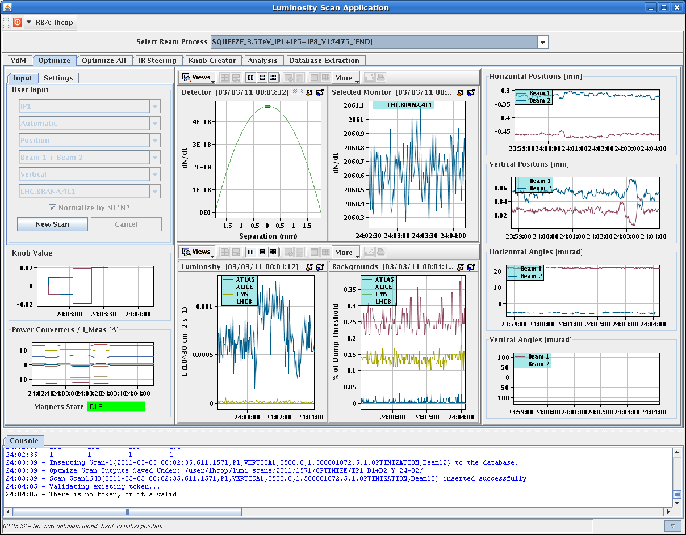
Beam-beam scan

Slide 10
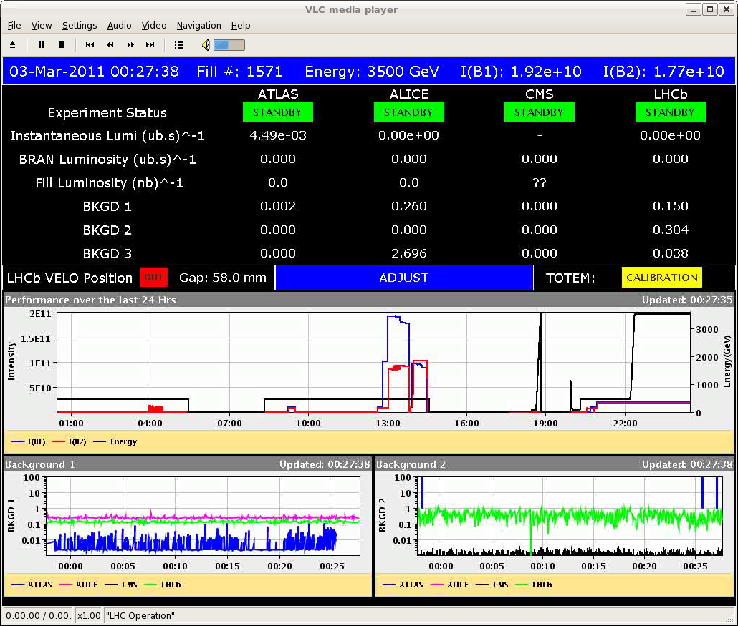
Luminosity…

Slide 11
Some more change in the sequences (LP):
changed the LHC user for the load ADT settings in the PREPARE COLLISIONS sub-sequence.
added the sub-seqeunce to drive the tune feedback settings for the squeeze in the SQUEEZE COMMISSIONING 2011 sequence (to be played as last year, drive the settings takes 20s with FB OFF, start the squeeze and start the QFB when the peak is in the windows)

Slide 12
Thursday March 3rd
06h39: Injection B2.
07h13: Prepare ramp. Problems with feedbacks (new dynamic function could not be sent to orbit feedback). Not confident to start ramp.
No chance to work on beta beat, coupling, … at 3.5 TeV. Beta beat team in all night → thanks…
07h45: Decide to prepare for access:
to repair LBDS and BIS frequency generator problem (connection)
quench heater power supply C22R7
cryo unstable temp sensor on RQF.A81

Slide 13
IP beta values (Glenn Vanbavinckhove et al)
Beam1 (after local and global correction):
IP β*_{x} (ex) β*_{y}(ey)
IP1 1.68 (0.08) 1.62 (0.20)
IP5 1.53 (0.18) 1.45 (0.72)
Beam2 (after local correction, no global correction):
IP β*_{x} (ex) β*_{y}(ey)
IP1 1.43 (0.06) 1.62 (0.06)
IP5 1.64 (0.16) 1.48 (0.03)
11.7% imbalance
9.5% imbalance

Slide 14
Ahead
 | Day | Shift | Time (h) | Activity
3 | THU | 7:45 | 7 | Prepare access.
3 | THU | 15:00 | 5 | Ramp to 3.5 TeV with pilot bunch.
3 | THU | 20:00 | 4 | Transverse damper for multi-bunch
4 | FRI | 0:00 | 8 | Beta beat, coupling, beta* correction at 3.5 TeV, pilot bunch
4 | FRI | 8:00 | 1 | BLM tests of new software
4 | FRI | 9:00 | 8 | Trial ramp to 3.5 TeV with 1 nominal bunch (RF blowup, orbit, emittance, damper, ...)
4 | FRI | 17:00 | 8 | Collimation setup 3.5 TeV before squeeze, 1 nominal bunch
4 | SAT | 1:00 | 6 | Qualification dump protection, injection protection, collimation
4 | SAT | 7:00 | 8 | Injection and dump setup (higher intensity, MP, …)
4 | SAT | 15:00 | 8 | Collimation setup 3.5 TeV before squeeze, 1 nominal bunch
4 | SAT | 23:00 | 8 | tbd
5 | SUN | 7:00 | 8 | Collimation setup 3.5 TeV before squeeze, 1 nominal bunch
5 | SUN | 15:00 | 8 | tbd
11 hours access in last 24h and more to come…

