Slide 1
Monday
08:30 – 11:00 Access for:
LBDS beam 2 problems: TSU unit changed
RQTD.A67B1: controller for the current lead heater changed
RQS.A67B1 power converter replaced and tested
12:00 – 13:30 Machine protection tests without beam
13:40 by trip of RD1.R5 until 19:40 (temperature of the building?)
In the shadow:
Heat run for Sector 12 and 23
Quench heater power supply (dipole) A13.R1 discharging – access to repair it
loaded new compensation coefficients for Main Bend QPS in Sector 12 ➔ we should have more margin now to pulse TI2 without problems
Test of faster ramp-down of Q4.R2 (presently the slowest) ➔ reduction by >15 mins in the ramp down
RQT13.L7B1 back in use (limited to 50 A) as well as RCBCV10.R5B1 (it was out of the SOC)
HWC of RCBVY5.L4B2

Slide 2
Monday
20:00 – 21:30 Communication problem with Injection BIC
21:30 Finally injecting
23:20: 3.5 TeV with beam
00:40 – 02:00 Squeeze to 1.5 m
02:00 – 07:00 Ramp down and BIC/Timing problem
07:00 Injecting

Slide 3
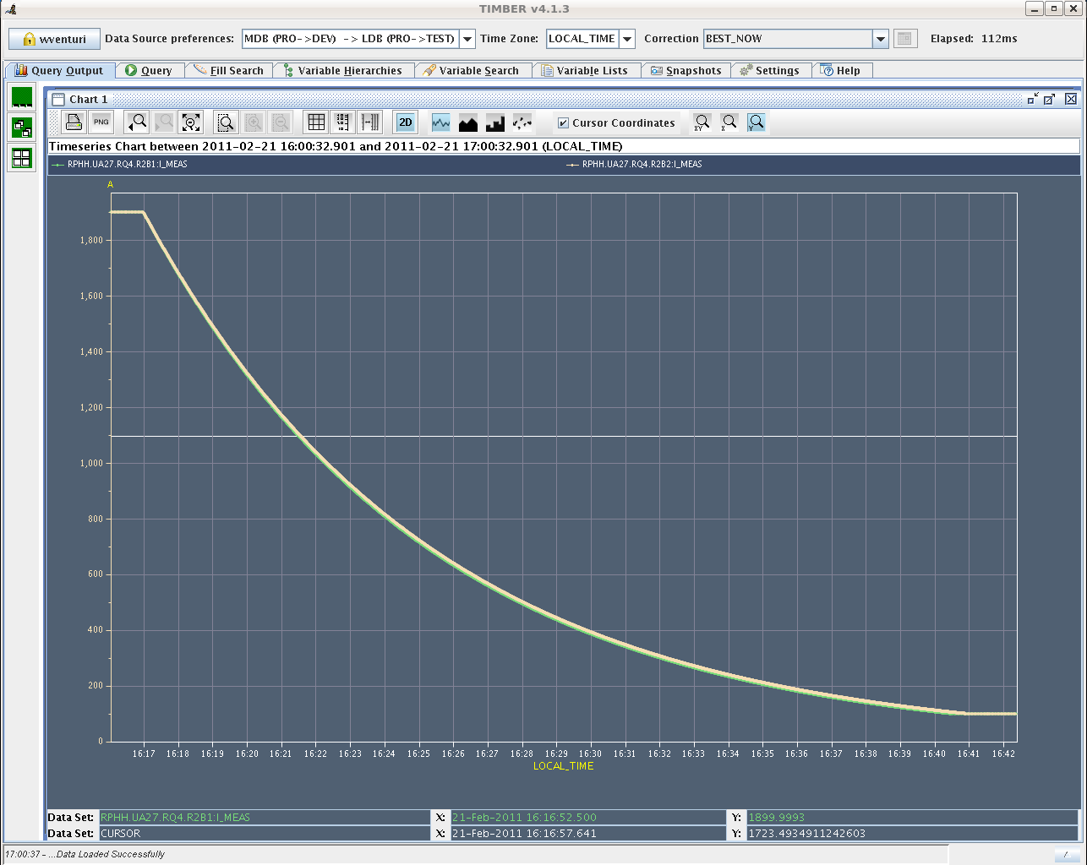
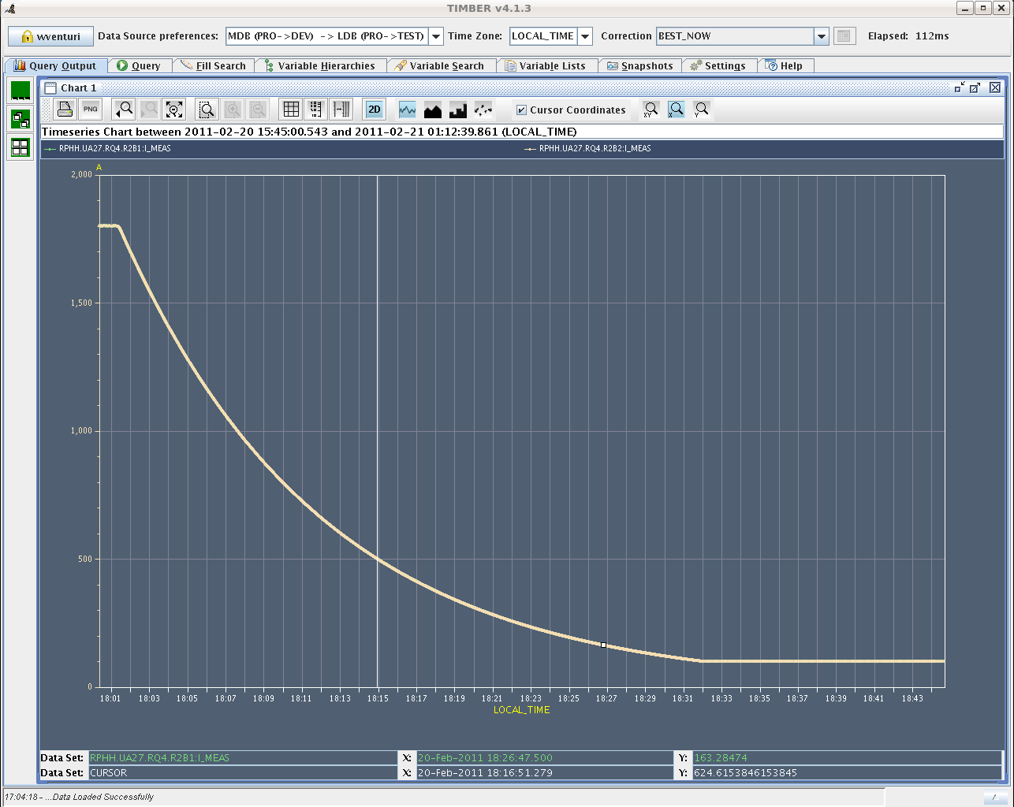
Ramp down speed-up
Q4.R2: slowest element in the ramp down
Before
Now with power converter in open loop during ramp-down (to be implemented in the ramp down sequence). >15 mins shorter

Slide 4
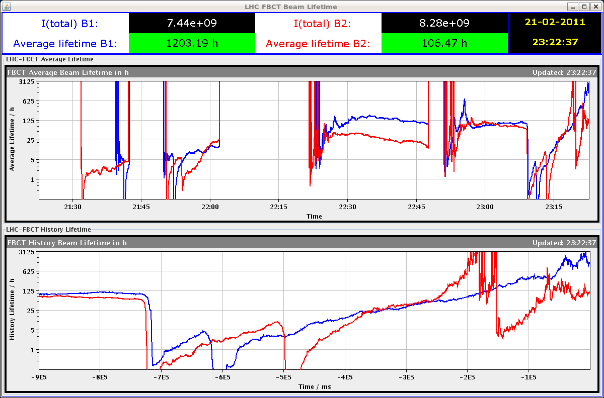
Ramp – only static part of b3 model

Slide 5
Ramp – only static part of b3 model
The Q' estimates are clamped above 30 units and below -15 Decay of about 7 units on flat-top plateau nicely visible.
R. Steinhagen

Slide 6
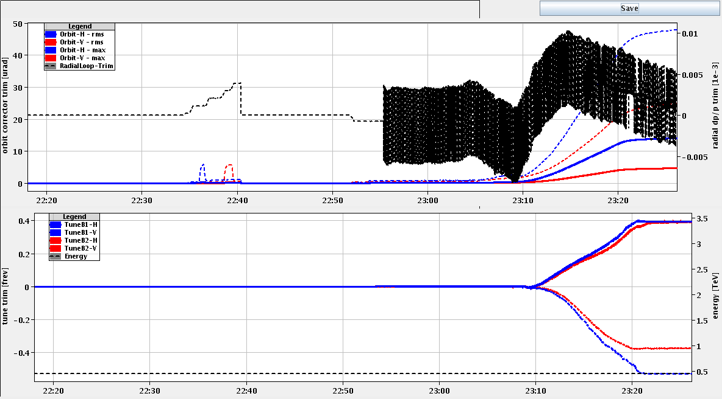
Ramp
The values of the Q-trims on the attached plot are not correct and should be divided by 3500/450. For some reason the OFC didn't get the correct energy.
R. Steinhagen

Slide 7
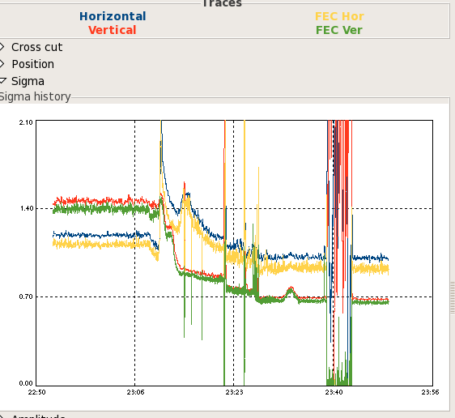
BEAM 1 beam sizes (mm)
Real blow-up, correlated to losses at the beginning of the ramp ramp (all other ‘steps’ = BSRT setting up)
F. Roncarolo

Slide 8
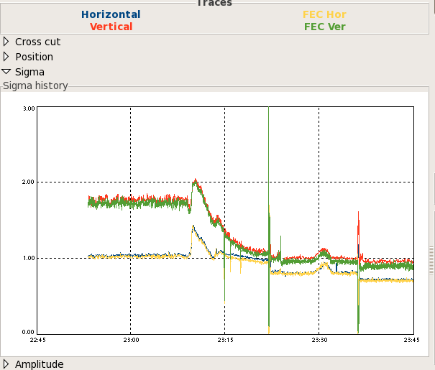
BEAM 2 beam sizes (mm)
Real blow-up, correlated to losses at the beginning of the ramp ramp (all other ‘steps’ = BSRT setting up)
F. Roncarolo

Slide 9
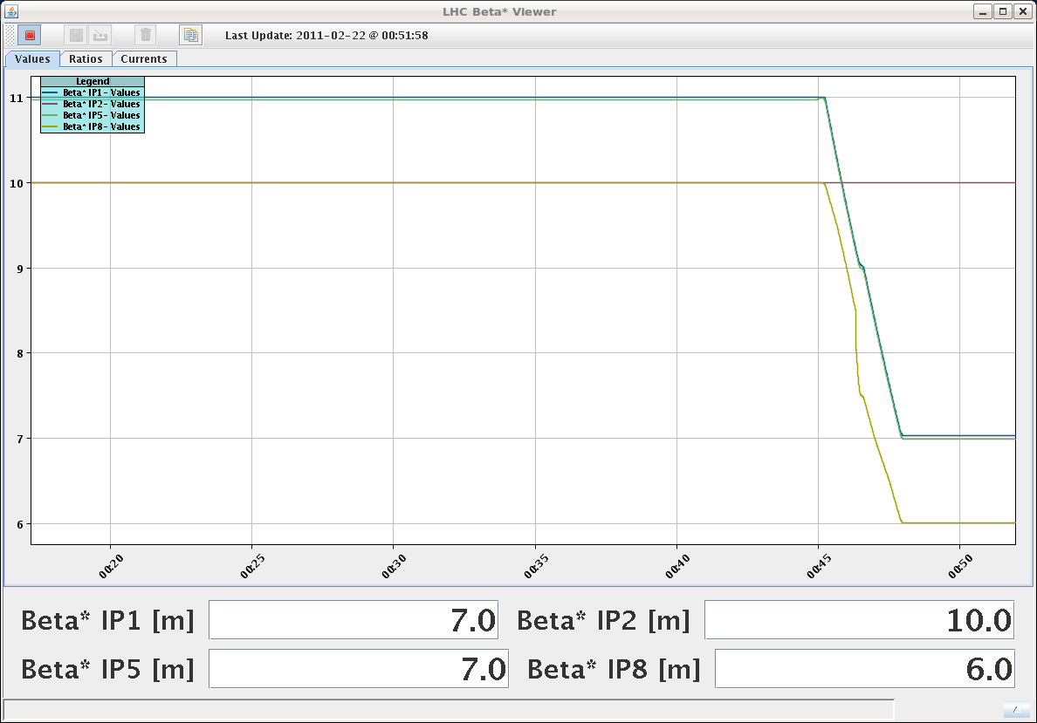
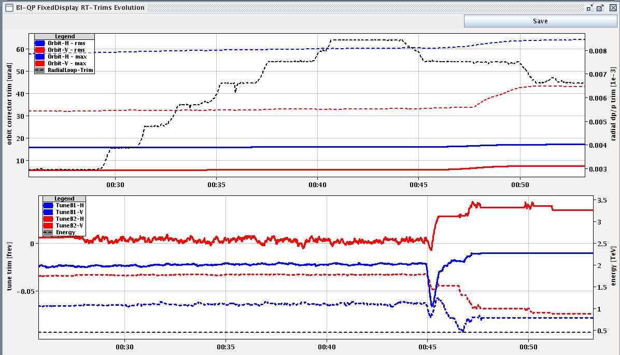
Squeeze – β*=7m
Tune and coupling correction
S. Redaelli, M. Lamont

Slide 10
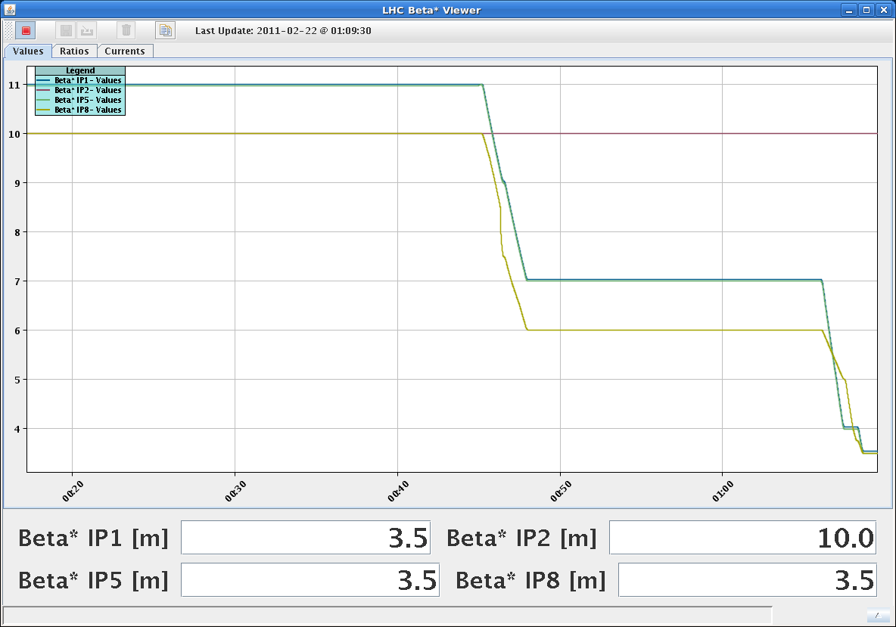
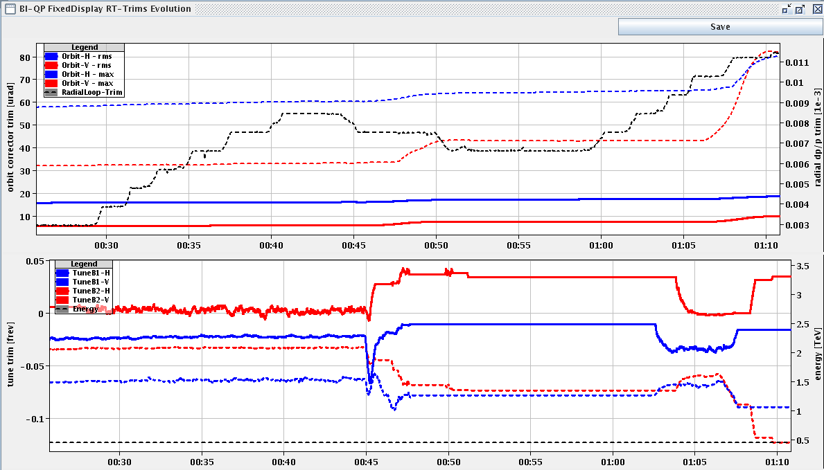
Squeeze – β*=3.5 m
Tune and coupling correction
S. Redaelli, M. Lamont

Slide 11
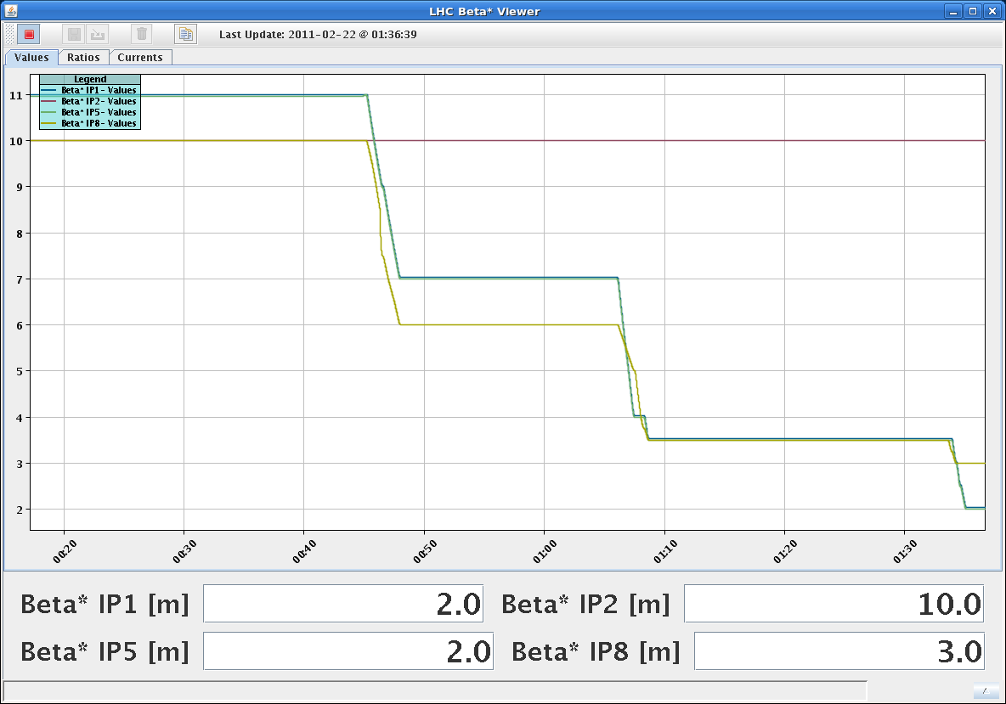
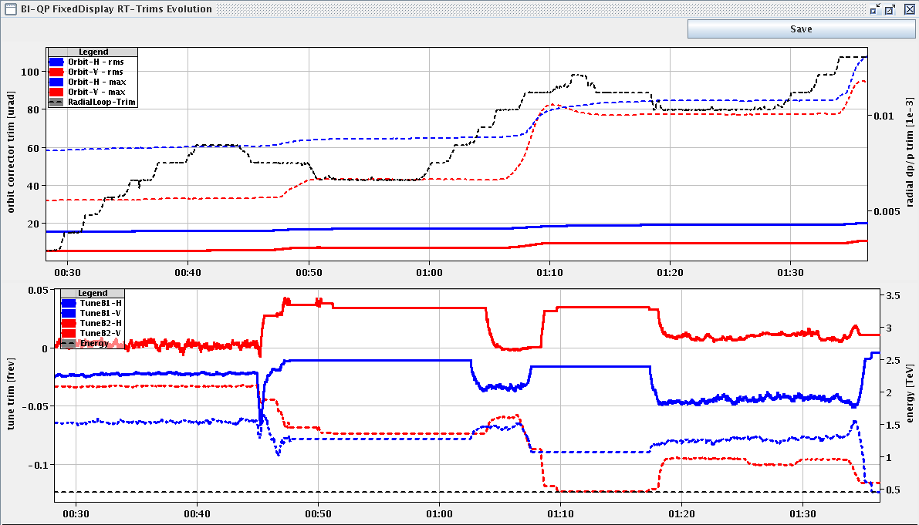
Squeeze – β*=2 m
Tune and coupling correction. Beam 2 lost during coupling compensation
S. Redaelli, M. Lamont

Slide 12
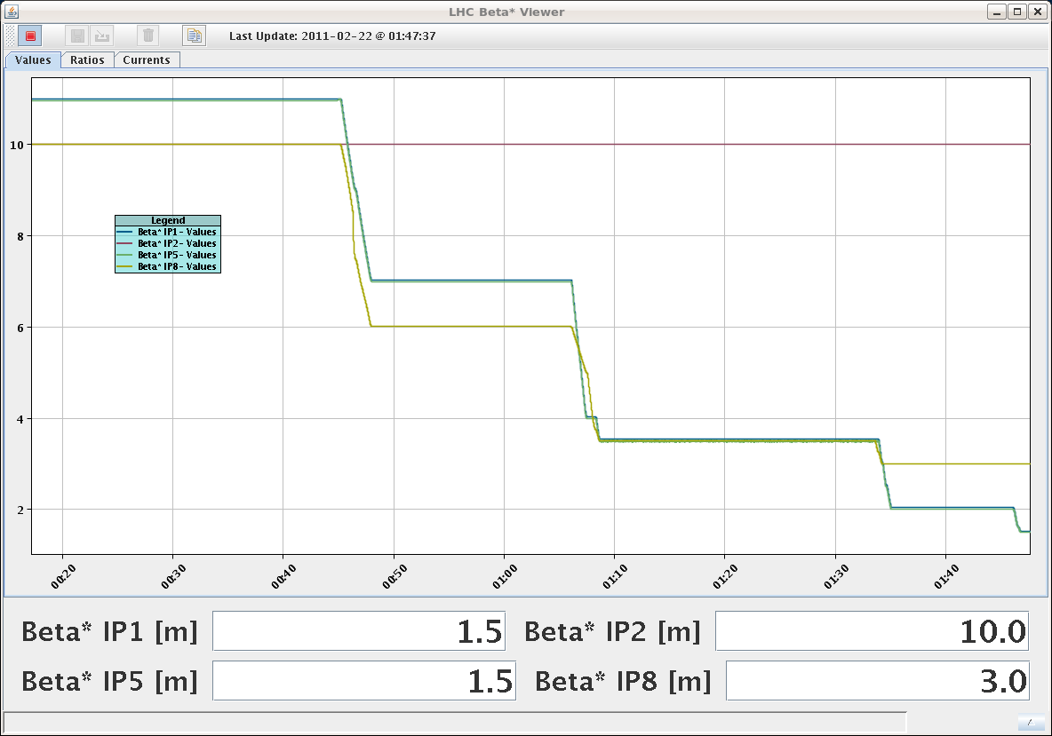
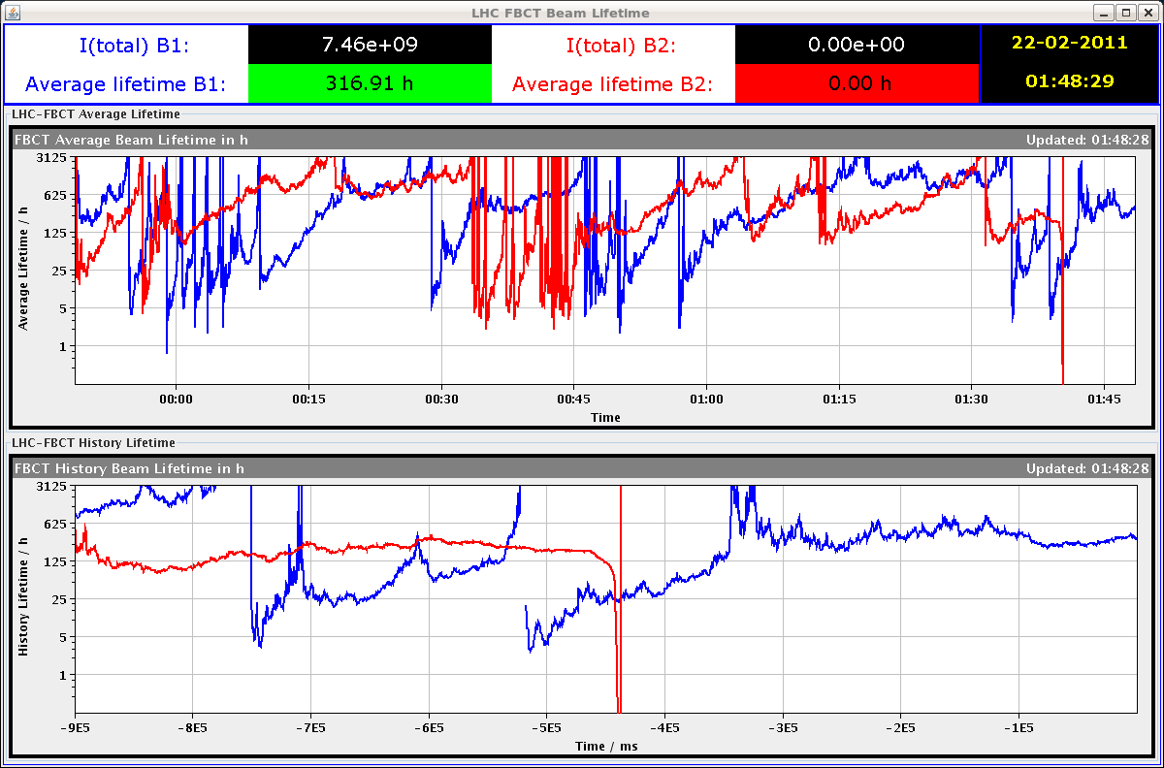
Squeeze – β*=1.5 m
Tune and coupling correction.
S. Redaelli, M. Lamont

Slide 13
Plan
Tue AM | MPS tests + Access/LBDS link check (DSO) – no beam
Tue PM | Test ramp + Test squeeze (Beta beating measurements)
Tue Night | Test dumps on the ramp (1.4 and 2.4 TeV) + pre-cycle and decay measurement
Wed AM | Cryo intervention in point 2

Slide 14
Access
Cryo intervention in Point 2 scheduled for Wednesday 23/2
Access requests:
DFBAA-LCM pressure controllers
RCBV11.R8B1 – 60 A power converter
RSS.A78B1 – power converter problem
UPS problem in US45
Power converter RD1.R5. Issue with the temperature of the building

Slide 15
