Slide 1
Last night
Lhc closed 15:00
Open all valves OK
All non mask interlock channels True
Set LBDS Bets at 450 GeV
15:29 Trying to arm B2 succeeded
B1 not possible to arm.
Ben and Etienne going to point 6
Access finished problem found
21:00 Bic loop closed
Both beams armed.

Slide 2
Last night
.
Injection BIC still faulty on LBDS
Preparing access in point 6.
21:20 Ramping to 3.5 TeV
21:34 Programmed dump at flat top ok
00:30 access finished
Loop closed
Injection BIC now receive the true signal from LBDS
Both Kicker ON
Etienne & op happy…
Trying to Puls Both kicker
Kicker B1 faulty!!
PFN generator faulty >> to standby ok
Injection Handshake
Difficulty to close the loop Bets faulty
Reset from JAN
01:15 ***Then ream and Kicker pulsing !!!!!
Sequencer checking
Q9 commissioning

Slide 3
Open issues & Access
RF LDBS frequency link check ongoing
RF power & frequency interlock ongoing
Injection Kicker synchronisation
LDBS timing synchronisation
MCS check
LBDS – Access to be completed
BLM threshold monitor factor change ongoing
BCT – SMP ongoing
H/C Completed
All sectors heat run > 5
RQT13.L7B1 high resistance failure
current will be probably limited to 50 Amps.

Slide 4
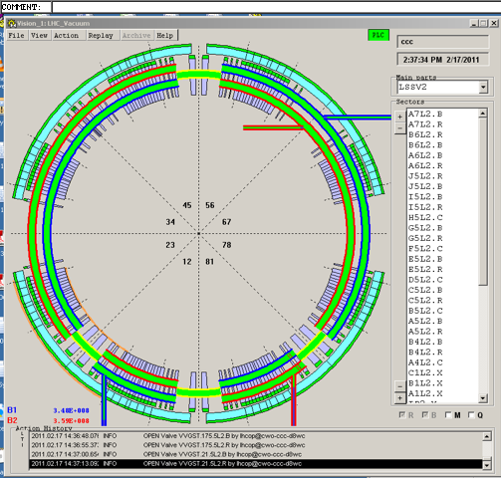
All open

Slide 5
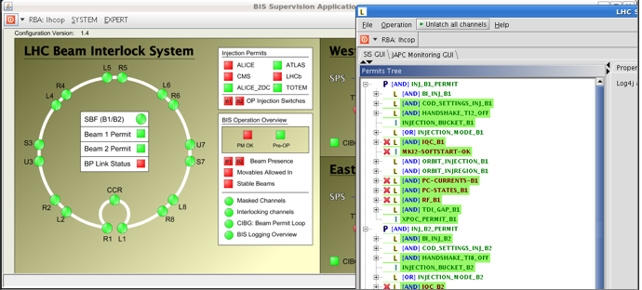
Bic loop closed

Slide 6
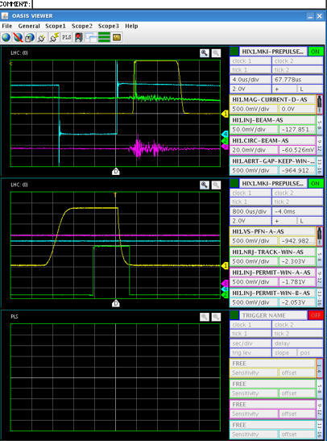
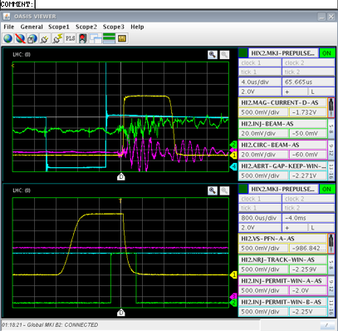
MKI’s

Slide 7
Last night
21:34 Programmed dump at flat top.
All seems fine, but the XPOC TSU timestamp is ~1.5 sec later with respect to the dump time from the timing and from the BIS.
LBDS colleagues investigating.
BIS IPOC in PM OK.
PM : BLM data OK, BIC OK, PIC OK, BPMs ~OK
(Missing data from LHC.BPM.SR8.B1RA), FGC OK, Timing OK.
SMP flags on confirmation page seem incorrect - tbc.
PM data to SIS does not seem to work.

Slide 8
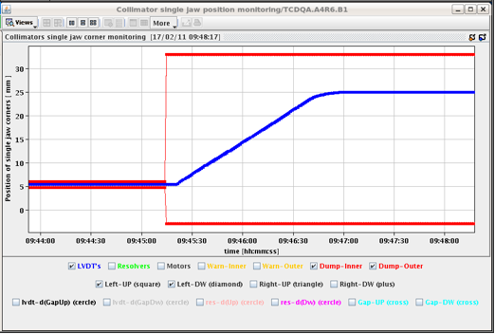
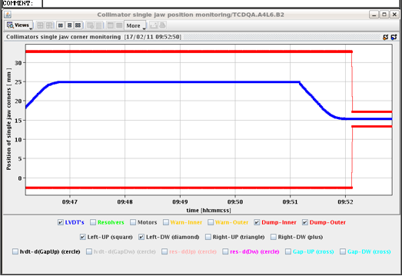
TCDQ
Parking and Injection sequence

Slide 9
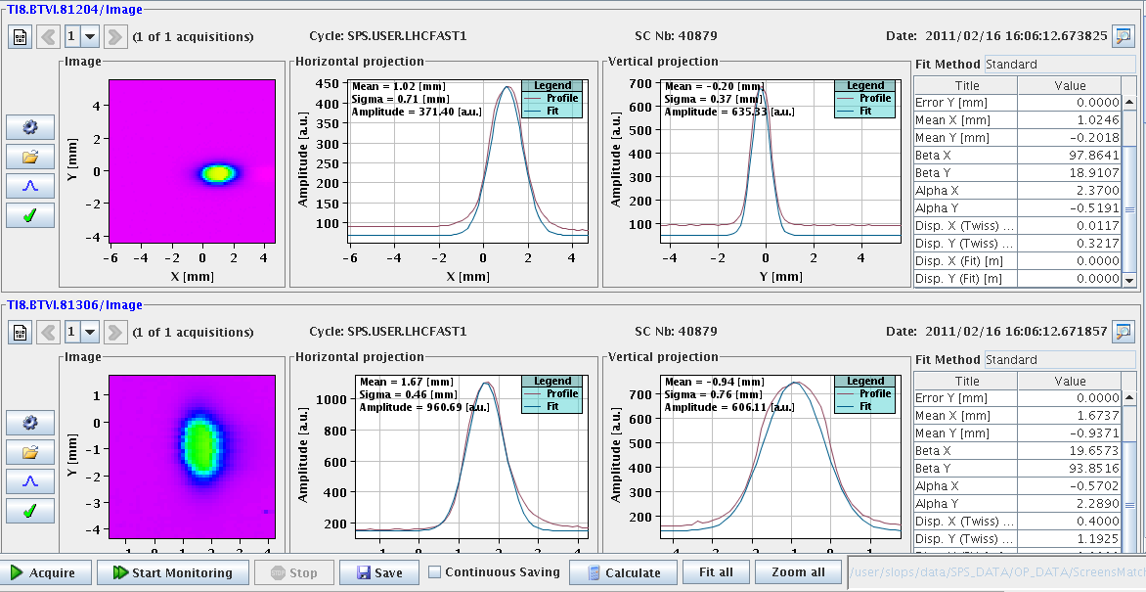
Beam on TI 8

Slide 10
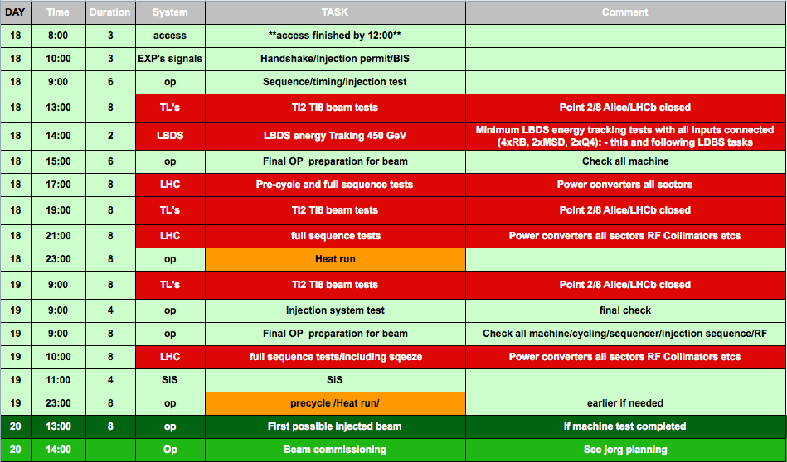
Planning
Weekend meeting at 9:30

Slide 11
Progress of the day
Beam on TI8/TI2
TI8 looks all OK (not touched during the TS)
BPM problems in TI2
- BPMI.215 and BPMI.291 have H and V planes inverted
- BPM.231 has a sign error for the H plane.
- BPMI.284 is very noisy, multiple triggers done
BIC
Loop closed
Timing/Injection sequence
LHC request OK
Frev
Prepulse ok

Slide 12
Progress of the day
RF
M1B1, M2B1 et M2B2 finished
M1B2 ok now (few quenches' in 2010)
Setting up for low level cavity control ongoing
BT
MKI pulsing
LBDS energy tracking
Q4L6 Q4R6 RMSD.LR6B1 RMSD.LR6B2
S45,56, 67,78 ramped to 3.5 TeV
Tested at 3.5 TeV
Tested also at 450 GeV

Slide 13
LBDS
LBDS tracking test.
During this test check the SMP energy sent around (Bruno). It should be coherent with the different failure modes forced below. During the energy ramps we should, at least on some ramps, also ramp TCDQ and collimators and check coherency.
With B1 and B2 armed
450 GeV trim RB 4 – 5 up (or start ramp on only this circuit): check dump
3.5 TeV ramp RB 7 – 8 down: check dump
450 GeV trim RB 6- 7 up: check dump
3.5 TeV trim RB 5 – 6 down: check dump
B2 armed at 450 GeV
Trim up Q4.R.B1: nothing should happen.
Trim up Q4.R.B2: provoke beam dump
B1 armed at 3.5 TeV
Q4.L.B2 Trim down / off: nothing should happen
Q4.L.B1 Trim down / off: Dump
TEST RF frequency (with Andy)
Test LBDS triggers when RF signal is cut.
Test connecting to the correct RF frequency B1 / B2.
XPOC latching with SIS
Inject & dump mode. Start ramp, injection should stop.

Slide 14
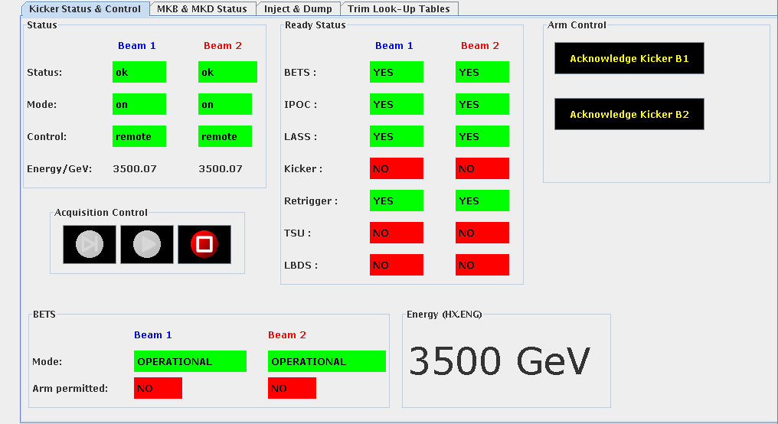
LBDS BETS at 3.5 TeV

Slide 15
90 meter optics tested

Slide 16
Progress of the day
OP
New squeeze functions:
Generated new functions for 2011 squeeze.
Standard (700s) and short (475s) version available.
Prepared nominal configuration at 3.5 TeV for crossing and separation.
found an issue with acceleration of RCBX (real or LSA?
Tested real functions on all magnets involved in IP1.
No issues with the functions.
Betastar distribution on the SMP:
For the first time, tested the full chain of generation and distribution of betastar factor based on magnet current measurements;
- Timing distribution seems ok (checked IP1 only);
consistent with previous betastar viewer tool;
- Minor issue found with the calibration curves (they stop at 2m).
Collimator betastar limit:
Could test for the first time the new implementation of collimator gap limits as a function of the beta* in different IPs
- Identified and solved 2 issues with the implementation (IP selection mechanisms, interpolation of limit vectors)

Slide 17
LSA
New LSA functionality
Tested the incorporation process with the new parameters:
START-OF_BEAMPROCESS
END_OF_BEAMPROCESS
PREVIOUS and NEXT optics for the incorporation rules. Works fine for matched optics and for intermediate stopping points.
Greg has the green light to release the new functionality
Laurette modified the sequencer tasks related to the SMP changes(FORCE/UNFORCE SFB and RELAXED THRESHOLD)

Slide 18
RF
RF AND ADT
-----------------------------------------------
RF Control GUI: OK
ADT Control GUI: OK
RF Settings and trims : OK
ADT settings : still to be confirmed for the ADT gain
ADT trim : OK
SEQUENCER TASKS
RF ON-OFF command and checks: tested with Module M1B1 : OK
-> Now taking into account that we have disabled cavities : does not fail anymore
Settings check for RF : failed because tolerance too tight, OK at next release
Settings check for ADT: OK
INCORPORATION of RF frequency : OK
LOAD INJECTION SETTINGS pour RF et ADT: OK
LOAD RAMP SETTINGS pour RF et ADT: OK

Slide 19
BLM
Completed checks:
Sent triggers for the
- Post-Mortem,
- XPOC (both beams checked),
- Capture data: IQC and Study buffers (new feature)
Verified the following continuous features:
- Serials for all electronics are correct
- Integrated dose calculation and storage (new feature)
- Monitor filter values propagation (new feature)
Verified the Sanity Checks complete successfully.
- MCS online check (new parameters have been included)
- Internal check of the beam permit lines
- Connectivity check thresholds
Verified the Generation and Drive of the system parameters (has been modified to include new features).
Not completed checks (ongoing):
- Lost packet statistics between the concentrator and FESA class
- Communication/Optical links performance between the tunnel and surface installation.
- Noise analysis of the acquisition system
- Perform 6 hours of HV modulation test to gather more values for better determination of the connectivity check thresholds (tonight after your confirmation).

