Slide 1
Last night
Lhc closed 15:00
Beam on Ti 8 /Ti2
Prepulse check synchronisation ok with LHCb /RF
17:00 Open Point 4 PC’s and RF
19:00 LBDS energy tracking tests
RB12 heater discharging need access
21:30 LBDS finished at high energy
21:35 RB 45 34 tripped.
21:40 LBDS test at 450 waiting the RB 45
New squeeze function tested in IP 1
23:00 Q9 in 2 and 4 faulty, RB12 qps not ok
23:00 we decide to postpone the BIC loop and the MKI test.
Heat run 81

Slide 2
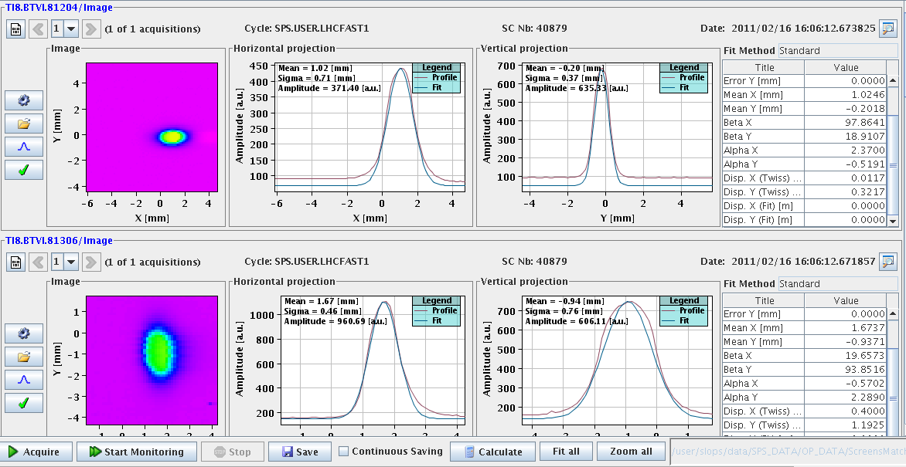
Beam on TI 8

Slide 3
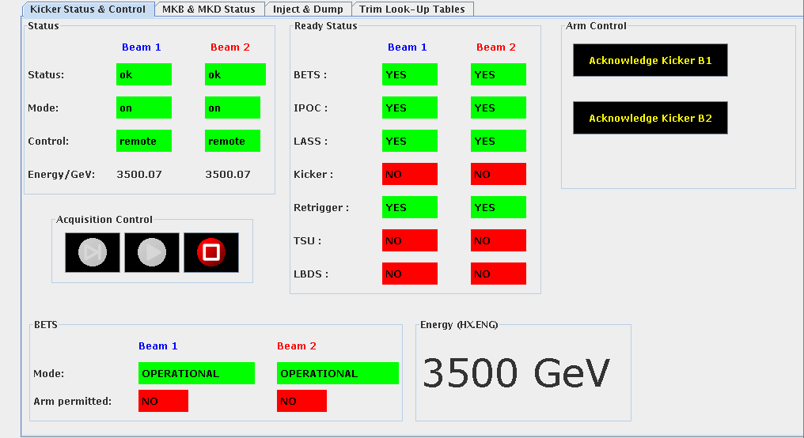
LBDS BETS at 3.5 TeV

Slide 4
LBDS
LBDS tracking test.
During this test check the SMP energy sent around (Bruno). It should be coherent with the different failure modes forced below. During the energy ramps we should, at least on some ramps, also ramp TCDQ and collimators and check coherency.
With B1 and B2 armed
450 GeV trim RB 4 – 5 up (or start ramp on only this circuit): check dump
3.5 TeV ramp RB 7 – 8 down: check dump
450 GeV trim RB 6- 7 up: check dump
3.5 TeV trim RB 5 – 6 down: check dump
B2 armed at 450 GeV
Trim up Q4.R.B1: nothing should happen.
Trim up Q4.R.B2: provoke beam dump
B1 armed at 3.5 TeV
Q4.L.B2 Trim down / off: nothing should happen
Q4.L.B1 Trim down / off: Dump
TEST RF frequency (with Andy)
Test LBDS triggers when RF signal is cut.
Test connecting to the correct RF frequency B1 / B2.
XPOC latching with SIS
Inject & dump mode. Start ramp, injection should stop.

Slide 5
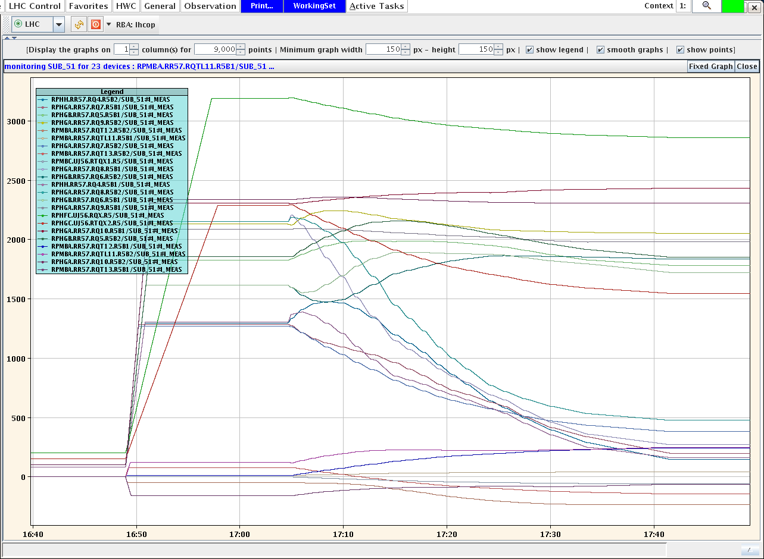
90 meter optics tested

Slide 6
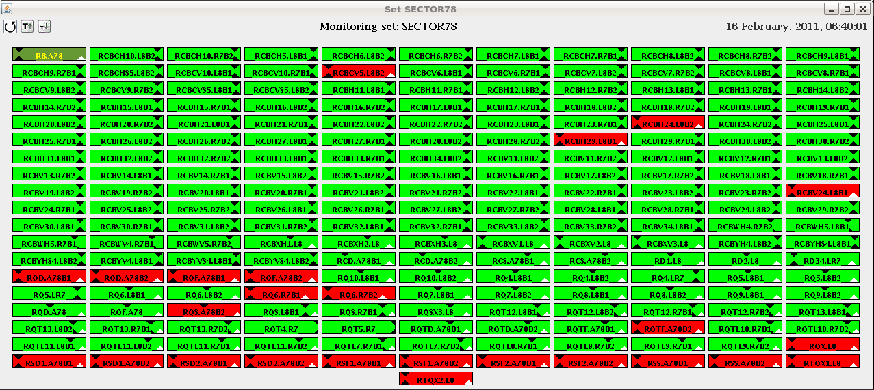
78
Sector 56/67/78 heat run
PGC loaded

Slide 7
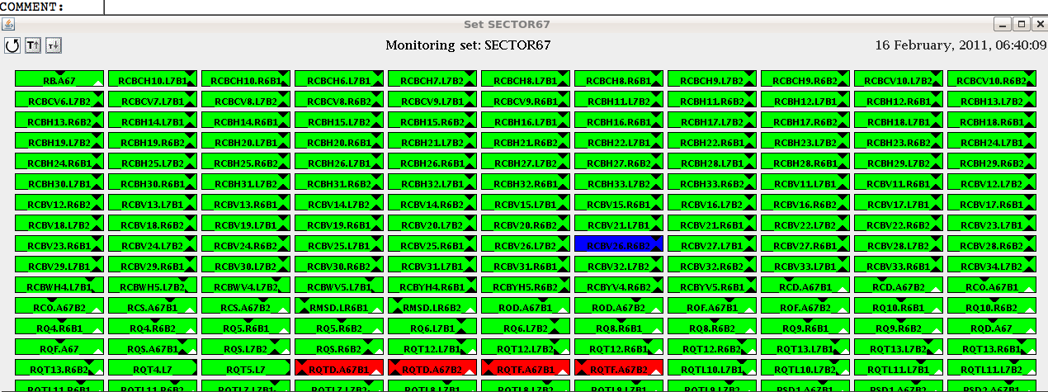
67

Slide 8
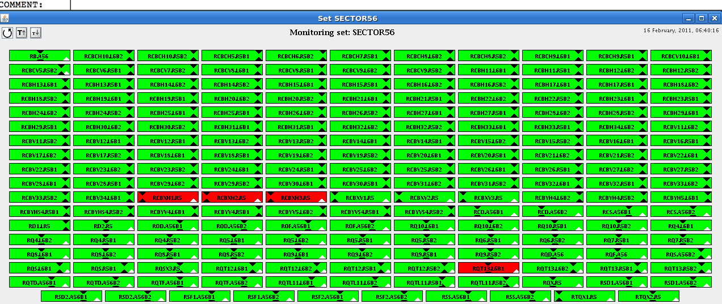
56

Slide 9
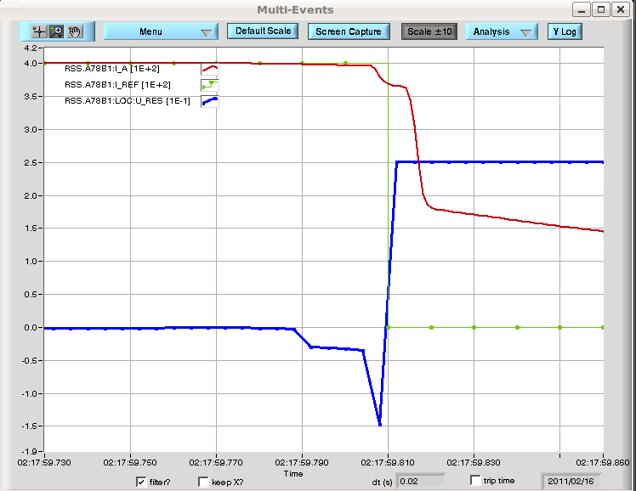

Slide 10
Progress of the day
Beam on TI8/TI2
TI8 looks all OK (not touched during the TS)
BPM problems in TI2
- BPMI.215 and BPMI.291 have H and V planes inverted
- BPM.231 has a sign error for the H plane.
- BPMI.284 is very noisy, multiple triggers
BIC
BSRT ready
connection problem solved.
Timing
Did real injection requests under LHC mastership with injection sequencer double threaded.
BPMs triggered fine with pre-pulse - concentrators fine with it (picked up by IQC, YASP).
BT pre-pulses arriving synchronously at MKIs (checked on OASIS).
IQC reacting fine.
Potential issues with the BCTs in IQC
Checked with BI solved
real dedicated filling tested ok
Frev distributed
Machine check out tests started

Slide 11
Progress of the day
BT
MKQ MKA AC-DIPOLE tested OK
MKI pulsing
Frev present
Prepulse trigger observed on OASIS
Impossible to close BIS loop
LBDS energy tracking
Q4L6 Q4R6 RMSD.LR6B1 RMSD.LR6B2
S45,56, 67,78 ramped to 3.5 TeV
Tested at 3.5 TeV
To be completed at 450 GeV

Slide 12
Progress of the day
Vacuum interlock test
Ring and Exp’s ready
Valves opening today
Interlock tests Done
PC
56 67 78 heat run
Few issues to be checked by MPP

Slide 13
LSA
New LSA functionality
Tested the incorporation process with the new parameters:
START-OF_BEAMPROCESS
END_OF_BEAMPROCESS
PREVIOUS and NEXT optics for the incorporation rules. Works fine for matched optics and for intermediate stopping points.
Greg has the green light to release the new functionality
Laurette modified the sequencer tasks related to the SMP changes(FORCE/UNFORCE SFB and RELAXED THRESHOLD)

Slide 14
BLM
Completed checks:
Sent triggers for the
- Post-Mortem,
- XPOC (both beams checked),
- Capture data: IQC and Study buffers (new feature)
Verified the following continuous features:
- Serials for all electronics are correct
- Integrated dose calculation and storage (new feature)
- Monitor filter values propagation (new feature)
Verified the Sanity Checks complete successfully.
- MCS online check (new parameters have been included)
- Internal check of the beam permit lines
- Connectivity check thresholds
Verified the Generation and Drive of the system parameters (has been modified to include new features).
Not completed checks (ongoing):
- Lost packet statistics between the concentrator and FESA class
- Communication/Optical links performance between the tunnel and surface installation.
- Noise analysis of the acquisition system
- Perform 6 hours of HV modulation test to gather more values for better determination of the connectivity check thresholds (tonight after your confirmation).

Slide 15
Open issues & Access
Handshake done
Few issues found continue on Friday morning
CO
BE/CO and IT/CS are asking for a network intervention tomorrow Thursday in the shadow of the PS POPS intervention.
2 minute network cut should be performed at 9:30am.
BT
LBDS Bets to be completed at 450GeV
PC’s
After first real heat run
Several pc’s tripped see sector status

Slide 16
Open issues & Access
Vacuum
Validation of TOTEM and ALFA interlock logic need detailed tests and as they use the collimator control system, need to be coordinated with Stefano.
RF
Prepulse tests Alice and LHCb ?

Slide 17
Planning

