Slide 1
Last night
Lhc closed 19:15
RB 78 tripped at 5800 Amps
Then ready again at 23:00
LBDS energy tracking tests
Heat run 56/67/78

Slide 2
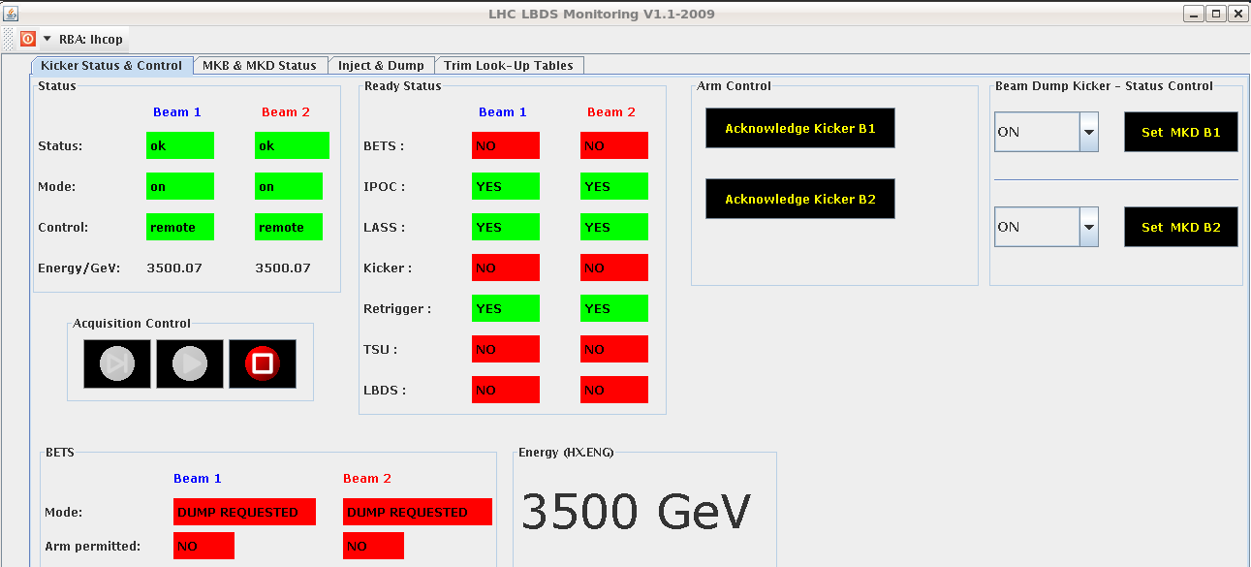
Lbds

Slide 3
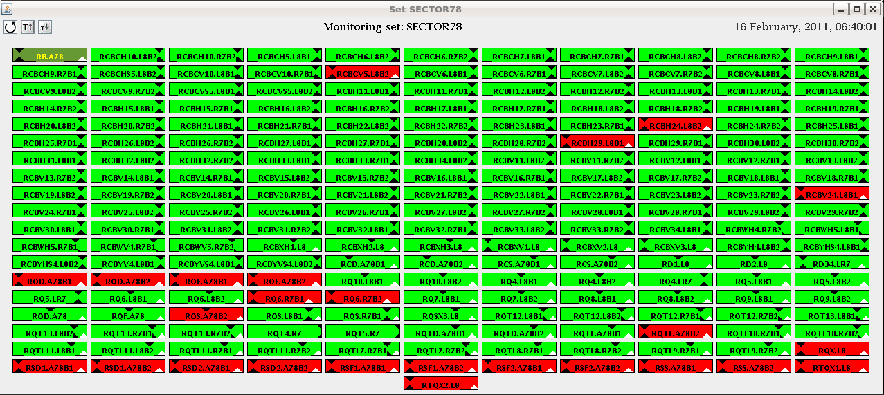
78

Slide 4
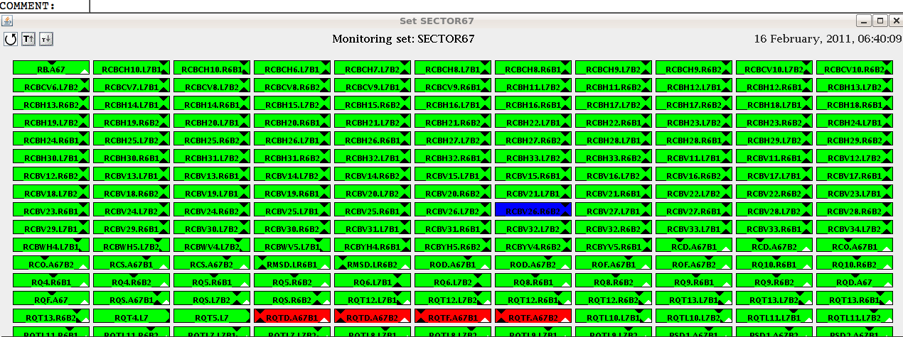
67

Slide 5
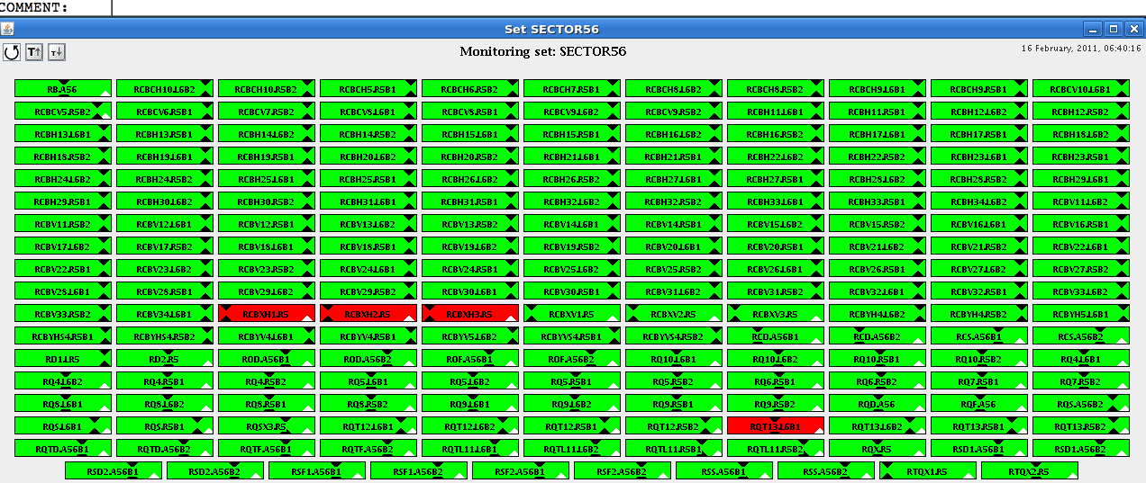
56

Slide 6
Progress of the day
BIC BLM
Ready..
Timing
Did real injection requests under LHC mastership with injection sequencer double threaded.
BPMs triggered fine with pre-pulse - concentrators fine with it (picked up by IQC, YASP).
BT pre-pulses arriving synchronously at MKIs (checked on OASIS).
IQC reacting fine.
Potential issues with the BCTs in IQC
publishing values > 0 without beam extracted (need to check with BI). Will add some more consistency checks in the IQC.
real dedicated filling tested ok
Frev distributed
Machine check out tests started

Slide 7
Progress of the day
BT
MKQ MKA AC-DIPOLE tested OK
MKI pulsing
Frev present
Prepulse trigger observed on OASIS
Impossible to close BIS loop
LBDS energy tracking
Q4L6 Q4R6 RMSD.LR6B1 RMSD.LR6B2
S45,56, 67,78 ramped to 3.5 TeV
Tested SMD table problem

Slide 8
Progress of the day
Vacuum interlock test
Ring and Exp’s ready
Valves opening today
Interlock tests Done 1 3 4 5 6 7
The vacuum valve functionality and interlock logic into the BIS have been tested for Pts 2 and 8. All is OK except for the validation of the interlock logic in and around the MKIs
PC
56 67 78 heat run
MSI 2/8 heat run
Tl’s interlocked element heat run done
Warm Magnet ON
SMP
Done ok.

Slide 9
Open issues & Access
Handshake done
Few issues found continue on Friday morning
BT
LBDS MSD Bets table faulty
Access needed point 6
PC’s
After first real heat run
Several pc’s tripped see sector status

Slide 10
Open issues & Access
Vacuum
Still an issue in LSS2/8
To be completed tomorrow
Validation of TOTEM and ALFA interlock logic need detailed tests and as they use the collimator control system, need to be coordinated with Stefano.
RF
Prepulse tests Alice and LHCb
To be tested during Beam test Ti2 Ti8
BIS
BIC
BTV-BSRT signal
interlock fault UA47R4 B1 (mask)
access

Slide 11
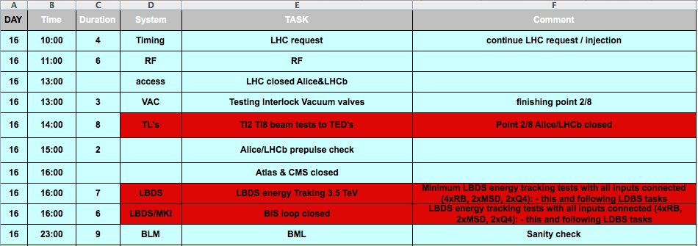
Planning

Slide 12
LSA
New LSA functionality
Tested the incorporation process with the new parameters:
START-OF_BEAMPROCESS
END_OF_BEAMPROCESS
PREVIOUS and NEXT optics for the incorporation rules. Works fine for matched optics and for intermediate stopping points.
Greg has the green light to release the new functionality
Laurette modified the sequencer tasks related to the SMP changes(FORCE/UNFORCE SFB and RELAXED THRESHOLD)

