Slide 1
Summary meeting 16/02/2011, 8:30
General information
Snubbers connected everywhere
Heat run with sector 56, 67 and 78 (RB excluded) carried out during the night
Circuit | RB comm. with Snubbers | Commissioning | GPM activated
RB.A12 | Yes | Not completed (RQ9.L2) | No
RB.A23 | Up to 2 kA | Not completed (problem on RB EE) | No
RB.A34 | Up to 2 kA | Not completed (problem on RB PC) | No
RB.A45 | Yes | Not completed (damaged board on RQD/F) | No
RB.A56 | Yes | Completed | Yes
RB.A67 | Yes | Completed | Yes
RB.A78 | Up to 2 kA | To be completed (problem on RB PC) | Yes
RB.A81 | Yes | Completed | No
Notes:
1

Slide 2
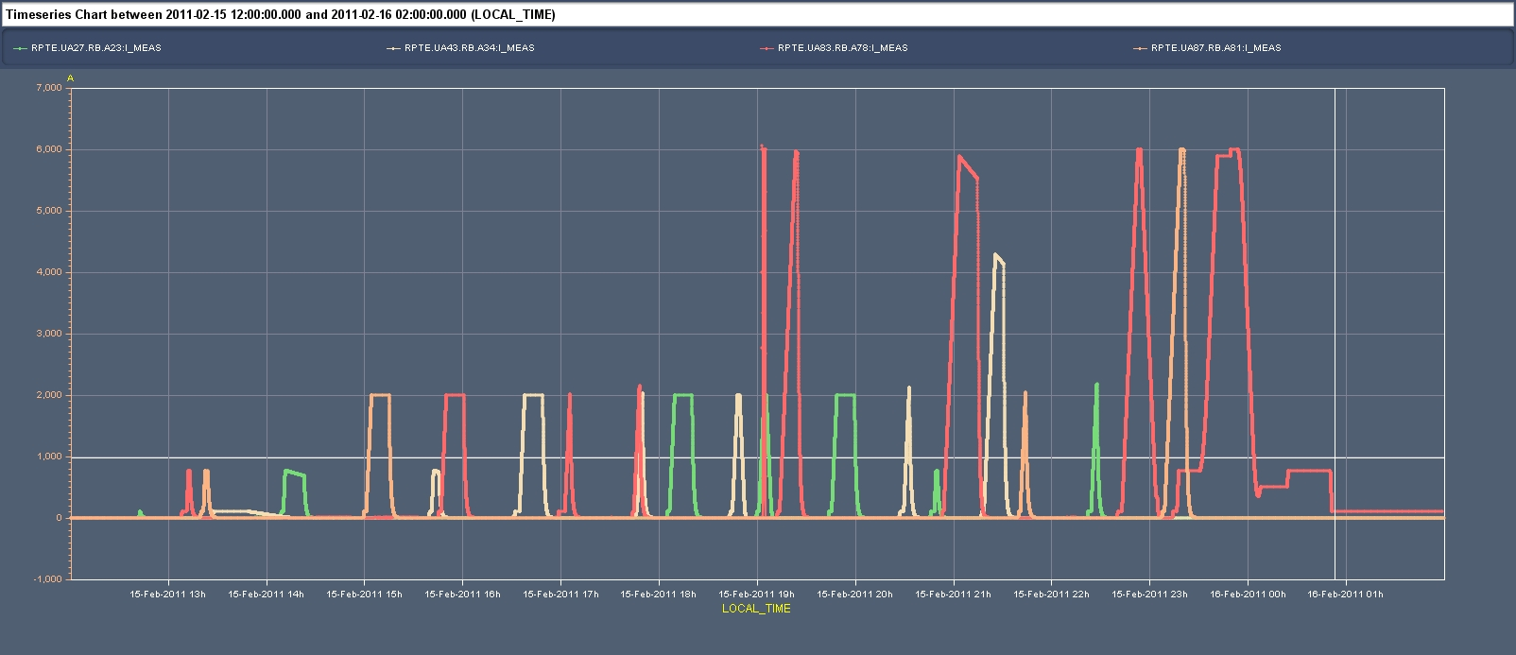
Tests on RB in several sectors yesterday

Slide 3
Missing circuits/tests
RCBXH3.L5 | PIC2 POWERING FAILURE | 4 / 9 (44%) | PIC2 CIRCUIT QUENCH VIA QPS | N/WPM | 4 | _ | PIC2 CRYO-OK | PCL | PCC.5 | PIC2 QPS-OK | PIC2 PC PERMIT | PIC2 POWERING FAILURE | PIC2 CIRCUIT QUENCH VIA QPS | PIC2 FAST ABORT REQ VIA PIC | PCS | PNO.d3 | PNO.a3
RCBXV3.L5 | PIC2 POWERING FAILURE | 1 / 5 (20%) | PIC2 CIRCUIT QUENCH VIA QPS | N | 5 | _ | PIC2 CRYO-OK | PCL | PCC.5 | PIC2 QPS-OK | PIC2 PC PERMIT | PIC2 POWERING FAILURE | PIC2 CIRCUIT QUENCH VIA QPS | PIC2 FAST ABORT REQ VIA PIC | PCS | PNO.d3 | PNO.a3
RCO.A45B1 | PNO.d3 | 4 / 5 (80%) | PNO.a3 | N | 4 | _ | PIC2 CRYO-OK | PCL | PCC.5 | PIC2 QPS-OK | PIC2 PC PERMIT | PIC2 POWERING FAILURE | PIC2 CIRCUIT QUENCH VIA QPS | PIC2 FAST ABORT REQ VIA PIC | PCS | PNO.d3 | PNO.a3
RQSX3.L5 | PIC2 POWERING FAILURE | 1 / 5 (20%) | PIC2 CIRCUIT QUENCH VIA QPS | N | 4 | _ | PIC2 CRYO-OK | PCL | PCC.5 | PIC2 QPS-OK | PIC2 PC PERMIT | PIC2 POWERING FAILURE | PIC2 CIRCUIT QUENCH VIA QPS | PIC2 FAST ABORT REQ VIA PIC | PCS | PNO.d3 | PNO.a3
RQ9.L2 | PIC2 POWERING FAILURE | 0 / 5 (0%) | PIC2 CIRCUIT QUENCH VIA QPS | N | 1 | _ | PIC2 CRYO-OK | PCL | PCC.4 | PIC2 QPS-OK | PIC2 PC PERMIT | PIC2 POWERING FAILURE | PIC2 CIRCUIT QUENCH VIA QPS | PIC2 FAST ABORT REQ VIA PIC | PLI1.c3 | PLI2.f3 | PLI2.e3 | PNO.a7 | PNO.c3 | PNO.c4 | PIC2 GLOBAL PROTEC. MECH
RQ9.R4 | PIC2 POWERING FAILURE | 0 / 5 (0%) | PIC2 POWERING FAILURE | N/WPM | 5 | _ | PIC2 CRYO-OK | PCL | PCC.4 | PIC2 QPS-OK | PIC2 PC PERMIT | PIC2 POWERING FAILURE | PIC2 CIRCUIT QUENCH VIA QPS | PIC2 FAST ABORT REQ VIA PIC | PLI1.c3 | PLI2.f3 | PLI2.e3 | PNO.a7 | PNO.c3 | PNO.c4 | PIC2 GLOBAL PROTEC. MECH
RB.A23 | PLI2.e2 | 8 / 10 (80%) | PLI2.b2 | Y | 3 | _ | PIC2 CRYO-OK | PCL | PQC | PCC.2 | PIC2 QPS-OK | PIC2 PC PERMIT | PIC2 POWERING FAILURE | PIC2 CIRCUIT QUENCH VIA QPS | PIC2 FAST ABORT REQ VIA PIC | PIC2 DISCHARGE REQ VIA PC | PIC2 DISCHARGE REQ VIA PIC | PLI1.a2 | PLI1.b2 | PLI1.d2 | PLI2.s1 | PLI2.b2 | PLI2.e2 | PLIM.b2 | PLIS.s2 | PLI3.a5 | PLI3.d2 | PNO.a6 | PNO.b2 | PIC2 GLOBAL PROTEC. MECH
RB.A34 | PLI2.e2 | 8 / 10 (80%) | PLI3.d2 | N/WPM | 2 | _ | PIC2 CRYO-OK | PCL | PQC | PCC.2 | PIC2 QPS-OK | PIC2 PC PERMIT | PIC2 POWERING FAILURE | PIC2 CIRCUIT QUENCH VIA QPS | PIC2 FAST ABORT REQ VIA PIC | PIC2 DISCHARGE REQ VIA PC | PIC2 DISCHARGE REQ VIA PIC | PLI1.a2 | PLI1.b2 | PLI1.d2 | PLI2.s1 | PLI2.b2 | PLI2.e2 | PLIM.b2 | PLIS.s2 | PLI3.a5 | PLI3.d2 | PNO.a6 | PNO.b2 | PIC2 GLOBAL PROTEC. MECH
RQD.A45 | PIC2 DISCHARGE REQ VIA PIC | 4 / 6 (66%) | PLI2.e2 | N | 4 | _ | PIC2 CRYO-OK | PCL | PQC | PCC.3 | PIC2 QPS-OK | PIC2 PC PERMIT | PIC2 POWERING FAILURE | PIC2 CIRCUIT QUENCH VIA QPS | PIC2 FAST ABORT REQ VIA PIC | PIC2 DISCHARGE REQ VIA PC | PIC2 DISCHARGE REQ VIA PIC | PLI1.b3 | PLI1.d2 | PLI2.s1 | PLI2.b3 | PLI2.e2 | PLIM.b3 | PLIS.s2 | PLI3.a5 | PLI3.b3 | PNO.a6 | PNO.b3 | PIC2 GLOBAL PROTEC. MECH
RQF.A45 | PIC2 DISCHARGE REQ VIA PIC | 4 / 6 (66%) | PLI2.e2 | N | 2 | _ | PIC2 CRYO-OK | PCL | PQC | PCC.3 | PIC2 QPS-OK | PIC2 PC PERMIT | PIC2 POWERING FAILURE | PIC2 CIRCUIT QUENCH VIA QPS | PIC2 FAST ABORT REQ VIA PIC | PIC2 DISCHARGE REQ VIA PC | PIC2 DISCHARGE REQ VIA PIC | PLI1.b3 | PLI1.d2 | PLI2.s1 | PLI2.b3 | PLI2.e2 | PLIM.b3 | PLIS.s2 | PLI3.a5 | PLI3.b3 | PNO.a6 | PNO.b3 | PIC2 GLOBAL PROTEC. MECH
For the commissioning of the RBs:
RB.A23 – powering failure+extraction from 6 kA / extraction from 6 kA
RB.A34 – powering failure+extraction from 6 kA / extraction from 6 kA
RB.A78 – extraction from 6 kA
For the 120 A correctors of the IT, the commissioning is not mandatory, apart the RCSXs
Those with cryo-regulation issues will be tried but won’t block
RCOSX3.L2 | PIC2 PC PERMIT | 0 / 4 (0%) | PIC2 POWERING FAILURE | N | 1 | _ | PIC2 CRYO-OK | PCL | PCC.1 | PIC2 PC PERMIT | PIC2 POWERING FAILURE | PNO.a1 | PNO.d1 | PNO.e1
RCOSX3.R1 | PIC2 PC PERMIT | 0 / 4 (0%) | PIC2 POWERING FAILURE | N | 1 | _ | PIC2 CRYO-OK | PCL | PCC.1 | PIC2 PC PERMIT | PIC2 POWERING FAILURE | PNO.a1 | PNO.d1 | PNO.e1
RCOX3.L1 | PIC2 PC PERMIT | 0 / 4 (0%) | PIC2 POWERING FAILURE | N | 4 | _ | PIC2 CRYO-OK | PCL | PCC.1 | PIC2 PC PERMIT | PIC2 POWERING FAILURE | PNO.a1 | PNO.d1 | PNO.e1
RCSSX3.L1 | PIC2 PC PERMIT | 0 / 4 (0%) | PIC2 POWERING FAILURE | N | 2 | _ | PIC2 CRYO-OK | PCL | PCC.1 | PIC2 PC PERMIT | PIC2 POWERING FAILURE | PNO.a1 | PNO.d1 | PNO.e1
RCSSX3.R8 | PIC2 PC PERMIT | 0 / 4 (0%) | PIC2 POWERING FAILURE | N | 2 | _ | PIC2 CRYO-OK | PCL | PCC.1 | PIC2 PC PERMIT | PIC2 POWERING FAILURE | PNO.a1 | PNO.d1 | PNO.e1
RCTX3.L5 | PIC2 POWERING FAILURE | 1 / 4 (25%) | PNO.a1 | N | 1 | _ | PIC2 CRYO-OK | PCL | PCC.1 | PIC2 PC PERMIT | PIC2 POWERING FAILURE | PNO.a1 | PNO.d1 | PNO.e1
RCTX3.L8 | PIC2 PC PERMIT | 0 / 4 (0%) | PIC2 POWERING FAILURE | N | 2 | _ | PIC2 CRYO-OK | PCL | PCC.1 | PIC2 PC PERMIT | PIC2 POWERING FAILURE | PNO.a1 | PNO.d1 | PNO.e1

Slide 4
Issues
RB.A23:
The delay between switches opening is smaller than nominal
Board to be changed in P2, access to point 3 for connection of loosen scope pin
RB.A34:
Power converter tripped at about 4.2 kA
Active filter loop to be verified
RB.A78:
Power converter tripped at about 5.9 kA
Active filter was disconnected
Intervention to verify active filter loop and re-connect the filter
RQD/F.A45:
Board A in position 31.L5 must be replaced (the coefficient was already improved for B board)
RQ9.L2 and RQ9.R4
QPS board exchange?
RCBXH3.L5, RCBXV3.L5 and RQSX3.L5:
PM stuck at position 250 - QPS board to be changed?
RCO.A45B1:
Voltage oscillations not clear – we did few 6-7 hours heat run!
RCBV24.L4B1: high resistance: loosen connection?
RQTD.A45B1: bad cryo-regulation - to be looked at by cryo-operation
RQTL7.R3B2: valve blocked - to be fixed on site
RQ10.R1: power cycle needed?

Slide 5
QPS issues (KDP)
RQ9.L2 noise problem to be solved
RQ9.R4 Returned to fault state after operating correctly for some time.
RQ10.R1 No power permit provided from the lead detector (to be considered by Reiner).
S45: Abort by B31.L5 - BS part, QF/QD. Symptoms: As if no busbar signal is available. Check if patch of Mike has been removed, check that all signal cables are correctly connected and/or, if needed, exchange the two BS boards, slots 3 and 4.
Replacement of the DQAMG of RCBXV3.L5 and RQSX.L5 (PM stops at step 250 - power cycle didn't help).
Replacement of the 'FPA/open/close' board of the DQSB in UA27. Delay is wrong on installed board (was correct last year).
Frequent losses of communication with the new global busbar detector: Problem to be discussed with Reiner.
Test instrumentation from snubber testing will have to be disconnected and removed from sectors S23, S34 and S67 (including Emmanuele's data loggers and scopes), S23 and S34 evidently after end of last tests Wednesday afternoon.
One probe has detached from the busway terminal in the DQS monitoring system in R34 (S23). Needs to be re-inserted.

Slide 6
Accesses
QPS will access in point 1, 2, 3, 4 and 5
PC will access PM85 and PM45
BSRT team will access RF zone to fix the B2 periscope
BLM team will access sector 67
All accesses shall be over by 13:00

