Slide 1
Summary of week 7
Hardware Commissioning:
M. Pojer, R. Schmidt and M. Solfaroli
Machine checkout and beam commissioning:
R. Giachino, J. Uythoven and J. Wenninger
Aims of the week
Finish HWC
Prepare machine for first beam

Slide 2
LHC check-out
Main targets of the week:
Finish HWC,
Close the beam interlock loop,
Test the beam dump,
Test the injection kickers,
Run the LHC through a full machine cycle,
Check the control system.

Slide 3
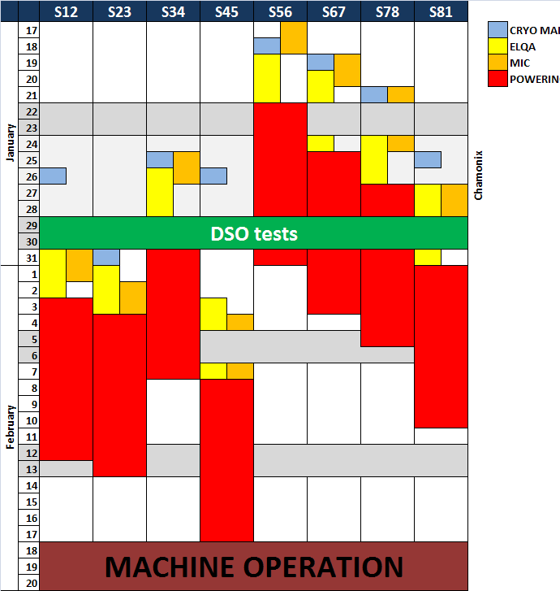
Planning evolution (HWC team)
November 11,2010
February 16, 2011
 |  | S12 | S23 | S34 | S45 | S56 | S67 | S78 | S81
January | 17 |  |  |  |  |  |  |  |  |  |  | CRYO MAINT.
 | 18 |  |  |  |  |  |  |  |  |  |  | ELQA
 | 19 |  |  |  |  |  |  |  |  |  |  | POWERING
 | 20
 | 21
 | 22
 | 23
 | 24 |  |  |  |  |  |  |  |  | Chamonix
 | 25
 | 26
 | 27
 | 28
 | 29
 | 30
 | 31
February | 1
 | 2 |  |  |  |  | LASS UPDATE
 | 3
 | 4
 | 5
 | 6
 | 7
 | 8
 | 9
 | 10
 | 11
 | 12 | DSO TESTS
 | 13
 | 14
 | 15
 | 16
 | 17 | MACHINE CHECK-OUT
 | 18
 | 19

Slide 4
Progress : HWC & checkout
From Monday to Friday HWC and machine checkout activities had to be performed in parallel.
Priorities were defined every day for HWC and for checkout activities, the focus shifting from HWC to checkout along the week.
Collaboration HWC-checkout was very smooth and should be reinforced next year, with aim to merge them into one activity.

Slide 5
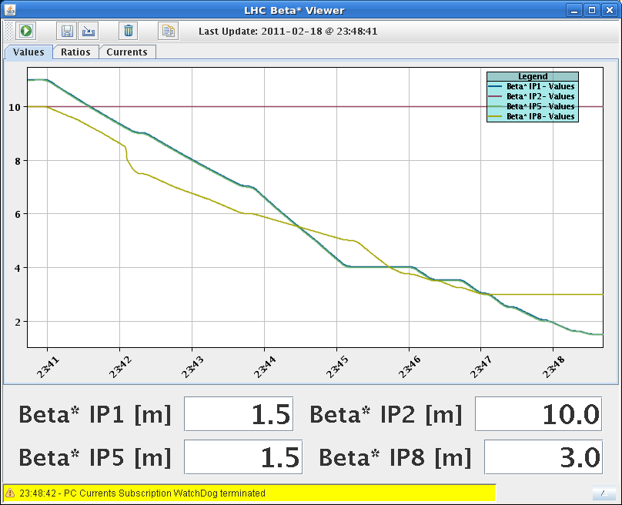
Machine cycle
HWC was completed Friday afternoon when the machine was ‘handed’ over to beam operation.
The same evening, the machine was pushed through the nominal proton cycle:
Pre-cycling of the magnets,
Injection,
Ramp,
Squeeze.
A number of control issues were identified – have been fixed or will be fixed in the coming days.

Slide 6
Powering status
Pre-cycles work well.
Heat runs:
All sectors were tested except S12 and S23: RB12 and RB23 trips – compensations for nQPS and TI2 transfer line cross-talk.
RQS.A76B1 powering fault.
RQT13.L7B1 high resistance failure.
Current limited to 50 A.

Slide 7
LHC progress : beam interlock and kickers
To close the beam interlock loop requires a number of conditions, the most difficult ones to achieve were:
LHC closed – no access (also experiments),
No powering failures,
Vacuum valves open,
BLM system operational.
>> tough constraints given parallel HWC activities.
After 3 unsuccessful attempts, the BIS loop was eventually closed the first time Thursday evening after intervention of the BIS and LBDS teams.
Thursday late night both dump and injection kicker systems were pulsing and ready for beam.

Slide 8
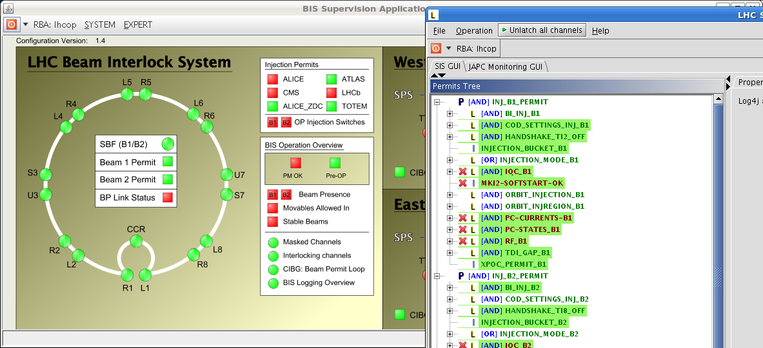
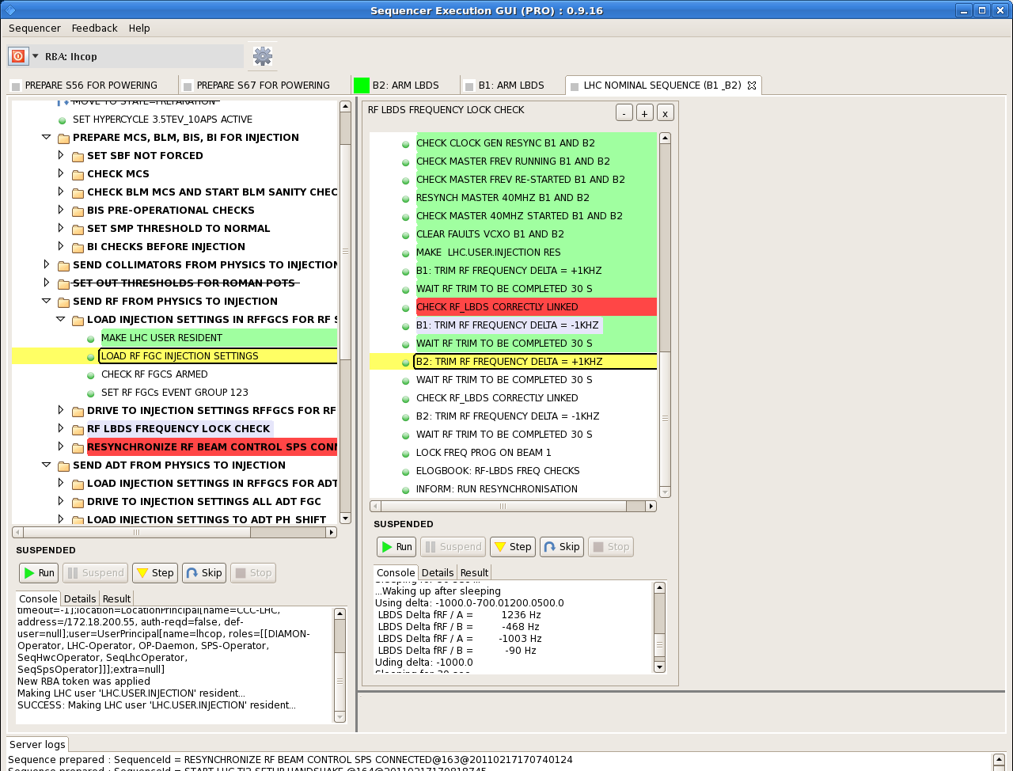
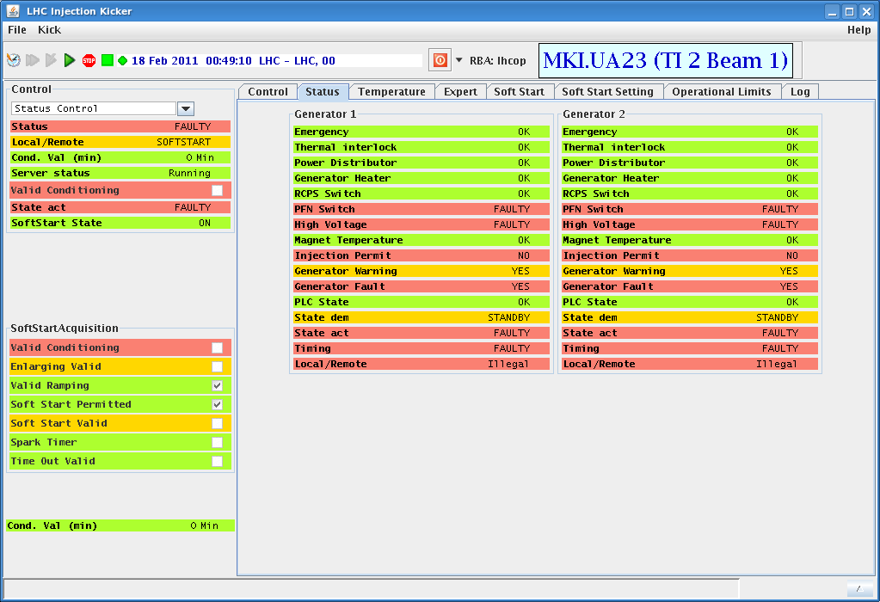
Controls
Along the week the OP teams with support from numerous equipment groups tested applications, front-ends, LSA core etc etc
Many thanks to all colleagues that helped us in this essential activity

Slide 9
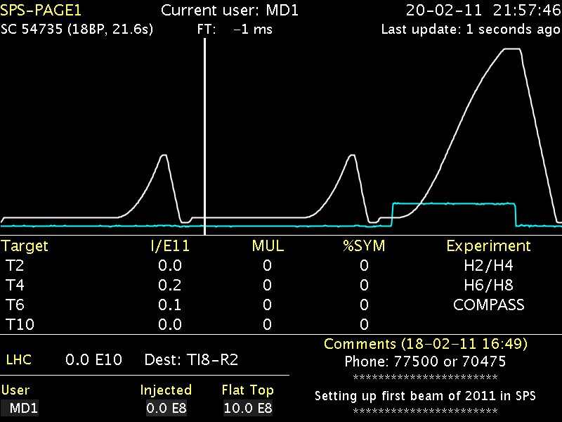
Injectors and transfer lines (1)
PSB started up with beam Wednesday 9th February.
PS started up with beam Friday 11th February (with a brand new main PS system).
SPS started up with beam Saturday 12th February.
Tuesday morning the SPS was aligned and the probe bunch was ready to be extracted to the LHC.

Slide 10
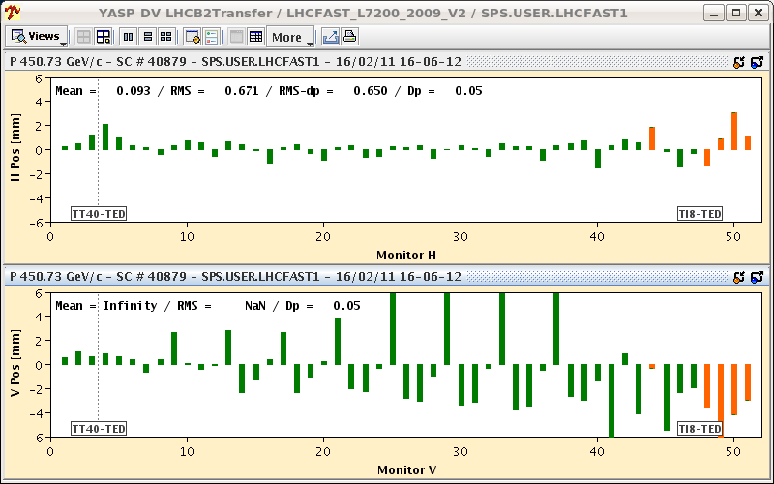
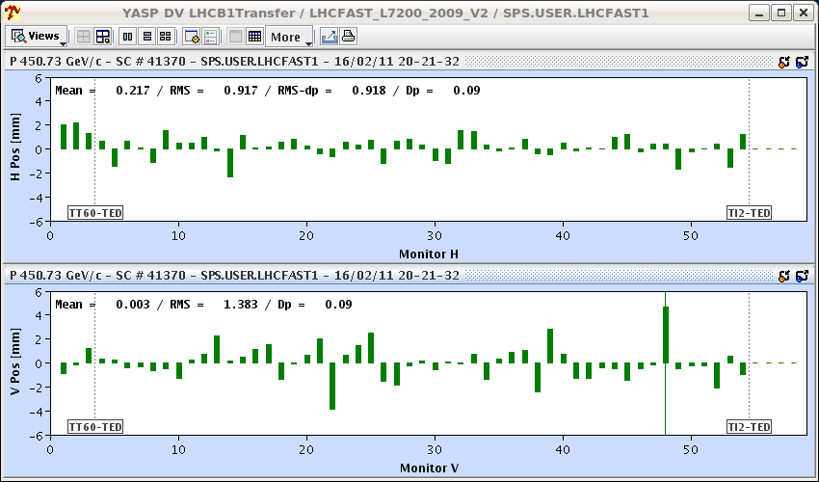
Injectors and transfer lines (2)
Tuesday evening probe bunches were extracted into the TT40 line (LHC beam2).
Wednesday afternoon beams were sent down the 3 km long TI2 and TI8 transfer lines to the downstream (LHC end) dumps.
The lines were ready for injection Thursday evening.
TI8
TI2

Slide 11
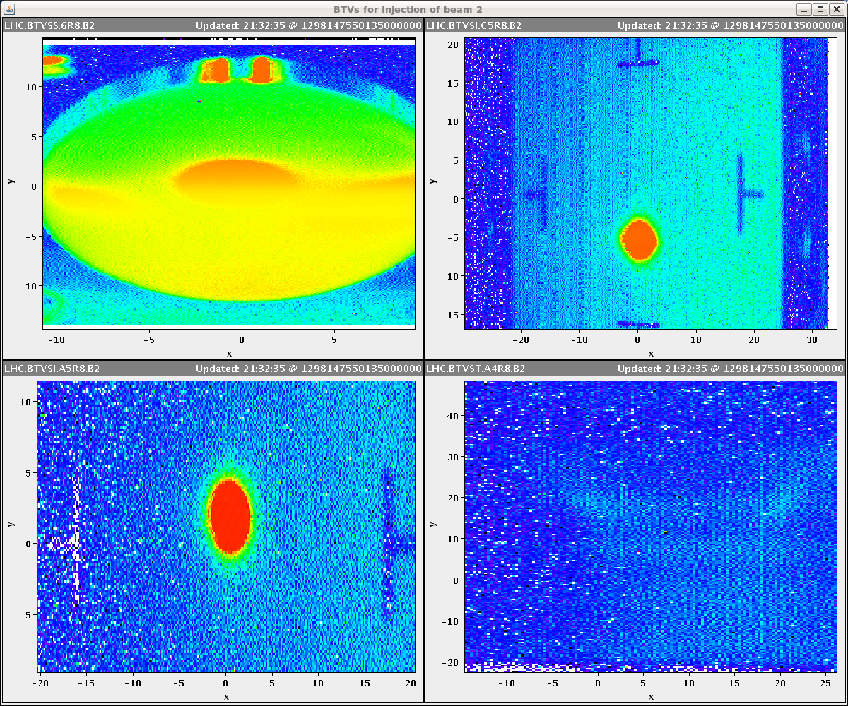
Saturday 19th February – D-day
After a morning and afternoon spent fixing the last problems related to powering, the LHC was ready for beam injection Saturday evening.
At 20:53 the dump was retracted from the TI8 line and the first beam was directed to the TDI block in front of LHCb.
Beam 2 was then threaded along the ring, and stopped at collimators on the way.
The orbit correctors were set to the settings that were used in December during the ion run.
Only minor corrections had to be applied during threading.

Slide 12
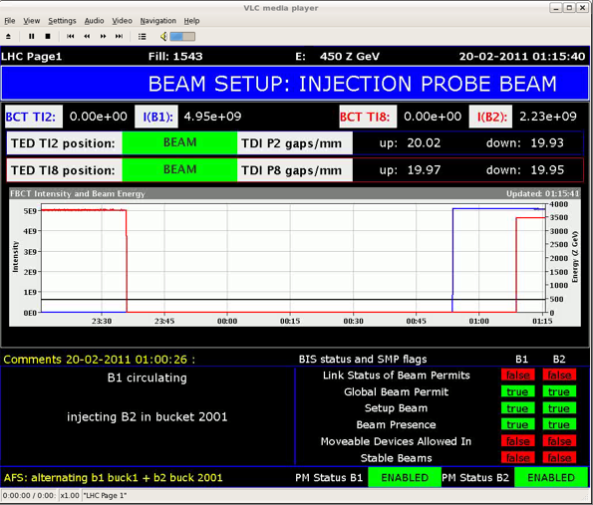
Beams circulating !
When the last collimator was opened and the beam re-injected… beam 2 circulated immediately with good lifetime – it was coarsely captured by the RF system (without RF expert intervention).
The same exercise was repeated for beam 1 – with the same outcome.
At 01:15 Sunday morning both beams were circulating !

Slide 13
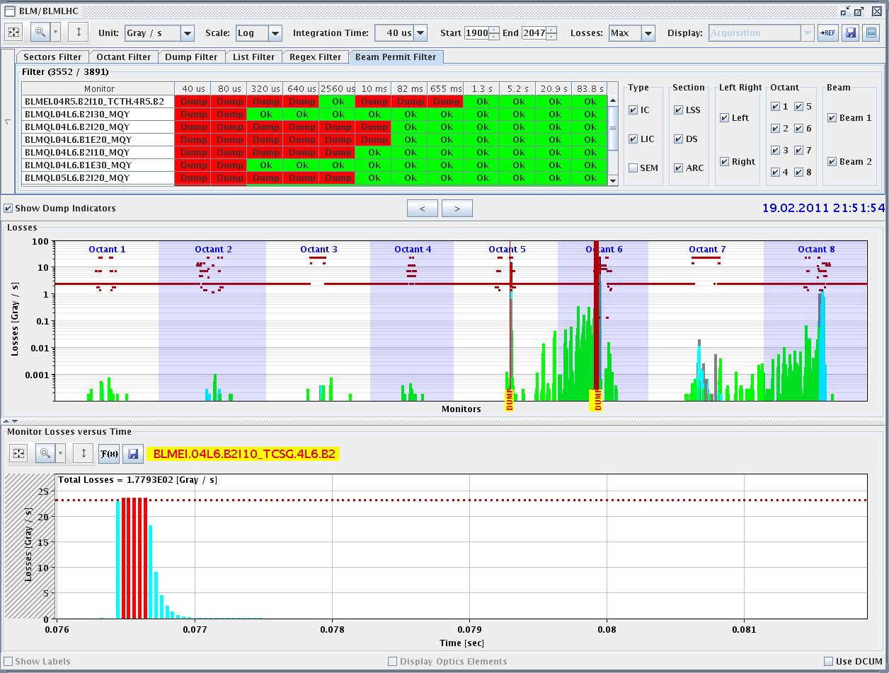
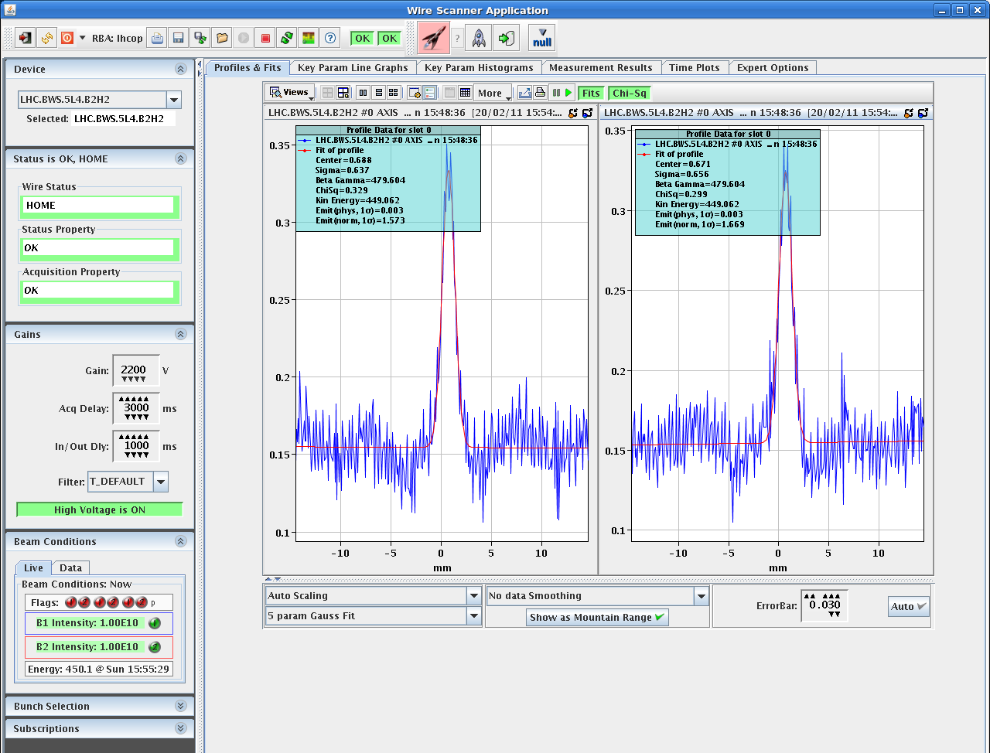
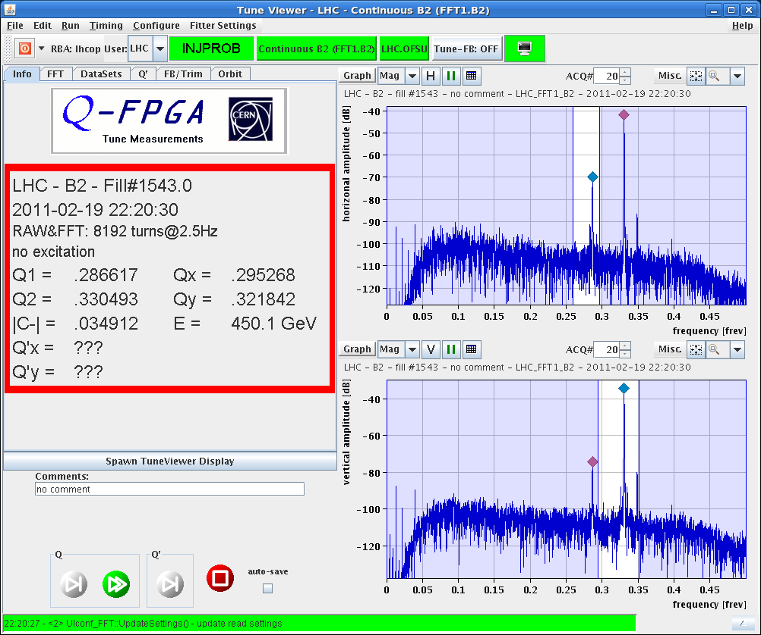
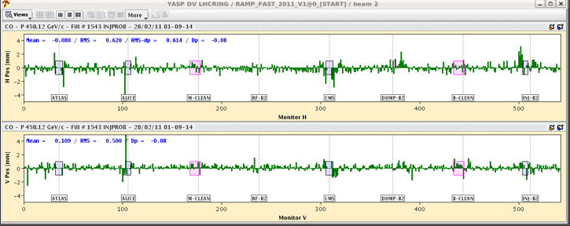
Beam instrumentation checks
It works !!!
Thank you BI !

Slide 14
Sunday 20th - consolidation
Proper capture of the beams was setup by the RF colleagues Sunday morning.
The morning and afternoon was used to checkout instrumentation and feedbacks:
All FBs essentially operational (with minor fix needed for orbit FB).
All instruments working – fine tuning of setups will continue in the next days.
BLM system protection functionality was validated.
Issue with LBDS beam 2 that triggers a dump spontaneously. It seems related to the Trigger Synch. Unit (TSU).

Slide 15
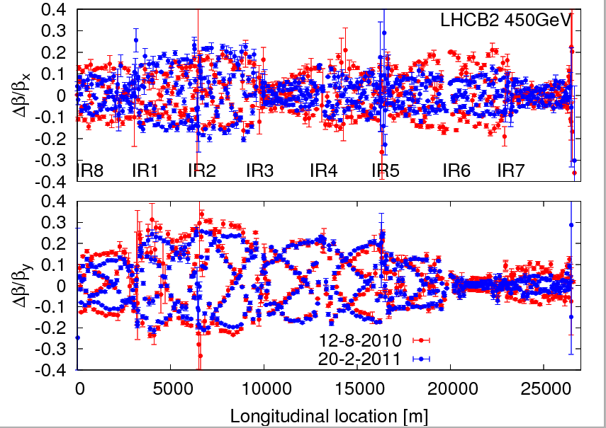
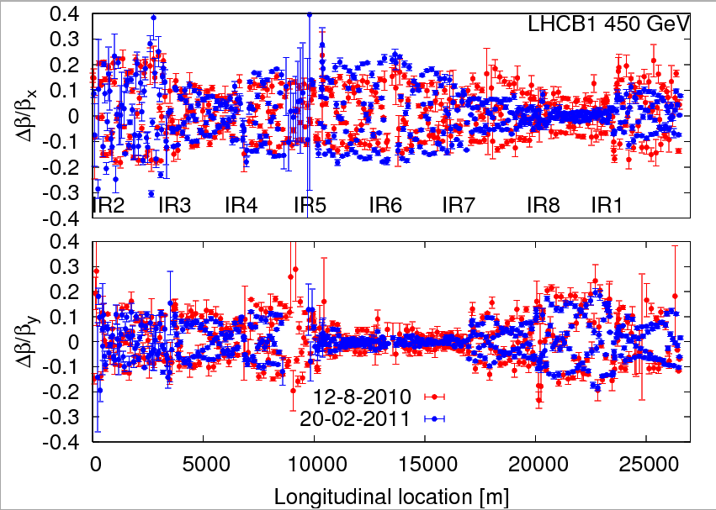
Sunday 20th - optics
Optics measurements at injection were performed Sunday afternoon.
Very good agreement with August 2010 measurements (with 2010 corrections applied !).
Beta-beat within 25-30%.

Slide 16
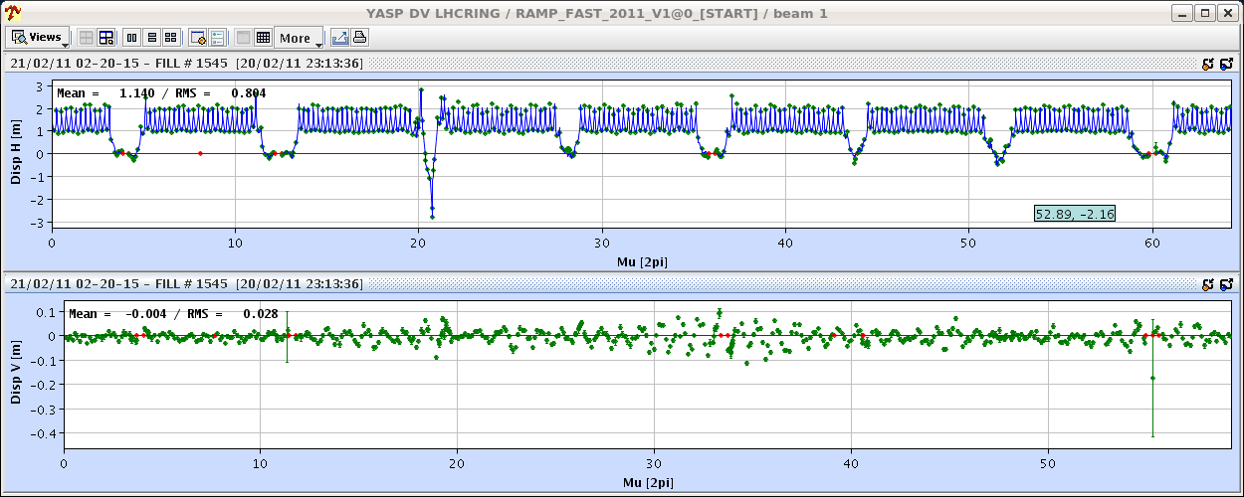
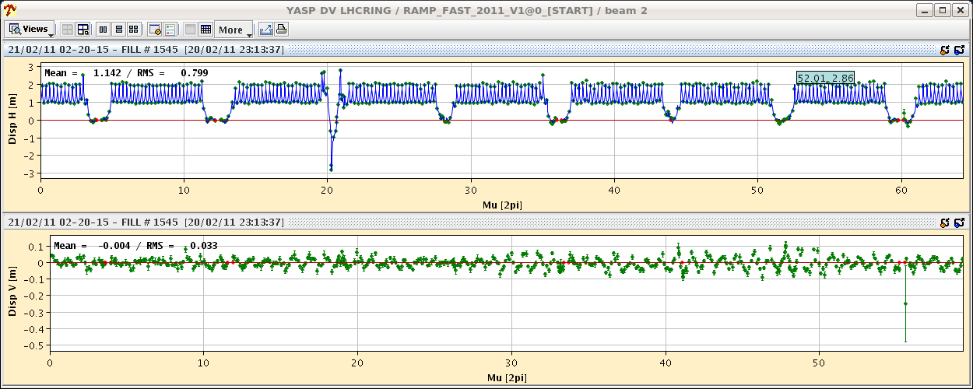
More optics
Dispersion…

Slide 17
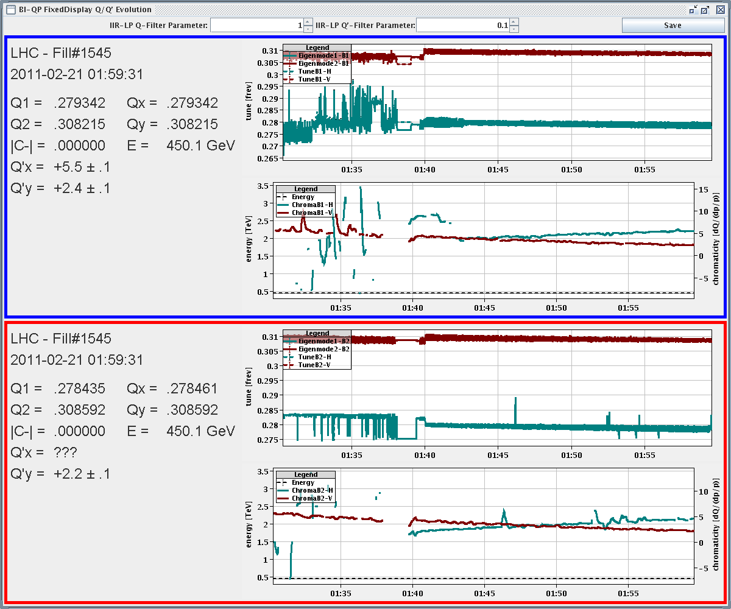
Sunday night
Q and Q’ decay measurements after pre-cycle (4 h).
Xing angles and non-closure.

Slide 18
Summary
Situation of the machine:
The LHC magnet and powering system is fully commissioned and the machine is in a very good state – as demonstrated by the rocket-speed startup with beam.
Low intensity beams circulating in both rings.
Orbits, tunes, chromaticity and optics at injection corrected and under control.
Essential beam instrumentation and feedbacks operational – fine tuning in the coming days.
Control system operational – smaller issues will be fixed in the coming days.
Stay tuned for the new fast ramp !

Slide 19
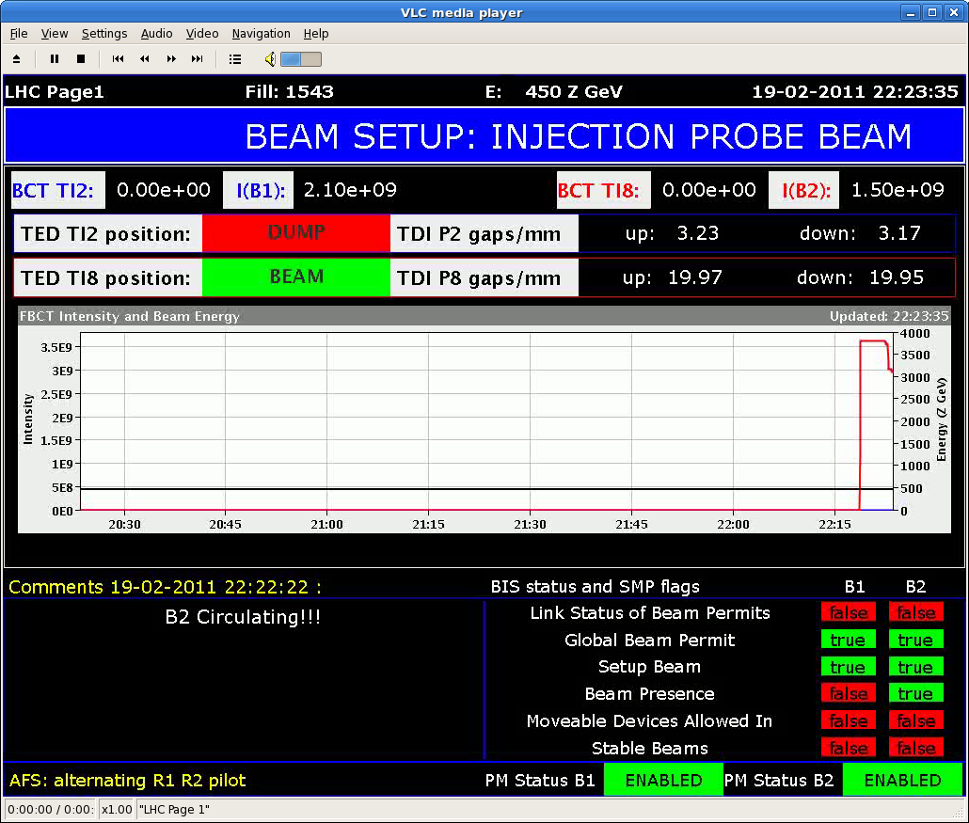
Thank you to all colleagues that made the past few weeks unbelievable successful !!!

Slide 20
Tentative planning of the week
Day | Shift | Time (h) | Activity
SA | A | 8 | Injection and first turn b1 (All expts. magnets off except Atlas & CMS)
SA | N | 4 | Injection and first turn b2
SA | N | 4 | Dispersion, CO, Q, Q',C- measure and correct - beam2/beam 1
SU | M | 8 | Circulating Pilot and RF capture b1 and b2
SU | A | 2 | MPS checks: BLMs, BPF (scraping)
SU | A | 4 | Feedbacks - recommissioning at injection (Q, orbit, radial)
SU | A | 4 | Beta beating measurements and correction@450 GeV
SU | N | 6 | Normal pre-cycle - decay measurement
MO | M | 8 | Dump checks
MO | A | 8 | Trial ramp to 3.5 TeV - test Q and orbit feedback - test dump
MO | N | 8 | Beta beating measurements and correction revisited
TUE | M | 8 | Injection setting-up
TUE | A | 8 | Switching on / compensate the experimental magnets
TUE | N | 8 | 100 A pre-cycle - decay measurement
WED | M | 8 | Rough collimator setup for first ramp
WED | A | 8 | Trial ramp to 3.5 TeV - test Q and orbit feedback - test dump
WED | N | 8 | Damper setup for nominal bunch
THU | M | 8 | Injection setup for nominal bunch
THU | A | 8 | Reference orbit flat + with bumps on
THU | N | 8 | Aperture at injection

