Slide 1
LHC – week 48 finishing up the ioning
Coordination: Gianluigi Arduini & Mike Lamont

Slide 2
Week 48 - Overview
Monday | Polarity reversal PM: Lost cooling/cryo/link
Tuesday | Recovery
Wednesday | Recovery ELQA Powering tests
Thursday | 03:00 Beam back Van der Meer scans - Alice
Friday | Van der Meer scans - Atlas and CMS
Saturday | Steady operation
Sunday | Steady operation

Slide 3
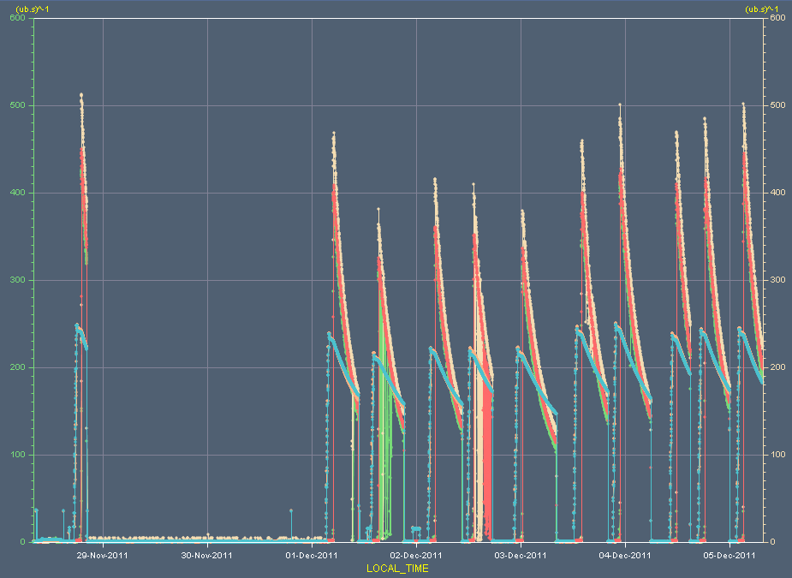
Luminosity & beam intensity
5e26 cm⁻²s⁻¹
4e12

Slide 4
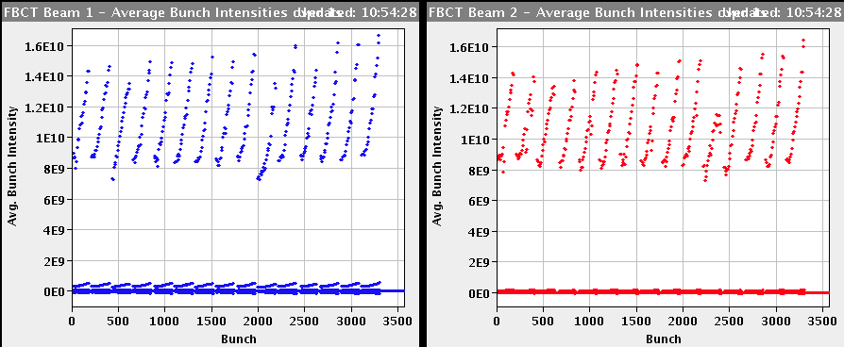
Typical bunch intensity distribution

Slide 5
W38 - fills
Date | Fill | CMS peak e24 | SB [hr] | CMS Int [ub⁻¹] | Dump
Mon 28 Nov | 2332 | 460 | 1:12 | 1.7 | PLC problem on M1B1
Thu 1 Dec | 2334 | 426 | 5:45 | 5.1 | OP
Thu 1 Dec | 2335 | 334 | 5:46 | 4.2 | OP
Fri 2 Dec | 2336 | 375 | 6:14 | 4.8 | OP
Fri 2 Dec | 2337 | 371 | 4:15 | 3.2 | QPS board problem on B10L2.
Sat 3 Dec | 2338 | 345 | 7:39 | 5.3 | OP
Sat 3 Dec | 2339 | 417 | 5:55 | 5.1 | OP
Sat 3 Dec | 2340 | 442 | 7:01 | 6.2 | OP
Sun 4 Dec | 2341 | 431 | 3:08 | 3.3 | BD self trigger
Sun 4 Dec | 2342 | 435 | 5:34 | 5.1 | OP
Mon 5 Dec | 2343

Slide 6
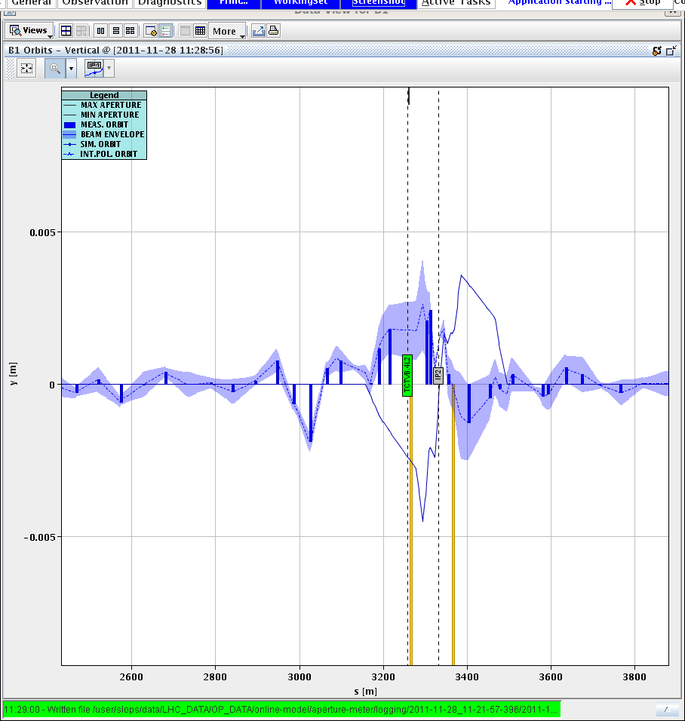
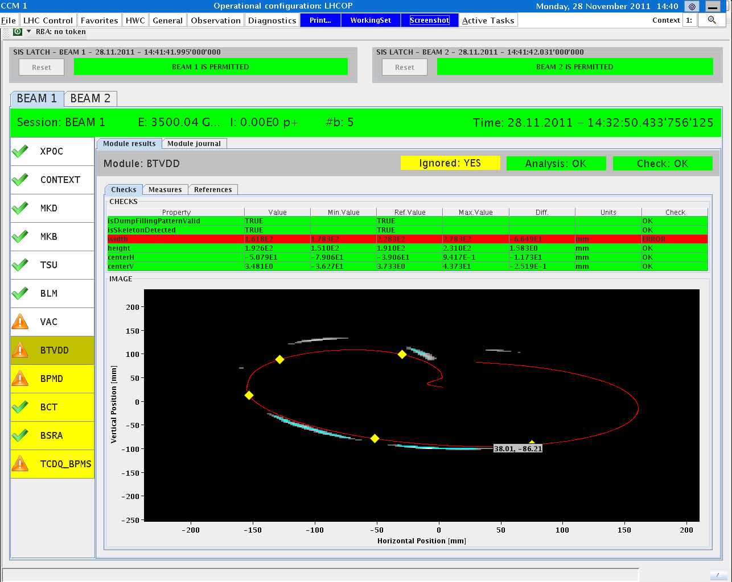
Polarity inversion - Monday
07:00 ALICE solenoid and dipole polarity switched to positive
External Crossing angle polarity unchanged at injection/ramp & squeeze
Crossing angle polarity switch when going in collision
12:00 TCT alignment check in point 2 after crossing angle polarity switch when going in collision
13:30-14:30: loss maps and asynch dump test
Loss maps OK (S. Redaelli) although deterioration in the vertical plane B1
Asynch dump ok (Jan Uythoven).

Slide 7
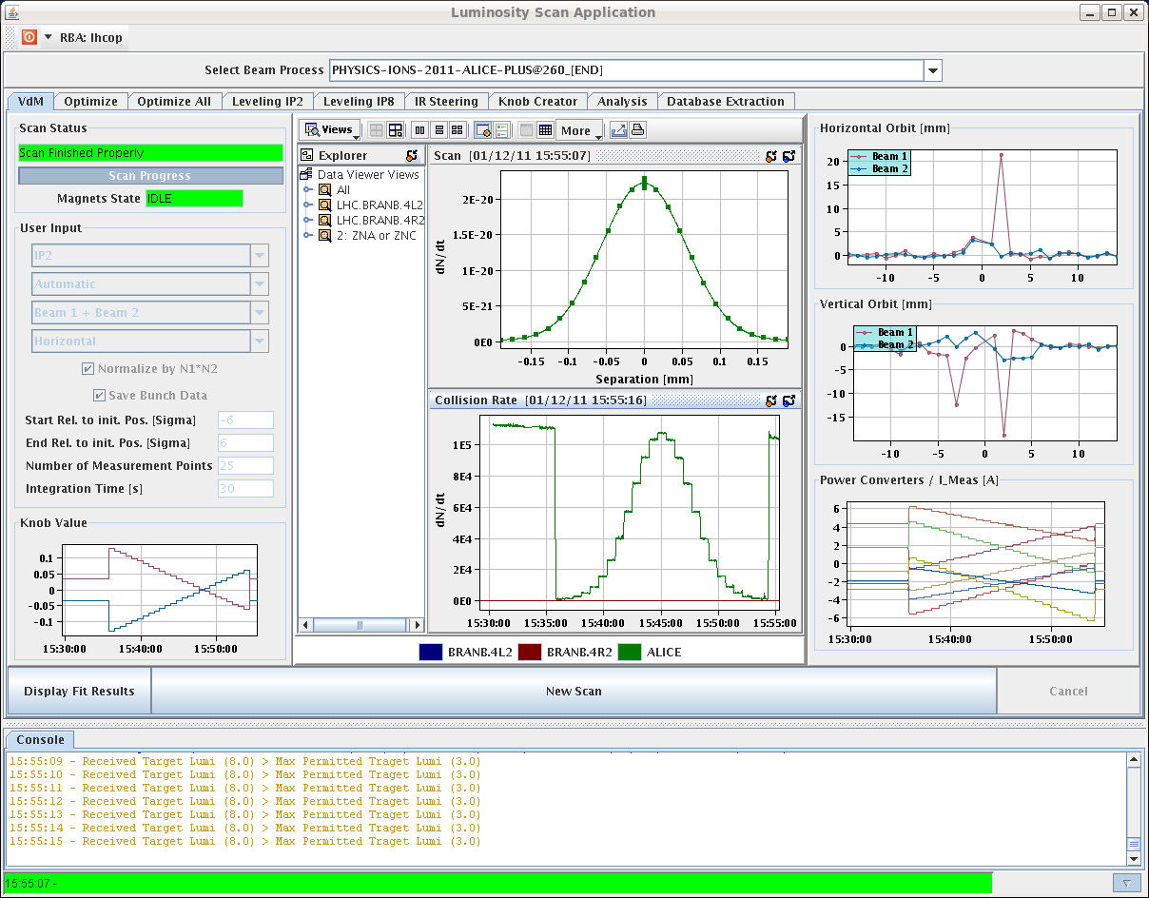
Thursday afternoon – Alice Van der Meer
+/- 6 sigma plus length scale scans…

Slide 8

Plots from Adam Jeff
Satellite & ghosts: fill 2334
Overall the situation is rather good. ~3% although we got cases down
The satellites at 10 and 15 ns disappeared but we have now some more satellites at 5 ns

Slide 9
Major Timeouts & ISSUES

Slide 10
Cooling problem point 4 – knock-on
At 20:26 Monday short circuit in water level sensor of the cooling tower SF4, which resulted in an drop of the 24 V network
  Cut the water to the cryo and at 20:29 lost the cryo
Deterioration of insulation vacuum on DSLC
permanent
turbo
pump
permanent
turbo
pump
vac
gauges
vac
gauges
DSLC 500 meters
DFBLC
Arc 3-4
Q7R Q11R
annex volume
current lead?
heater?
Simplified insulation vacuum layout
Sector 3-4
UJ33

Slide 11
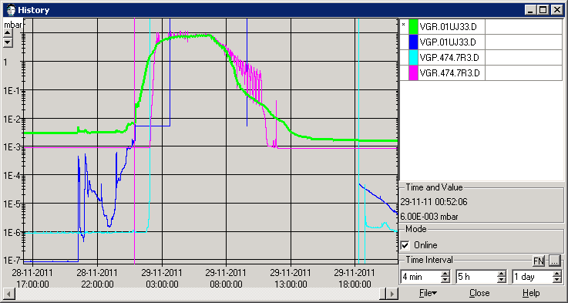
Summary of events to Tuesday
Ice observed on DFBLC annex volume Oct 2011
Annex volume connected to DFBLC volume 11/10/11
Cryo stop P4 28/11/2011 pm
Pressure in DSLC rises to 10 mbar in few hours
VSC piquet intervention to install mobile pump
Nominal vacuum conditions re-established
Annex volume still in communication!!
Cause of leak??
Paul Cruikshank TE/VSC 29/11/2011

Slide 12
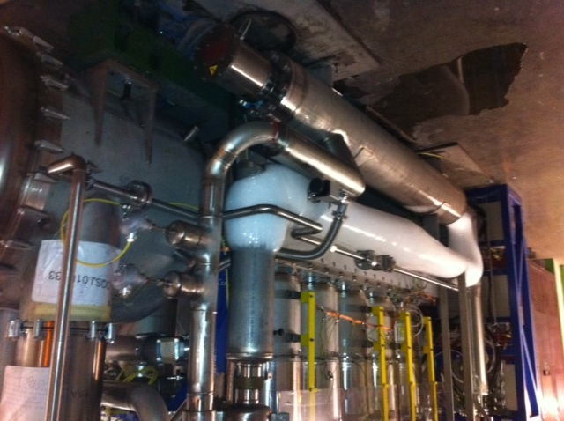
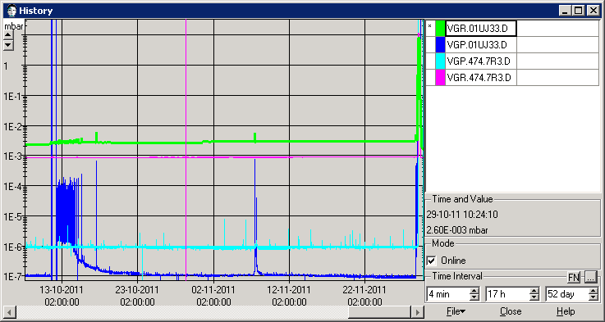
DFBLC/DSLC – looking back
Pressure perturbation seen on DSLC
when put into communication with annex
Self recovery of pressure indicates air leak
Icing of annex volume Oct 2011,

Slide 13
DFBLC/DSLC – actions this week
Type of vacua: Beam vac, Cryo insulation vac, anti-condensation vac
=> They should never be mixed !!!
Vac volumes separated, each pumped separately
Heater electrical part protected in case of power failure and re-icing
Serge Claudet

Slide 14
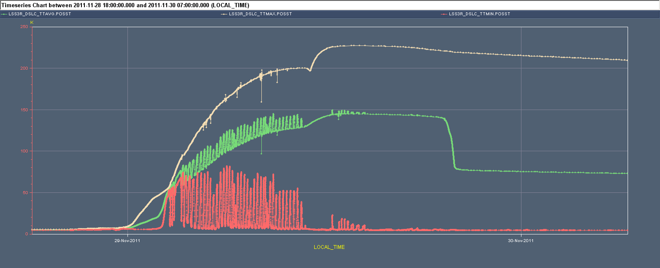
DFBLC/DSLC - consequences
Max. Temperature on DSLC reaching 250 K at 14:00 and in a short period ➔ needed ELQA before powering (A. Siemko)

Slide 15
Wednesday evening
Following ELQA, revalidation of circuits via HWC powering tests:
  PIC2-Circuit quench via QPS and PNO.A3 were done on the following: RQS.A34B2, RQTL7.R3B1, RQTL7.R3B2, RQTL8.R3B1, RQTL8.R3B2, RQTL10.R3B1, RQTL10.R3B2, RQTL11.R3B1, RQTL11.R3B2, RQT12.R3B1, RQT12.R3B2, RQT13.R3B1, RQT13.R3B2, RQTL9.R3B1, RQTL9.R3B2, RSS.A34B1, RSS.A34B2, ROD.A34B1, ROD.A34B2, ROF.A34B1, ROF.A34B2
22:57 MP3 confirmed all circuits tested are fine.
PIC 2 circuit quench via QPS and PNO.a3 have been carried out. Resistances have been measured and no relevant changes have been found!
Back in business shortly afterwards
Mirko, Matteo, Sandrine

Slide 16
Surface PAD point 3 - Wednesday
The door at P3 (PZ33) is broken and needs repair. The access team is preparing, and should start the repair at 8:30. First estimate is that this work will take 8 hrs
After the door is fixed. a patrol of pt 3 will be needed, as the PZ33 is forced.
Until the repair of PZ33 door starts, a CSA Guardian is stationed at PZ33 to control access
Apologies from OP to Serge di Luca and team who’d been turned away a few days before in order to prepare for beam

Slide 17
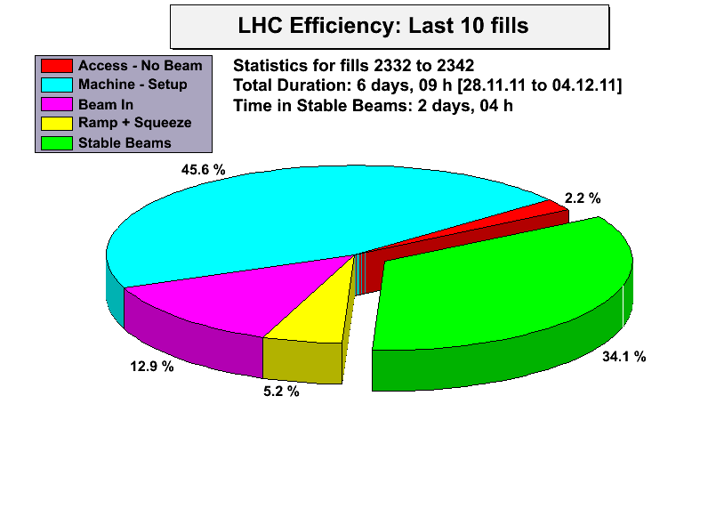
Efficiency

Slide 18
INTERESTING OPERATIONAL STUFF

Slide 19
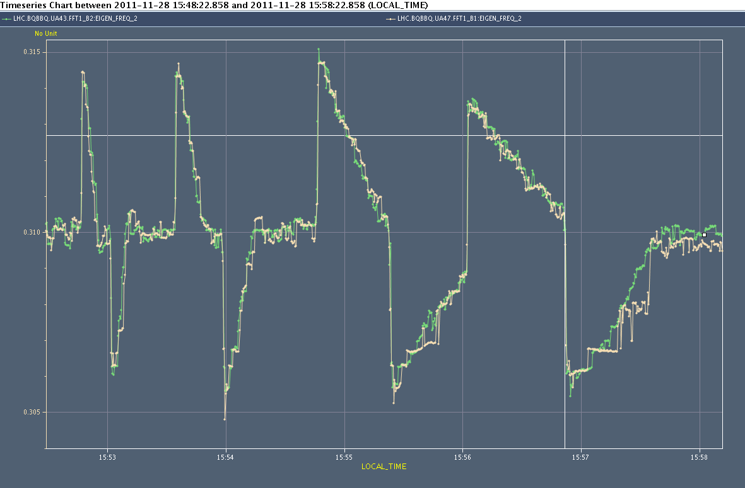
Tune feedback (R. Steinhagen)
Checked Tune-FB response for various bandwidth:
for a reduction factor of five (0.2) the tune (step) perturbation is taken out after about 30 seconds (90% to 10%). Programmed bandwidth changes are linear (as by design).
Bandwidth reduction should reduce the maximum oscillation amplitude presently causing spurious QPS trips during the squeeze.
Following squeeze done with tune feedback (BW reduced by factor 5) ON in both planes ➔ no QPS trip and tune under control
BW: 1 0.5 0.2 0.1

Slide 20
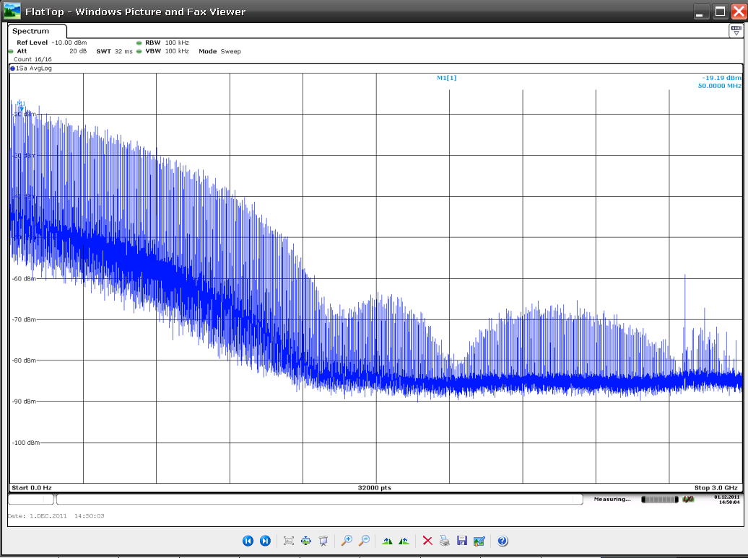
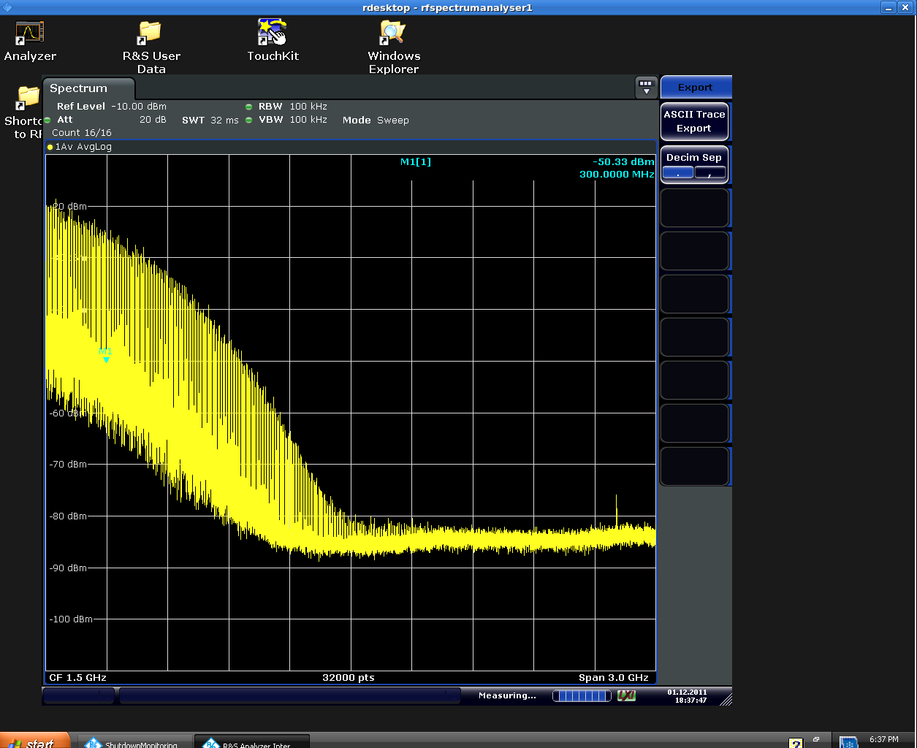
Alternate blow-up method
Start StableBeams
After 3 hours
dry test on the machine without beam performed
Would like to test without beam at injection energy. 30 min should be enough. Will provide a rough scaling of the new method vs. the old one (in term of bunch lengthening vs. rms phase noise)
Monday, Tuesday or Wednesday. Test in the ramp with a least 2 batches evenly spaced around the ring. We could also go for a full physics filling.
Philippe Baudrenghien

Slide 21
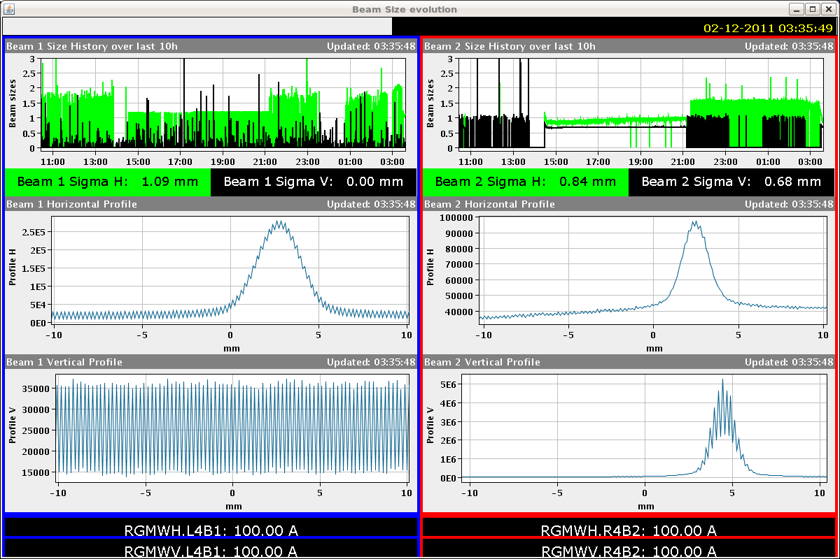
BGI optimization ongoing
Mariusz

Slide 22
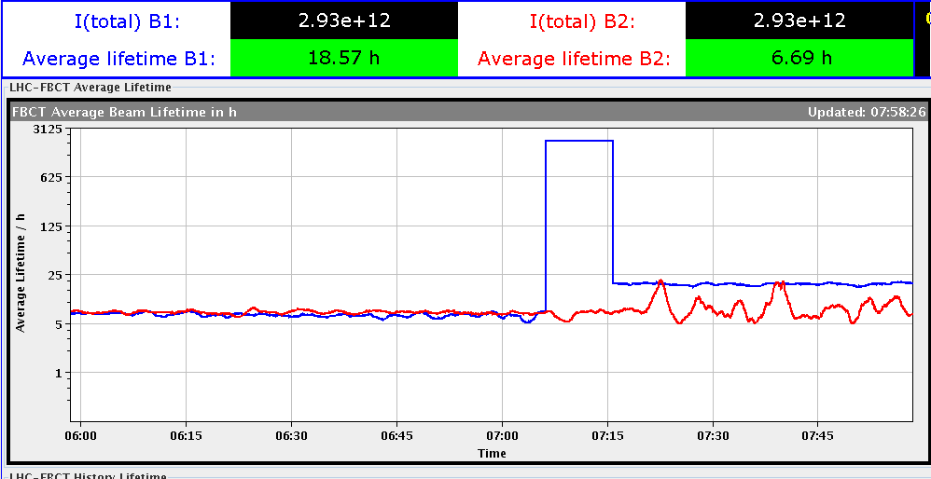
Beam lifetime

Slide 23
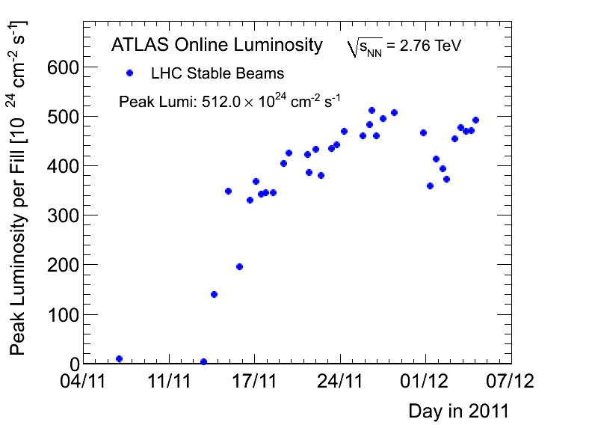
Atlas ions - luminosity

Slide 24
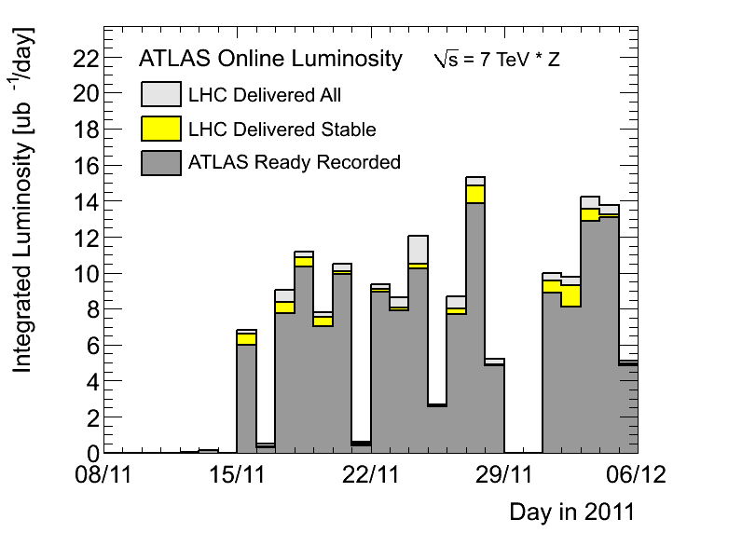
Atlas – ions - per day

Slide 25
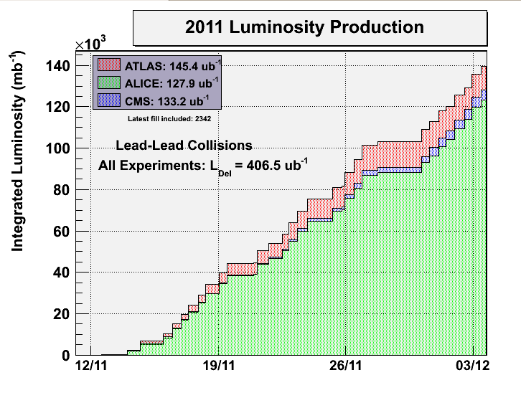
Integrated…

Slide 26
Incoming
ADT: physics fill with gated damping (24 bunches not damped) to assess possible coexistence damper/BBQ measurement (EOF – now)
Ion Quench test MD (> 8 hours)
  Plus scraping test in CMS (30 minutes or so)
  Proposed for today
Alternative blow-up method (Philippe)
  Monday? Test with beam at injection energy. 30 min should be enough. That will provide a rough scaling of the new method vs. the old one (in term of bunch lengthening vs. rms phase noise)
  Monday, Tuesday or Wednesday. Test in the ramp with a least 2 batches evenly spaced around the ring. We could also go for a full physics filling.
(100 ns checks in SPS)

