Slide 1
Thursday 1st December
Lumi scan limits checked (in preparation for next fill VdM scans).
Trims of up to 150 um per beam in IP1 & IP2 both planes both beams were done (IP5 is equivalent to IP1).
10:45 Dump #2334
Fill for VdM
Some problems with 200ns_352b_344_324_0_24bpi15inj_IONS bunch/batch configuration
Ended with 200ns_352b_344_324_0_24bpi15inj_IONS2
Check LDM on flat-top – Adam Jeff

Slide 2
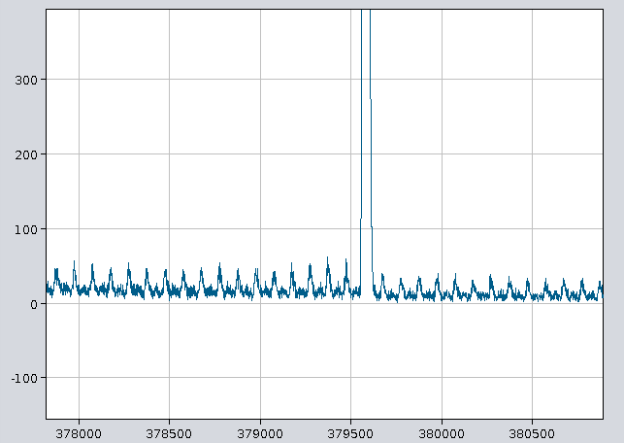
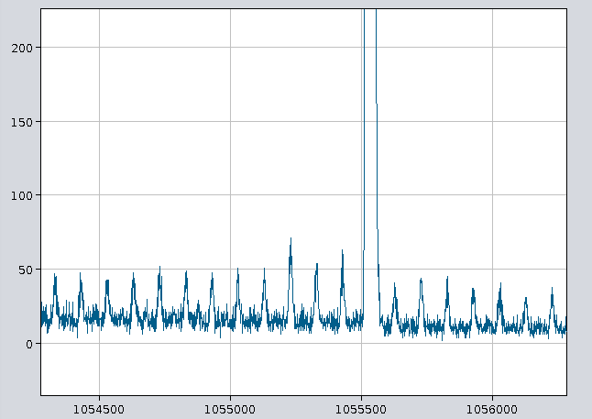
LDM analysis
Beam 1: Satellites 0.31% Ghosts 2.5%
Beam 2: Satellites 0.29% Ghosts 2.4%

Slide 3
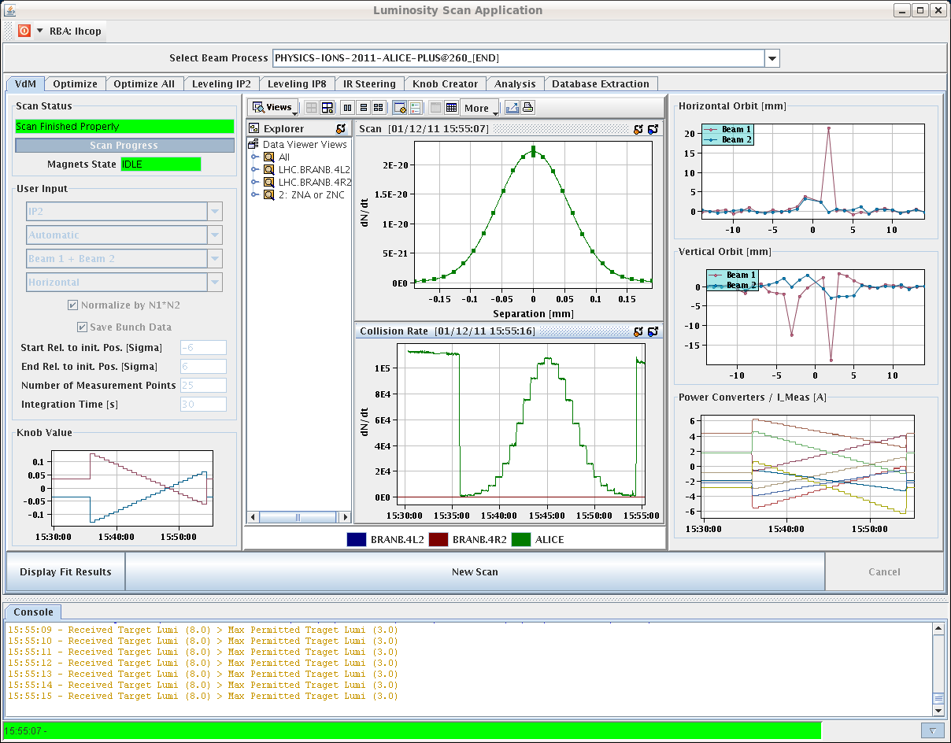
Thursday afternoon
15:30 Stable beams
Alice VdMs +/- 6 sigma; length scale scans…

Slide 4
Thursday evening
18:20 scans finished
hold beams for 2e6 events for Alice
21:15 dump beams
At 22.10 pilots were injected and after corrections dumped
The IPOC of the TSU for B1 failed during the dump and caused the block of the XPOC for B1.
Expert was called and after careful analysis of the situation and of a dry dump he confirmed the system works fine but further offline analysis is needed.

Slide 5
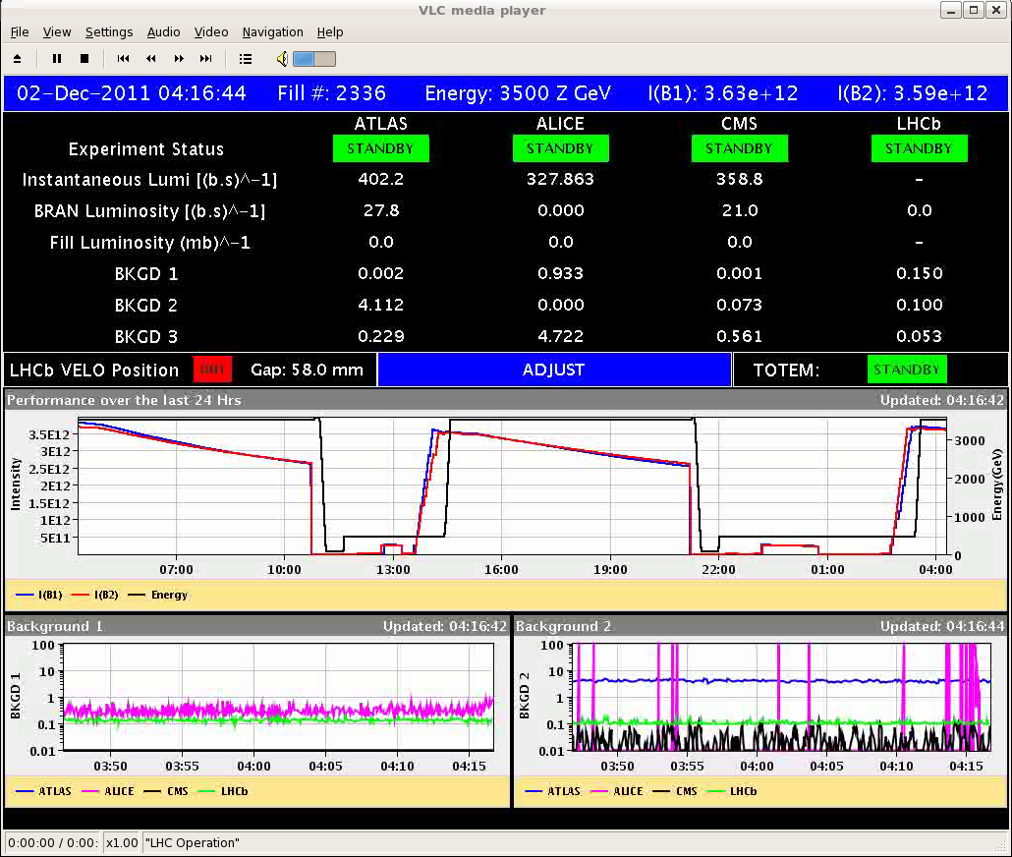
Friday morning
Some delay filling
SPS RF
LINAC3
04:20 Stable beams #2336

Slide 6
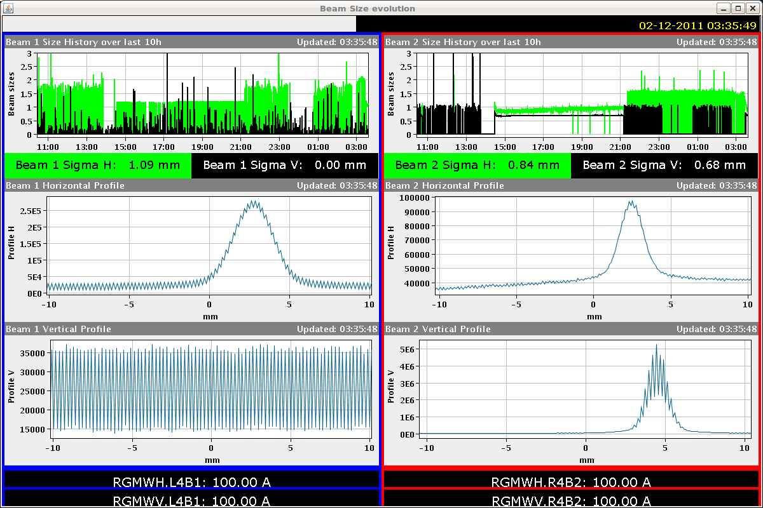
BGI optimization ongoing
Mariusz

Slide 7
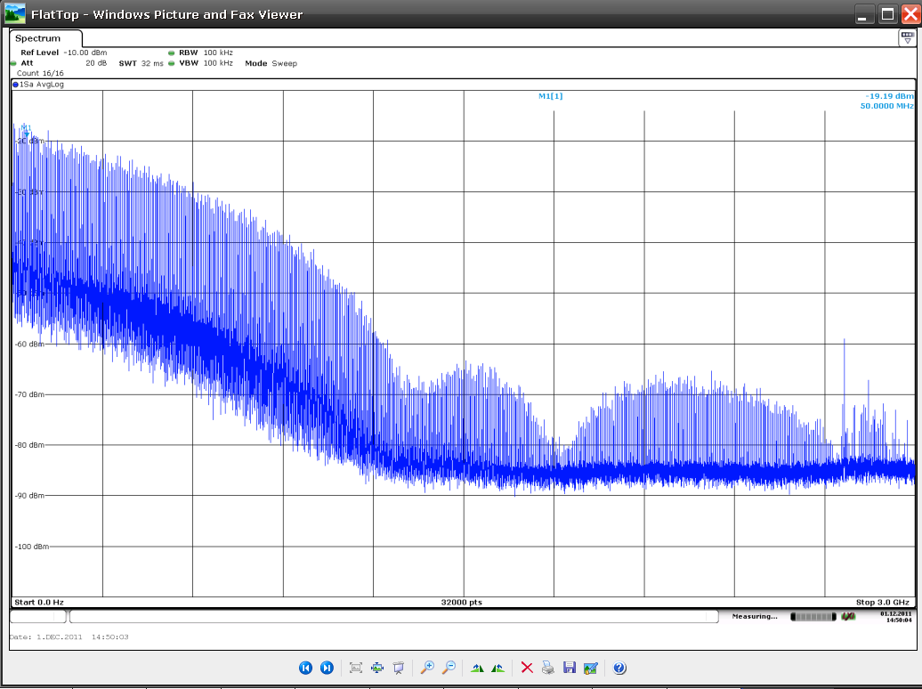
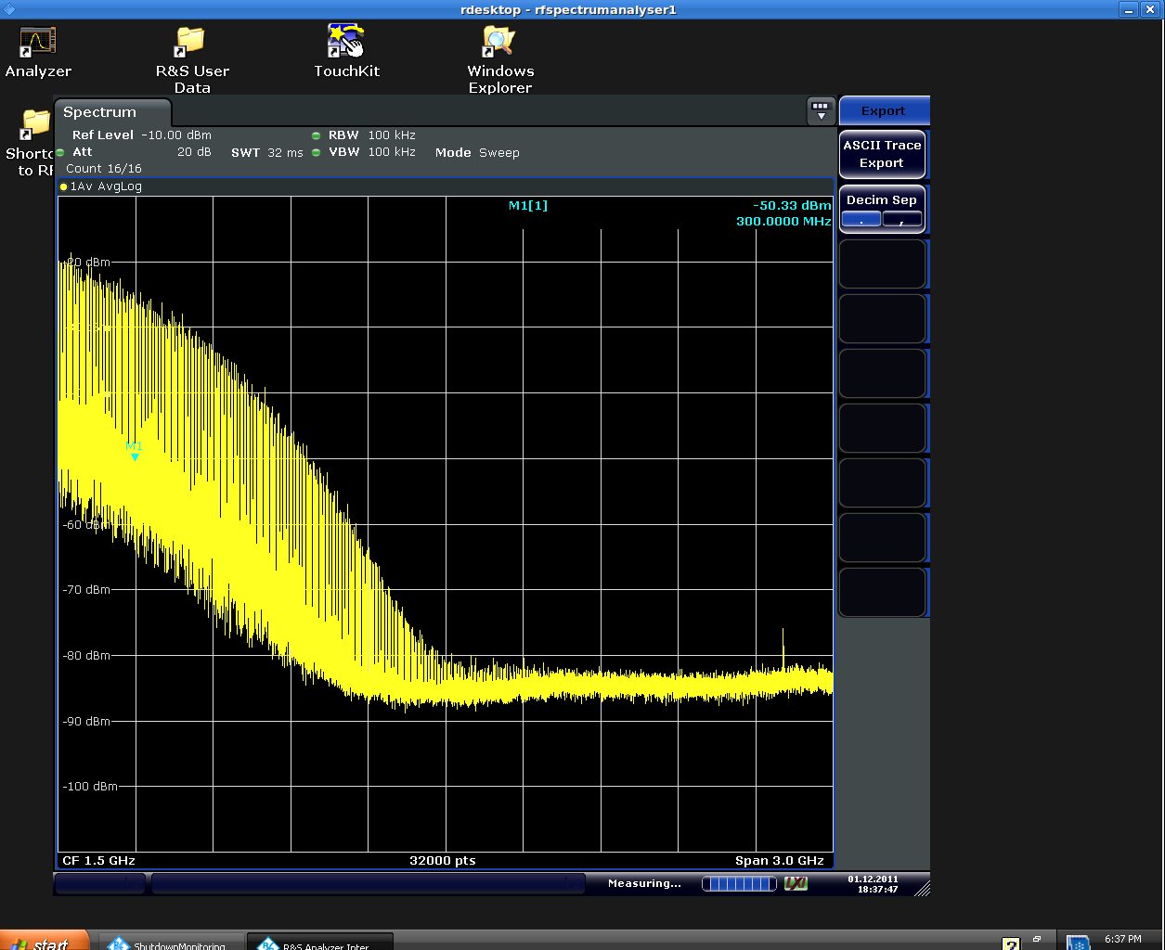
Alternate blow-up method
Start SB
After 3 hours
1. To-morrow morning we check the created RF spectrum on a test bench in the lab. No effect on operation
2. To-morrow afternoon we run a dry test on the machine without beam. Can be done during ramp-down for example
3. Monday? Test with beam at injection energy. 30 min should be enough. Can be done when ready to fill. That will provide a rough scaling of the new method vs. the old one (in term of bunch lengthening vs. rms phase noise)
4. Monday, Tuesday or Wednesday. Test in the ramp with a least 2 batches evenly spaced around the ring. We could also go for a full physics filling.
Philippe Baudrenghien

Slide 8
Today
Re-fill for Van der Meer scans
ADT 15 minutes check of bunch mask to verify that it is working correctly and no changes are necessary.
200ns_352b_344_324_0_24bpi15inj_IONS2
normal "high intensity" 200ns ion batches
Verify satellites and ghost charge with LDM
ATLAS & CMS
Re-fill for physics…

Slide 9
Incoming
ADT: physics fill with gated damping (24 bunches not damped) to assess possible coexistence damper/BBQ measurement
Use bunch mask to inhibit damping for a normal Physics fill. Do not change any other parameters. The only risk here is that the first bunch train with no damping will suffer more blow-up
Ion Quench test MD (> 8 hours). Proposed for Mon 5/12

