Slide 1
Overview LHC Operation Week 46
Coordinators:
Ralph Assmann and Jan Uythoven
John Jowett for the ions

Slide 2
The Weekend
Friday
00:35 Stable Beams Fill #2302
06:07 Dumped by RF HOM 4B2 temperature interlock
09:34 Stable Beams Fill #2303
14:48 Dumped by spurious opening of quench loop RQF S12
Access for QPS, change switch RDC A12B2
22:41 Stable Beams Fill #2304
Saturday
05:15 Dumped by operator
08:10 Stable Beams Fill #2305
14:24 Dumped by operator
Problems with RF klystron filament current 2B1,
Dumps beam
RF check in tunnel
Dumps beam again, keep cavity 2B1 off, B1 RF voltage reduced from 14 MV to 12.2 MV at 3.5 TeV

Slide 3
The Weekend
Sunday
02:43 Stable Beams Fill #2308
09:27 Dumped by operator
12:53 Stable Beams Fill #2309
14:30 Life time drop, seems to be longitudinal
17:29 Beam dump, preventive dump, loss cryo maintain S34. Cold compressor trip Point 4.
19:00 Intervention for MKD switch replacement to be done now, teams preparing. Also EPC intervention on RCBCV10.R3B1 is set for 8pm
Expect Cryo ok for Monday 9 am

Slide 4
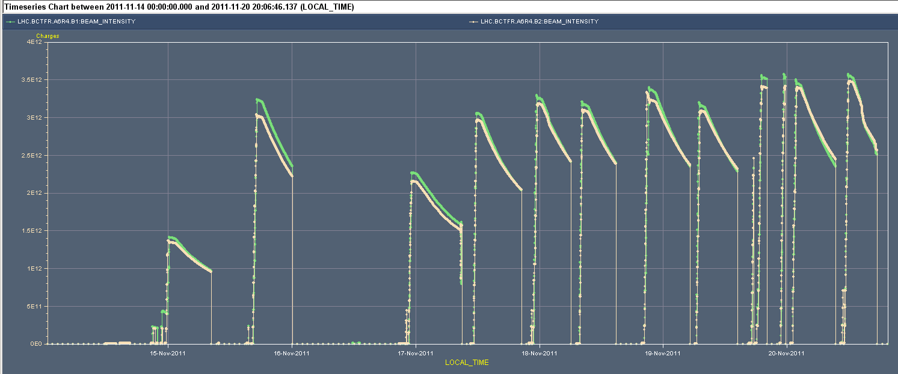
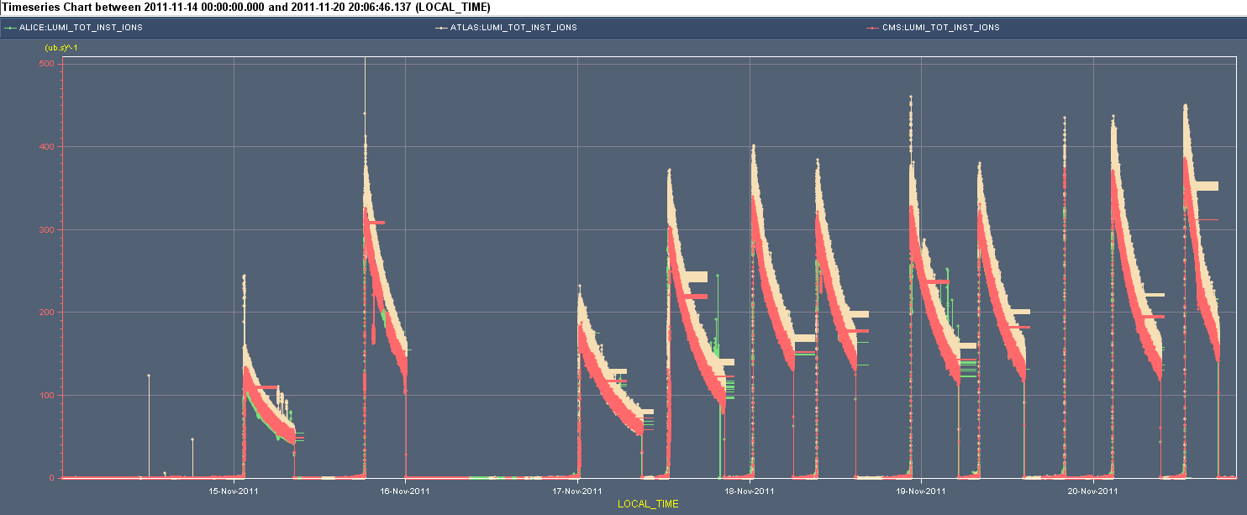
Beam Current and Lumi Plots
3.5e12
RF cavity
PS Wire Scanner
PS Septum
358 x 358 b
400
170 x 170 b

Slide 5
Stable Beams
Fill # | Start time | Duration [h] | Initial lumi | Integrated lumi | Reason Dump
 |  | [hh:mm] | [cm-2s-1] | [ub-1]
2294 | Tue 01:30 | 6:54 | 1.40E+26 | 2.0 | RF vacuum intlk
2297 | Tue 18:22 | 5:42 | 3.50E+26 | 4.6 | Cryo problem 34
2300 | Thu 00:21 | 8:38 | 1.95E+26 | 3.4 | Operator
2301 | Thu 12:56 | 7:03 | 3.30E+26 | 4.7 | Operator
2302 | Fri 00:35 | 5:34 | 3.68E+26 | 4.7 | RF HOM temperature
2303 | Fri 09:34 | 5:16 | 3.42E+26 | 4.3 | Spurious QPS on RQF S12
2304 | Fri 22:41 | 6:33 | 3.45E+26 | 5.1 | Operator
2305 | Sat 08:10 | 6:13 | 3.46E+26 | 4.8 | Operator
2308 | Sun 02:43 | 6:38 | 4.05E+25 | 5.7 | Operator
2309 | Sun 12:53 | 4:37 | 4.25E+26 | 4.4 | Cold Compresser S34
 | Total | 58h43min |  | 43.7
About expected for this year

Slide 6
Stable Beams > 50 %

Slide 7
Luminosity determined by injector chain
02:43 Stable beams Fill #2308.
Higher intensities from the injectors. Django et al optimizing efficiency through the chain (on cost of time for NA experiments: ~2h).
New peak luminosity.

Slide 8
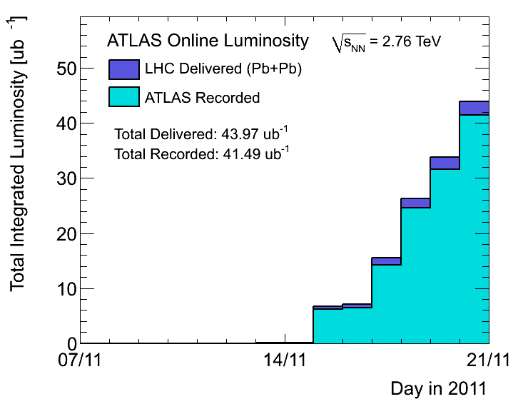
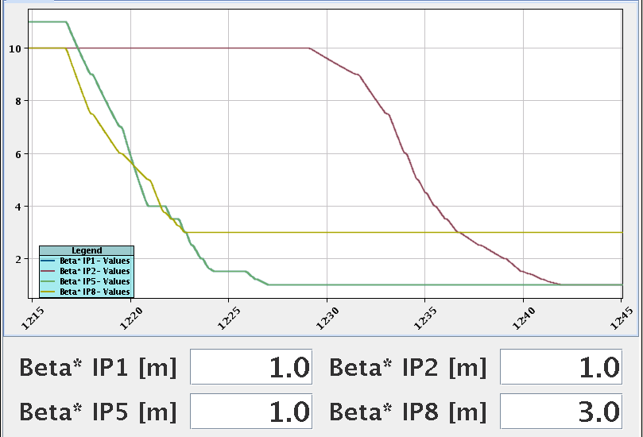
Peak Lumi and Integrated lumi
2010
Thanks Atlas, for the quick updates of statistics!
In 2010: Max 137 bunches, larger β*, smaller bunch intensities

Slide 9
CMS comparison with 2011

Slide 10
Typical bunch intensity pattern
24 bunch train from the SPS
This are 12 injections from the PS of 2 bunches, 200 ns spaced Loss of intensity of the first bunches due to Intra Beam Scattering, first bunches sitting longer at SPS injection energy
First two bunches looked after by the RF especially well (loops on these cavities), so less losses.

Slide 11
Monday – First Real Fill
∼10:00 PS vacuum recovered after replacing leaky wire scanner by vacuum pipe, start taking ions again.
Finally made it that night: colliding 170 x 170 ion bunches

Slide 12
Nice pictures of dumped beam
Showing abort gap always a bit populated
Often XPOC B1 BLM TCDS just above threshold

Slide 13
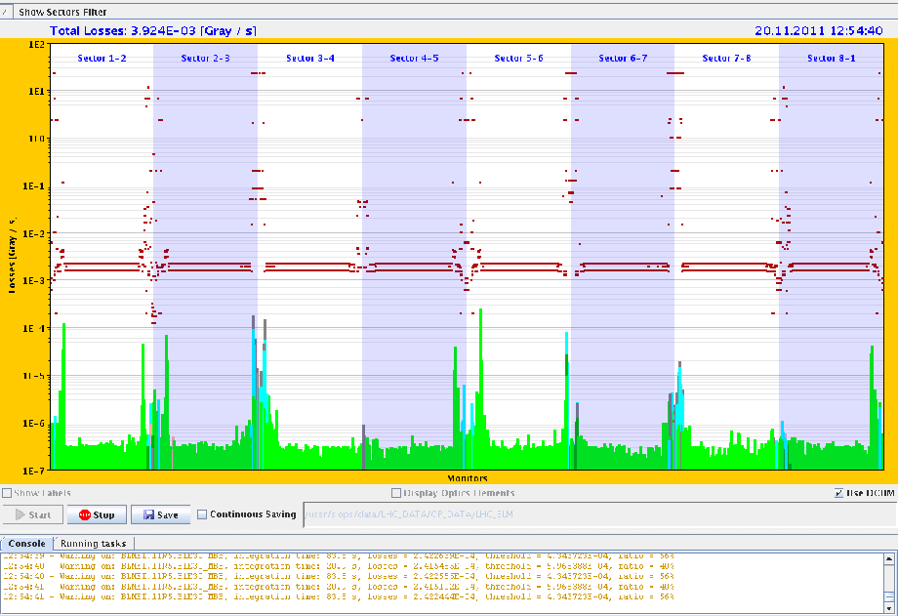
BFPP losses 11R5
BFPP (Bound Free Pair Production) losses OK
At BLM especially installed for ions
Increased BLM dump limits factor 2
Now with latest record lumi up to 56 % of dump threshold

Slide 14
Injection B2: different sources of problems and confusion
Several differences between injection protons and ions:
Injection kicker pre-pulse after RF changes
Delay initially set with an off-set of 104 ns, because something changed in OASIS (scope) delays
Injection cleaning on at injection
“Pilot” still seen by BPMs as sensitivity of BPMs not changed for nominal filling as done for protons, leading to beams dumped by interlocked BPMS in point 6.
Presently running without injection and without abort gap clearing
Beam Quality Monitoring from SPS
BQMSPS to strict on the ions, limits needed to be relaxed for the beam to come out
Work on the beam by Thomas
Over-injecting the “pilot” hitting the BLM thresholds in the injection region
Dump threshold on these BLMs was reduced because ALICE running with retracted vertical TCTs
The “pilot” was too big
OK after reducing the pilot intensity to half the nominal intensity and increasing the BLM threshold by a factor of 2
Problems copying steering setting of the transfer lines on the SPS side from LHCIONS2 to LHCIONS1

Slide 15
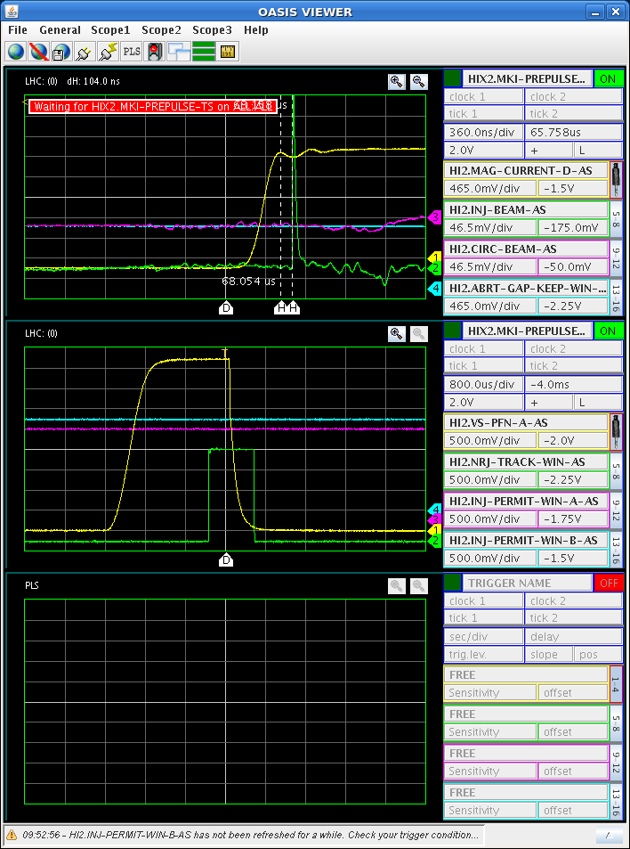
MKI pre-pulse delay adjustment
Beam position difference w.r.t. kick pulse in comparison with 2010 nominal position: 104ns
This is now shifted, relative to 2010 for both beams and also for the protons….

Slide 16
B2 horizontal and vertical injection oscillations
MKE - SPS
MKI - LHC

Slide 17
PS Proton Injection Septum

Slide 18
No more protons
Wednesday, planned p-Pb MD and stable beams
11:50 injected 1 pilot for B1
12:20 No beam PS due to suspected vacuum leak on PS Proton Injection Septum
Access PS for investigations
We suspect that an electrical fault under vacuum degrades significantly the vacuum in the ring when used. The septum is condemned until a next meeting tomorrow morning.
Most likely no water leak
Pulsing the septum has a certain risk to create a vacuum leak to air, resulting in several days of interruption to operation.
20:45 Injecting Pb again – forget about protons for the day
Thursday: no more protons in the complex for 2011
Jan Borburgh Volker Mertens

Slide 19
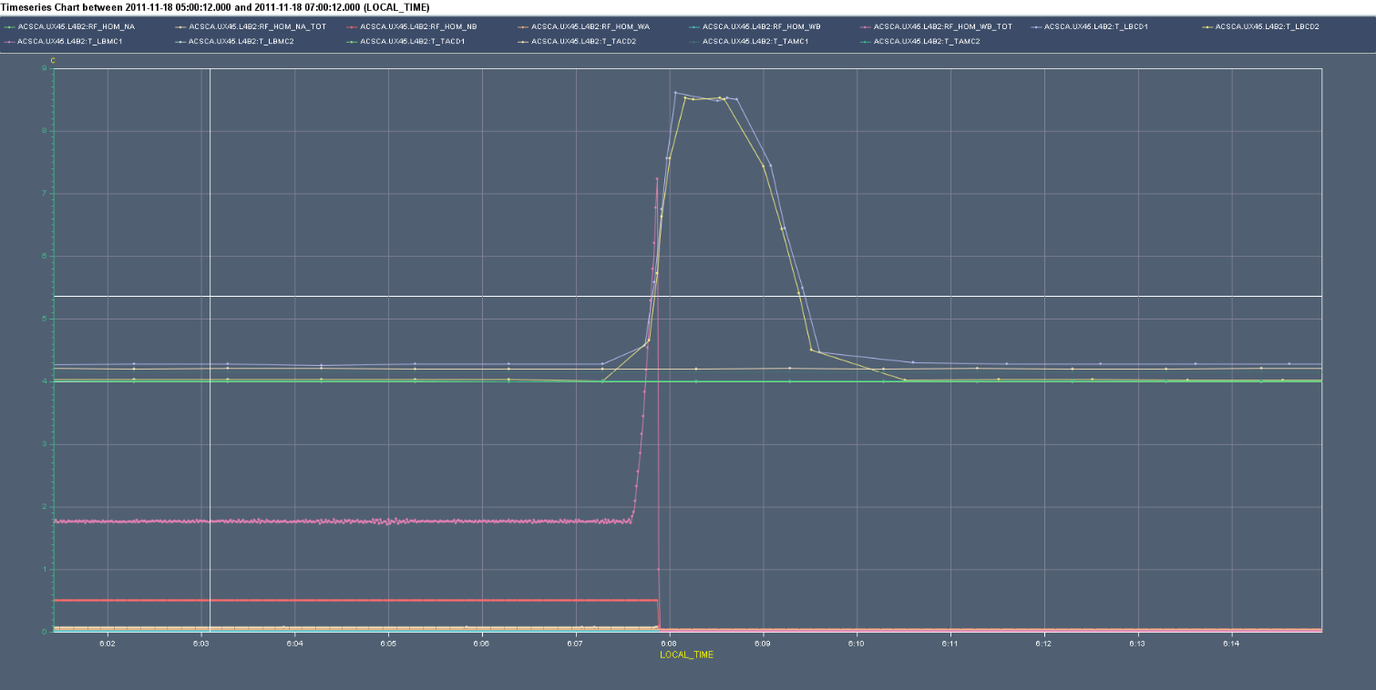
RF HOM 4B2 – Beam Dump Friday morning
This is a picture to illustrate the HOM signals of this morning
As you can see the 2 temperature and the RF power went up at the same time
This looks a real signal
Luca Arnaudon
1 degr
1 min

Slide 20
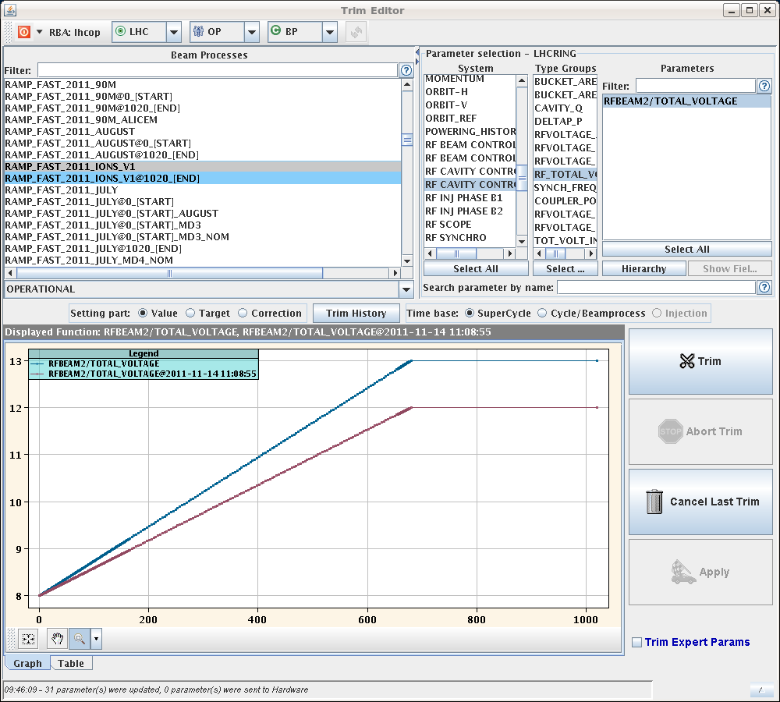
RF Voltage. First up ...
Increase RF voltage at injection and at flat top
8 MV at injection
First 13 MV, then 14 MV at flat top
Seems to be good for life time (and lumi)

Slide 21
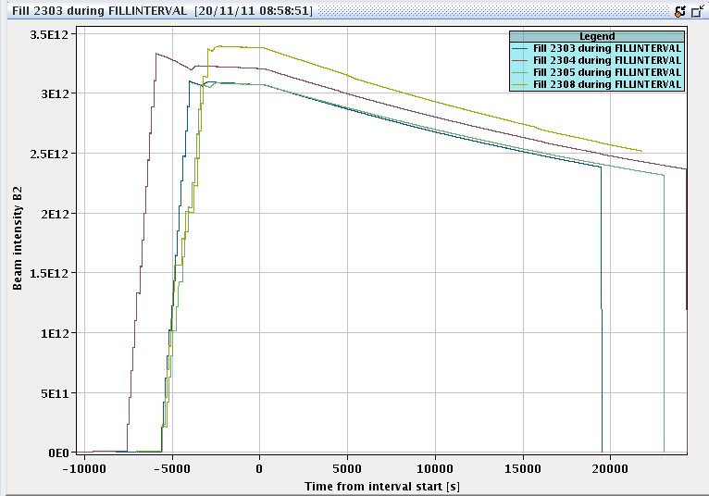
...then down
2 x trip at flat top, RF filament current error on cavity 2B1
B1 RF voltage reduced from 14 MV to 12.2 MV at 3.5 TeV for fill 2308 onwards
Reduced V-RF
B1 intensities different fill
B2 intensities different fill
Stefano Redaelli

Slide 22
Beam Dump Switch Problem
Thursday
11:00 Problem on dump kicker B1, one switch is dying and may need to be exchanged.
Pulse is perfectly fine but loosing some redundancy on re-triggering in case of an erratic on this switch.
An interlock has been masked for the time being to allow to go in physics.
Additional surveillance in place
Started switch replacement on Sunday evening in shadow of cryo problem

Slide 23
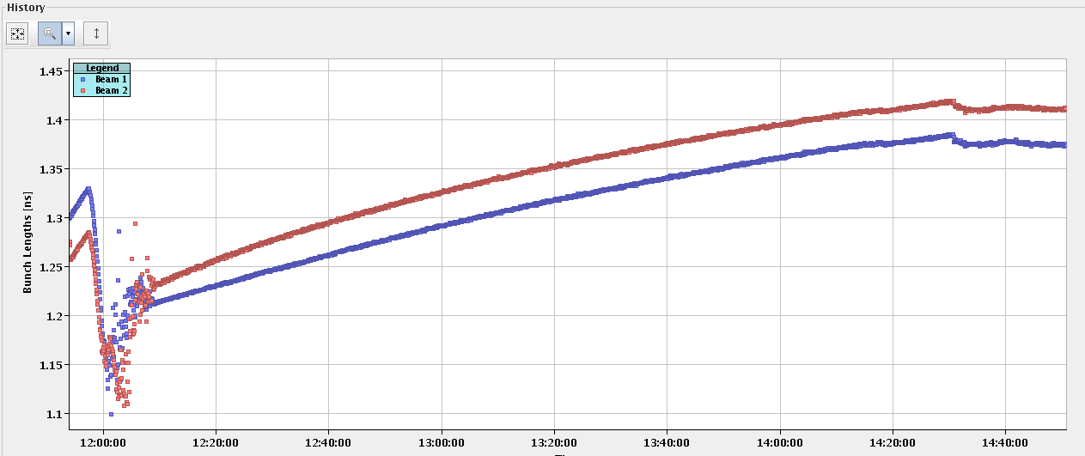
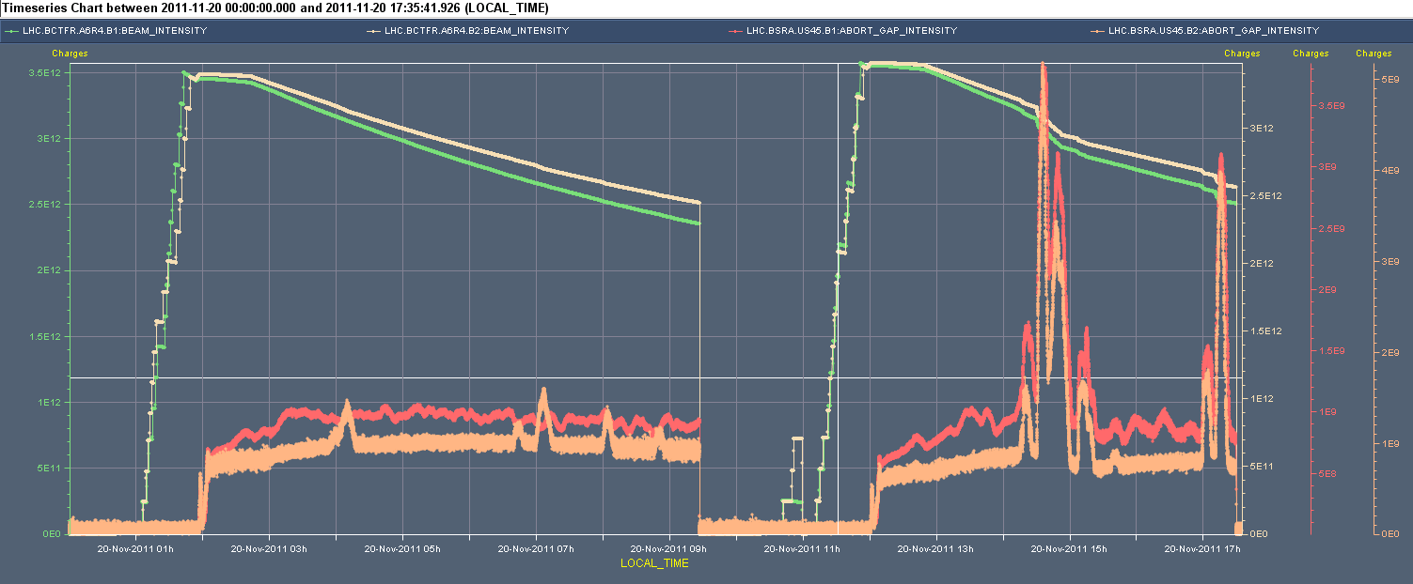
Sunday, Fill #2309: Life time drop
BCT losses
Abort gap population
Bunch length
Strange it affects both beams

Slide 24
Cryo problem Point 6
Recently looking better with about 1 drop every 5 minutes
Will discuss strategy of when and which intervention required

Slide 25
Plan
Pb-Pb physics
Cryo recovery & MKD switch replacement: ok for about 9 am
Problem with access doors ……
RF
Any lesson from cavity 2B1 which we should take into account?
RF unstable – abort gap population – to check
Scraping test for CMS delayed by 1.5 weeks.
Access
Installation of four BLMs for IP2 Aperture checks (4hours)
CMS
EPC 60A corrector (RCBCV10.R3B1)
Done !
Some ADT work
RF 7B1 klystron and cavity 2B1
Too late to go in this morning….
12 hours for beam dump switch / generator replacement
Finishing now
Coordinators this week: Barbara Holzer & Jorg Wenninger

