Slide 1
Friday 18th November
06:07 Beam dump by RF temperature interlock (HOM 4B2).
Total delivered Pb-Pb lumi in 2011 reached 19.6 ub-1 in ATLAS.
09:34. Stable beams. Fill #2303.
Turnaround of 3h27 minutes!
14:48 Beams dumped. Spurious opening of the quench loop on the RQF in S12
16:35 QPS access for the switch on RDC.A12B2 . ALICE also in.
18:30 end of access
22:41 Stable beams Fill #2304
Peak lumi’s ALICE: 296.9353 ATLAS: 381.07175 (???) CMS: 326.4134
05:15 Beam dump by operator
08:10 Stable beams Fill #2305
Turnaround of 2h55 minutes !!
Peak lumi’s ALICE: 295 ATLAS: 342 CMS: 307

Slide 2
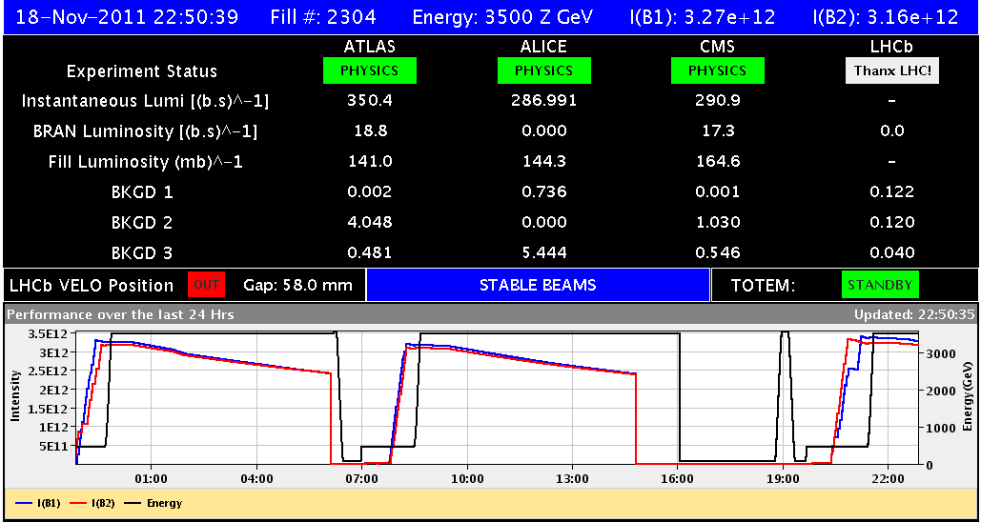
Friday
3h27min
7h53min Check PC, QPS access

Slide 3
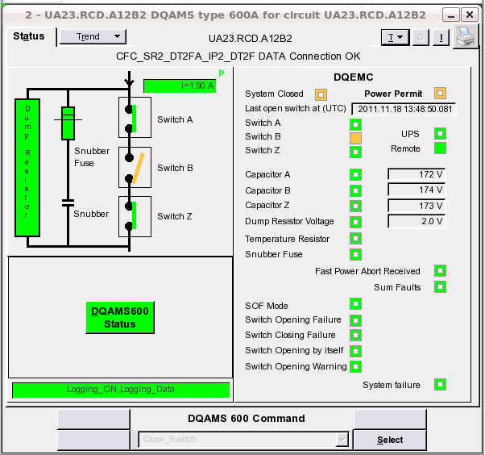
QPS
One QPS switch in S12 failed to close. on UA23.RCD.A12B2
Access required to exchange switch

Slide 4
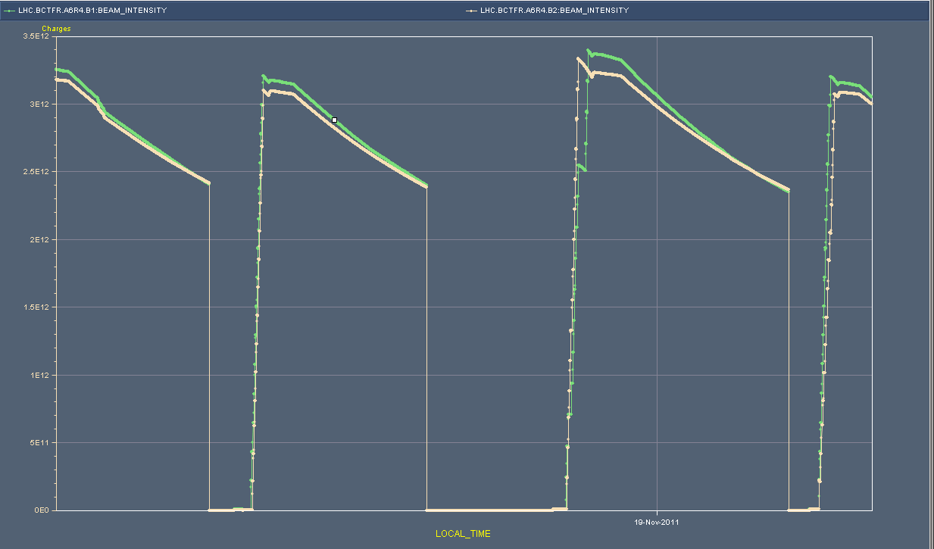
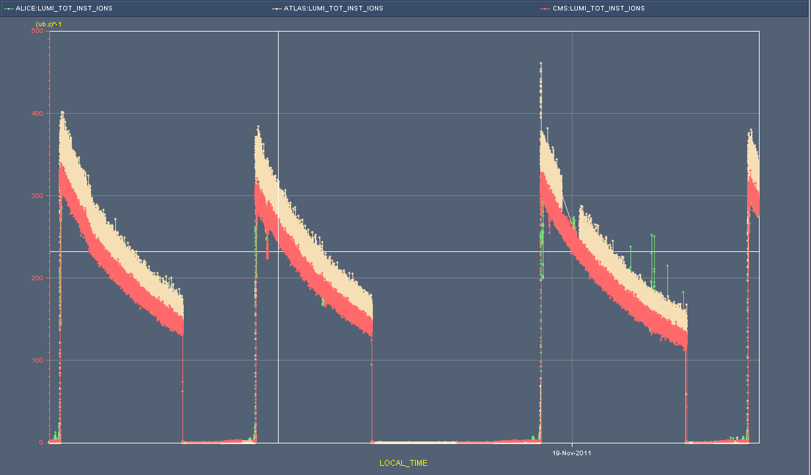
Friday 00:00 to this morning
Slightly irregular LHC cycle

Slide 5
Wire scanner
“Emittances”: values of the first measured bunch:
Proton equivalent emittances
Slightly larger than protons B1H = 2.39 B1V = 2.48 B2H = 3.92 B2V = 3.26
Change WS intensity limits to allow scan of 3e12 charges at injection and 1e12 charges at flat top for ion run.

Slide 6
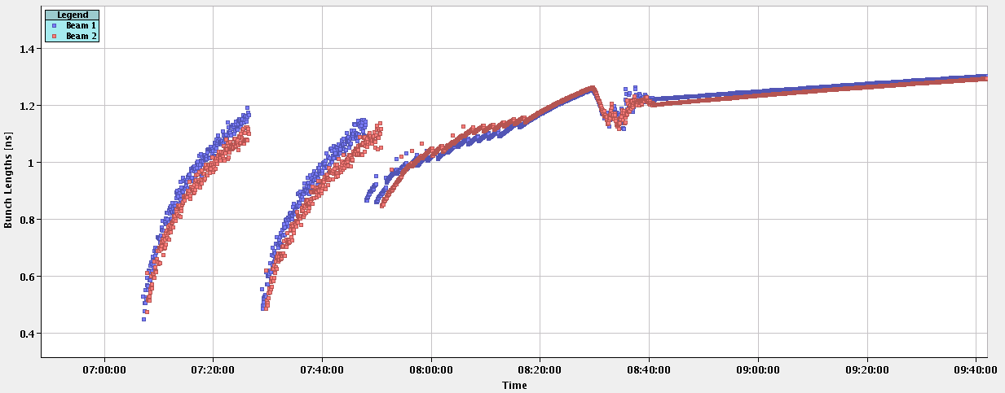
RF blow-up during the ramp
End up with 1.2 ns bunch length

Slide 7
Fill #2304

Slide 8
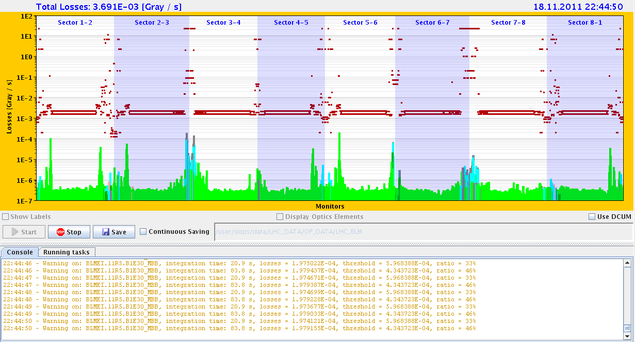
11R5 losses beginning of fill
46 % of dump threshold, reproducible

Slide 9
Plan
Pb-Pb physics
15 minutes CMS at injection: scrape pilot
Access
Installation of four BLMs for IP2 Aperture checks (4hours)
CMS !
EPC 60A corrector (RCBCV10.R3B1)
Some ADT work
RF 7B1 klystron
12 hours for beam dump switch / generator replacement
Tuesday 08:00, if switch stable till then

