Slide 1
Wed/Thu 2-3.11.11
Cryo back at 17:30
Beam back at 19:00
IR2 aperture until ~03:00
Since then no beam from the SPS:
  Connector problem on MKD
  Connector eroded, needs to be exchanged
Best latest estimate: ~12h from now → Thu ~20:00
Best to come back first with low intensity MD?

Slide 2
Summary of aperture measurements:
We performed aperture measurements in IR2 with different crossing angle configurations and betastar = 1m. These measurements complement the first measurement campaign of the 29th of October and provide a coverage of both sides of the aperture.
This time, measurements were performed for a different polarity and a different amplitude of the vertical crossing angle: +120 urad (B1 notation) compared to -80 urad of the previous nmeasurements. The aperture was probed for B1 and B2 separately with additional crossing bumps added on top of the nominal crossing. The lumi scan angles and an additional external 4-C bump were used (same knobs as in the previous measurements).

Slide 3
Summary of the measurements for Xing = +120 urad:
B1 - V -> Unknown bottleneck found for a TCT opening of 12.5 to 13.0 sigmas
B2 - V -> Triplet aperture found for a TCT opening of 15.0 to 15.5 sigmas
For B1, the bottleneck is located somewhere upstream of the TCTVB.4L2. Its location could not be identified. For B2, the bottleneck is found at the triplet R2 as expected.
TCTVB collimators were aligned around the reference orbit for precise aperture measurements. After the B2 measurement, the TCTVB.4R2 was re-centred around the beam for precise beam envelope determination. We found 4.57 sigma, as calculated from the collimator gap measurement.
Like usual, apertures are given in terms of the TCT opening when the aperture bottleneck is moved from the TCT to the triplet (these results depend sligthly on the bump shape - to be corrected offline). The nominal sigma for a 3.5um normalized emittance is assumed.
Note that for B2, the TCDD.4L2 (movable mask in front of D1 for the incoming B1) was found to limit the B2 aperture at about ~14-15 sigmas. Showers on the L2 side disappeared when the TCDD mask was moved to +/-15mm. This is not expected and should be investigated further.
We could not repeat the aperture measurement for the negative Xing configuration and for an amplitude of -120urad because the beams were dumped due to losses from a colliamtor movement.
Note that we established reference orbit for both signs of the external Xing with amplitudes of +/-120urad and for these two configurations we established beam-based collimator alignement.
Parasitically, we measured tune shifts and coupling as a function of bump amplitudes to be used to quantify the effect of triplet field quality.

Slide 4
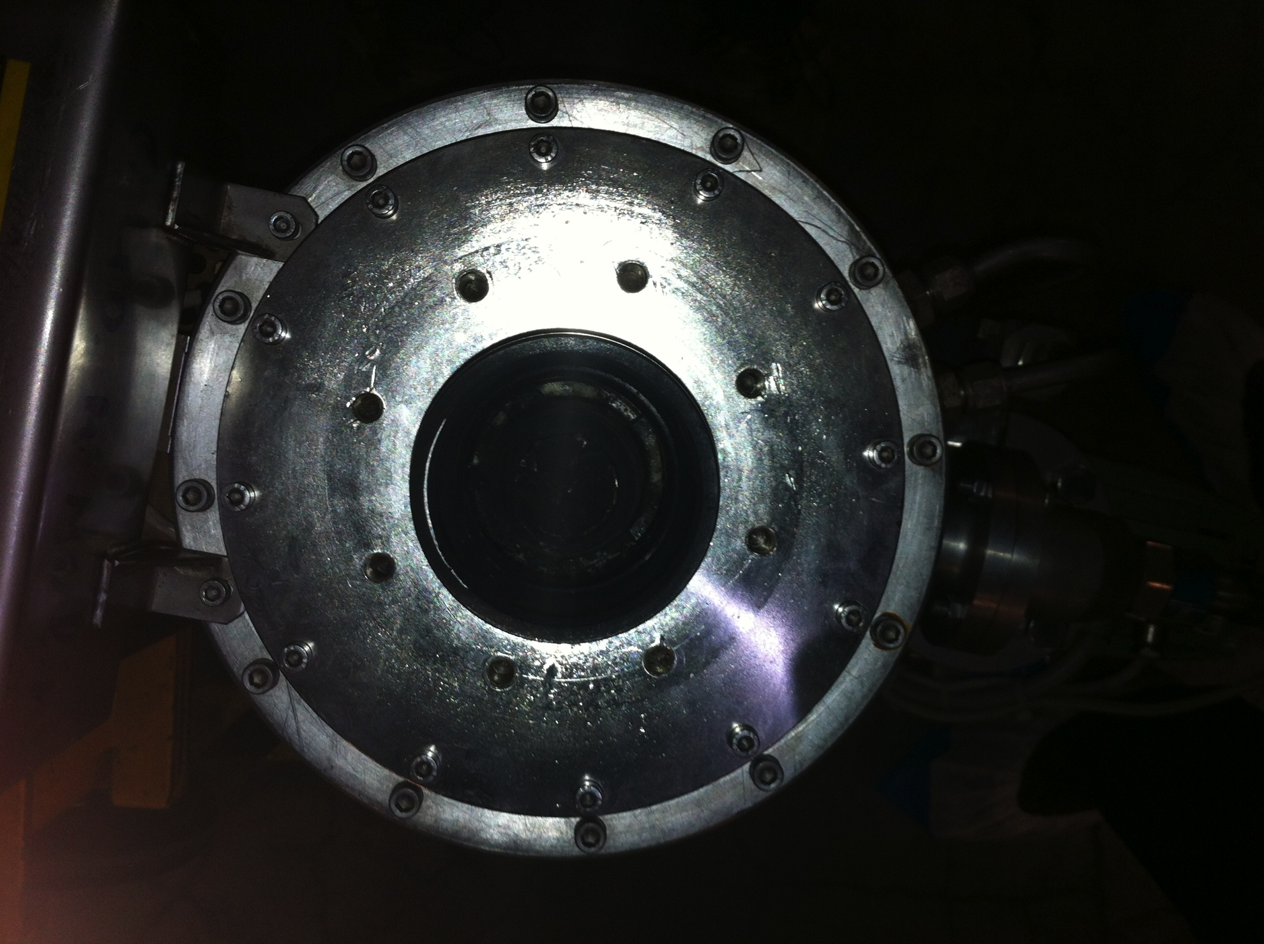

Slide 5
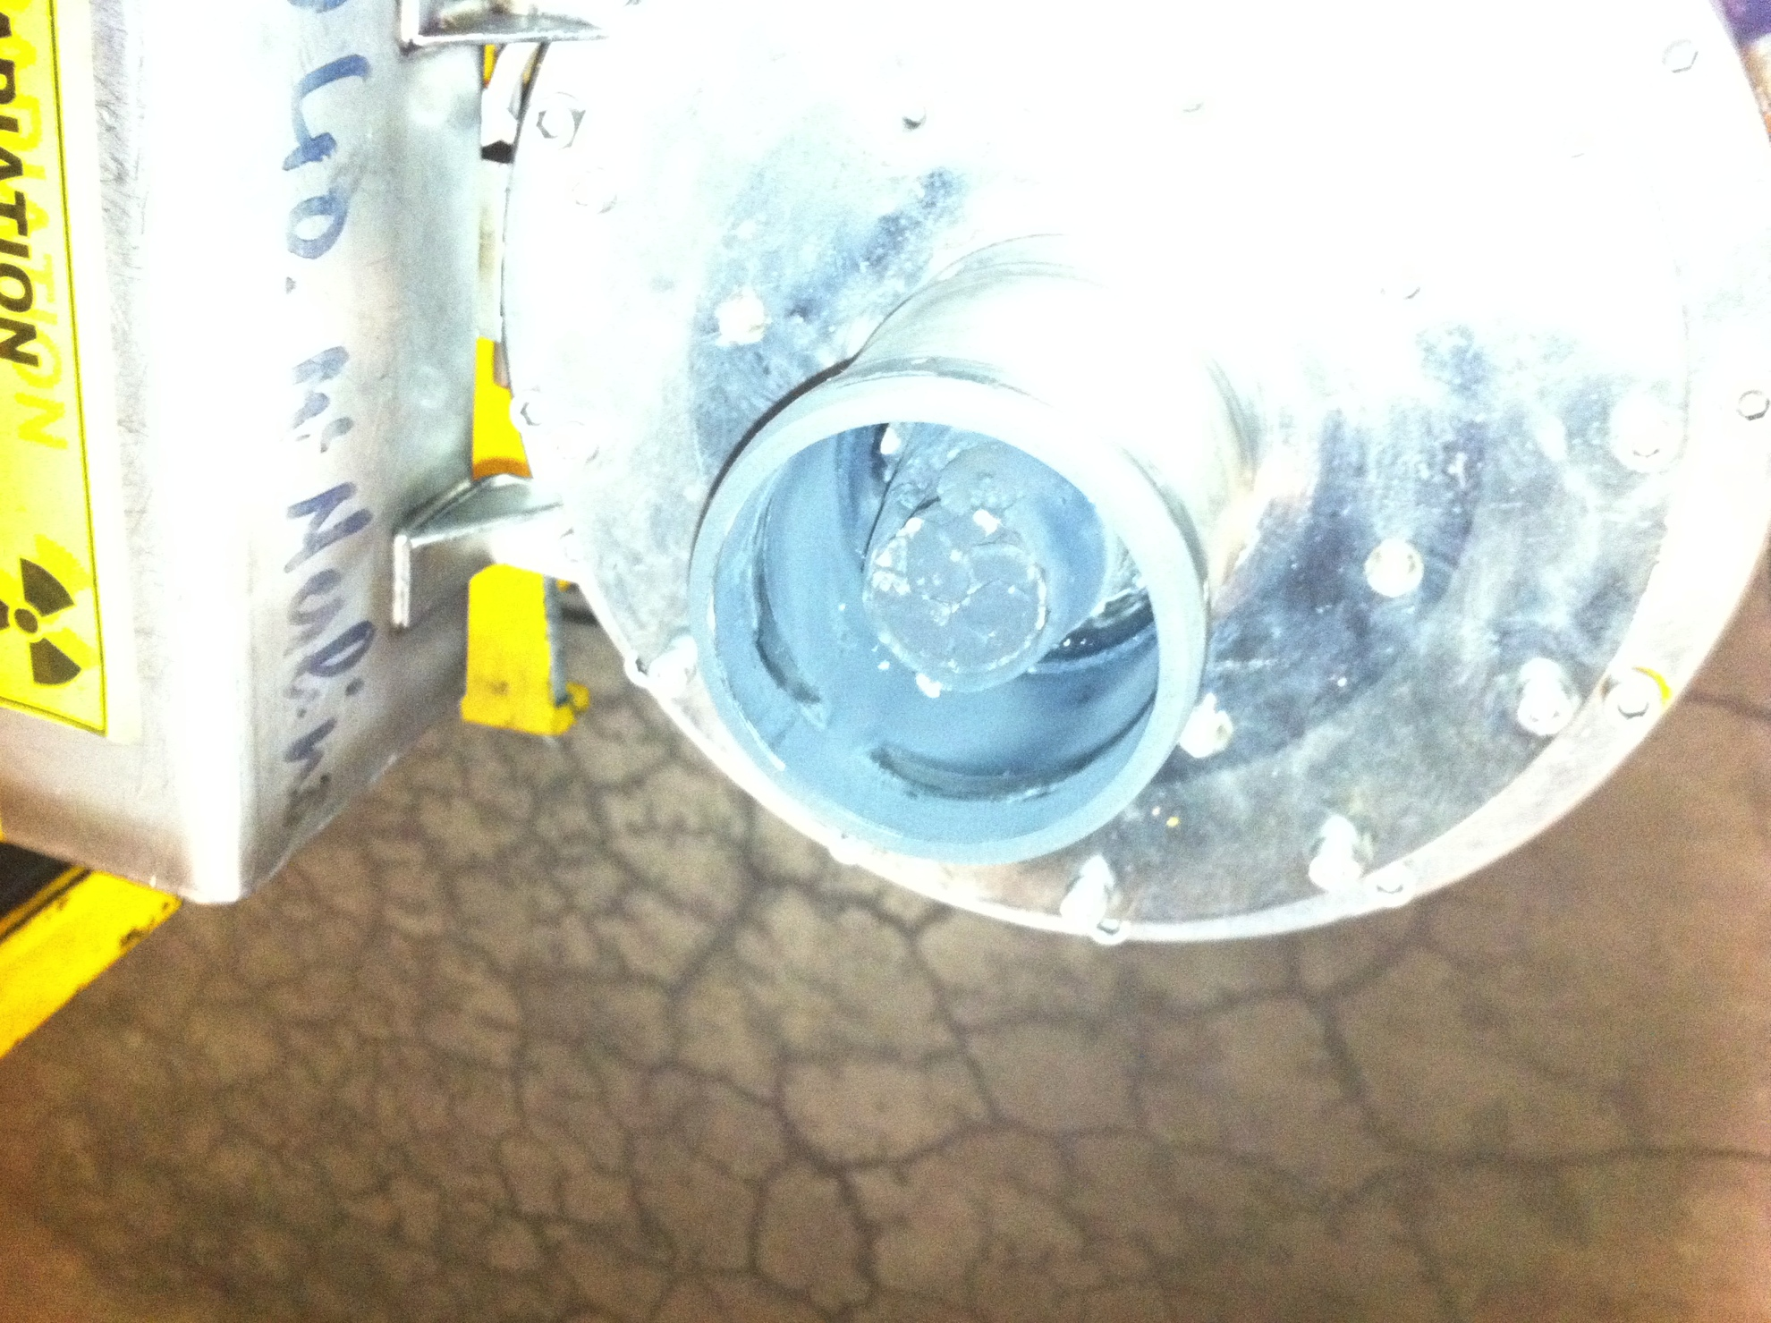

Slide 6
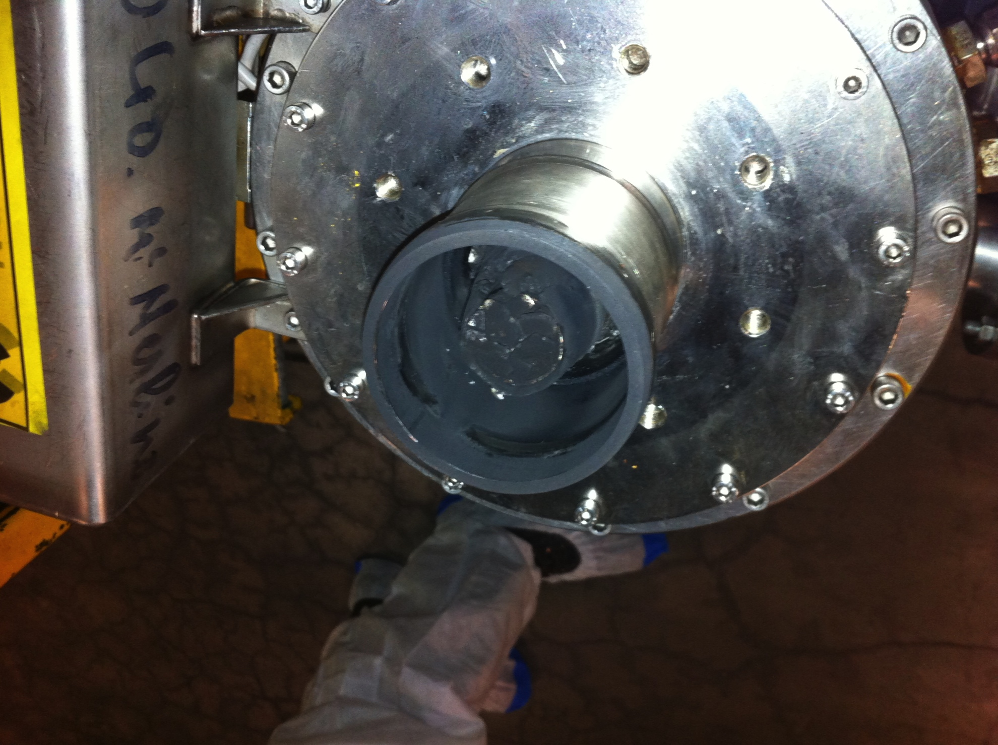

Slide 7
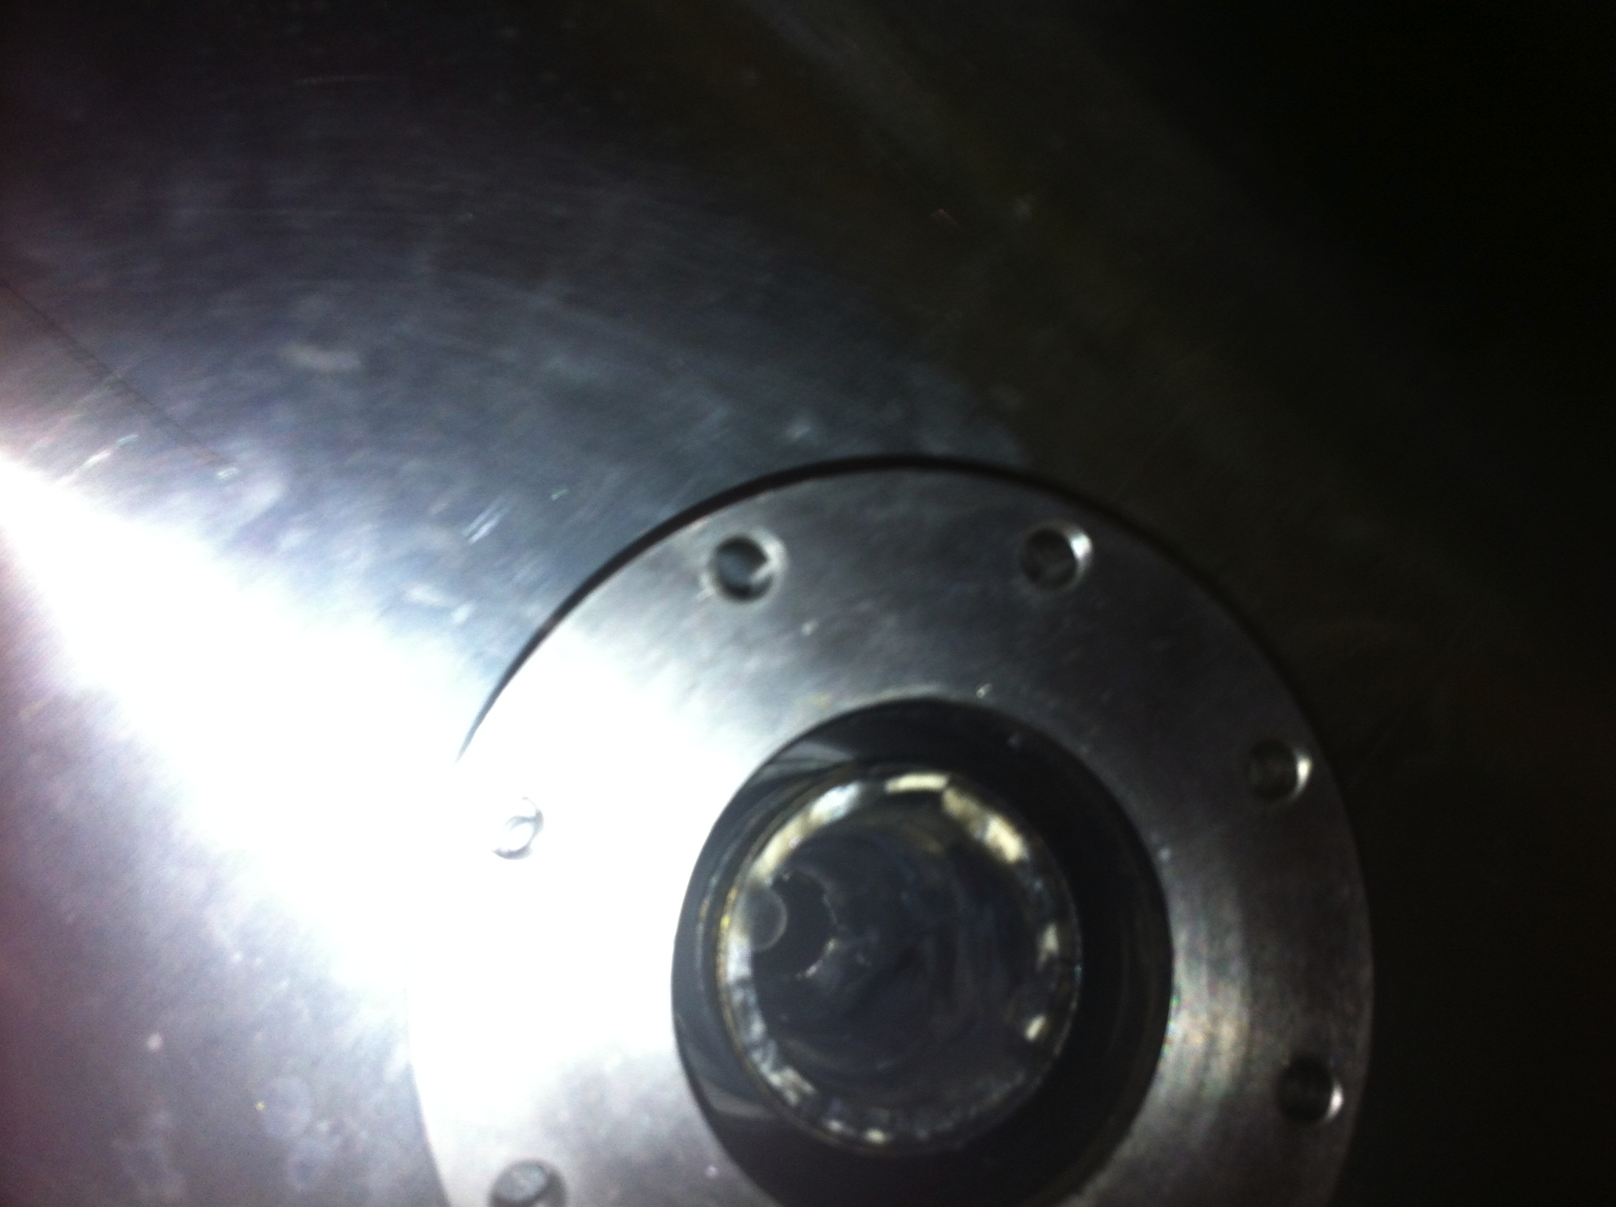

Slide 8
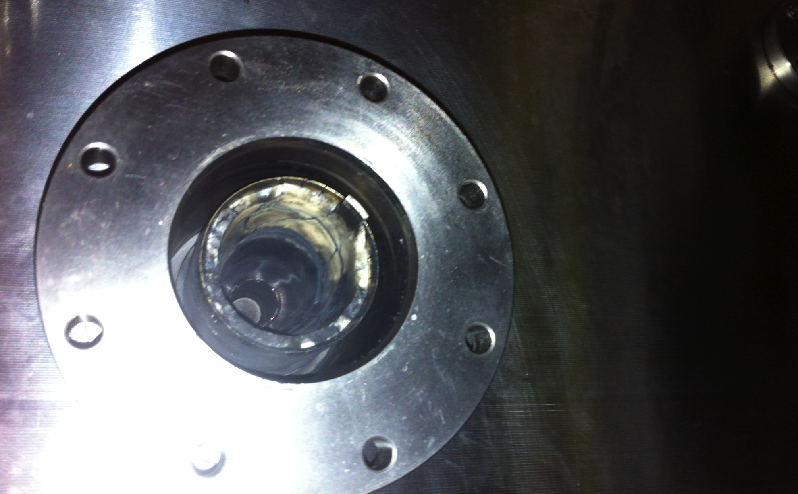

Slide 9
Draft MD Planning Wed (2.11.)
Day | Time | MD | MP
Wed | 07:00 | Ramp down, cycle
 | 09:00 | 450 GeV → 3.5 TeV: ATS and tight collimation settings – Squeeze in IR1&5 to 40cm beta*. Optics correction. Collide (no crossing angle). Show adequate protection with tight collimation settings. Show full protection. Provides 2.5 times higher pile-up potential… | A
 | 19:00 | Ramp down, cycle
 | 21:00 | 450 GeV → 3.5 TeV: IR2 Aperture Measurement – To verify parameters for ion commissioning, part of early commissioning | B
Thu | 05:00 | Ramp down, cycle

Slide 10
Draft MD Planning Thu (3.11.)
Day | Time | MD | MP
Thu | 05:00 | Ramp down, cycle
 | 07:00 | 450 GeV: Injection stability and losses – check steering constraints, define limits for correctors, operational procedure for more stable injection line steering | B
 | 14:00 | 450 GeV: Quench margin at injection – BLM thresholds required at injection, room for optimization | C
 | 18:00 | 450 GeV → 3.5 TeV: Quench margin at 3.5 TeV – apply transverse damper method, confirm May result, longer sustained losses, identify other possible limitations (know already about BLM power supplies); If any beam left Wire Scanner Quench Test | C
Fri | 02:00 | Ramp down, cycle.

Slide 11
Draft MD Planning Fri (4.11.)
Day | Time | MD | MP
Fri | 02:00 | Ramp down, cycle.
 | 04:00 | 450 GeV: Beam instrumentation – understand dynamic aperture in LHC, compare to models, experimental reference case for upgrade studies | B
 | 11:00 | 450 GeV: Beam shape
 | 13:00 | 450 GeV → 3.5 TeV: Longitudinal beam stability – Explore single and multi-bunch stability in longitudinal phase space, instability thresholds, optimal and required RF parameters | B
 | 18:00 | Ramp down, cycle.
 | 20:00 | 450 GeV → 3.5 TeV: ATS – Simultaneous squeeze to 0.1m in IR1 and IR5 with pilot beam, test of possible future upgrade optics for LHC | A

Slide 12
Draft MD Planning Sat (5.11.)
Day | Time | MD | MP
Sat | 02:00 | 450 GeV → 3.5 TeV: Tight collimation settings
 | 08:00 | Ramp down, cycle.
 | 10:00 | Combined ramp & squeeze
 | 14:00 | End of MD#4. Ramp down and cycle
 | 16:00 | Start of ion commissioning

