Slide 1
Mon/Tue 31.10.11 – 1.11.11
Machine in excellent shape. No issues…

Slide 2
MD Planning Sun – Mon (30. – 31.10.)
Day | Time | MD | MP
Sun | 16:00 | Ramp down, cycle
 | 18:00 | 450 GeV → 3.5 TeV: Dry run ATS optics | A
 | 21:00 | Ramp down, cycle
 | 23:00 | 450 GeV: Tune working points – half integer WP, more space for tune footprint, lower crossing angle, lower beta*, … | A
Mon | 07:00 | 450 GeV → 3.5 TeV: Proton-Lead – feasibility of new physics scenario | A/B
 | 23:00 | Ramp down, cycle

Slide 3
MD Report: p – lead test (J. Jowett et al)
Injected 4 ion bunches in B2 and then injected protons in B1.
Put 308 proton bunches in (4x72 +18) in and saw no noticeable effect on the Pb beam.
Could not complete the filling of the protons due to the filling scheme with injections offset by 2.5 ns, which caused the BI instrumentation to give misleading readings.
Also, changing of hyper-cycles with Fidel running caused some settings mismatches → could not trim Q or Q'. The Q' was ~8 for the horizontal and 4 for the vertical.
Dumped both beams and reset the circuits to injection. Then prepared to ramp 2 proton pilots and 2 Pb pilots.
Successful ramp…
Re-phase RF to timing for collision in ATLAS and CMS

Slide 4
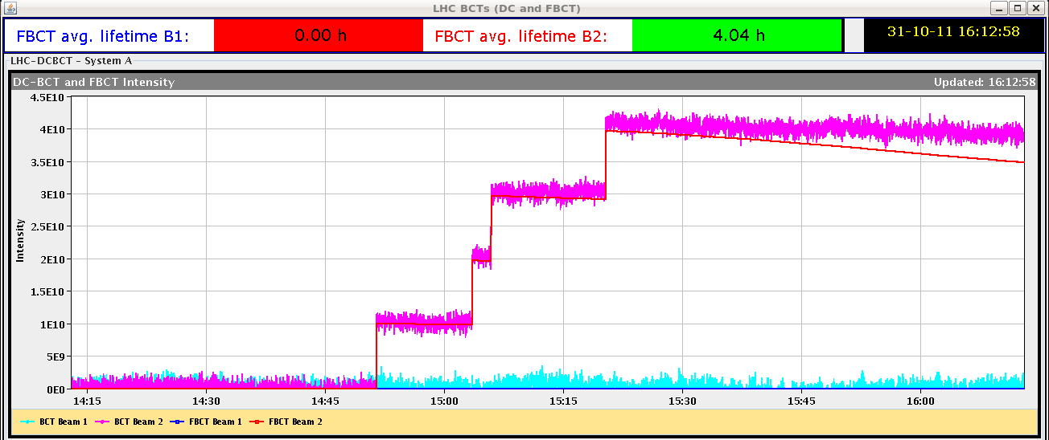
First 2011 ion beams

Slide 5
Ion bunch lengthening

Slide 6
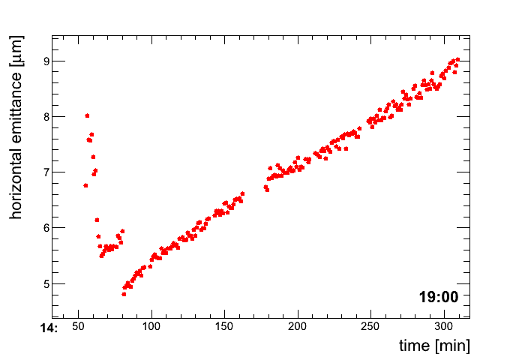
Ion emittance growth 3rd fill

Slide 7
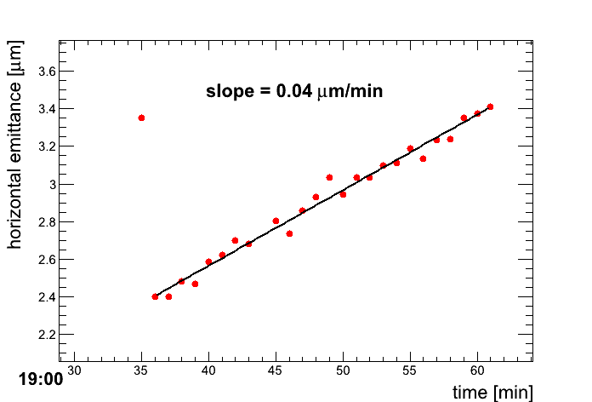
Ion emittance growth 4th fill

Slide 8
First p – lead stored beams in LHC

Slide 9
Ramp of p – lead beams

Slide 10
Re-phasing

Slide 11
IR2 Aperture Follow-up
Analyzing expected aperture and comparing to measurement.
Wednesday (8h30 meeting and LMC): Decision if an additional aperture measurement is required.
In case required:
Perform measurement in slot of combined ramp and squeeze → Wednesday 21:00 to Thursday 05:00.
Perform combined ramp and squeeze MD Saturday 06:00 to 14:00.
Provides solution for early cross-check of IR2 aperture with 1m β*.

Slide 12
ADT Procedure (Daniel and Wolfgang)
We have 3 sets of settings
for pilot intensity (~1e10)
for nominal beam (~1.3e11)
for high intensity (~3e11)
If the damper is running with low intensity settings (for example for ions/p) it is important that before any new beam with a different (i.e. higher) bunch intensity is injected D. Valuch or W. Hoefle must be contacted to change settings.
Leaving ADT beam position modules at high gain (i.e. for pilot bunch intensity) and injecting nominal or high intensity bunches could damage the front-ends. It is not sufficient to switch off the damper to protect our electronics!

Slide 13
BI MD Preparation (F. Roncarollo et al)
In preparation of BI MD one needs a 10-15 min access in US45 and UA43 (no tunnel, no RF zone access) in order to setup:
the new matching monitor
a special BPM designed to observe betatron oscillation at injection
Will be scheduled in any available slot.
If none available: plan it at the end of the ramp down just before the MD.

Slide 14
Non-linear MD (M. Giovannozzi et al)
After MD an access is required to disable the MKA kicker.
A dedicated period of 2 hours is reserved in the allocated MD time for access and subsequent pre-cycle.

Slide 15
MD Planning Tue (1.11.)
Day | Time | MD | MP
Tue | 01:00 | 450 GeV: TDI Vacuum – understand source of heating, check for HOM’s. Parasitically: UFO studies | C
 | 09:00 | 450 GeV: UFO studies - Understanding UFO’s and possible limitations. Parasitically: scraping setup & first tests (on other beam?) | C
 | 11:00 | 450 GeV: Scraping for beam shape - More accurate beam models for machine protection studies and beam loss simulations (high intensity tails)
 | 13:00 | 450 GeV → 3.5 TeV: LR beam-beam with 25ns – Assess required crossing angle and achievable beta* (performance) with 25ns | C
 | 21:00 | Ramp down, cycle
 | 23:00 | 450 GeV → 3.5 TeV: Beam instrumentation – Improvements of LHC beam measurements. One goal: calibrated BSRT emittance data for beam1 and beam2 at 3.5TeV | B
Wed | 07:00 | Ramp down, cycle

Slide 16
MD Planning Wed (2.11.)
Day | Time | MD | MP
Wed | 07:00 | Ramp down, cycle
 | 09:00 | 450 GeV → 3.5 TeV: ATS and tight collimation settings – Squeeze in IR1&5 to 40cm beta*. Optics correction. Collide (no crossing angle). Show adequate protection with tight collimation settings. Show full protection. Provides 2.5 times higher pile-up potential… | A
 | 19:00 | Ramp down, cycle
 | 21:00 | 450 GeV → 3.5 TeV: Combined ramp & squeeze - Feasibility of changing the LHC optics during the ramp. Gain ~7min (400s) per ramp initially. Higher efficiency for physics | B
Thu | 05:00 | Ramp down, cycle

Slide 17
MD Planning Thu (3.11.)
Day | Time | MD | MP
Thu | 05:00 | Ramp down, cycle
 | 07:00 | 450 GeV: Injection stability and losses – check steering constraints, define limits for correctors, operational procedure for more stable injection line steering | B
 | 15:00 | 450 GeV: Quench margin at injection – BLM thresholds required at injection, room for optimization | C
 | 19:00 | 450 GeV → 3.5 TeV: Quench margin at 3.5 TeV – apply transverse damper method, confirm May result, longer sustained losses, identify other possible limitations (know already about BLM power supplies); If any beam left Wire Scanner Quench Test | C
Fri | 03:00 | Ramp down, cycle. Access for MKA (preparation non-linear MD).

Slide 18
MD Planning Fri (4.11.)
Day | Time | MD | MP
Fri | 03:00 | Ramp down, cycle. Access for MKA (preparation non-linear MD).
 | 05:00 | 450 GeV: Non-linear dynamics – understand dynamic aperture in LHC, compare to models, experimental reference case for upgrade studies | B
 | 13:00 | 450 GeV → 3.5 TeV: Longitudinal beam stability – Explore single and multi-bunch stability in longitudinal phase space, instability thresholds, optimal and required RF parameters | B
 | 21:00 | Ramp down, cycle.
 | 23:00 | 450 GeV → 3.5 TeV: ATS – Simultaneous squeeze to 0.1m in IR1 and IR5 with pilot beam, test of possible future upgrade optics for LHC | A
Sat | 05:00 | Ramp down, cycle.
 | 06:00 | End of MD #4

