Slide 1
MD Planning Tue (1.11.)
Day | Time | MD | MP
Tue | 01:00 | 450 GeV: TDI Vacuum – understand source of heating, check for HOM’s. Parasitically: UFO studies | C
 | 09:00 | 450 GeV: UFO studies - Understanding UFO’s and possible limitations. Parasitically: scraping setup & first tests (on other beam?) | C
 | 11:00 | 450 GeV: Scraping for beam shape - More accurate beam models for machine protection studies and beam loss simulations (high intensity tails)
 | 13:00 | 450 GeV → 3.5 TeV: LR beam-beam with 25ns – Assess required crossing angle and achievable beta* (performance) with 25ns | C
 | 21:00 | Ramp down, cycle
 | 23:00 | 450 GeV → 3.5 TeV: Beam instrumentation – Improvements of LHC beam measurements. One goal: calibrated BSRT emittance data for beam1 and beam2 at 3.5TeV | B
Wed | 07:00 | Ramp down, cycle
Cryo Problem

Slide 2
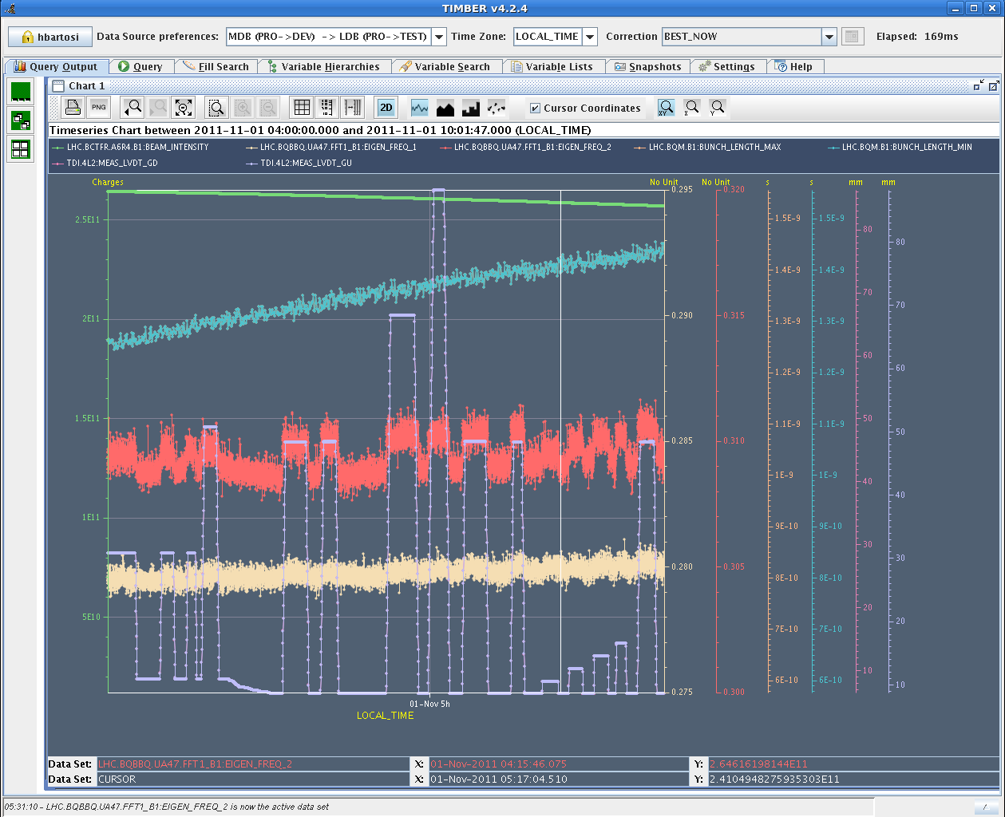
Tue 01/11 – TDI studies
Aim: Measure TDI impedance (mainly transverse)
Parasitically: UFO studies
Measurement of tune shift vs. TDI gap for high intensity bunch (~2.5x10¹¹ p).
Measurement with multi-bunch not clean
H. Bartosik, B. Salvant et al.

Slide 3
Tue 01/11 – TDI studies
Single high intensity bunch:
Tune shift with changing TDI gaps were recorded (already done but either with small intensity and/or transverse damper on). Vertical tune shift >1e-3 with a noise of 1e-4.
Measurements confirm quantitative measurements on B2 in 2010, i.e. it seems there was no degradation of the transverse impedance.
However, as already observed in 2010, both TDIs lead to a significant tune shift (~-8E-4 at nominal TDI injection setting for 2.6E11 p/b), corresponding to a large vertical effective impedance (first quick calculation: 3.25 MOhm/m at nominal injection setting to 5.2 MOhm/m at 3.7 mm half gap, subtracting the effect of the beta function at the location of the TDI). To be confirmed by more serious computations.

Slide 4
Tue 01/11 – TDI studies
50 ns beam
We tried to see beam induced signals when moving the TDI in and out, but nothing interesting was seen on ADT or BBQ.
The only odd observation is that the vacuum seems to be better at injection with the TDI close to the beam than far from the beam, which is the opposite of what was observed during the ramp. This should be investigated but is probably not a beam physics issue.
Next steps
perform same measurements for other collimators (in particular the TCTVB).
Assess longitudinal impedance with TDI gap and not only the transverse effects.

Slide 5
Tue 01/11 – UFO studies
Verification of procedure for kicking single MKI kickers and MKQ kickers with low intensity
Pulsed single MKI kickers and MKQ kickers in the last injection gap without beam after injecting 1236 bunches
Preliminary results from UFO buster / BLM data analysis:
Often candidate UFOs after MKI pulse in Pt.2 and Pt.8 found. Sometimes even several events (cf. e.g. events at 9:40 and 9:54)
Delay of first event to MKI pulse between 12.8ms and 128ms (for free fall t=sqrt(2*19mm/9.81ms^-2) = 62ms expected).
No UFOs at MKQ found

Slide 6
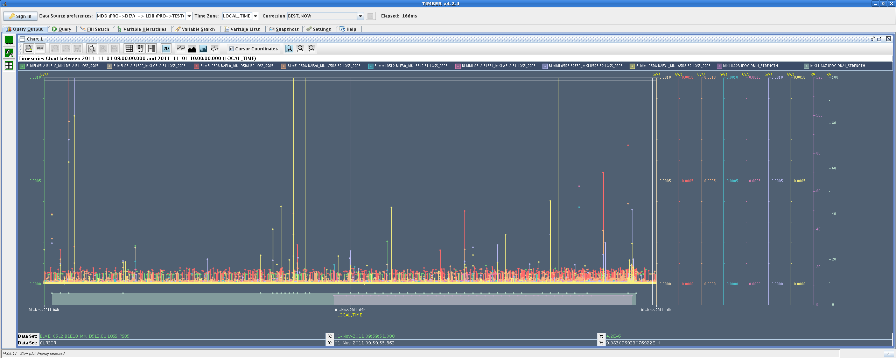
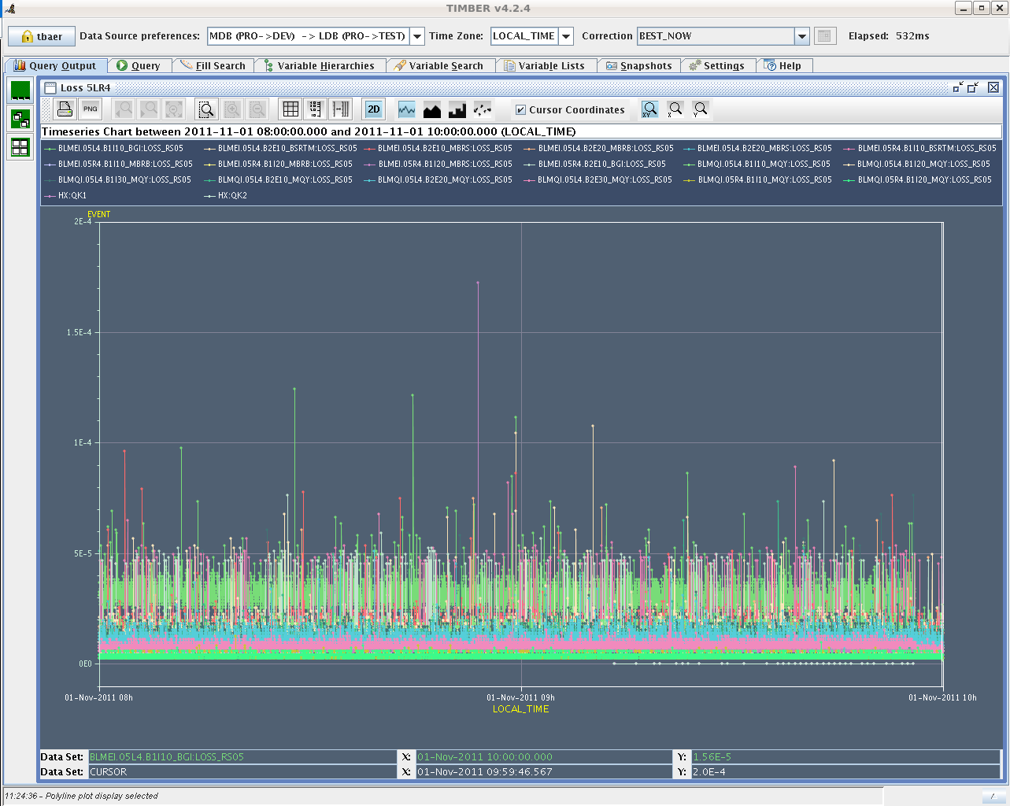
Vacuum at TDI
MKI
T. Baer, J. Uythoven et al.
MKQ

Slide 7
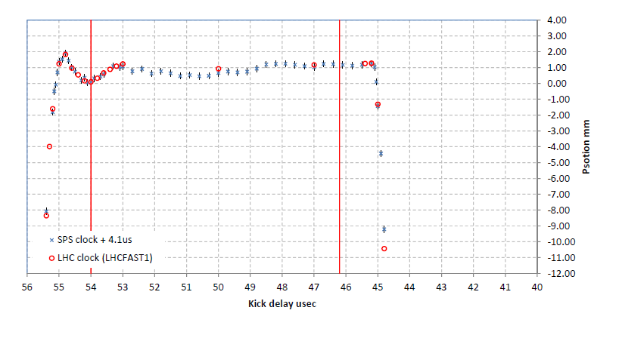
SPS MKE waveform calibration
10:37: Trip of cryogenics in point 8
Accesses
Measurements of the MKE4/6 SPS extraction kicker waveform
Preliminary summary:
Finished calibration of MKE4 kick waveform with LHC clock. Find a 4.1 us difference wrt the calibration made with SPS clock, but the same waveform (when a 0.4 mm static offset is accounted for). What is strange is that the 54 us delay for the pilot seems to be at a different location compared to the waveform measured with the individual bunch positions at injection into the LHC...we will come back to try and investigate with INDIV or 12b
B. Goddard

Slide 8
MD Planning Wed (2.11.)
Day | Time | MD | MP
Wed | 07:00 | Ramp down, cycle
 | 09:00 | 450 GeV → 3.5 TeV: ATS and tight collimation settings – Squeeze in IR1&5 to 40cm beta*. Optics correction. Collide (no crossing angle). Show adequate protection with tight collimation settings. Show full protection. Provides 2.5 times higher pile-up potential… | A
 | 19:00 | Ramp down, cycle
 | 21:00 | 450 GeV → 3.5 TeV: Combined ramp & squeeze - Feasibility of changing the LHC optics during the ramp. Gain ~7min (400s) per ramp initially. Higher efficiency for physics | B
Thu | 05:00 | Ramp down, cycle

Slide 9
MD Planning Thu (3.11.)
Day | Time | MD | MP
Thu | 05:00 | Ramp down, cycle
 | 07:00 | 450 GeV: Injection stability and losses – check steering constraints, define limits for correctors, operational procedure for more stable injection line steering | B
 | 15:00 | 450 GeV: Quench margin at injection – BLM thresholds required at injection, room for optimization | C
 | 19:00 | 450 GeV → 3.5 TeV: Quench margin at 3.5 TeV – apply transverse damper method, confirm May result, longer sustained losses, identify other possible limitations (know already about BLM power supplies); If any beam left Wire Scanner Quench Test | C
Fri | 03:00 | Ramp down, cycle. Access for MKA (preparation non-linear MD).

Slide 10
MD Planning Fri (4.11.)
Day | Time | MD | MP
Fri | 03:00 | Ramp down, cycle. Access for MKA (preparation non-linear MD).
 | 05:00 | 450 GeV: Non-linear dynamics – understand dynamic aperture in LHC, compare to models, experimental reference case for upgrade studies | B
 | 13:00 | 450 GeV → 3.5 TeV: Longitudinal beam stability – Explore single and multi-bunch stability in longitudinal phase space, instability thresholds, optimal and required RF parameters | B
 | 21:00 | Ramp down, cycle.
 | 23:00 | 450 GeV → 3.5 TeV: ATS – Simultaneous squeeze to 0.1m in IR1 and IR5 with pilot beam, test of possible future upgrade optics for LHC | A
Sat | 05:00 | Ramp down, cycle.
 | 06:00 | End of MD #4

