Slide 1
Wednesday 26 October 2011

Slide 2
Wednesday 6:22 back in stable beams, Fill 2254
Beam intensity: 1.9E14
Bunch intensity: 1.4E11
Initial luminosity: 3.5 10³³ cm⁻²s⁻¹
Integrated Luminosity: 34 pb⁻¹
09:30 Beam dump due to cryo fault sector 12 (false temperature reading, most likely SEU)
Access PM56 to change power converter, RQT13.R5B1. Problem with MAD. ~1 hour lost because key not returned by RP piquet.
13:35 injection of probe beams
14:22 injection physics beams
Problems with BPM back: no data from several crates (front-end memory issue). Mitigated by reboot, but coming back.
Parking position of TDI in P8 set to +/-20mm (for crosschecking dependence of vacuum on TDI position)

Slide 3
Two independent problems with BPM
First problem solved by 18:00: Two BPM front-ends (interlock crates in pt6) were sending too much data to the OFC (50 Hz vs. nominal 25 Hz) which overloaded the OFC. Traced to new version of the BPM phase-in application, and reverted back to old version (Eva, Serkan and Ralph).
18:43 injection physics beams but again BPM data missing (injection line B2 and ring). Beam dumped due to injection losses.
Second problem (maybe) solved by 20:00: missing BPM data due to memory issue: One of the BPM turn by turn data concentrators was left in a setting for acquiring every bunch for a large number of turns at injection. Setting was apparently put in place for the 90m Beta* MD and left in afterwards (Ralph and Verena)
→ injection line BPM data back

Slide 4
Fill #2256 and #2257
20:32 Steering injection lines.
21:19 injection for physics fill 2256
22:54 stable beams
Beam Intensity: 1.98E14
Average bunch intensity: 1.43E11
Peak luminosity: 3.66 10³³ cm⁻²s⁻¹
Beam losses during last part of squeeze up to 50% of thresholds in IP2 and IP7
23:03 beam dump: Power converter, trip of RCS.A34B1
Integrated Luminosity: 1.8 pb⁻¹ (9 minutes stable beams)
23:54 injection probe beam fill 2257
00:57 beam dump: RQTF.A67B1 tripped during the squeeze, likely the well known conflict between QFB and QPS (no QPS post mortem data available)

Slide 5
Fill #2258
1:50 injection probe beam fill 2258
3:52 stable beams
Beam Intensity: 1.95E14
Average bunch intensity: 1.41E11
Peak luminosity: 3.56 10³³ cm⁻²s⁻¹
4:33 beam dump: dilution kicker power supply → access to exchange (in the shadow: BLM and aperture kicker access)
Integrated Luminosity: 8.2 pb⁻¹
MQ27L2 QPS not ok, quench buffer being sent repeatedly: access planned at 7:20 (RP piquet needs 1 hour to come)

Slide 6
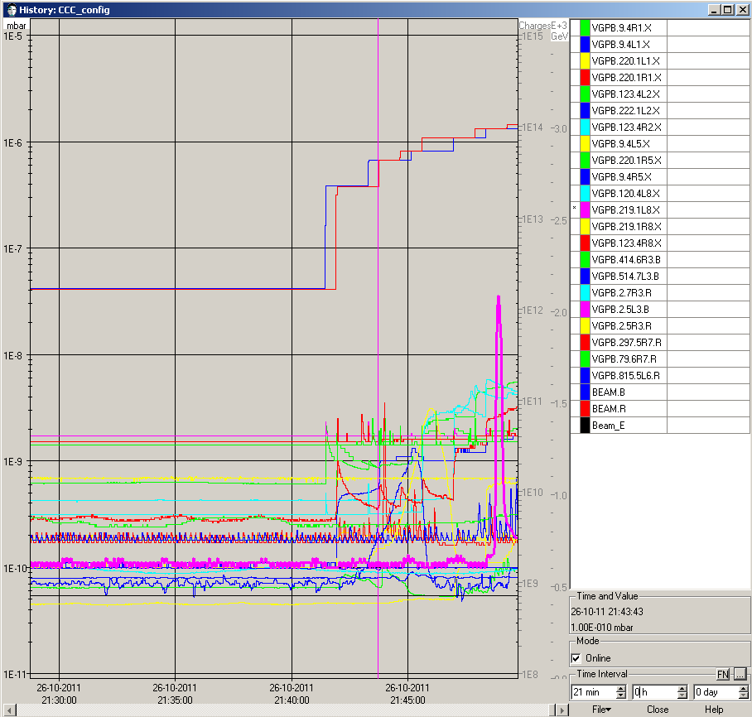
Vacuum spike IP8 during injection

Slide 7
Others
Two dry-runs of the squeeze function for IP2.
The one at 4:56 was successfully finished without trip.

Slide 8
Outlook
Now – Friday morning: Luminosity production
Friday (24 hours) preparations for ion run using proton pilot beams
ALICE squeeze to 1.0 m, beta beating measurement
Aperture measurement
Checking/setting injection orbit
Saturday – Sunday 16:00 (End of proton physics 2011) : Luminosity production
18:00 Sunday – 6:00 Saturday 5 November: MD block 4
Others:
Enhance satellites to 1-2% (currently at 0.1-0.2%) of main bunches: aim for LHC test fill Thursday afternoon.
Main bunch intensity around 1.2E11
Maybe end of fill study reducing the ADT gain (check beam lifetime, emittance growth, luminosity lifetime)
Friday (ion preparation): ADT changing crate computers and install blow-up functionality

