Slide 1
Overview LHC Operation
Week 43
Machine Coordinators:
Barbara Holzer & Jan Uythoven

Slide 2
Weekend 29th and 30th October
Friday
  19:53 beams dumped fault transformer Point 1
  Cryogenics lost in sector 12
Saturday
  11:00 Cryo recovered.
  Spent the rest of the day and part of the night on IP2 1 m β* optics checks and aperture measurements in preparation of the ion run
Sunday
  02:40 Transverse damper checks for p+: OK
  04:00 Some injection steering
  07:27 Stable beams with enhanced satellites, fill #2266
  09:49 Vacuum spike at point 4 around the BGI dumped the beam
    All BGIs switched off
  12:57 Stable beams fill #2267 (fast refill, although BQM problems!)
  17:17 Last proton physics beam dump of 2011
  18:00 Start MD - ATS optics dry run
  22:00 Start MD on tune working points, one hour ahead of time
Monday
  07:00 Start of Proton – Lead MD.

Slide 3
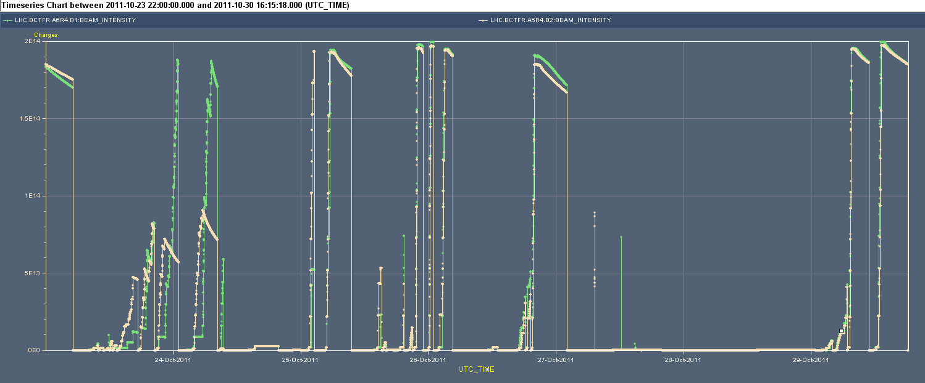
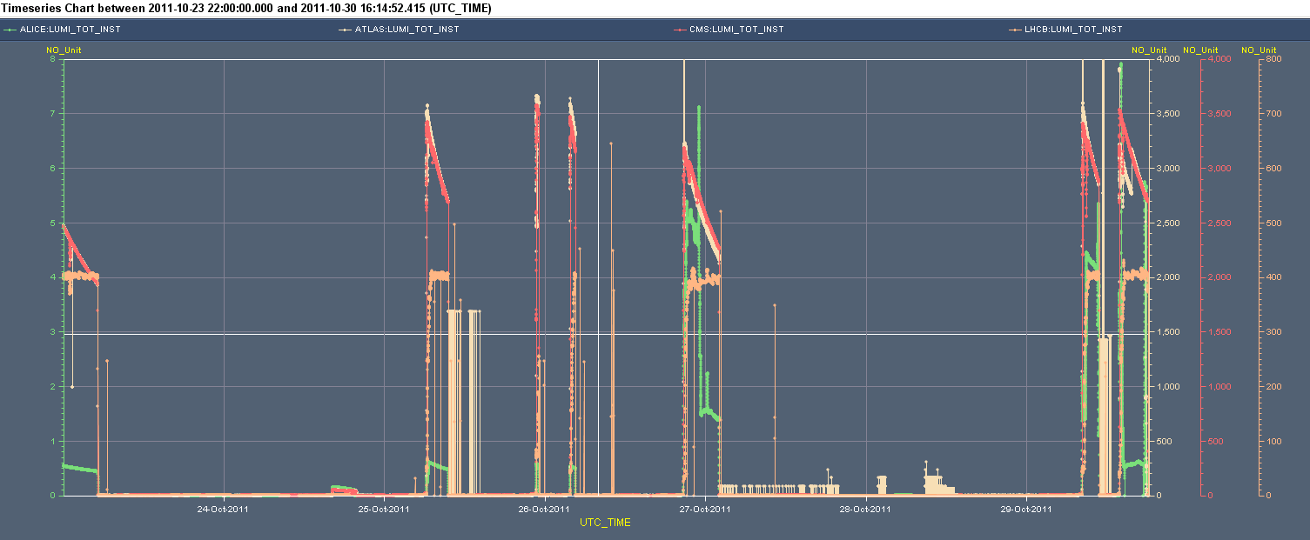
Week 43 overview
2e14
Cryo
BPMs
Lost Cryo
IP2 squeeze
Transformer-> Cryo
IP2 Squeeze
25 ns test
Enh.
satellites
BCTs
High pile-up
8e30 cm-2s-1 (Alice)
(ATLAS, CMS) 4000
Lumi’s
LHCb @ 400

Slide 4
Physics fills
Fill # | Length | Peak lumi [e33 cm-2s-1] | Integrated lumi [pb-1] | Reason for dump
2267 | 4h12min | 3.5 | 46 .3 | Operator dump
2266 | 2h22min | 3.5 | 26.5 | BGI vacuum
2261 | 5h20min | 3.3 | 50.5 | Cryo maintain MSR6
2258 | 1h02min | 3.5 | 8.2 | PC dilution kicker LBDS
2256 | 0h09min | 3.6 | 1.8 | PC, RCS.A34B1
2254 | 3h11min | 3.5 | 34 | Cryo, sector 12, most likely SEE
2252 | 3h16min | 0.05 | 0.4 | Operator, end of high pile-up
2242 | 10h26min | 3.5 | 95 | Trip RCBX
Total | 29h58min |  | 216.4

Slide 5
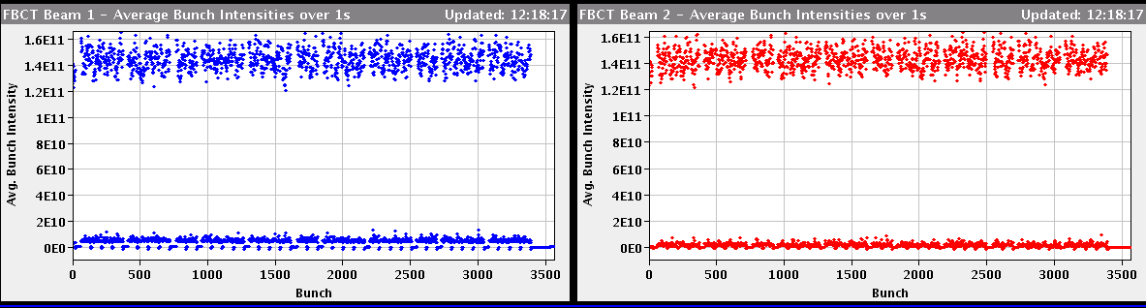
Last physics fill
The average bunch intensity was changing between
1.43 and 1.5e+11 in the SPS.
LHC vacuum has been fine for the last fills (not counting the BGI one)
Enhanced satellites seem to work well
To take into account for 2012
Just before last dump separated beams in ATLAS, (3sigma V, 1sigma H per beam)

Slide 6
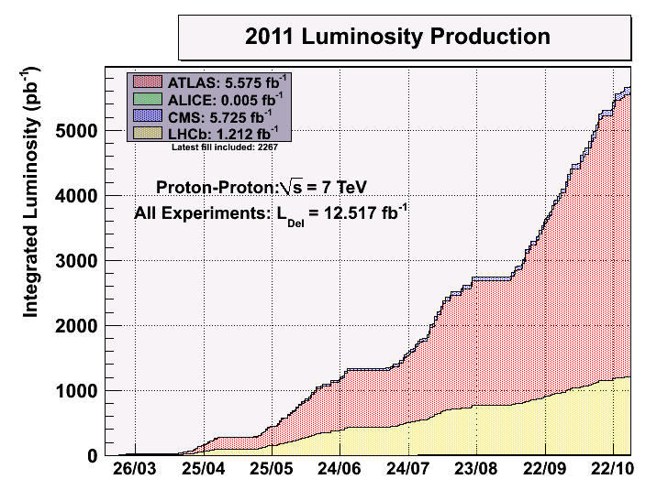
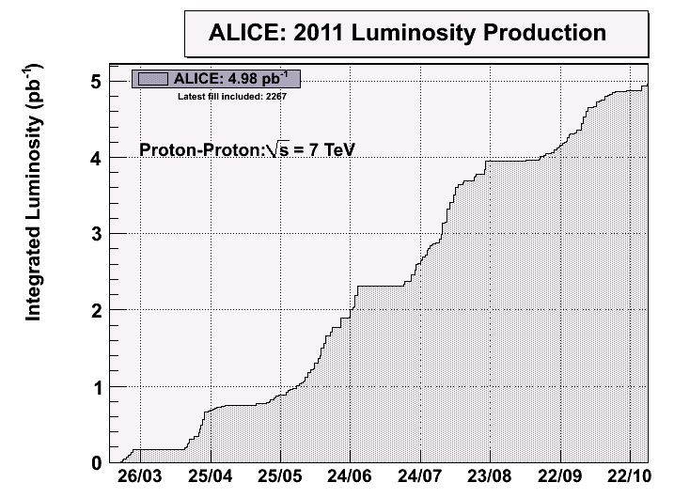
End of Proton Physics 2011

Slide 7
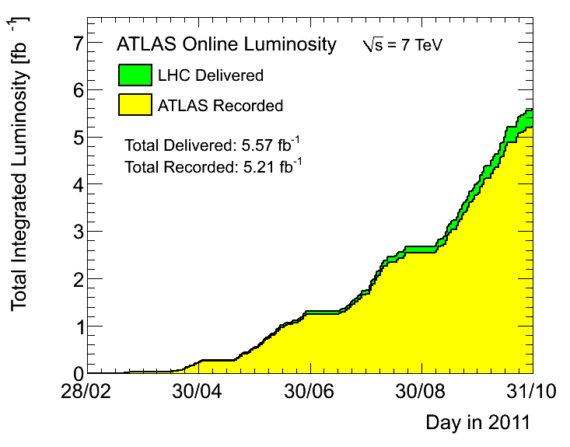
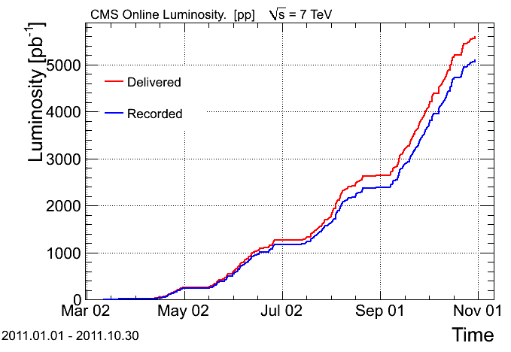
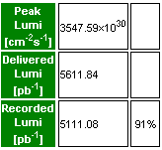
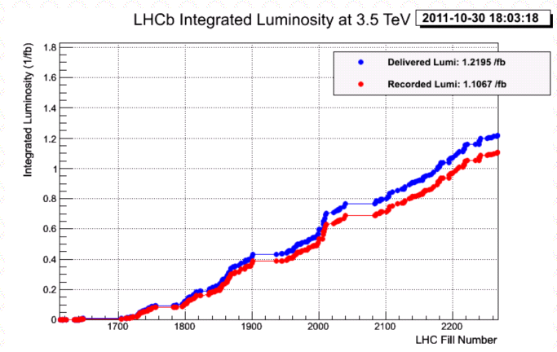
CMS, Atlas & LHCb
CMS record peak lumi this week:

Slide 8
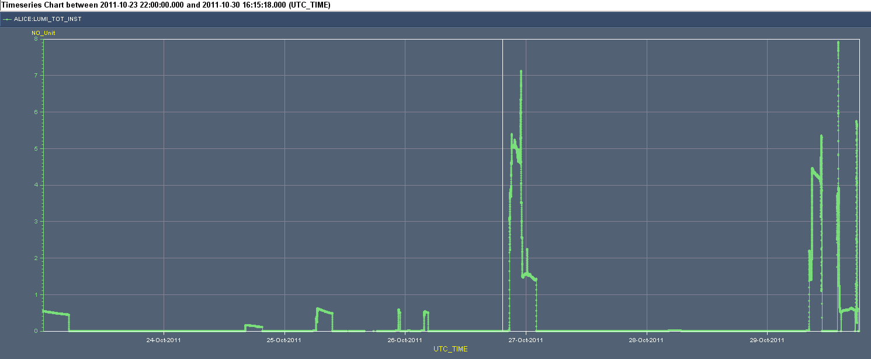
Alice – enhanced satellites
Running with enhanced satellites
2-3-5 % intensity of nominal bunches
Peak lumi between 5 and 8e30 cm-2s-1
Normal detector running at 0.5e30 cm-2s-1
8e30 cm-2s-1

Slide 9
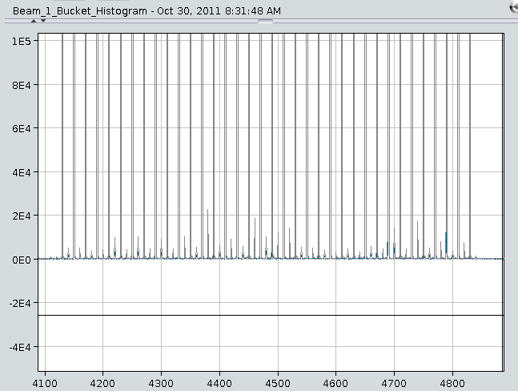
LDM picture of satellites Sunday morning fill
Satellites around 2 – 3 % of nominal bunch intensity
Enhanced 25 ns satellites from the PSB

Slide 10
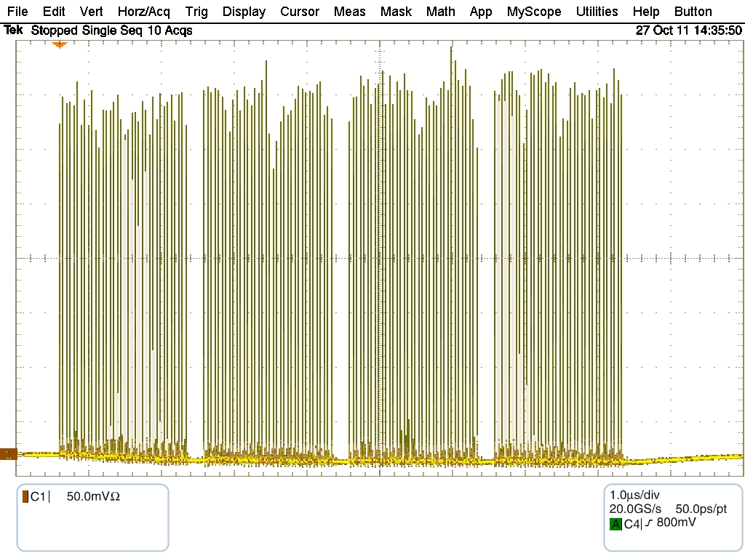
Fill with enhanced satellites for Alice
Wall current profile SPS beam
Average over sequential 10 turns, 20 ms before extraction
144 bunches with satellites
Satellites going up to about 8 %, average of few %
T.Bohl, S.Hancock

Slide 11
Satellites Fill #2261 (Enrico Bravin)
Satellite distribution for fill 2261. The satellite near the bunches range between 1.5% and 6% with an average of 3%.

Slide 12
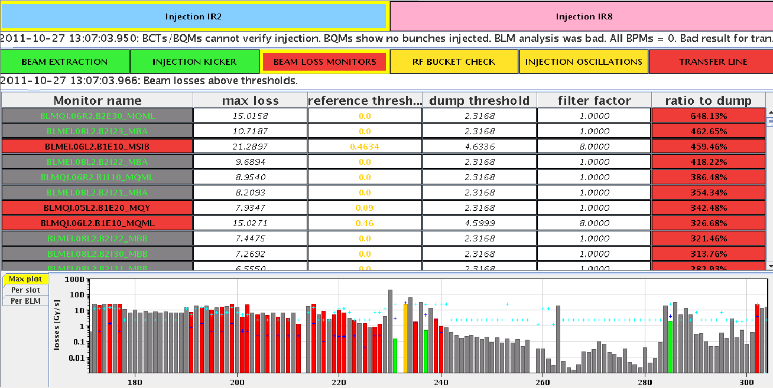
First injection of 144 bunches with satellites, B1
Losses on ring BLMs factor 6.5 above dump level!
Most likely due to injection problems in the SPS, blowing up the beams, and “corrected” by reduced scraping.
Subsequent injections with satellites were very clean

Slide 13
The SEE “Quench” of dipole magnet B8.L2
The magnet quench is indeed due to a spurious self-trigger of a quench heater discharge power supply. Such an event has not been observed so far in LHC, also not during radiation test campaigns.
This type of power supply has been successfully tested in the TCC2 area (year 2000 campaign) up to 380 Gy (sub-circuits including the trigger circuit were operational up to 1.1 kGy). To my best knowledge a spurious trigger can only be explained by substantial losses.
That’s what we had....
Reiner Denz

Slide 14
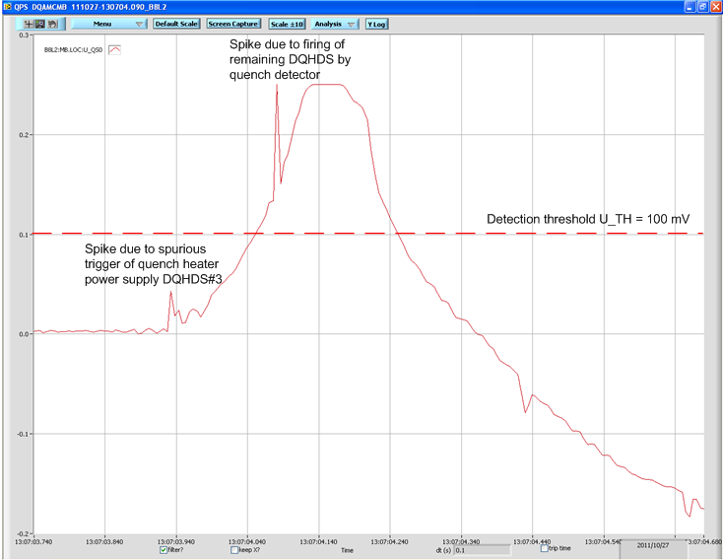
QPS signal dipole magnet B8.L2

Slide 15
On October 28th at 19:53
  A fault in the voltage regulation circuitry of the transformer supplying LHC Point 1, LHC Point 18 and the Meyrin Site
  The circuit was switched off
  The autotransfer mechanism correctly switched in the alternative supply lines 9 seconds later
  On October 29th at 01:15
  The electronics was replaced and the nominal network configuration had been re-established
Atlas
Point 18
The Meyrin Site

Slide 16
Atlas
Point 18
The Meyrin Site

Slide 17
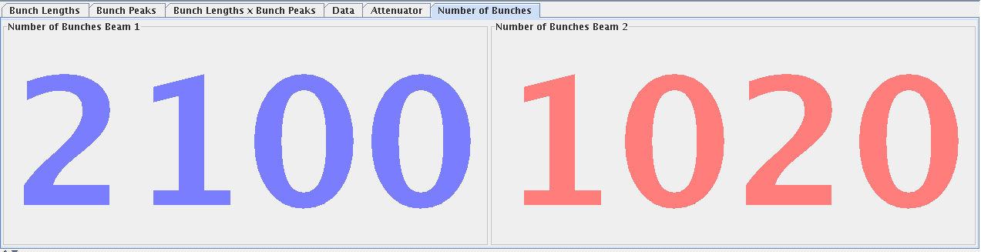
25 ns
Finally managed to inject 2100 (B1) against 1020 (B2) bunches with spacing of 925 ns between trains of 72 bunches.
Blow-up and losses are still observed along the bunch trains but there is a trend to improvement of the lifetime
Heat load data have been collected as well as vacuum data and they indicate an improvement when normalized to current but they must still be analyzed in detail
The injection of the beam was strongly hampered by the pressure rise on MKI8 and in particular by magnet D. Because of that the filling scheme had to be adapted to minimize the pressure rise and therefore the impact on the filling rate.
During a soft-start of kicker MKI8 a pressure spike has occurred and it required an extended conditioning
  Electrical breakdown in MKI8-D kicker magnet during SoftStart (54.3kV, 1200ns). This followed an extended period of 25ns beam and vacuum of ~9e-9mbar in the MKI8 tanks as well as high pressure in the nearby beam pipes.
  SIS vacuum interlock, and reluctance to further increase the limit, is justified
  ALL electron cloud solenoids were turned off around the MKI8 kickers resulting in the high pressure – this did not help.

Slide 18
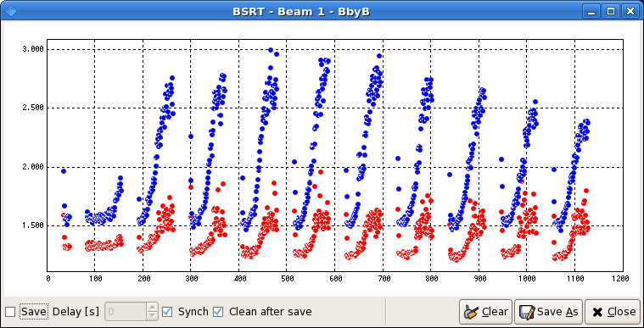
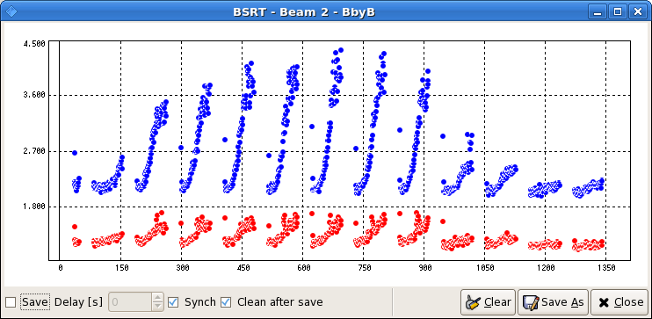
BSRT bunch by bunch transverse beam size (Fill 2249)
Horizontal
Vertical

Slide 19
High pile-up run
Injected 11 high intensity bunches (2.3-2.5e11ppb, ~2um at the SPS) to give IP1/5 10 high pile-up colliding pairs (+1 colliding pair for IP8 and IP2)
Minimized the time at injection by a semi-dedicated SPS supercycle
(LHC4+CNGS only)
Observed emittance blow up at the LHC: ~3-3.5um in collisions from wire scanners
Achieved a peak pile-up of about 35
Observed once again the impact of number of HO collisions of loss pattern (lower losses for lower number of HO collisions)
Separation scans to reduce the pile-up in steps for both CMS and ATLAS (~20% reduction per step)
At the end, turned off ADT with head-on colliding beams to observe possible coherent modes
Additionally, acquired orbit data which will be looked at offline.

Slide 20
Transverse damper
Friday 8:30 – 16:30 update of ADT: D. Valuch, F. Dubouchet, W. Hofle :
“We have installed new front end computers, new drivers, new fesa classes and upgraded firmware in the signal processing units.”
No problems with subsequent physics fills on Sunday
To be set-up again for ions !

Slide 21
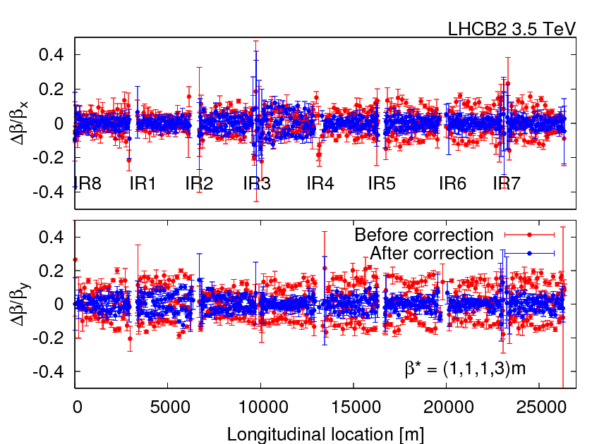
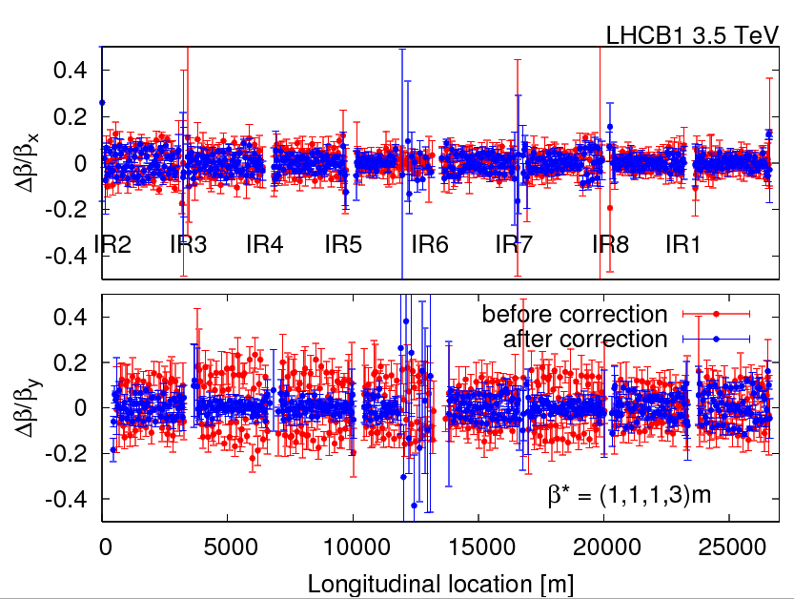
IP2 squeeze 1 m, in prep. of ion run
Checked coupling and other optics corrections applied yesterday that were incorporated
The coupling correction was increased from a knob value of 0.8 to 1.1. Resulting coupling about 0.0017, both beams
Beta-beat correction was calculated for beam 1 and beam 2. Only 20 correctors, for both beams, around IP2 are used. This resulted in a reduction of the beta-beat from 20% to a peak 10%.
betastar was measured with the K-modulation

Slide 22
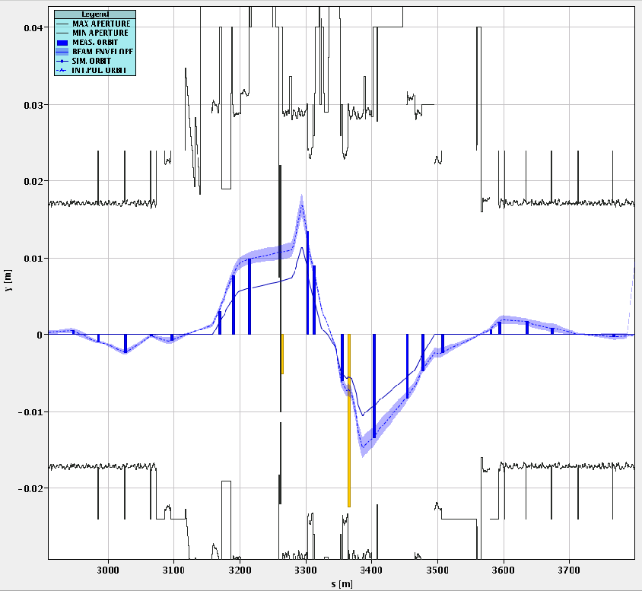
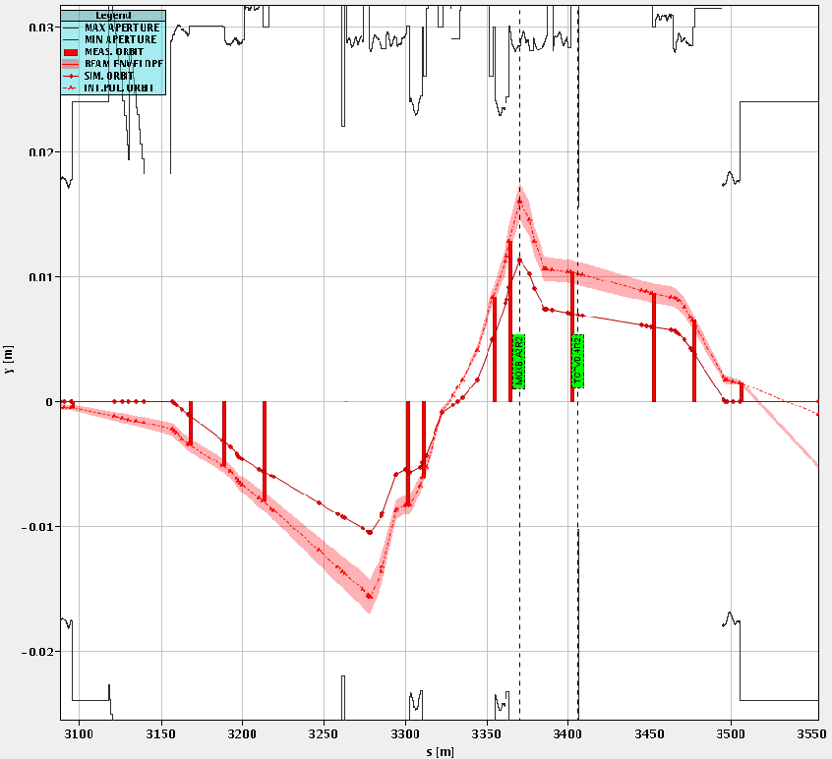
Measured beams at IP2 with apertures
B1
B2

Slide 23
Triplet Aperture Checks in IP2
We performed the local IR measurements with the technique used already in IP1 and IP5: Local crossing bumps are added to the reference orbit in the crossing and separation planes. An alignment of the TCTs of IR2 was performed to establish reference centres and accurate 12sigma gaps.
Starting configuration: -80urad crossing angle; squeezed beams (1m) and separated by 2 x 700 um.
For IP2, we immediately noticed that the strength of the standard lumi angle knobs was not sufficient to probe the aperture. So, we had to add on top of them additional crossing knobs generated with the correctors upstream (separated knobs for B1 and B2).
For the vertical planes, we found some puzzling results because we saw indication of aperture restrictions upstream of the TCTVB collimators. We did not manage to reach the aperture of the triplets.
The minimum aperture for the vertical case were found to be (but not at the triplet!):
  B1-V -> 15.5 to 16.0 sigmas
  B2-V -> 16.0 to 16.5 sigmas
  Due to the uncertainties, the V measurement was only made on one side – other side to be done (for polarity inversion).
For the horizontal planes, the measurements were cleaner. We found:
  B1-H -> 16.0 to 16.5 sigmas
  B2-H -> 15.5 to 16.0 sigmas
Note that these results are given in terms of TCT aperture corresponding to the opening that "exposes" the triplet aperture. These results depend slightly on the shape of the bumps used to probe the aperture and therefore detailed offline analysis is required for precise quantitative estimates.
Parasitically, we also measured tune shifts versus orbit amplitude. The results will be analysed.
According to Joerg it is likely that the apertures will be revisited after the MD block during the ion set-up period
More slides from Joerg on “Latest News” page

Slide 24
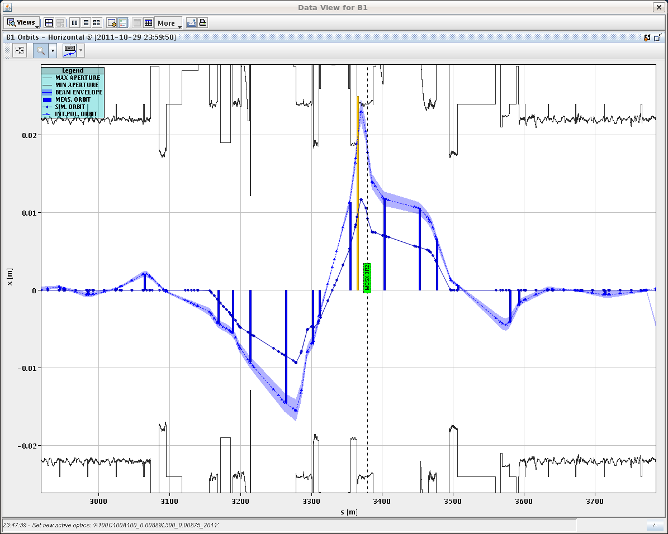
H plane B1
Observed aperture limit consistent with triplet AP!
J.Wenninger et al.

Slide 25
From 80 to 140 urad
Operation at 140 urad requires 2.8 mm more orbit margin (peak) in the triplet.
Beam size with ε=3.5 um is 1.5 mm at beta* 1 m.
We need additional 2σ to accommodate the 140 urad crossing angle (wrt situation for the AP measurement).
>> minimum triplet aperture of 16 sigma with 80 urad to ensure that the triplet is >= 14 sigma with 140 urad.
Presently under discussion if the ion run can be done at β* = 1 m at IP2, or if one has to back off slightly

Slide 26
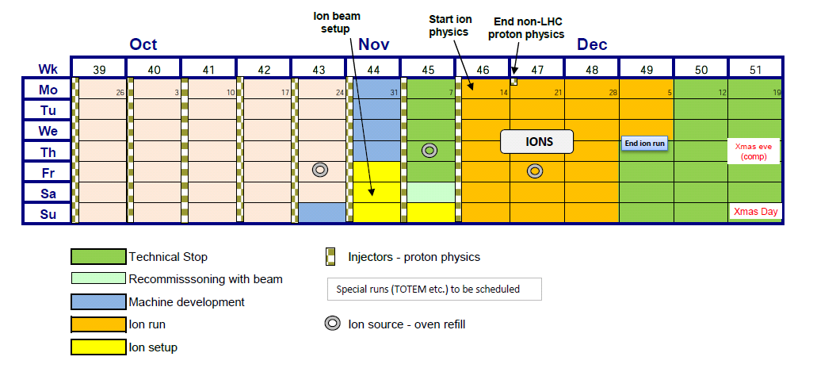
MD Program & Following
Slides Frank
https://espace.cern.ch/lhc-md/default.aspx
MD coordinators: Ralph, Frank & Giulia
Machine coordinators: Ralph & Gianluigi

