Slide 1
Thursday 27th October
00:57 fill 2257 dumped during squeeze (RQTF.A67B1)
03:52 stable beams fill #2258
4:33 Dumped, problem of LBDS dilution kicker power supply
05:50 MQ27L2 QPS not ok, Access required
08:17 Decide to also change the Beam Dump MKBH-B B2 power converter
Also access for MKA in IP4 and BLM IP8 change of filter
10:15 LHC ready for injection. Preparing for injection with increased satellites.
13:02 Beams dumped when attempting to inject B1 144b. "Quench" B8L2.
Recover magnets and check TL with injections on TI2 TED.
16:00 Prepare LHC for injection, steering of the transfer lines.
19:25 Filling for physics
20:51 Stable beams fill #2261, with enhanced satellites. Initial lumi's 3.2e33 and 3.7e30 (Alice) cm-2s-1
22:40 Cryo operator just told us that a vacuum pump on the cold box (QSRB) at point 6 stopped and the helium level on the box is going down. The vacuum piquet is coming: hope he arrives at time not to stop the cryo plant.
02:05 Beams dumped, lost the cryo maintain in MSR6. Integrated lumi: 51, 0.06, 50, 7 pb-1

Slide 2
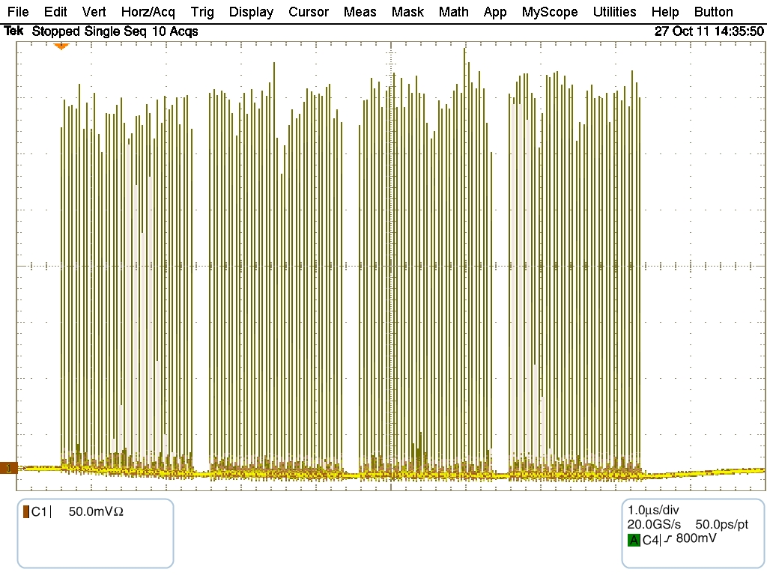
Fill with enhanced satellites for Alice
Wall current profile SPS beam
Average over sequential 10 turns, 20 ms before extraction
144 bunches with satellites
Satellites going up to about 8 %, average of few %
T.Bohl, S.Hancock

Slide 3
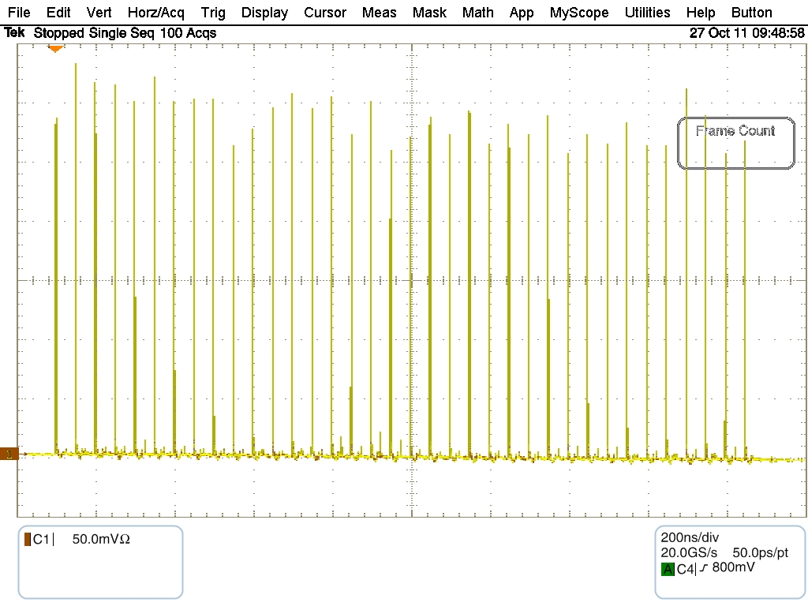
Same for 36 bunches, averaged over 100 turns

Slide 4
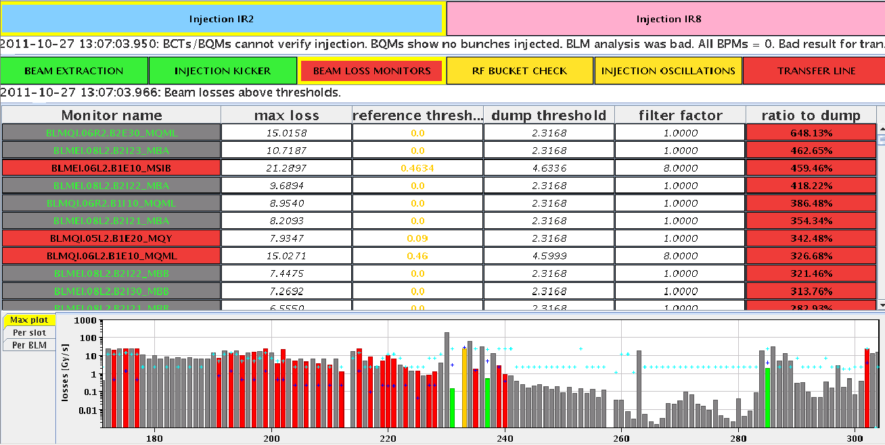
First injection of 144 bunches, B1
Losses on ring BLMs factor 6.5 above dump level!
Most likely due to injection problems in the SPS, blowing up the beams, and “corrected” by reduced scraping.

Slide 5
Losses in the LHC transfer line
All 156 bunches did end up on the beam dump (from XPOC)
The PIC interlock came 143 ms after the injection losses, the beam was dumped after 2.5 turns in the machine

Slide 6
The SEE “Quench” of dipole magnet B8.L2
The magnet quench is indeed due to a spurious self-trigger of a quench heater discharge power supply. Such an event has not been observed so far in LHC, also not during radiation test campaigns. The electronic circuit in question is made out of classical bipolar electronics supposed to exhibit a better immunity against SEU than modern devices.
This type of power supply has been successfully tested in the TCC2 area (year 2000 campaign) up to 380 Gy (sub-circuits including the trigger circuit were operational up to 1.1 kGy). To my best knowledge a spurious trigger can only be explained by substantial losses.
That’s what we had....
Reiner Denz

Slide 7
QPS signal dipole magnet B8.L2

Slide 8
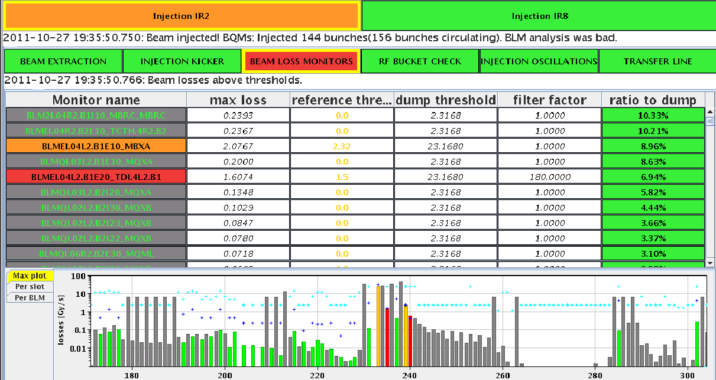
Tried to do better after this
Correction of beam into SPS
Injection with TI2 downstream TED in
Normal 12 bunches
Normal 36 bunches
36 bunches with enhanced satellites
All OK
Injection steering in LHC Transfer Lines and take fewer bunches first to play it safe
Fill for physics – injection VERY CLEAN !
Max losses in ring 10 % instead of 650 %
(second injection B1 even 3.2 % max)

Slide 9
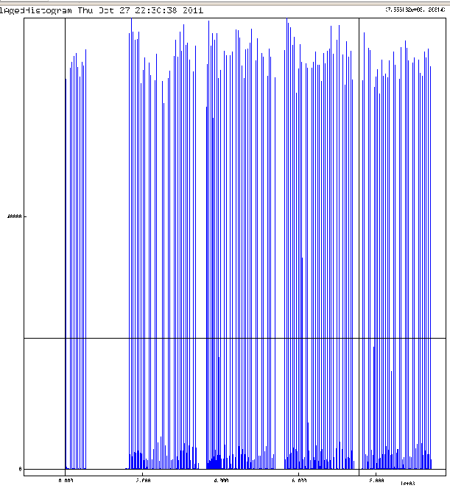
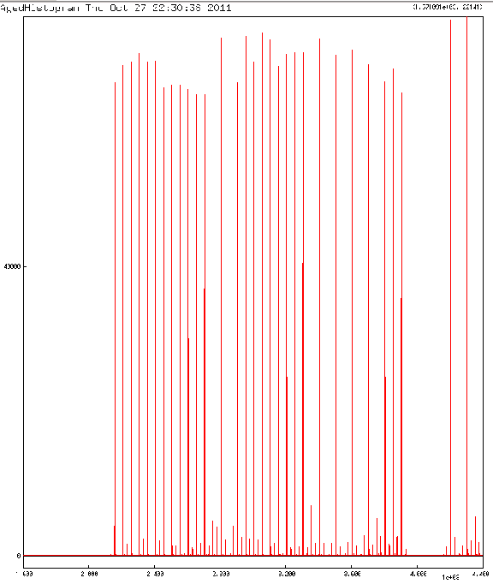
20:51 Stable beams fill #2261
Slightly reduced normal bunch intensities
Satellites visible
LDM:

Slide 10
Alice running 5e30 cm-2s-1 (instead of 0.5)
Luminosities Wednesday & until this morning
3500
500
5
ALICE would like to further increase their lumi. We arrived indeed at 7.1 and they asked to go back and stabilize to 6.8… finally ran at about 1.5e30 cm-2s-1

Slide 11
The Plan
Cryo maintain back around 9 am. Pre-cycle and take beam for...
... test of IP2 squeezed optics to 1 m and aperture measurements, in preparation of the ion run.
Scheduled for 24 hours (max, plan to finish earlier)
Ideally start around 8 am – will be more like 11 am
In Parallel: upgrade of Transverse Damper controls.
Normal Physics
Transverse Damper needs about 2 hours of checks with nominal beams before going back to physics
With or without enhanced satellites
Sunday 18:00: start of MD period

Slide 12
Today: 1 m Squeeze IP2
IP2 squeeze to 1 m (keeping present nominal settings throughout the cycle), and beta-beat measurements at (1 bunch/beam non-colliding at 1E10):
3 m (3.5 m for comparison to last year??)
2 m
1.5 m
1 m
Correction + beta-beat measurements
Aperture measurements (intensity < 6E9) with TCTs alignment (in case there is beam and time left, the IP2 Xing angles will be increased till a maximum of 140 urad (zero internal angle))

