Slide 1
90 m loss maps
Summary on loss map with 90m (RP HOR = 12 sigma, RP VER = 10 sigma):
Preliminary analysis done.
Leakage seen to RP locations and neighbouring cold magnets, into R1 & R5 for beam1, into L1 and L5 for beam 2
In horizontal plane, leakage is at the 2e-3 level.
In vertical plane, leakage is at the 2e-4 level.
OK for stable beams with intensities of up to 1e13. This intensity would give comparable absolute losses into the LHC cold magnets as during standard physics (compared to IR7 DS magnets).

Slide 2
90 m async dump
Check of asynch dump at 00:37 on 19/10 with RPs in...
Losses on XP/TCT/triplets at or below 1e-5 level for B1 and 5e-5 for B2
Losses at triplets and XP are slightly higher than the losses seen on the TCTH elements (factor ~1.5)
BLM data in XPOC seems to be incorrect for B2 - do not see the losses at the dump elements - experts to check
Can conclude that dump protection elements are protecting triplets, XPs and TCTs, and that TCTs are not protecting XPs/triplets at these settings Brennan Goddard

Slide 3
Wednesday 19th October
Optics measurements >>
11:25 Beams dumped
Reasonably smooth injection, ramp, unsqueeze
Starting scraping with TCP.D and TCP.C for both beams for TOTEM
16:39 Self-triggered beam dump
Energy tracking verification error on MKBH B, beam 2.
Dumped due to BEI card on MKBhB beam 2.
18:15 beams back in
20:35 All IPs optimized
Despite small emittances at injection, ended up with larger beams at flattop than the fill before. Transverse damper sensitivity was set to also damp pilots.

Slide 4
Wednesday evening
22:12 Scraping with TCP.D6R7.B2 to 4 sigmas complete
A very patient Gianluca
22:37 Beams dumped RQT13.L4B2 tripped
just when scraping was complete for both beams...
Access required (Greg Hudson). RQT13.L4B2 has the power converter replaced
ADT thresholds reverted to nominal by Daniel Valuch
Switch to Van der Meer program with appropriate safeguards
TOTEM and ALFA have removed their override keys: they cannot move outside stable beams;
OUT thresholds loaded: they will be active until stable beams;
Prepared Physics settings for ALFA: they will be loaded in stable beams; we have ~1 sigma retraction from the physics settings at 10 sigmas used for loss maps;
TOTEM pots will remain out.

Slide 5
Thursday morning
Injection, ramp and squeeze:
1 probe per beam over injected
36 "nominal" per beam: N ~9-11e10p/bunch, 3-4 um emittance
16 private for ALICE; 16 private for LHCb; 4 private for ATLAS/CMS..
4:30 During squeeze (~65 m) beams dumped by SIS interlock on B2 COD settings.
SIS settings not relaxed as required for 90 m – nominal restrictions in place
The check of these CODs was later disabled by JW.
Back to the 90m physics with tight Roman pot settings.
Prepared the injection with the hybrid scheme and reverted all the interlock configurations for this operation configuration.

Slide 6
Thursday morning
OP team getting pretty good at injecting, ramping, and unsqueezing and wirescanning
08:15 back into unsqueeze

Slide 7
Summary of the beta-beat measurements:
Measurements were conducted with corrections implemented during the previous 90m MD (5th of May 2011).
The beta-beat in both beams before corrections was ~30%, after the corrections this was reduced to 10% level.
For beam 1: The normalized horizontal dispersion has been slightly reduced. The error bar is worse than for the measurement at 5th of May.
Vertical dispersion is comparable to previous measurement. The error bar is worse than for the measurement at 5th of May.
For beam 2 off-momentum, off-line analysis will be needed.

Slide 8
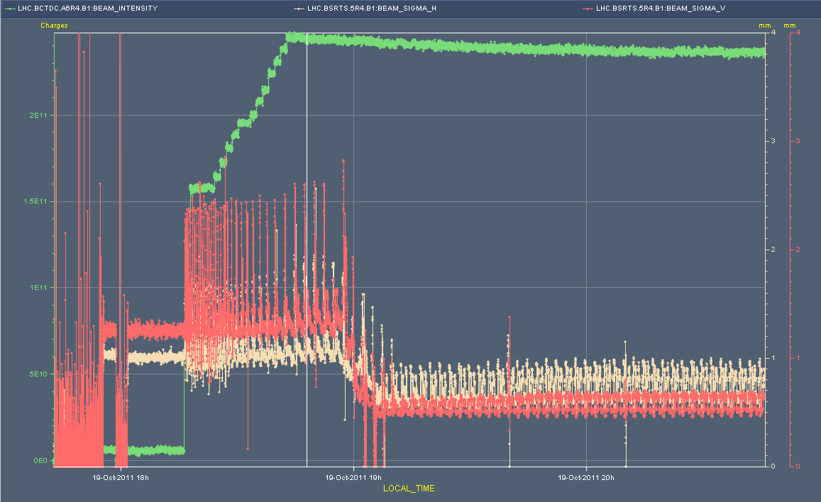
BSRT beam size

Slide 9
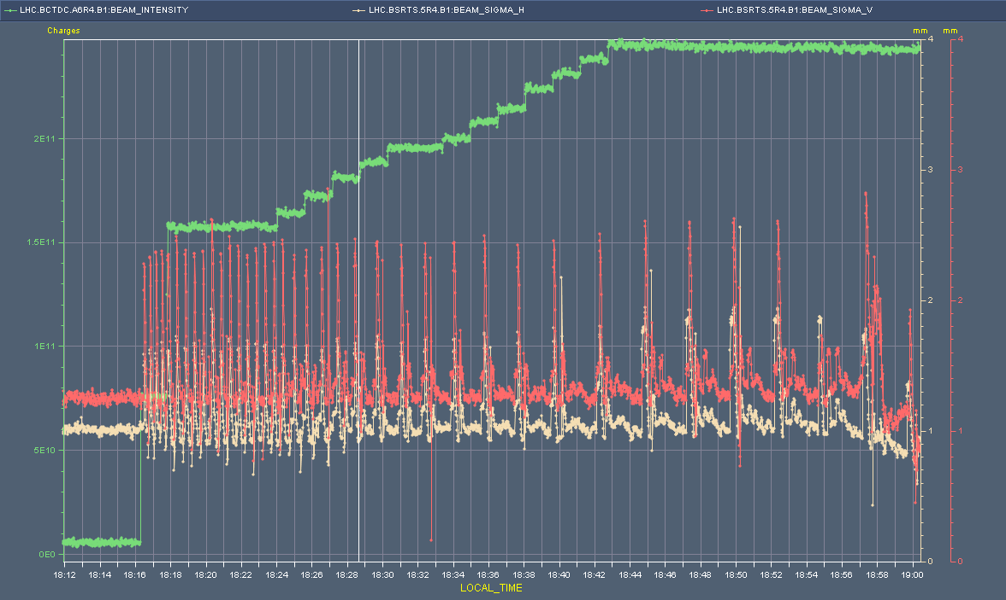
BSRT beam size

Slide 10
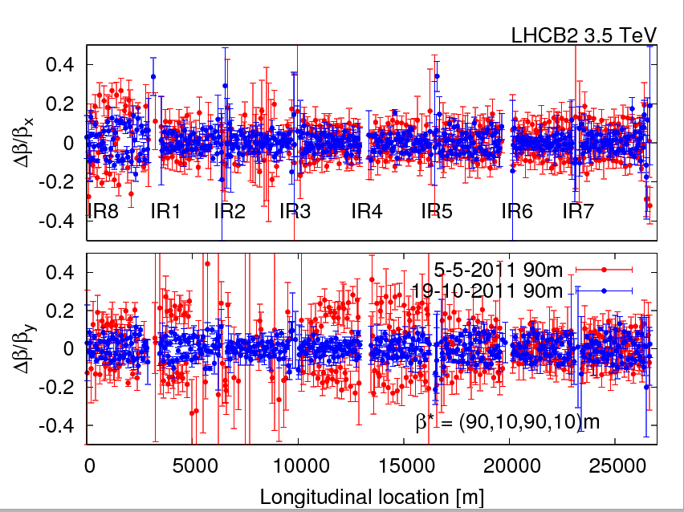
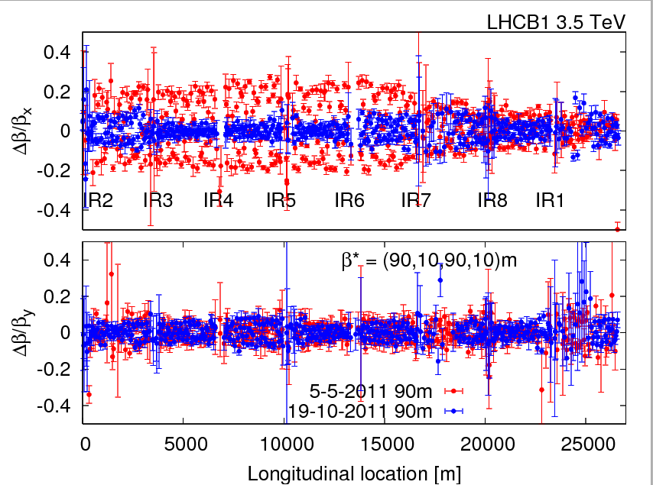
Beating
Rogelio, Glenn et al

Slide 11
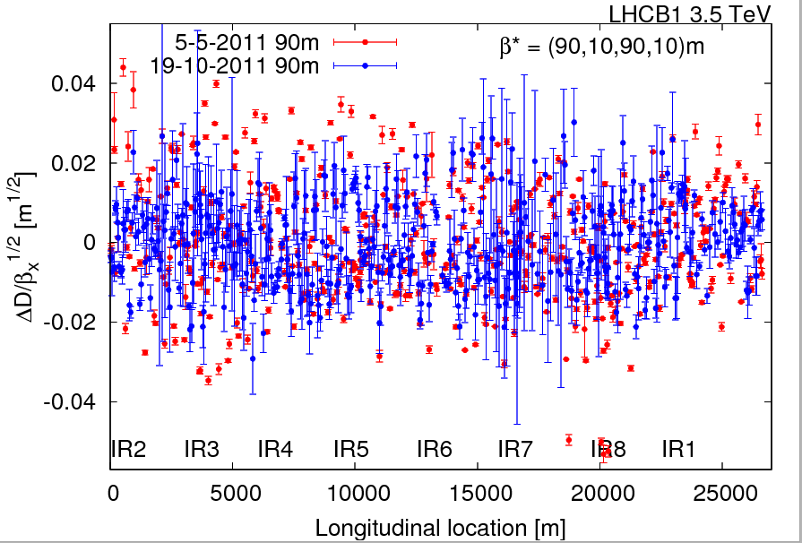
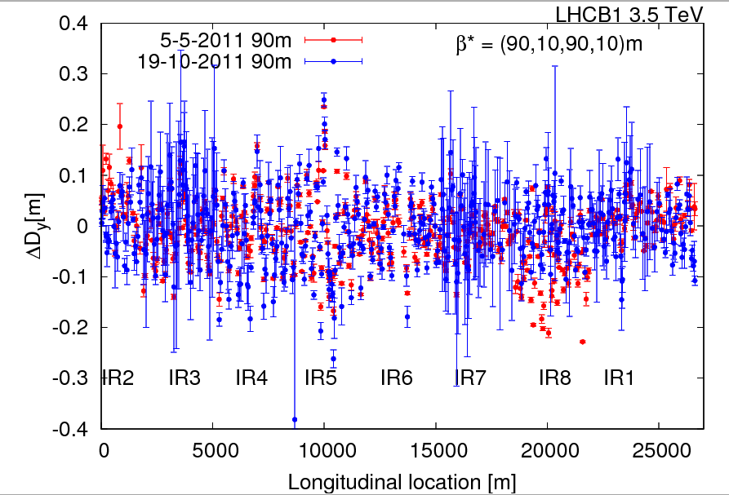
Dispersion
Rogelio, Glenn et al

Slide 12
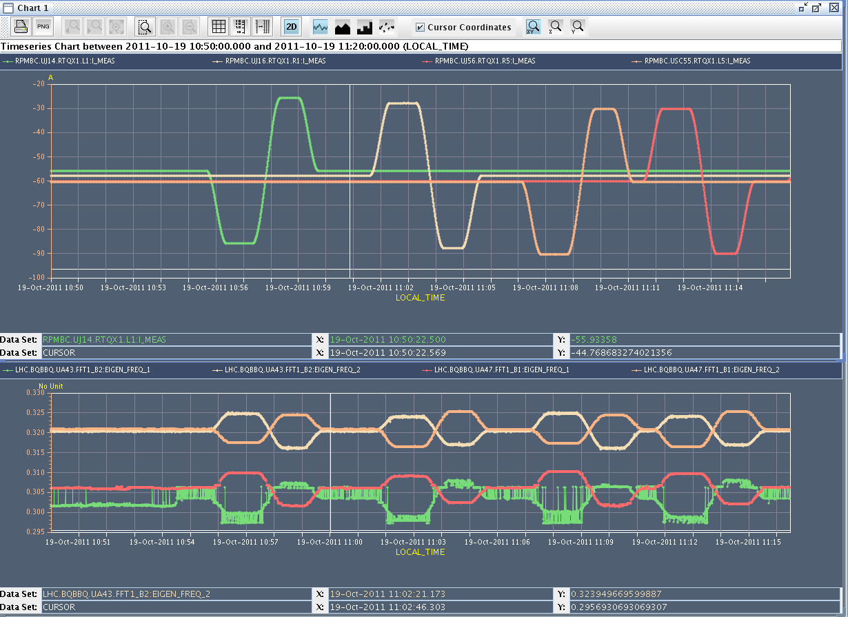
K modulation
Marek, Rogelio, Glenn et al

Slide 13
Incoming
Data taking until around
VdM evening/night
Possible loss maps as stocking filler, no high luminosity
24 hours for 25 ns provisionally starting at 08:00 Friday

