Slide 1
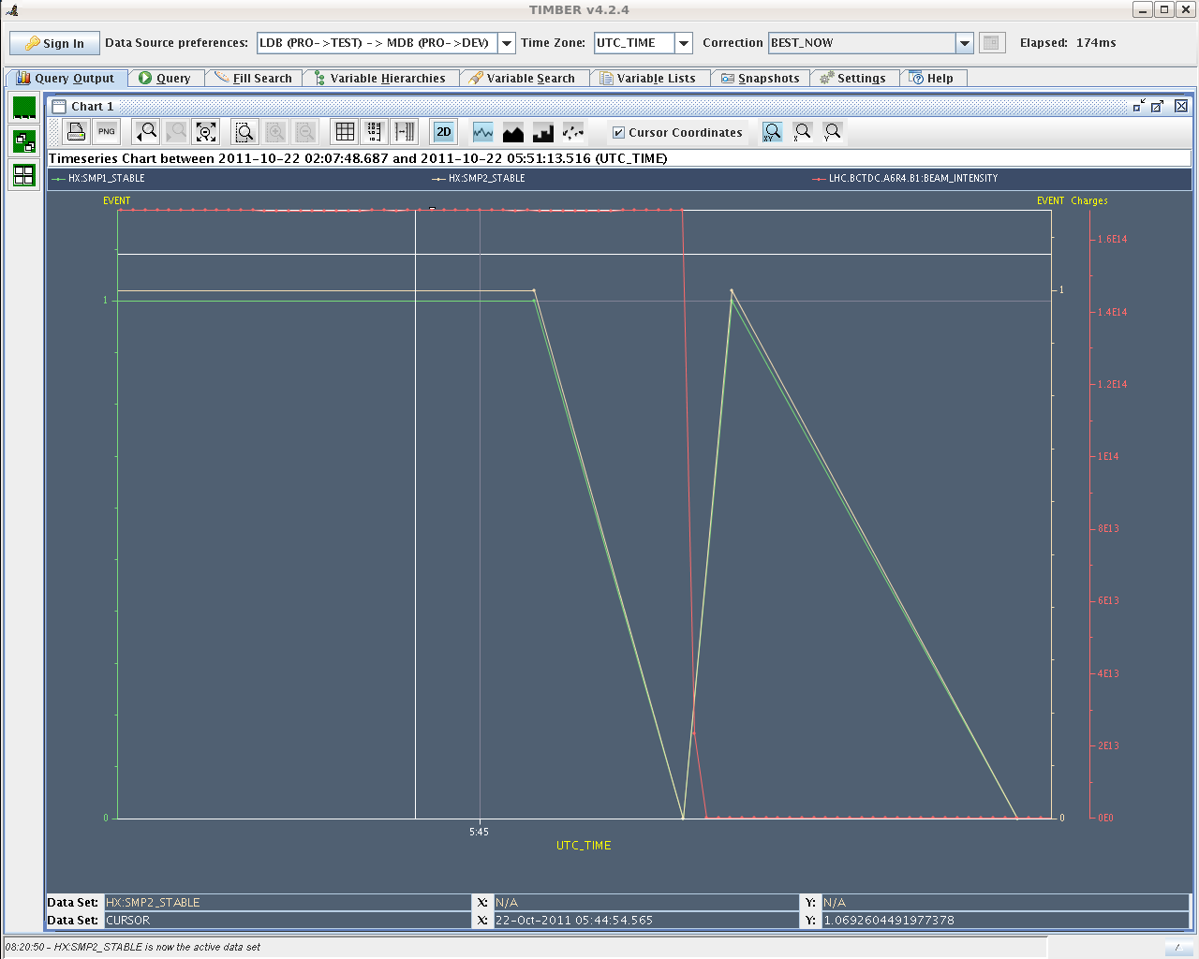
LHC Status Sun Morning 21-Oct
Bernhard Holzer, Mike Lamont
Reminder:
06:45h Stable beams
07:45h Dump: LHCb triggered (possibly a glitch of the stable beams flag)
From timber we see a glitch of the stable beam flag and
movable devices allowed flag
08:34h Injection, Ramp Squeeze
clean & straight forward
I1
b1
b1

Slide 2
Sat Morning
1.4*10¹¹
11:14h Luminosity
16:43h Luminosity
Giulia from vacuum called: increase of vacuum in CMS
visible since 12h48. We called the experiment and they
confirmed there is a that time an increase of background. To be
followed up.

Slide 3
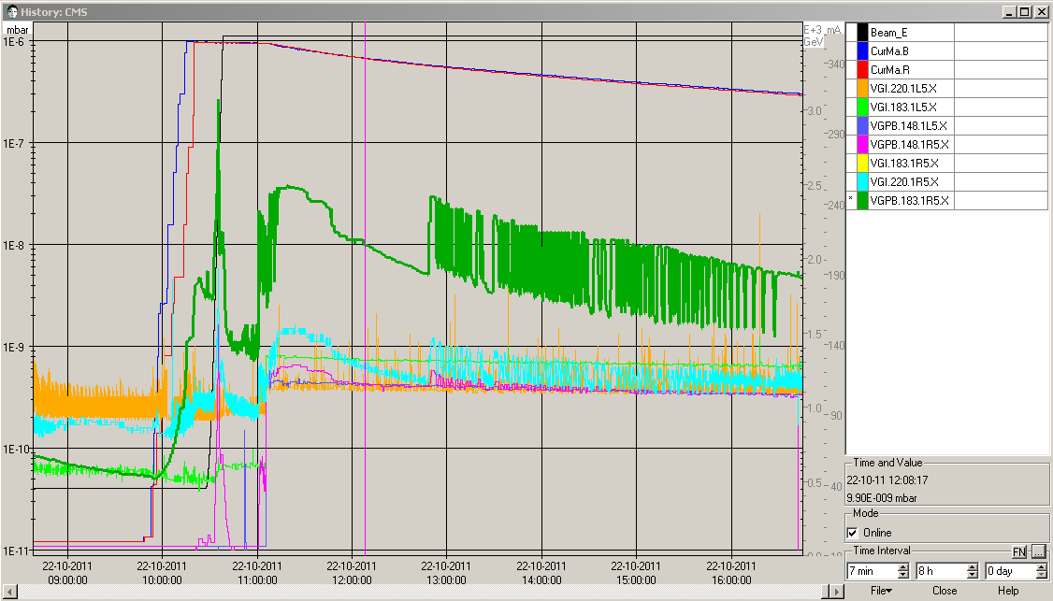
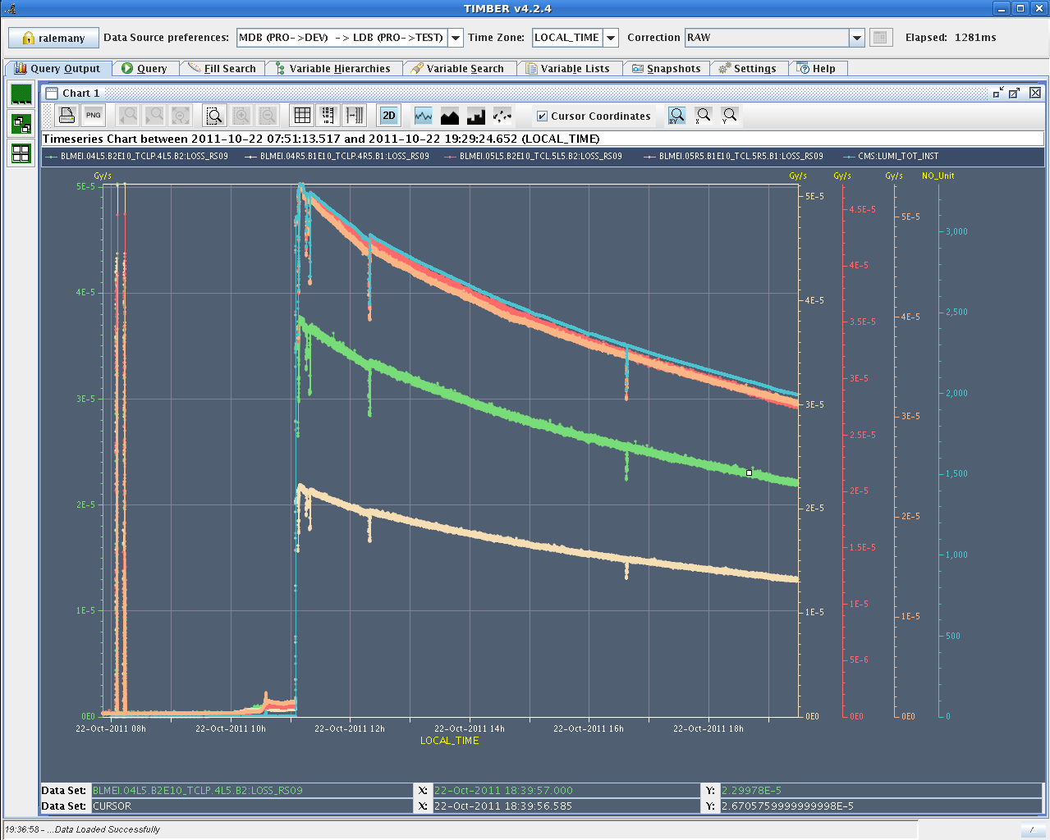
Sat Late
VGPB.183.1R5x
VGI.220.1R5x
stable beams,
12:48h vacuum ... ?
VGI.220.1L5x
10⁻⁸
10⁻¹⁰
12:48h
cms lumi signal,
local loss rates

Slide 4
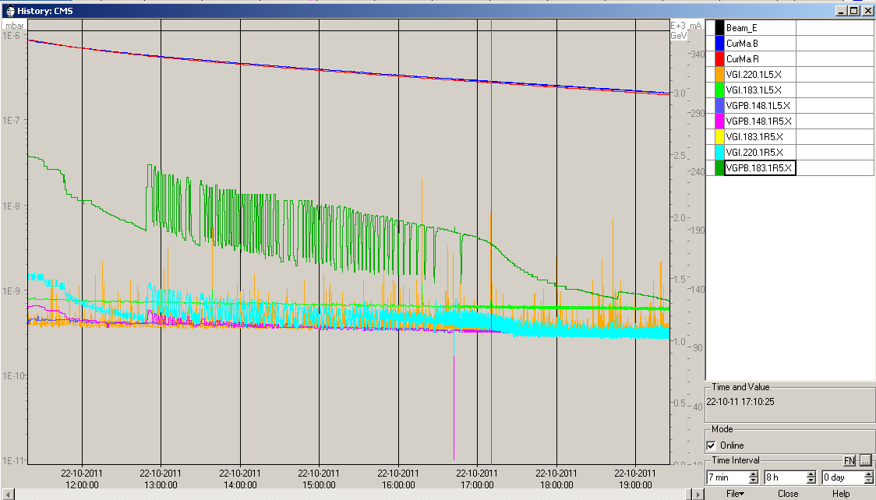
Sat Late
19:25h still stable beams
... and stable vacuum now !!
Apology: Orbit correction without separating LHCb -> luminosity jumped to 460 Hz/ub
-> separate LHCb in the vertical plane before correcting the orbit
01:45h Dump: Dump due to QPS trigger on RCBXV2.R1
12:48h

Slide 5
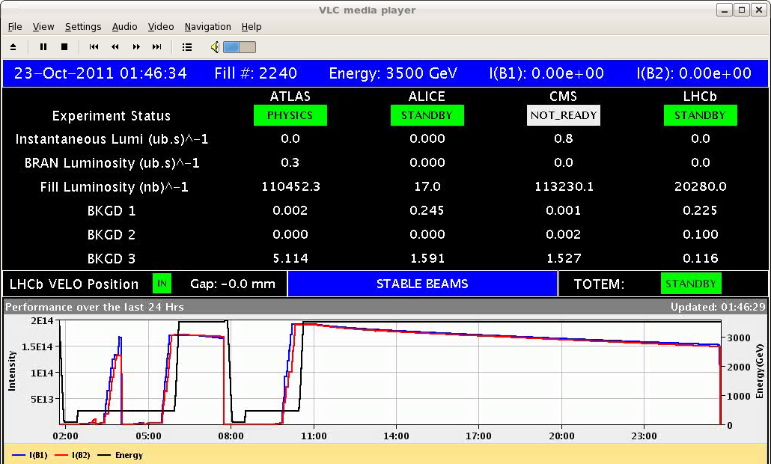
Sun night
113 pb ⁻¹ accumulated in 14.5 h
01:53h Restart: small rf problem: line 5B2 didn't switch off on RF-LL piquet & everybody is happy again.
03:16h Collimator is interlocking. Right jaw does not move (TCL.5r1.b1)
piquet & everybody is happy again.

Slide 6
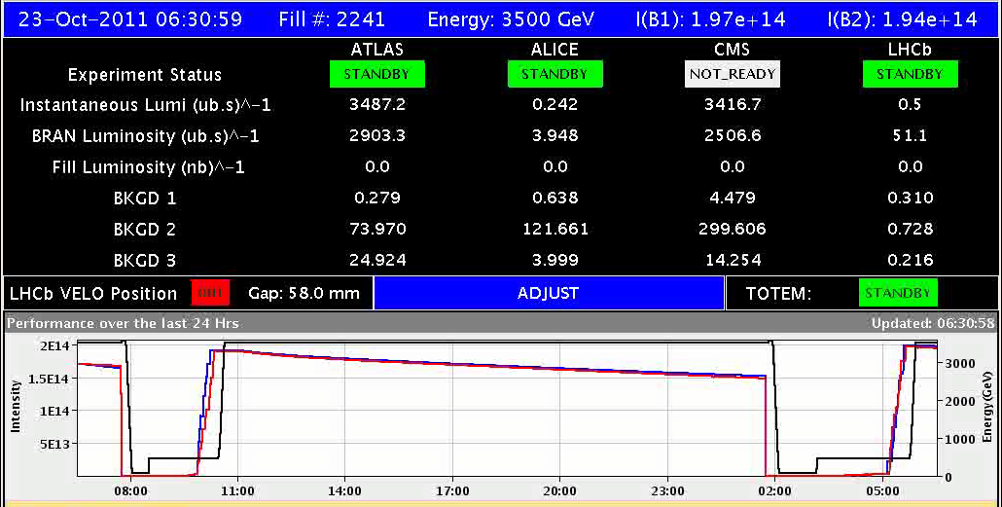
Sun Night
03:56h Injection
Emittances B1H = 1.56 B2H = 1.9
B1V = 1.39 B2V = 1.9
05:45h ramp, squeeze, lumi

