Slide 1
2011-10-06 TE-EPC PIQUET BAD MANIPULATION
07:00 Alice dipole down. 400kV Glitch informed by TI operator [OP eLogBook].
07:15 TE-EPC Piquet called by the TI for analysing the alarm on EMT401 - ALICE Dipole mentioning also an electrical glitch
07:22 TE-EPC Piquet asked to the CCC a PO-LHC-Piquet token (RBAC) for analysis
PO-LHC-Piquet token gives the permission to get the status and control all the LHC converters (machine AND experiments)
He selected ALICE DIPOLE converter with FGCRun+ (TE-EPC Diagnostic Tool)
He used the get command to read the status
And reset ALICE Dipole converter remaining faults by the command ‘s pc of’ which has two functions (reset and put the converter OFF)
After finishing the analysis of ALICE dipole converter trip, TE-EPC Piquet wanted to check the status of all the LHC machine converters to see what was the impact of the electrical glitch
He selected all the LHC converters (machine AND experiments)
Instead of using again the ‘get status’, he applied the last command by error: ‘s pc of’ to all LHC converters
As consequence, all the converters ON were stopped including CMS and ATLAS converters

Slide 2
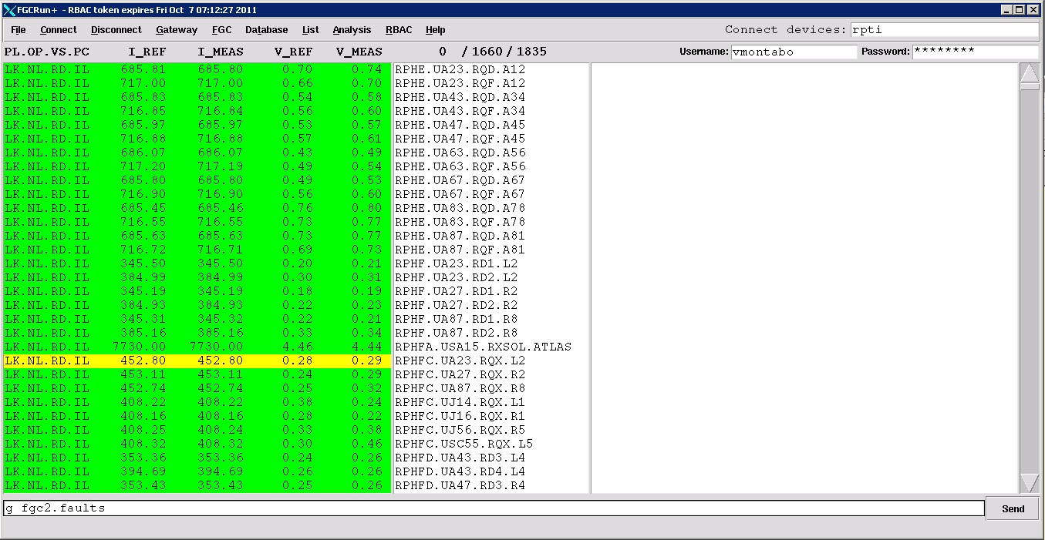
2011-10-06 TE-EPC PIQUET BAD MANIPULATION
FGCRun+ Tool

