Slide 1
Monday 26th September
7:30 Beam dump, QSP on RQX.R1, lost cryo in ITR1, 91 pb-1.
Cryo recovery, needed about 1.5 h.
Setting of TI2 collimators to 5 sigma – reduces losses in the line a bit but no miracles, effect of change to be studied in more detail
11:15 Injection
12:48 Stable beams fill #2157, initial L = 3.2e33
14:37 Beam dump, RF klystron vacuum, int lumi = 19 pb-1
Measured and adjusted the Orbit-FB's calibration factor for the B2 dispersion orbit suppression – indicates a positive effect
17:43 Stable beams fill #2158, initial L = 3.1e33
22:31 Beam dump, PC triplet R2, int lumi = 43 pb-1
23:45 Access PO for triplet – exchange a power module on RQX.R2
QPS-OK was found missing for RQTL11.R5B2 – needed power cycle
02:45 Injecting again – injection not very clean
05:09 Stable beams fill #2160, initial L = 3.0e33
07:04 Beam dump, 4 circuits tripped in sector 56, likely SEU, int. L = 19 pb-1

Slide 2
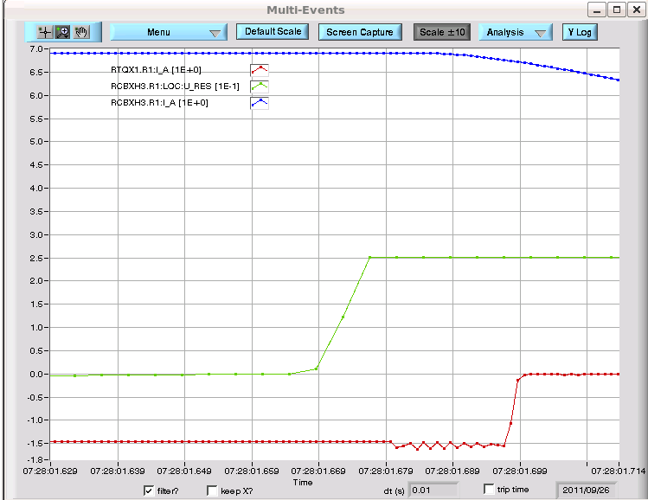
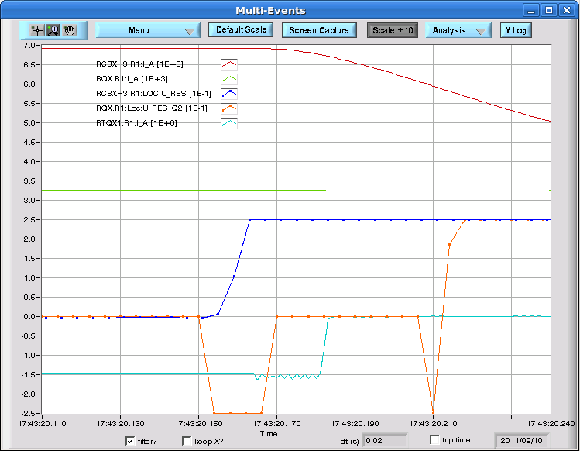
QSP on RQX.R1
Similar event as Sep 10th, where the QPS signal of Inner Triplet.R1 saturates and heaters were fired: SEU?
Cryo lost for this IT.R1 due to the quench heater firing, but recovered after about 1.5 hour
The only signal from QPS is on the RCBXH3.R1, where the U_res increases and saturates at 250 mV; there is no PM from the main circuit
Yesterday
10th September

Slide 3
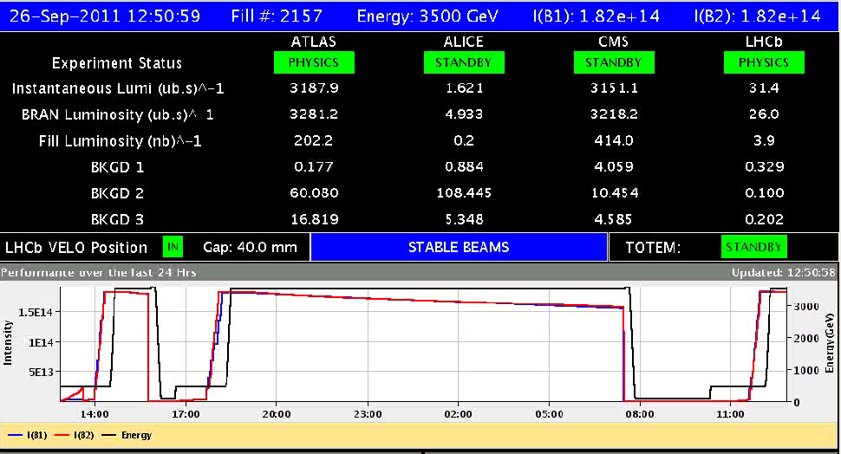
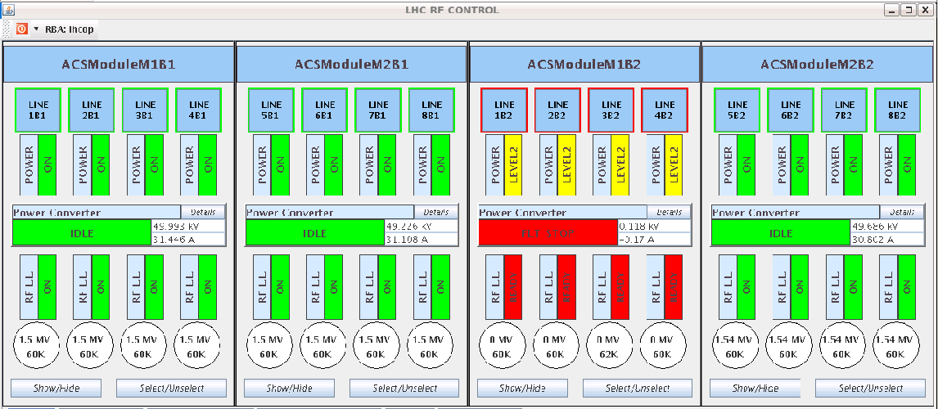
Fill #2157
Dumped by RF klystron 2 vacuum 2 interlock B2: reset and refill....

Slide 4
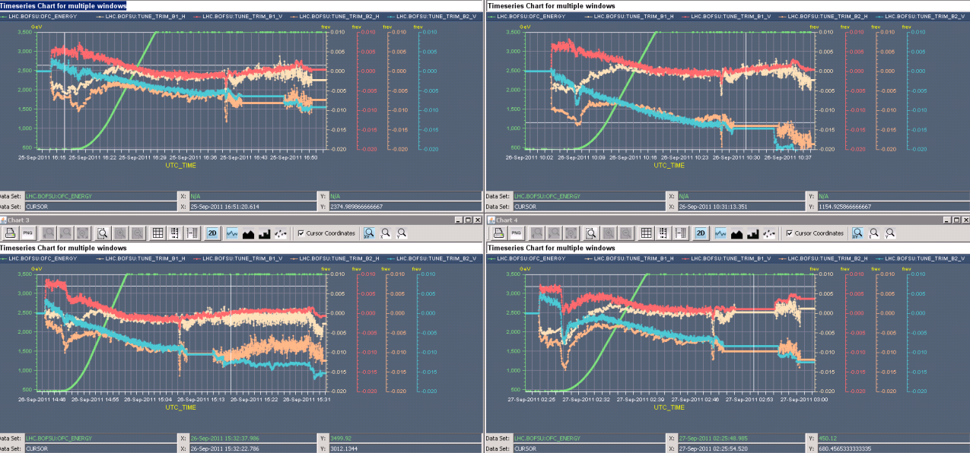
Tune Feed Back switching off during squeeze
Tune-FB B2 seems to systematically switch 'off' during the middle of the Squeeze, possibly due to large coupling deviations.
Test ramp with two bunches, step through squeeze for coupling corrections

Slide 5
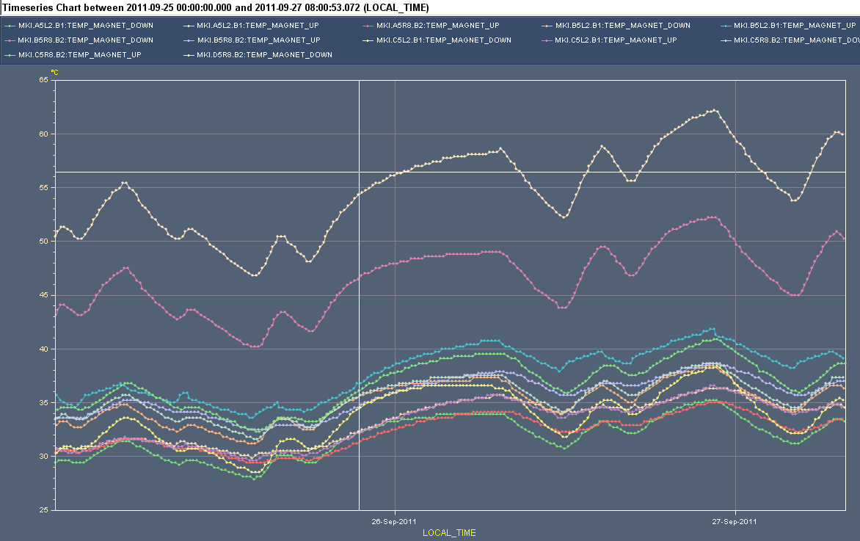
MKI “integrated lumi measurement”
Injection kicker MKI magnet reaching 62.5 degrees
1 degree above injection threshold

Slide 6
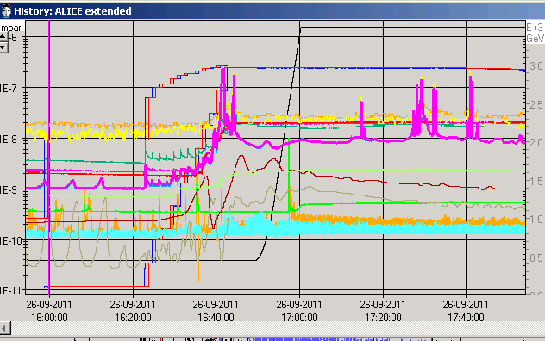
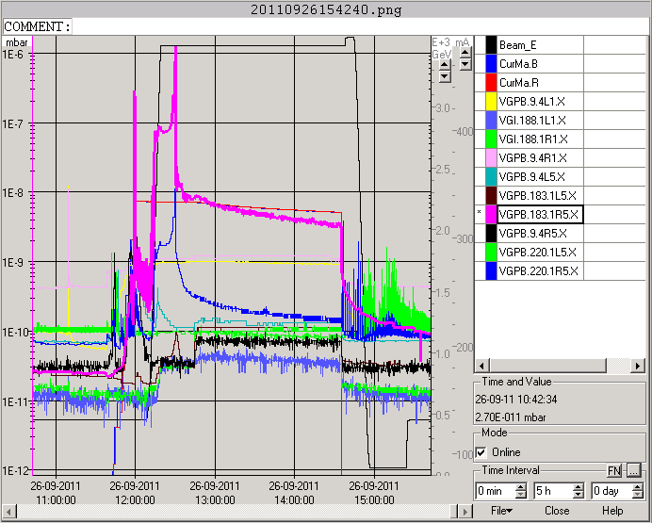
Vacuum – better but to be watched
1e-6
VGPB.123.4L2 - ALICE
Better
1e-6
VGPB.183.1R5 - CMS
Peak 1e-6 mbar on morning ramp

Slide 7
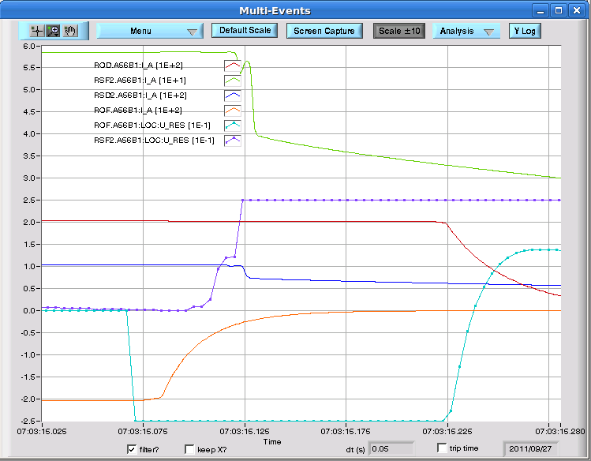
07:04 Beam dump
the U-res of ROF.A56B1 is suddenly going to saturation and the circuit trips; the other circuits tripped by coupling.
problem with the MQ.21L4 (quench buffer in progress)
Access required
XPOC no BCT data – old problem which was thought to be solved….

Slide 8
Plan Produce lumi, except:
Tuesday
Access MQ.21L4 (quench buffer in progress)
Switch powering configuration
Change LHCb polarity
Test ramp with two bunches: step through squeeze for coupling correction to solve tune feedback problem
Test ramp for abort gap cleaning at 3.5 TeV with 36 bunches
Friday
06:00 dump physics fill
90 m optics until Saturday morning 07:30
Saturday
Am: VIP visit – machine access
Close and search before noon

