Slide 1
Tuesday 20 September 2011

Slide 2
Fill # 2129
Stable beams: 10:05 – 20:27 (RF trip of Line 2B1 – probably noise on a sensor)
Peak lumi: 3.25 10³³ cm⁻²s
Delivered Lumi: 78 pb⁻¹
Test of e-cloud solenoid installed last week at recombination area right of IP2:
The test of the changes in current are inconclusive (no significant pressure change observed)
Either the solenoid has no effect, or the field was not strong enough to give a noticeable effect ( ie if it is a threshold issue)
→ The situation is to be followed up by the vacuum team

Slide 3
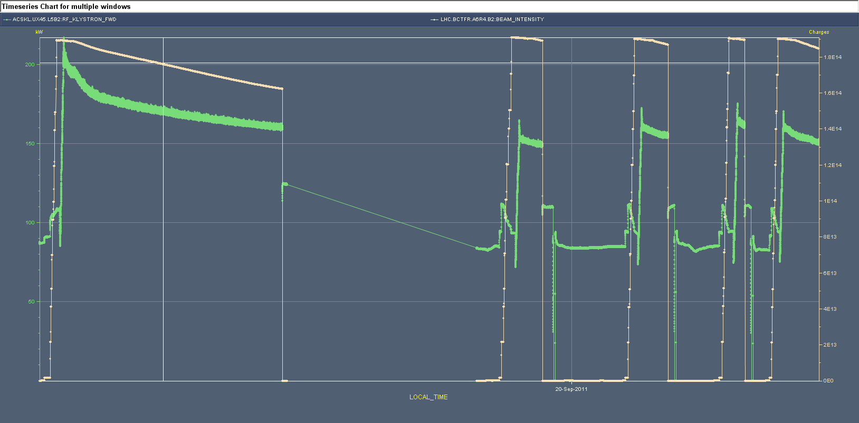
RF Intervention (Monday)
P. Baudrenghien: “We have solved the problem with klystron 5B2 that was pushed close to saturation power (> 200 kW) at the start of flat top. The problem was with the circulator: we fine-tuned the regulation of the ferrite current with temperature. We have also fine-adjusted the cavity tune. After that, the power was reduced to ~ 160 kW.
Klystron 5B2 output power and beam2 intensity for the last fills that made it thru ramping. The peak power is reduced from 220 kW (Fill 2124, before intervention) to 170 kW (fills 2126-2129, after intervention).

Slide 4
Issues
MKI data missing for 1 injection of B1
MKI point 8 kicker fall time – to be checked by experts
Problem with B2 tune measurement on the ‘continuous’ system
Investigation ongoing
Tune feedback B1 switched itself off and tune feedback B2 was switched off during for the squeeze from 1.5m to 1m (horizontal tunes manually adjusted by -0.005 for both beams)
BLMs > 30% of dump level at > 5s integration times:
MQX in IP1 and IP5
threshold increase pending
Alice background problems (vacuum)

Slide 5
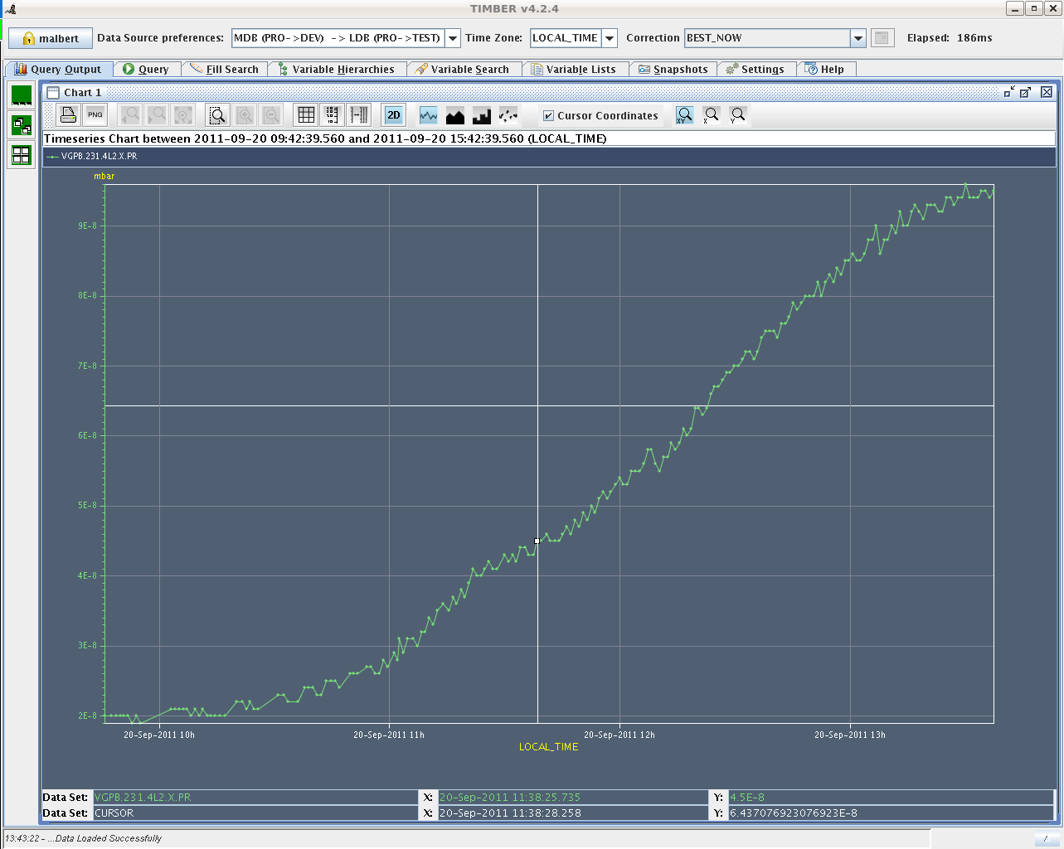
Vacuum left of IP2

Slide 6
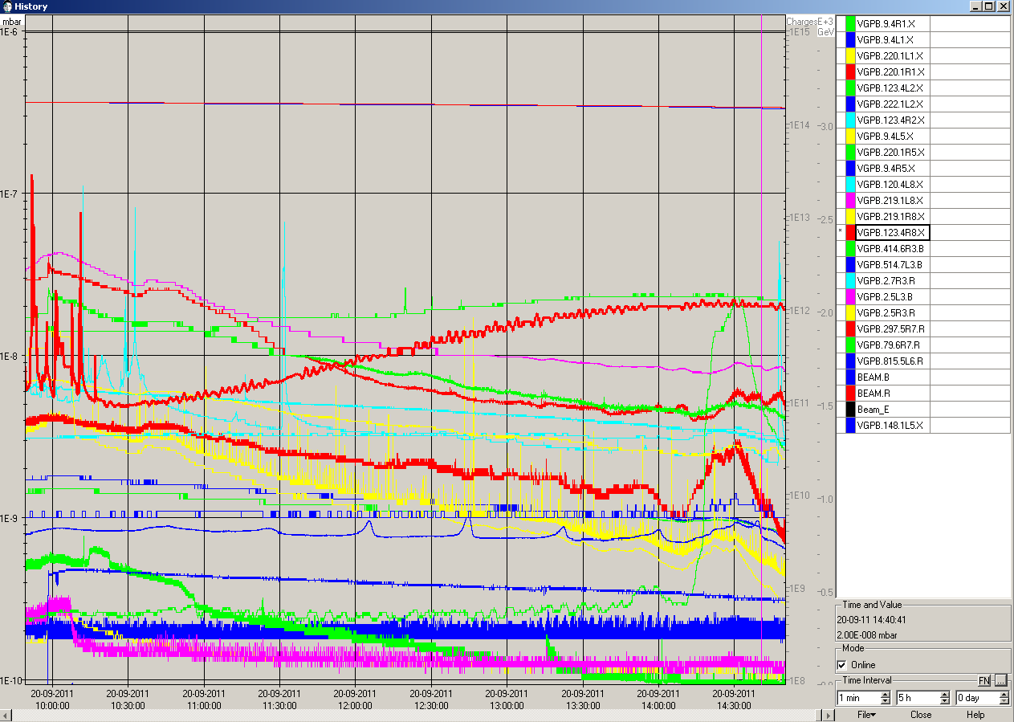
Vacuum stabilizing (14:30) at ~2E-8 mbar
Left of IP2
Right of IP8

Slide 7
Debunching – abort gap population – beam losses
P. Baudrenghien: “Yesterday we access UX45 and replaced the RF modulator card on Cav1B1. (This module had a problem 9 days ago – Friday 7 th – that was traced to a bad cable but we wanted to make sure that it was not the module’s connector). Being in a hurry we did not adjust the phasing of the clocks carefully enough and this placed one of the LLRF loop close to instability.
The “klystron polar loop” became unstable ~ 12:00 to-day, showing very large effect on voltage (dropped from 1.5 MV to below 1 MV), activity on phase loop, detuning of the cavity but barely any effect on the lifetime as the noise frequency was outside the Beam response (see attached fig). When we tried to cure it around 14:00, we restored the cavity field/tune but moved the noise spectrum close to the beam response, resulting in large debunching ~14:00 (1.2E11 p in abort gap corresponding to ~ 3.6E12 unbunched beam). The loss were stopped after opening the offending LLRF loop. Notice that the loss B1 resulted in very similar (although ~ twice smaller) loss in B2. There is no hardware coupling.
We then worked parasitically to solve the problem with the Klystron Polar Loop and have now restored it to normal state. Nothing special to be done for next fill.”

Slide 8
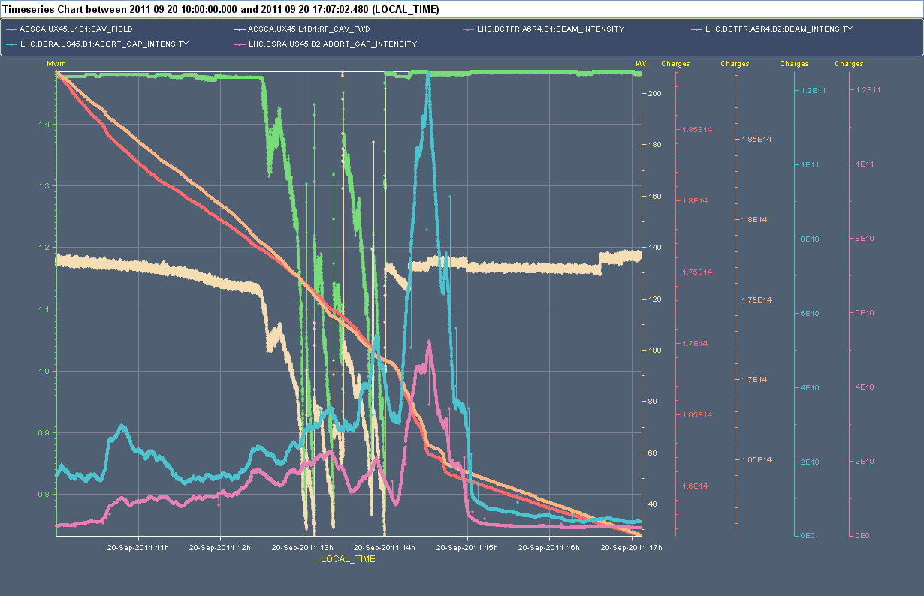

Slide 9
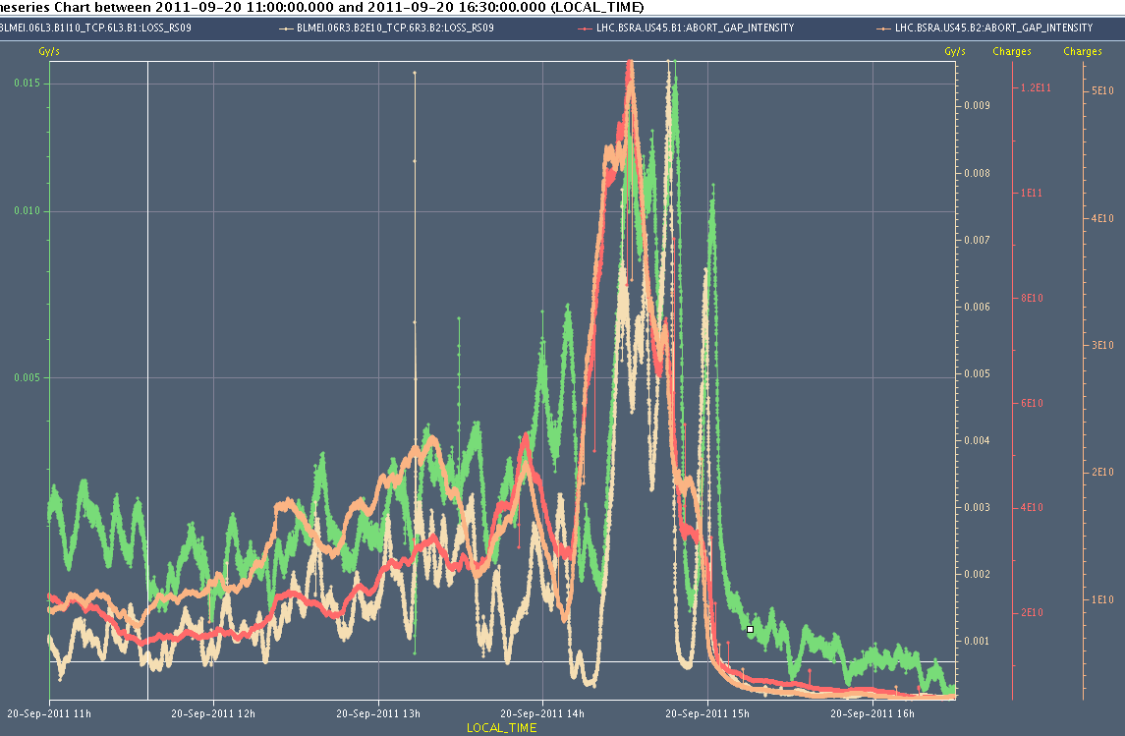
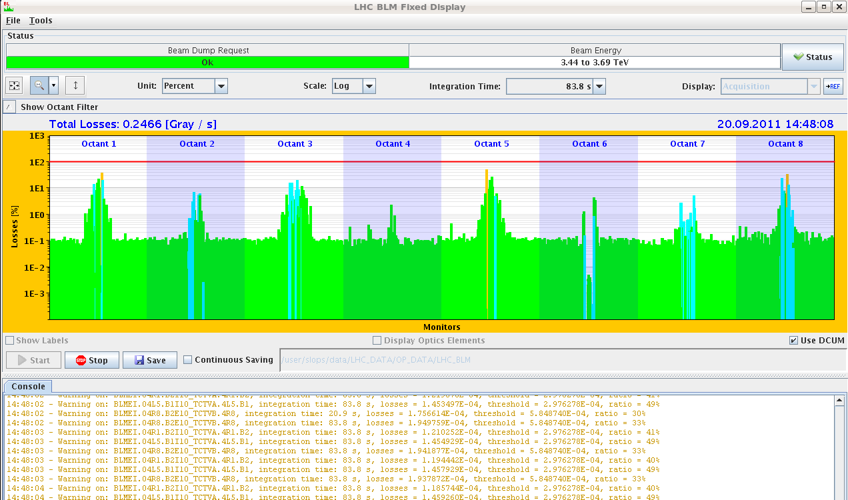
Beam Losses of the unbunched beam
TCTs right of IP1 and left of IP5 and right of IP8 getting close to dump level (up to 65%)
→ Problematic as we got close to dumping the beam with the abort gap still heavily populated

Slide 10
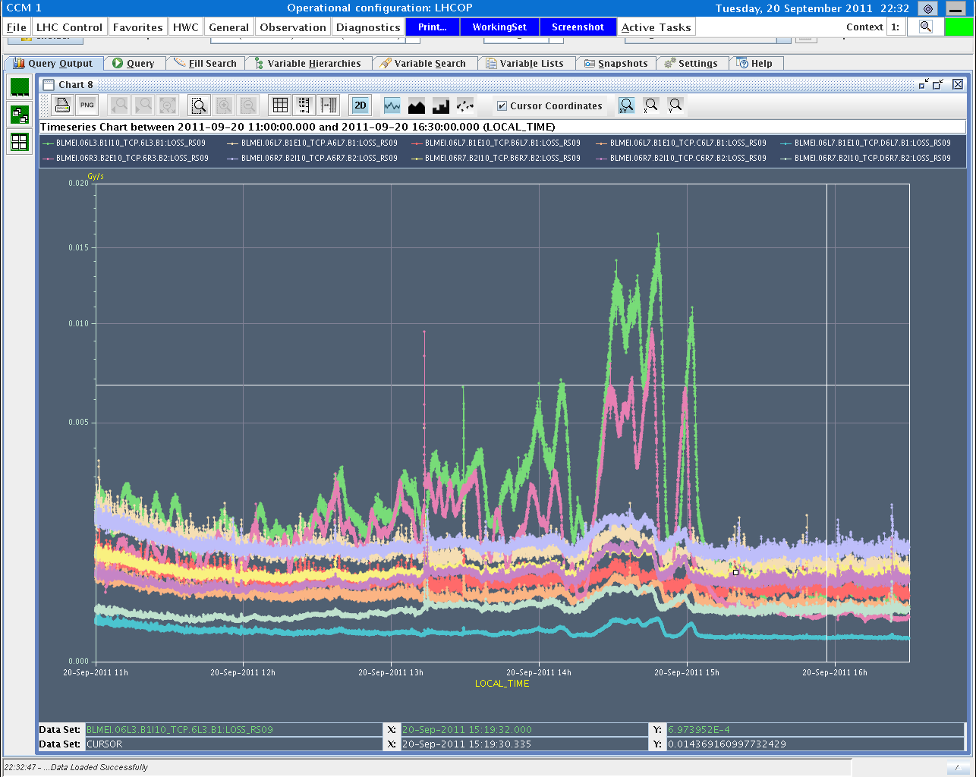
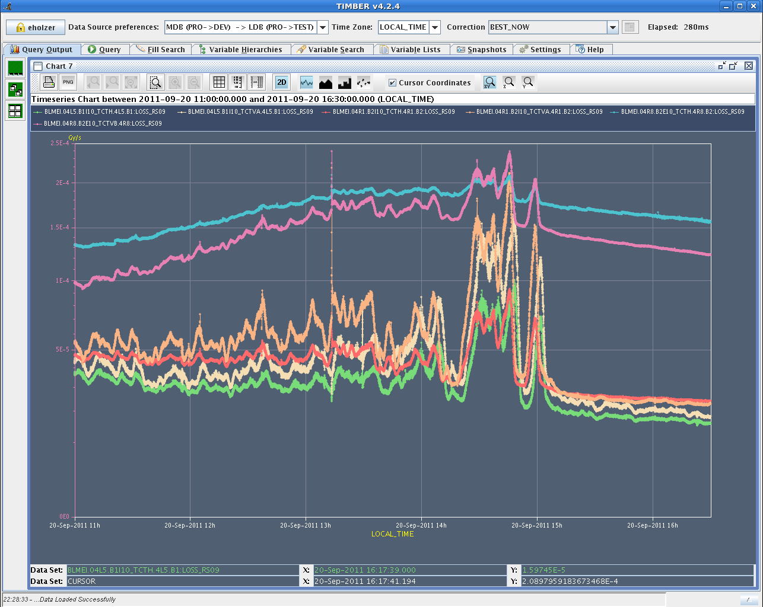
Losses TCT R8, R1 and L5
Losses TCP IP3
Losses TCP IP7
Losses TCT R8
Losses TCT R1 and L5

Slide 11
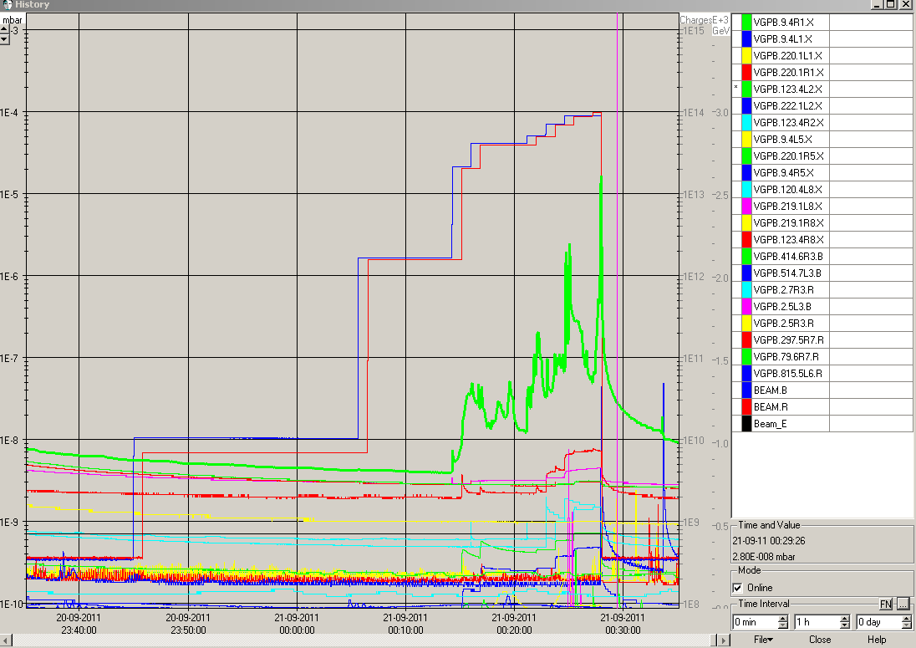
Night Tuesday to Wednesday
Fill # 2130 and # 2131 dumped by vacuum left of IP2 (average bunch intensity 1.41E11)

Slide 12
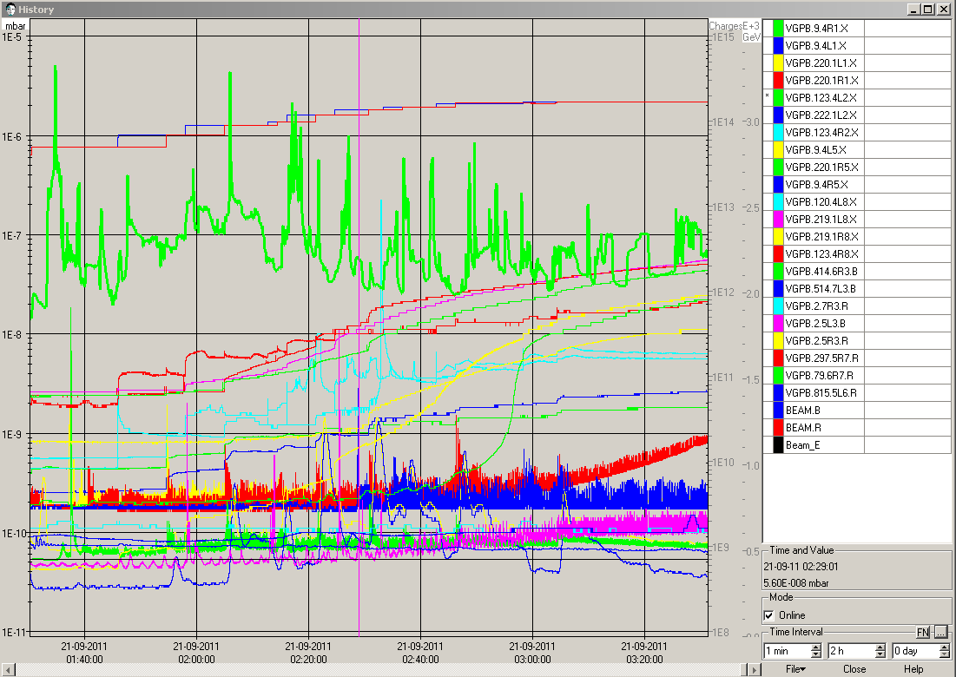
→ solenoid current 4L2 increased to 5A
Fill # 2132: 30 minutes scrubbing at 450 GeV (amplitude of spikes going down)

Slide 13
Average bunch Intensity reduced to 1.3E11
Fill # 2133 and # 2134 dumped by vacuum spike left of IP2

