Slide 1
Sat/Sun 17/18 Sep 2011
Until Sat 3:30: Stable beams.
Stopped by collimator temperature interlock.
Sat 7:00 – Sun 8:30: Cryo stop IR4 and recovery.
PLC problem due to SEU. Had this before in IR4, but now a different PLC. Need redundancy (being prepared).
Sun 10:00 – Sun 22:00: Repeated trip of ion pump and close-by RF module.
Change of power supply did not fix problem.
Found broken HV link between two ion pumps. Fixed.
Mon 01:44: Stable beams
Ongoing

Slide 2
Report Week 37 (R. Assmann & G. Arduini)
Highest stored energy: 107 MJ
Highest average bunch int: 1.39 ×10¹¹
Highest peak luminosity: 3.3 ×10³³ cm⁻² s⁻¹
Most productive fill: 117 pb⁻¹ in 16.5 h
Highest pile up for the experiments...
Above average efficiency: 31% in stable beams
Week production: 433 pb⁻¹
But could have been better: many problems, almost all weekend lost...
Cryo PLC problem in IR4
Vacuum pump in IR4
Injection issues
...

Slide 3
Statistics
Red = potentially intensity/luminosity related
Fill (nb) | L (10³³ cm⁻²s⁻¹) | Length (h) | Int. L (pb-1) | Dump cause
2101 | 3.1 | 3 | 32 | CL temperature sensor (RB.A56) SEU candidate
2103 | 3.2 | 8 | 70 | Doors pt. 4
2104 | 3.2 | 3.3 | 32 | CL temperature sensor (RQ6.R5) SEU candidate
2105 | 3.3 | 16.5 | 117 | Programmed dump
2110 | 3.3 | 6.5 | 57 | nQPS (DQAMGS.RB.A78.B9L8)
2117 | 3.2 | 8.8 | 75 | Temperature interlock on collimator TCP.B6.B1
2124 | 3.25 | >5.5 | >50 | ongoing
Total |  | 51.6 | 433
Integrated luminosity >433 pb⁻¹ in ≈1 week
Stable beams: >51.6 h out of 168 h
~31% of time in stable beams

Slide 4
Intensity and luminosity: Best LHC fill...
Beam energy
B1/B2 intensities
Instantaneous luminosity

Slide 5
Losses & Lifetime at Start of Physics

Slide 6
Week 37 seen from CMS...
3.3 × 10³³ cm⁻² s⁻¹
CMS missed initial lumi...
The best LHC fill
Tevatron
LHC 2010

Slide 7
Seen from ATLAS...

Slide 8
Peak luminosity (ATLAS)...

Slide 9
Integrated luminosity: 3.14 pb⁻¹

Slide 10
2011 Efficiency
Week 37 with 31% of time in stable beams was above average
(but felt much worse)

Slide 11
Changes/improvements
Installation of anti e-cloud solenoid right of Pt 2 (V. Baglin).
ADT gain changed for high bunch intensity (D. Valuch).
Beta* limits put on the tertiary collimators (S. Redaelli).
Collimator temperature interlock raised from 50 deg C to 55 deg C on skew primary collimators in IR7.
Cooling capacity increased to maximum for primary collimators and first two secondary collimators in IR7 (O. Aberle).
Cryo deployed R5 improved handling of cryo T sensor.
Access given for CMS pump problem: faulty cable on a temperature measurement. Resolved.

Slide 12
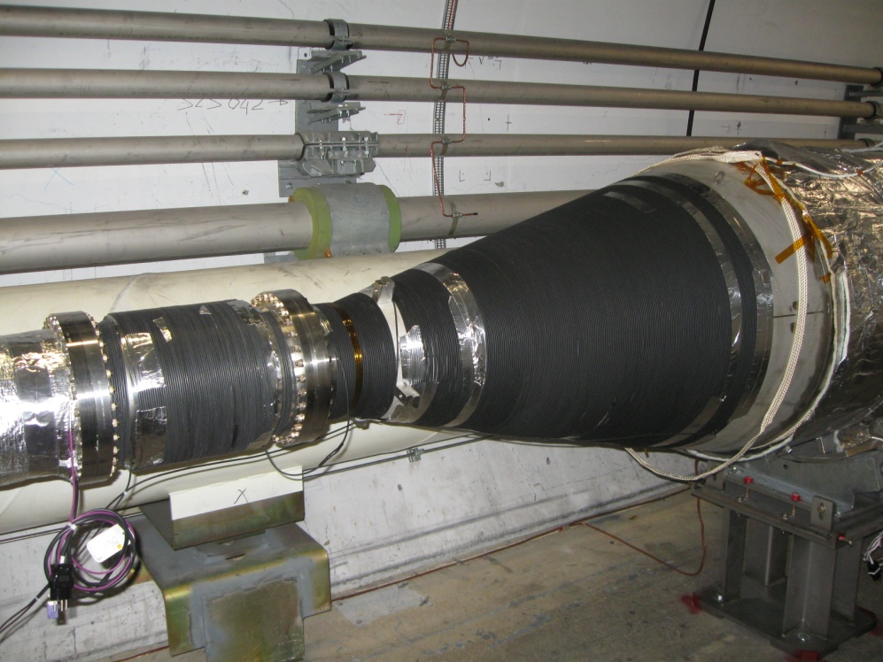
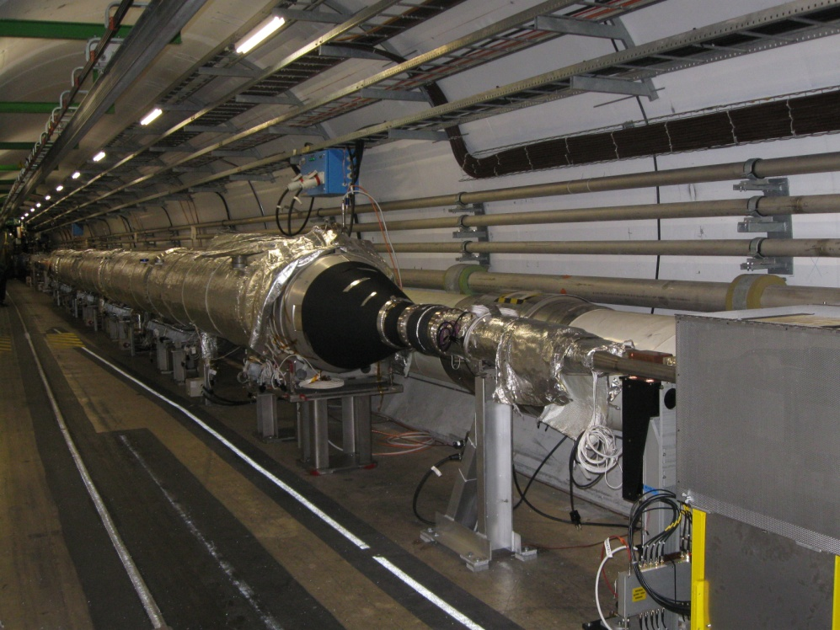
Anti e-cloud solenoids for IR2 (R)
Installation of anti-ecloud solenoid right of Pt 2 ➔ 500 m of cables installed and solenoid powered (V. Baglin and team)

Slide 13
Beta* limits
Beta* limits on new TCT functions (before physics) implemented
S. Redaelli

Slide 14
Problems (week ended Friday night)
Beam-related issues
Vacuum in point 8
Background in ALICE
Heating of collimator
Problems encountered with time lost:
Cryo PLC problem ➔ 25 h
Vacuum pump in IR4 ➔ >12 h (until Sun 22:00)
Injection tuning ➔ 10.5 h
Controls network ➔ 8.5 h
Collimator controls ➔ 5 h
Access system ➔ 4 h
BPM interlock limits ➔ 1.5 h
Total: 66.5 h

Slide 15
Vacuum & Temperature IR8

Slide 16
IR8 Losses

Slide 17
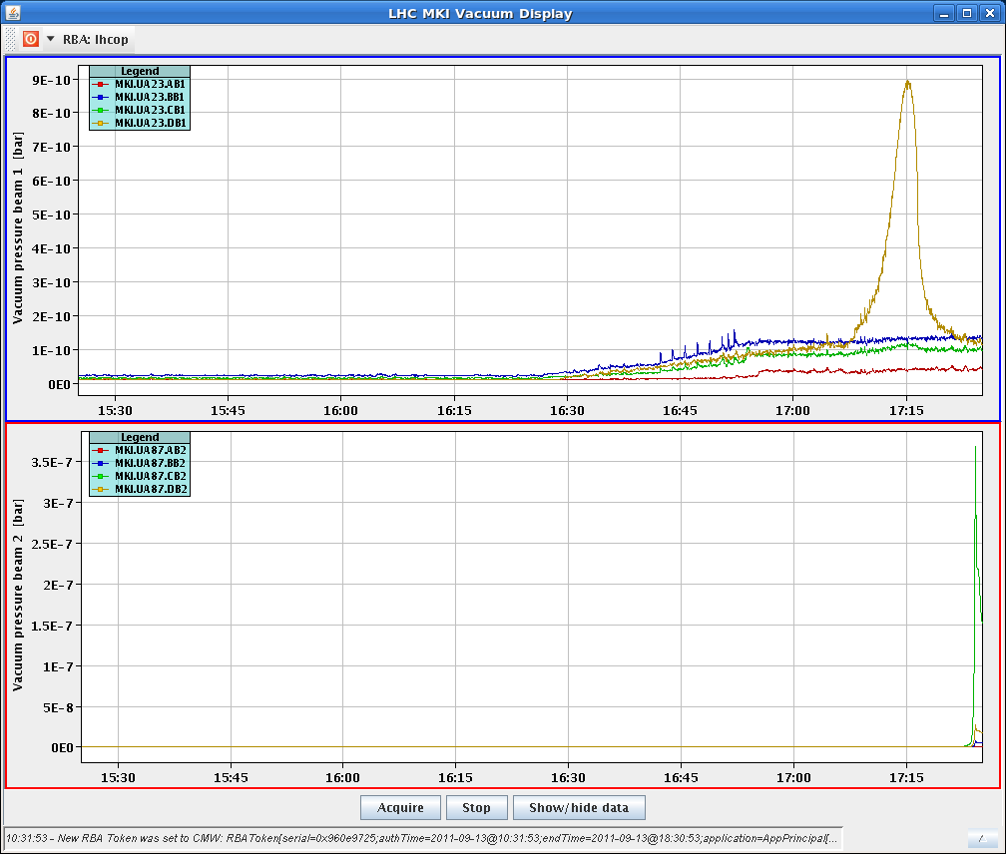
IR8 MKI Vacuum Spikes
Vacuum pressure spike on MKI in point 8 during the squeeze (e-cloud solenoids are on). Local orbit drift during the squeeze leading to e-cloud build-up in the magnet?

Slide 18
MKI Heating

Slide 19
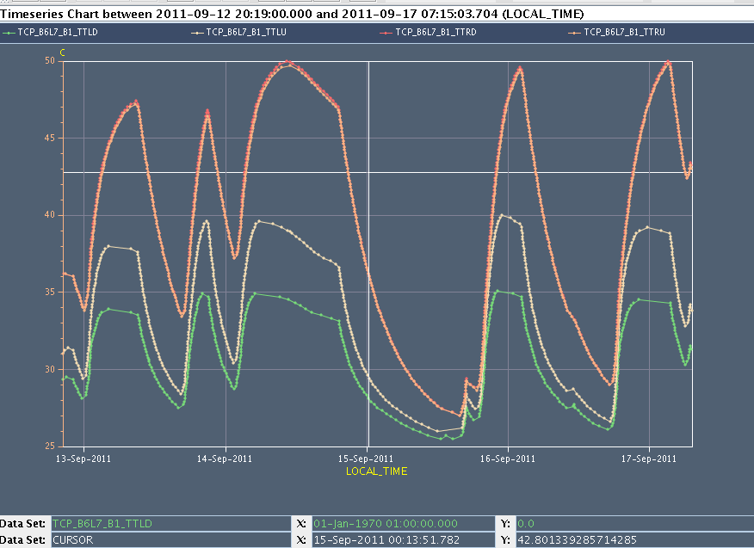
Collimator jaw temperature (TCP)

Slide 20
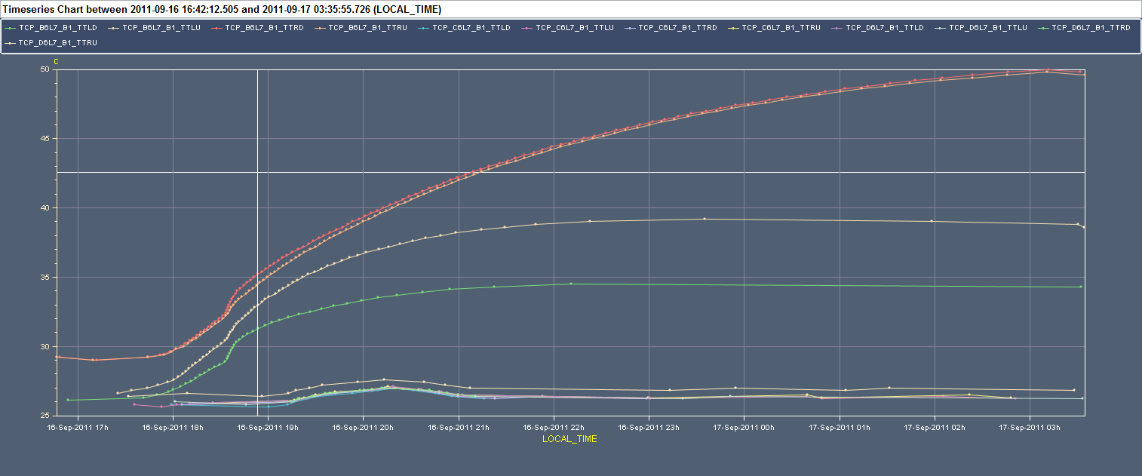
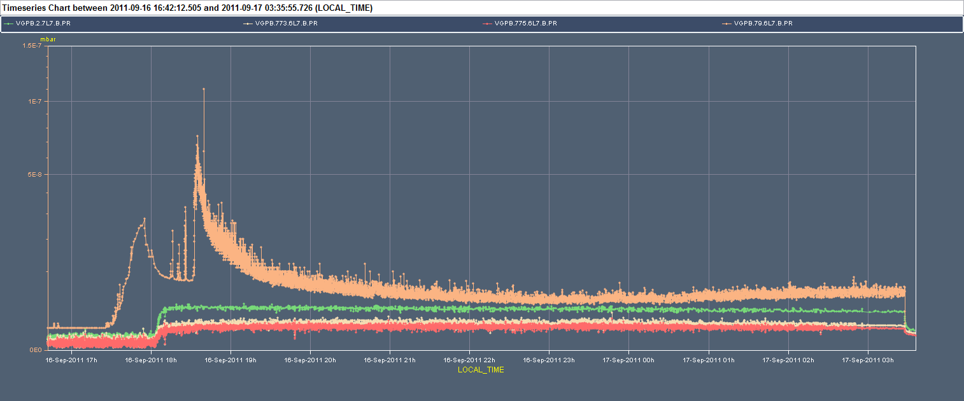
Collimators temperature and vacuum

Slide 21
RF noise issue?
Ph.Baudrenghien:
"We could not investigate the RF with circulating beam (phase noise analyzer needed 30 min to warm-up and it was urgent to dump...). Without beam the RF noise was checked at 3.5 TeV conditions and then at 450 GeV. It was normal.
The loss of B1 around 14:00 in the last fill shows the clear signature of debunching: we had ~ 5E11 drop in FastBCT, with an increase to 2E10 in abort gap population (5E11 uniformly spread around the ring gives ~ 2E10 in the 3 microsec long abort gap), followed by the same drop in DC-BCT and cleaning of the abort gap ~ 15 min later (= time for debunched beam to reach the inner momentum collimator jaw). See picture attached. If it comes back during the night with a large amplitude (check same signals on timber, abort gap population should not exceed 5E10), call both LLRF piquet and me. We keep investigating with next fill in any case.

Slide 22
RF noise issue?

Slide 23
RF noise issue?

Slide 24
Problems (week ended Friday night)
Beam-related issues
Vacuum in point 8
Background in ALICE
Heating of collimator
Problems encountered with time lost:
Cryo PLC problem ➔ 25 h
Vacuum pump in IR4 ➔ >12 h (until Sun 22:00)
Injection tuning ➔ 10.5 h
Controls network ➔ 8.5 h
Collimator controls ➔ 5 h
Access system ➔ 4 h
BPM interlock limits ➔ 1.5 h
Total: 66.5 h

Slide 25
Cryo stop in IR4
Sat 07:00 Cryo problem in point 4
From E. Blanco: First beam dump caused by a cryo PLC not reachable anymore (UX45_QUI) and then 14 minutes later a WFip segment with problems:
We intervened in the tunnel (UX45) and replaced the PLC and let the cryo operators recover as soon as possible. The diagnose is to confirm by Schneider once they analyze the dump, but it seems that a SEU can be likely the cause.
Second the WFip problem was caused by an electrical problem (circuit-breaker down). As it was in UX45 I’ve rearmed the breaker and everything went fine. By contrary ½ later it seems that breaker has gone down again. To diagnose by TE/CRG.
Recovery of sector 34 – 45 started at ~11:00

Slide 26
Vacuum pump problem
Ion pump in IR4 switches off, interlocking RF module M2B2
10:00 switch off w/o beam
10:52 switch off with beam
power supply exchanged
17:30 switch off with beam
Ion pump is diagnosed OK. Vacuum controls looking for cable/connector/rack issues ➔ access
Intervention sur un boitier local de pompe ionique:
22:00 fixed… la liason HT entre les deux pompes ioniques VPIA.7.5L4.R et 44.5L4.R etait cassee. Apres avoir refait la soudure de la HT de la pompe ionique VPIA.7.5L4.R une legere remontee de pression lors de son redemarrage est apparue sur la VGP.1.5L4.R. Vannes re-ouvertes.

Slide 27
Controls network problem
The network problems have been fixed since 9:30am when the network switch for the Service IP57 feeding various important servers such as CS-CCR-LSA1, CS-CCR-CMW1 and CS-CCR-JAS5 was powered off then on. Enzo Genuardi was first called around 2:30am and came in at around 3:30am. He shutdown any machines on Service IP57 that he suspected were sending too much traffic or bad traffic. However this did not fix the problem. All that is known for the moment is that many machines on Service IP57 worked perfectly (e.g. DIAM1, JAS5) however many others could only send a few kilobytes before a TCP connection blocked (e.g. LSA1, DIAM2, Q4DS7). We have not seen a switch working partially before so it took some time to make the decision with Edoardo Martelli of IT/CS to power off / on the switch. Alastair Bland, BE/CO.

Slide 28
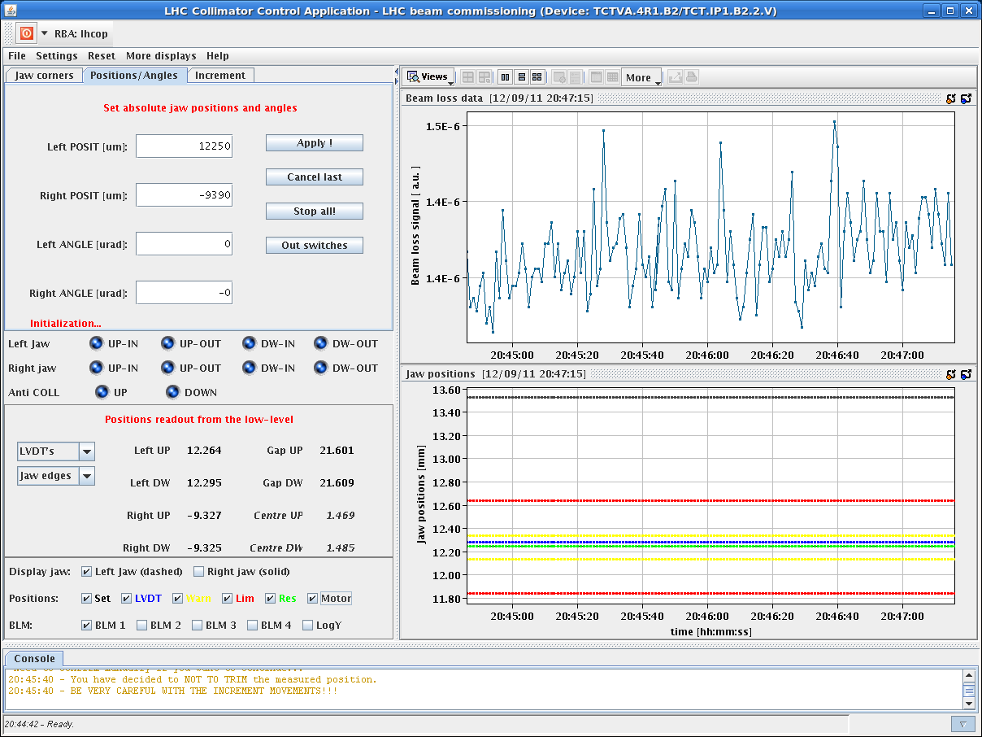
TCTVA.4R1.B2 Issue: PXI Crate Stuck...
Normal that LSA settings U & D are identical if no tilt requested
The LVDT readings were correct.
Discrepancy occurred while collimator was moving to injection. Collimator movement should stop
Jaw moved from parking to the injection position according to LVDT and resolver ➔ no active interlock. ➔
Published information on the motor step was corrupted: likely occurred occurred during physics (SEU?).
Improvements on the sequence to detect such events before injecting being considered.

Slide 29
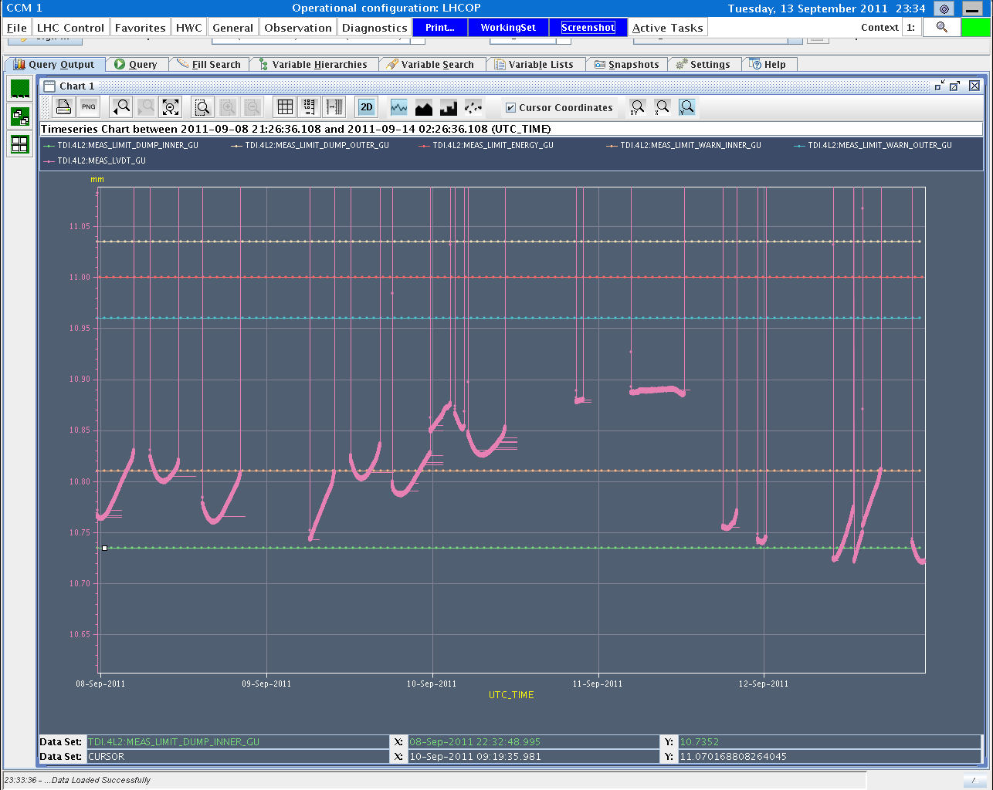
TDI controls problem
OK after repeating the sequence twice!!
Due to noise in the measurement of jaw positions leading to gap opening outside limits.
TDI.4L2 gap interlocks were changed by 100 um to avoid an interlock due to a drift of the position reading.
S. Redaelli

Slide 30
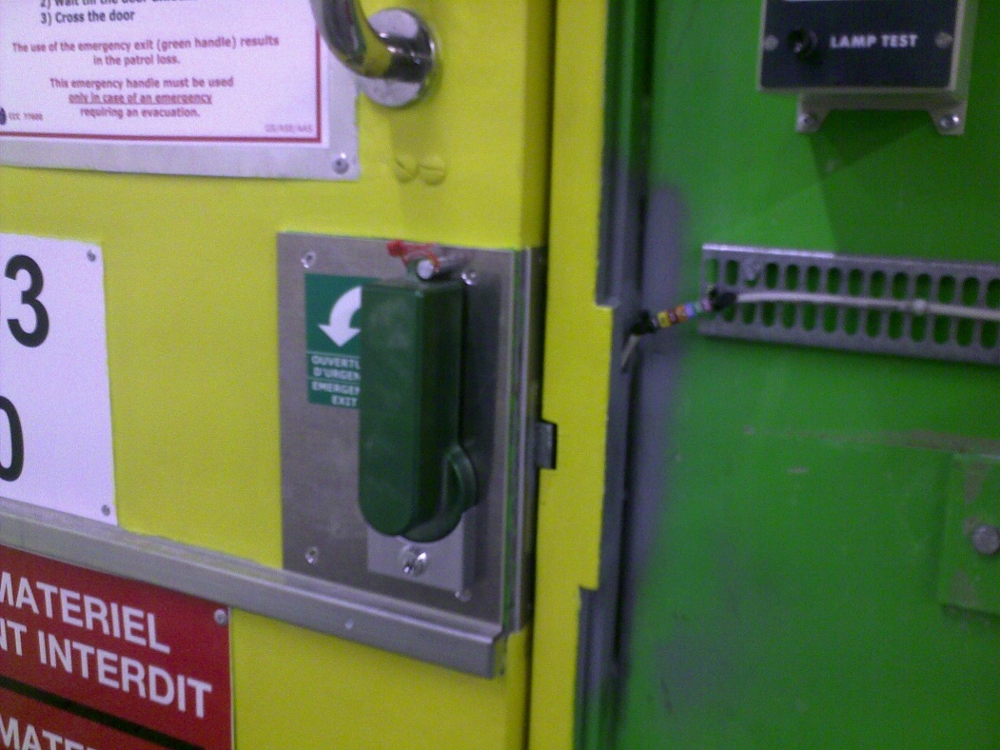
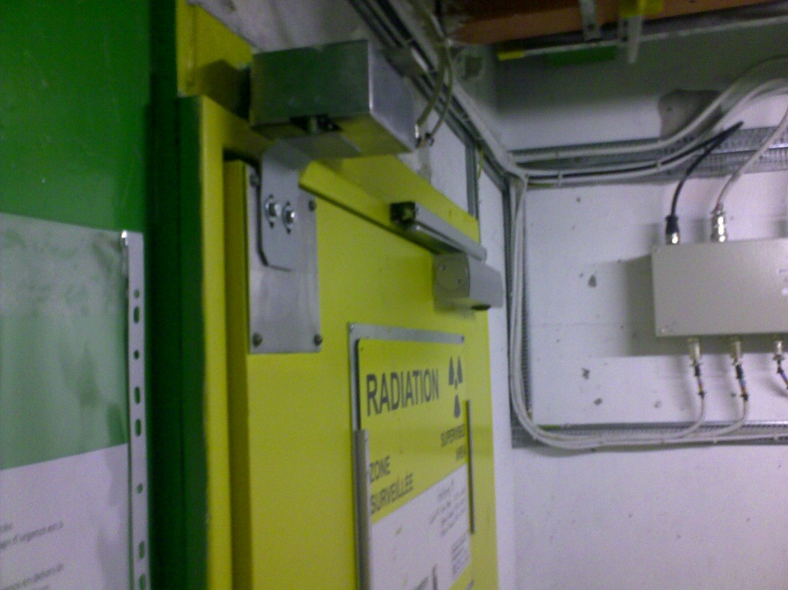
Access Door Opening…
YCPS03=US450,YCPS04=US450 not well closed after access on 11/9 + technology of XX(?) -century

Slide 31
Tue 13/9 – Wed 14/9

Slide 32
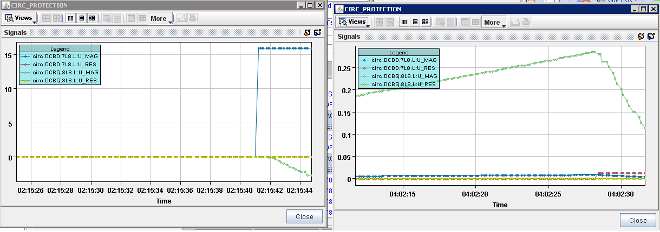
nQPS trip
Fri 02:15 trip of Sector 78 – due to sudden jump of U_MAG signal on nQPS DQAMGS.RB.A78.B9L8 (SEU?). End of physics #2110. 57 pb⁻¹ in 6.5 h.
Fri 04:02 second trip of Sector 78 during pre-cycle ➔ power-cycle DQAMGS.RB.A78.B9L8
M. Zerlauth

Slide 33
SUMMARY OF INJECTION STUDIES - Chiara, Wolfgang, …
Sorting out injection problems with 144b
injection for B2 appeared fine for 12 b but had already offset of 600 um at the MSI; loss shower from TL dumped while injecting 144b
checked if recently seen bunch dependent injection oscillations causes the dump --> pattern visible but not strong
steered trajectory focusing around horizontal collimators
situation improved, but seems to be for two reasons:
ion cycle in the SPS was put in again which resumed the same cycle conditions as for yesterday's trajectory steering --> dependency of trajectory on cycles which are before the LHC cycle to be checked
careful steering around collimators in the horizontal plane brought further loss reduction
injected 3 x 144 b with losses OK
B1 steering more tricky because one BPM reading needed to be flipped in sign --> to be checked with kick response
B1 losses improved finally by ~50% and checked with 2 x 144b being OK
sticking to one dedicated filling super cycle with always the same cycle composition could avoid these problems
for both transfer lines we see big shot to shot variations of the trajectory, B1 more sensitive --> MSE stability to be followed up

Slide 34
SUMMARY OF INJECTION STUDIES - Chiara, Wolfgang, …
Checking trajectory drift in TI2
Checks only for B1. TI 2 trajectory corrected. Settings copied to pilot cycle. Masks: maskable ring BLMs, BPM.P6, TI 2 BLMs, opened TCDI thresholds.
Check TCDI center for 3 collimators in I&D mode with pilot, moving full gap. Removed masks. Check TCDI center for 2 collimators with 12 b, moving only one jaw at a time.
RESULTS: Values in [um] show measured beam centre wrt to the actual coll. centre: beam ctr shift beam ctr shift pilot 12b TCDIH.29050 -240 (-0.3 sig) --- TCDIH.29205 + 20 (0.03 sig) + 20 (0.03 sig) TCDIV.29509 -400 (-0.3 sig) -200 (-0.15 sig)
measured beam centre for 12 b is consistent with BPM readings from trajectory
maximum shift of 0.3 sigma measured
trajectory correction before the measurement did not deteriorate injection oscillations
the shot to shot trajectory variation in TI 2 horizontal is in average ~330 um (max 1mm), so centre shifts of todayare of the same order as shot to shot variations
a full re-setup of the TL with new trajectory and collimator centering will probably not improve the situation significantly on the long term
TCDI setup with pilot cycle is appropriate, critical TCDIs potentially tbc with 12b
since no significant trajectory drift at the critical TCDIs has been measured, opening the TCDIs from 4.5 to 5 sig remains valid (last validation done beginning of March)

Slide 35
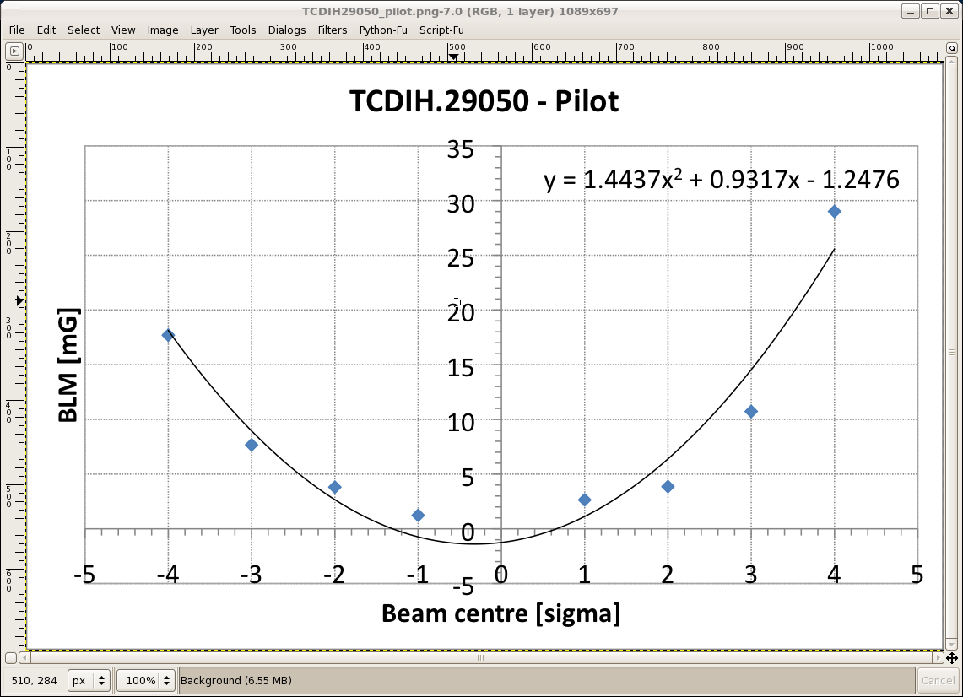
Centering Transfer Line Collimator

Slide 36
Plans
Go for physics
To be considered:
Proper setup of transverse damper for high bunch intensity.
Open TCDI gaps from ± 4.5 σ to ± 5.0 σ.

