Slide 1
Friday September 16th
06:00 – Ongoing injection problems on beam 2
07:42 – Start of injection investigations
11:11 – Injection problem fixed. Resteering of transfer line. Change due to perturbations from ion cycle?
11:42 – Start of checks for transfer line collimators
12:09 – Switching polarity of LHCb dipole and compensators
14:45 – 30min stop of beam from injectors due to restoring of second control system for SPS compensators
Cryo has put up improved system for handling of T sensor problem into R5.
16:41 – End of checks for injection collimators. Go to physics:
16:58 – Injection for physics. Losses fine now.
17:54 – Start of ramp
18:13 – Start of squeeze
18:38 – Stable beams. Fill #2117.
From RF: Keep bunch intensity at 1.4e11. Klystron T regulation.

Slide 2
SUMMARY OF INJECTION STUDIES - Chiara, Wolfgang, …
Sorting out injection problems with 144b
injection for B2 appeared fine for 12 b but had already offset of 600 um at the MSI; loss shower from TL dumped while injecting 144b
checked if recently seen bunch dependent injection oscillations causes the dump --> pattern visible but not strong
steered trajectory focusing around horizontal collimators
situation improved, but seems to be for two reasons:
ion cycle in the SPS was put in again which resumed the same cycle conditions as for yesterday's trajectory steering --> dependency of trajectory on cycles which are before the LHC cycle to be checked
careful steering around collimators in the horizontal plane brought further loss reduction
injected 3 x 144 b with losses OK
B1 steering more tricky because one BPM reading needed to be flipped in sign --> to be checked with kick response
B1 losses improved finally by ~50% and checked with 2 x 144b being OK
sticking to one dedicated filling super cycle with always the same cycle composition could avoid these problems
for both transfer lines we see big shot to shot variations of the trajectory, B1 more sensitive --> MSE stability to be followed up

Slide 3
SUMMARY OF INJECTION STUDIES - Chiara, Wolfgang, …
Checking trajectory drift in TI2
Checks only for B1. TI 2 trajectory corrected. Settings copied to pilot cycle. Masks: maskable ring BLMs, BPM.P6, TI 2 BLMs, opened TCDI thresholds.
Check TCDI center for 3 collimators in I&D mode with pilot, moving full gap. Removed masks. Check TCDI center for 2 collimators with 12 b, moving only one jaw at a time.
RESULTS: Values in [um] show measured beam centre wrt to the actual coll. centre: beam ctr shift beam ctr shift pilot 12b TCDIH.29050 -240 (-0.3 sig) --- TCDIH.29205 + 20 (0.03 sig) + 20 (0.03 sig) TCDIV.29509 -400 (-0.3 sig) -200 (-0.15 sig)
measured beam centre for 12 b is consistent with BPM readings from trajectory
maximum shift of 0.3 sigma measured
trajectory correction before the measurement did not deteriorate injection oscillations
the shot to shot trajectory variation in TI 2 horizontal is in average ~330 um (max 1mm), so centre shifts of todayare of the same order as shot to shot variations
a full re-setup of the TL with new trajectory and collimator centering will probably not improve the situation significantly on the long term
TCDI setup with pilot cycle is appropriate, critical TCDIs potentially tbc with 12b
since no significant trajectory drift at the critical TCDIs has been measured, opening the TCDIs from 4.5 to 5 sig remains valid (last validation done beginning of March)

Slide 4
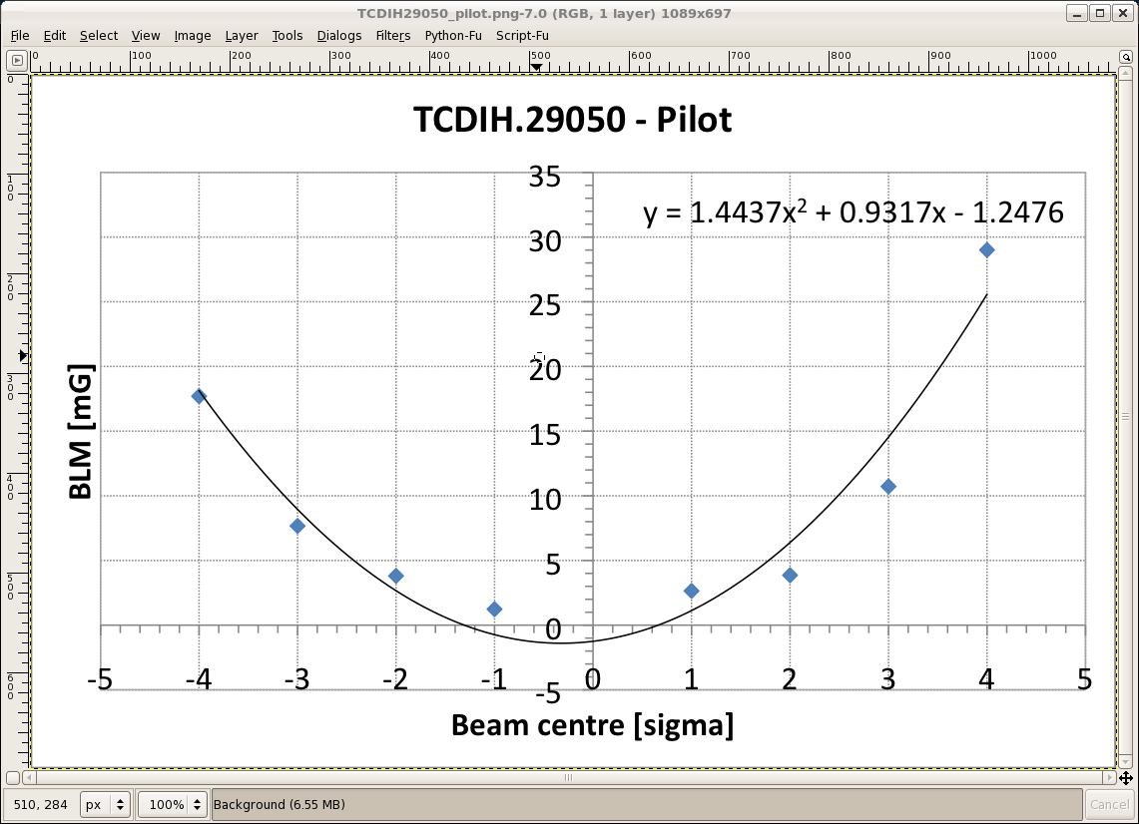
Centering Transfer Line Collimator

Slide 5
Saturday September 17th
03:28 – Beam dump due to temperature interlock on collimator TCP.B6.B1. Collected 75 pb-1 in 8h50.
04:55 – Injection
06:31 – Ramp
06:57 – Beam dump at flat top. Lost cryo in point 4 (PLC fault and FIP problem). Stopped cold compressor.
Recovery estimated earliest at 21:00…

Slide 6
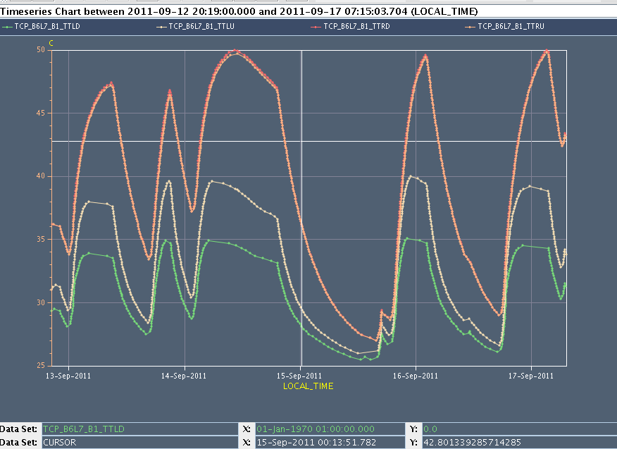
Collimator jaw temperature (TCP)

Slide 7
Ahead
Cryo recovery: until ~21:00 earliest
Accesses in shadow of cryo recovery:
Access for CMS water pump (CMS to switch magnet off)
Access CMS tunnel forward detector: ~2h
RF intervention to remove limitation for bunch intensity (UX45): ~1h
e-cloud solenoid IR2: ~6h
QPS in 78: ~0h30
MKIC LSS8 vacuum intervention
BLM crate reset IR2: ~1.5h
BI intervention UA47: ~3h
Repair power converter RSS.A34.B1
Delivering integrated luminosity…

