Slide 1
Wednesday September 14th
02h39: Stable beams. Fill #2105.
Problem cryo temperature sensors in L5. To be followed up at the next access opportunity.
08h11: Centered orbit. Trimmed by 7 Hz.
08h14: Optimizing.
09h13: FIP_Com_Lost with QPS controller on MB.8R1.
09h56: RSS.A45B1 tripped. Beam still in. Power converter problem - could be due to radiation. An access would be required to repair it.
13h54: Life time drop for beam 1. No additional losses detected, no luminosity drop either. ➔
15h33: re-optimising IP5 (was requested)
15h55: ALICE background has dropped and they increased their luminosity from 0.5Hz/ub to 0.8Hz/ub ➔ leveling.
17h25: correcting the orbit
17h57: FSU dead announced by Big Sister! Reconnected again ...uffff
19h13: Beam dump by EIC.

Slide 2
Fill #2105

Slide 3
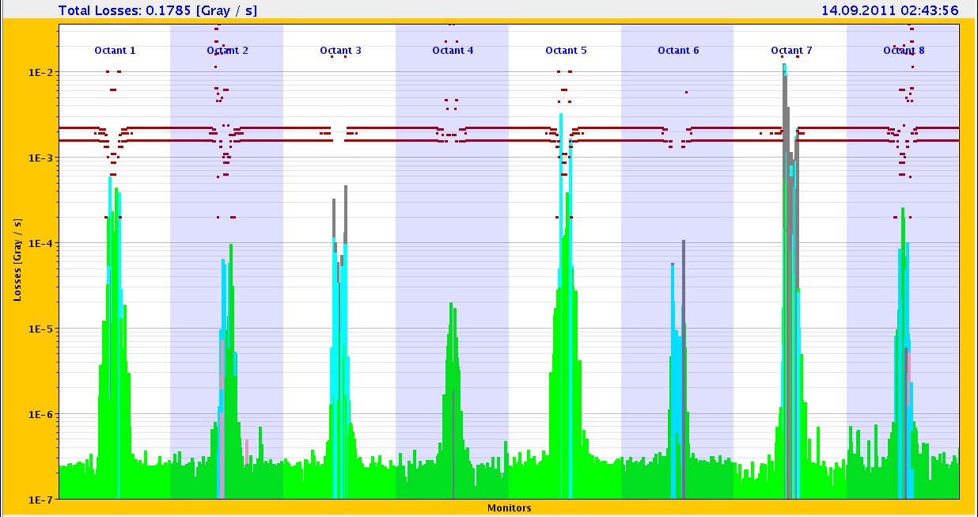
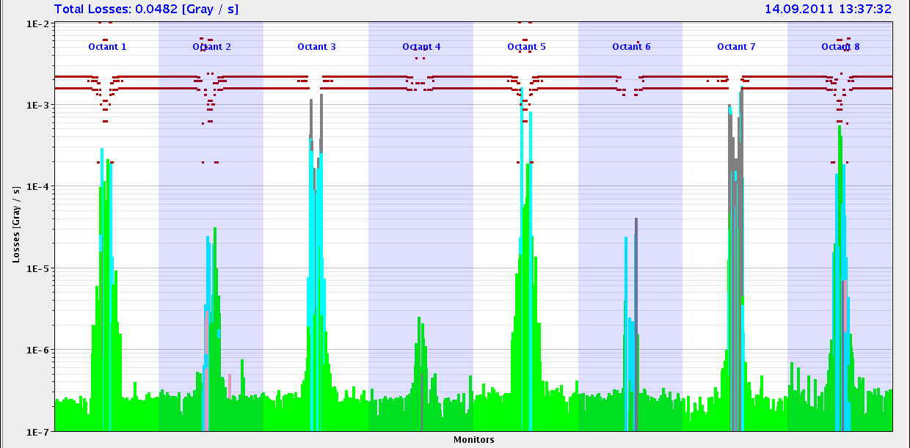
Losses at start and after 11 hours
0h05 in stable beams
down
up
10h58 in stable beams

Slide 4
RF noise issue?
Ph.Baudrenghien:
"We could not investigate the RF with circulating beam (phase noise analyzer needed 30 min to warm-up and it was urgent to dump...). Without beam the RF noise was checked at 3.5 TeV conditions and then at 450 GeV. It was normal.
The loss of B1 around 14:00 in the last fill shows the clear signature of debunching: we had ~ 5E11 drop in FastBCT, with an increase to 2E10 in abort gap population (5E11 uniformly spread around the ring gives ~ 2E10 in the 3 microsec long abort gap), followed by the same drop in DC-BCT and cleaning of the abort gap ~ 15 min later (= time for debunched beam to reach the inner momentum collimator jaw). See picture attached. If it comes back during the night with a large amplitude (check same signals on timber, abort gap population should not exceed 5E10), call both LLRF piquet and me. We keep investigating with next fill in any case.

Slide 5
RF noise issue?

Slide 6
RF noise issue?

Slide 7
RF noise issue?

Slide 8
MKI Heating

Slide 9
Bunch intensity pattern end of 17h fill
Bunches colliding in LHCb only have lower losses!
➔ Lumi burn-off is lower due to lower luminosity!?

Slide 10
Intensity and luminosity

Slide 11
Was a productive day seen by ATLAS...

Slide 12
Week so far as seen from CMS

Slide 13
2011 records

Slide 14
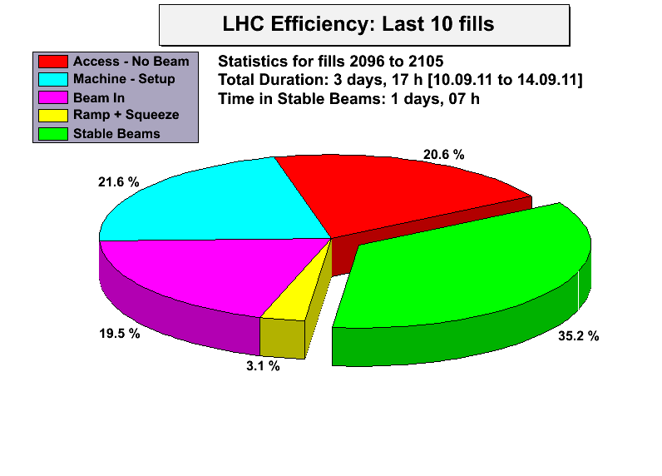

Slide 15
Wed/Thu September 14th/15th
19h13: Ramp down and recovery...
19h47: RQT12.R1B1 tripped during rampdown.
20h02: cryo operator is resetting T sensors in 45 and 67
20h16: Access for QPS & RP experts at PM15/UJ16.
20h17: Access delegated to ALICE for a short access.
21h21: Test from cryo:
Look like they will be able not to block the valve regulation when the wrong temperature comes from top of current lead.
22h02: QPS situation of RB.A12 seems stable and OK, however QPS experts still trying to fix the controller of RQT12/RQTL11.
22h28: QPS expert will have to reprogram a card for the controller of RQT12/RQTL11. The estimate for this is ~1h.
23h53: QPS is OK for RQT12.R1B1.
00h07: Pre-cycle.
01h09: Controls problems affecting PS, SPS, LHC. Network issue.

Slide 16
Wed/Thu September 14th/15th
05h21: Access starting in PM85 for a circuit breaker of the RB.A81.
06h10: Access finished.
Controls problems ongoing...

Slide 17
Ahead
Recover from controls stop…
Delivering integrated luminosity…
Pending:
Reconfiguration of the electrical network ➔ ongoing.
Damper set-up for higher intensity (4 hours)
TI2 TCDI alignment checks (2 hours)
Setting beta* limits on new TCT functions (before physics)

