Slide 1
Sat 17/9 – Sun 18/9
07:00 Cryo problem in point 4
From E. Blanco: First beam dump caused by a cryo PLC not reachable anymore (UX45_QUI) and then 14 minutes later a WFip segment with problems:
We intervened in the tunnel (UX45) and replaced the PLC and let the cryo operators recover as soon as possible. The diagnose is to confirm by Schneider once they analyze the dump, but it seems that a SEU can be likely the cause.
Second the WFip problem was caused by an electrical problem (circuit-breaker down). As it was in UX45 I’ve rearmed the breaker and everything went fine. By contrary ½ later it seems that breaker has gone down again. To diagnose by TE/CRG.
Recovery of sector 34 – 45 started at ~11:00

Slide 2
Sat 17/9 – Sun 18/9
Few more trips of the WFip rack circuit breaker affecting RF in Sector 45 ➔ intervention of TE/CRG – EN/EL (until evening).
Problem identified on a heater for the RF cryogenics. Temporary fix found.
Cavities in Sector 34/45 have reached a temperature of 70/84 K ➔ Contacted RF expert: short reconditioning only in case of need.
Switched ON RF as soon as possible (5 AM)
06:30: Frequent trips of cavity 2B2 ➔ Access to replace a controls power supply (completed by now)
08:00 Got the OK from RF to go ahead

Slide 3
Sat 17/9 – Sun 18/9
Over night shift crew started to switch ON all the circuits as they become available
Cryo conditions completely recovered at 08:30
Pre-cycling

Slide 4
Accesses
CMS Pump problem: faulty cable on a temperature measurement. Resolved.
Collimator cooling to maximum possible (O. Aberle):
“We (together with S. Gatard from RP) have been to Pt 7 and I have opened the three TCP and the first 2 TCS on each side to the maximum valve position. There was not much stoke left. The operation during last winter stop of increasing the cooling to two third of nominal flow is the maximum we can do with the actual configuration, limited by the main distribution line. I measured a flow rate of 0.8 - 0.9 on the TCSG.B5L7.B1, with no change in flow with the last opening of the valve. Compared to the winter stop value we might be even a bit lower”
Temperature interlock levels for primary collimators and first two secondaries increased from 50 to 55 C after consultation with V. Baglin.

Slide 5
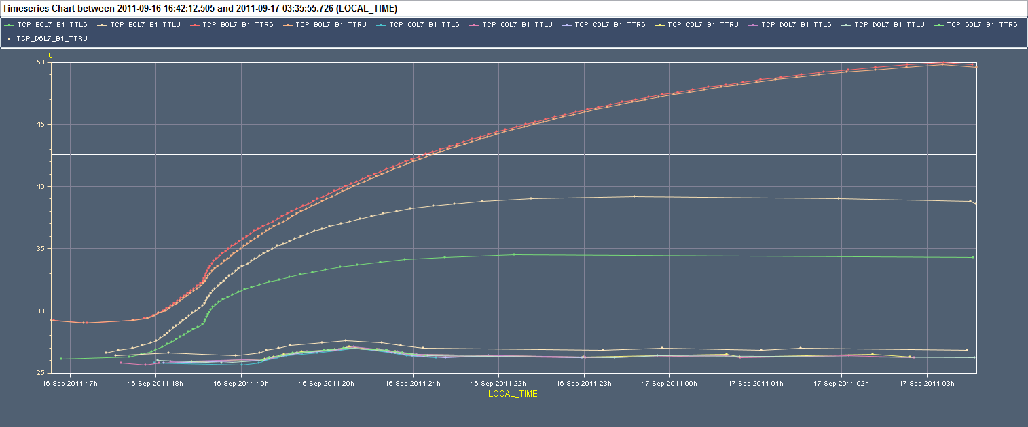
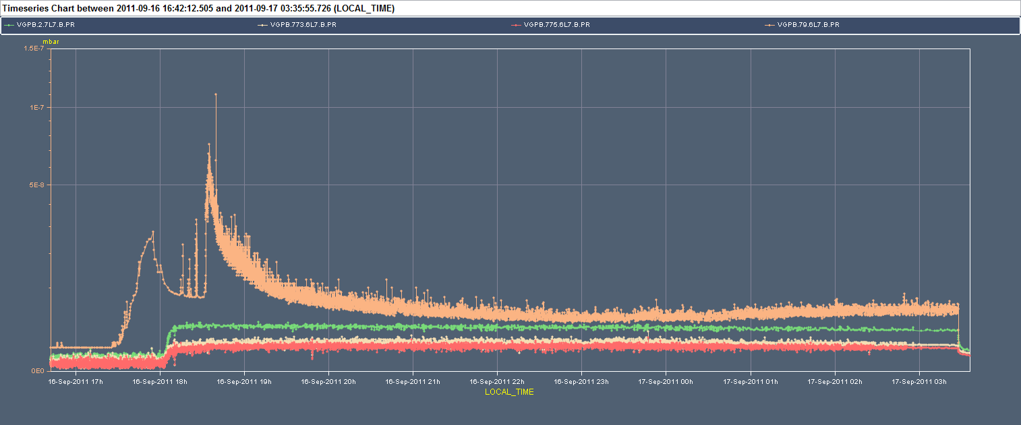
Collimators temperature and vacuum

Slide 6
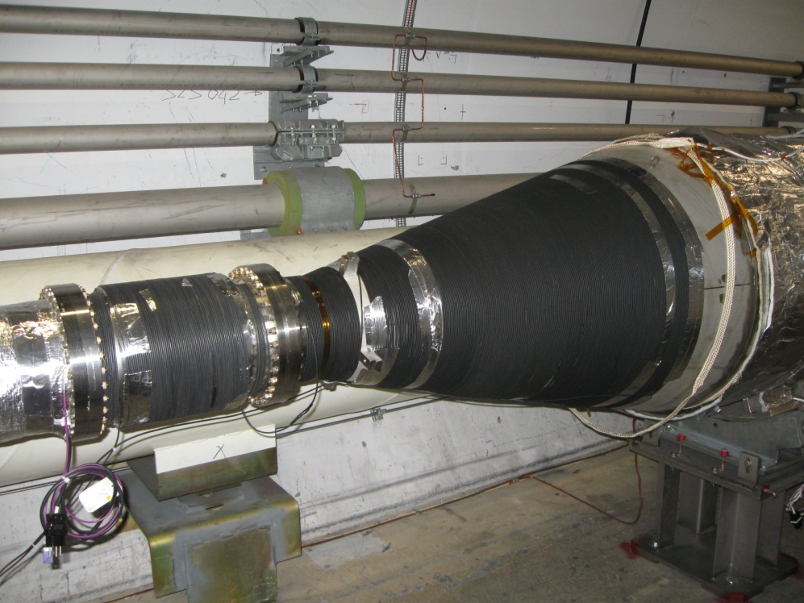
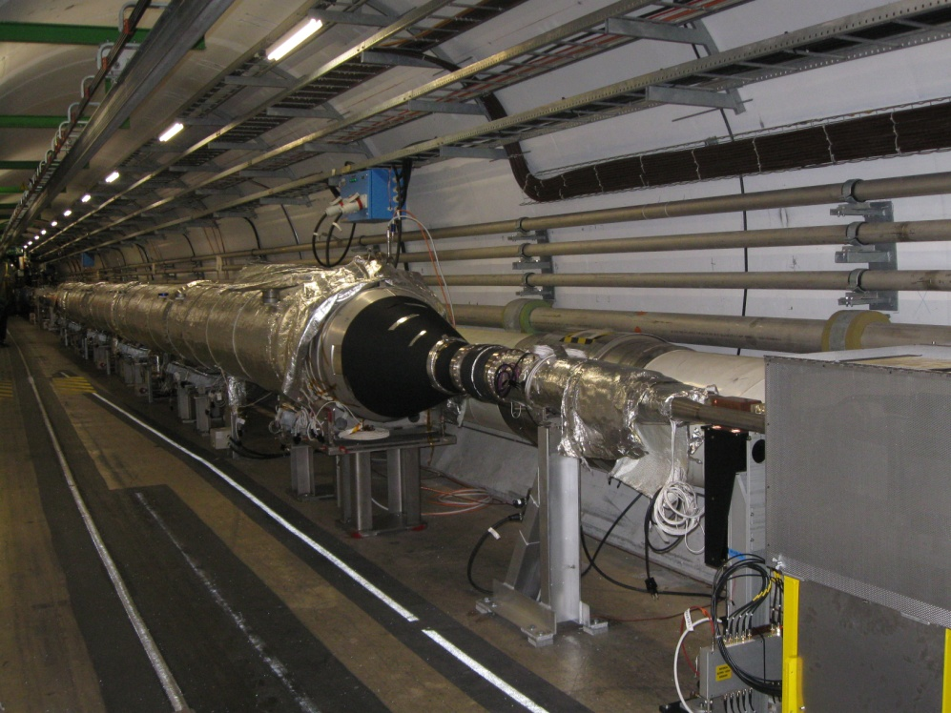
Accesses
Installation of anti-ecloud solenoid right of Pt 2 ➔ 500 m of cables installed and solenoid powered (V. Baglin and team)

Slide 7
Accesses
Electronics card replaced for the vacuum gauge at the MKI_C replaced
RSS.A45.B1 power converter replaced
Temporary fix by CV of a water leak (UJ56) detected during EPC access
Vacuum gauge control problem fixed in UJ47
QPS intervention in Sector 78

Slide 8
Plans
Go for physics

