Slide 1
LHC Status Tue Morning 7-Sep
Bernhard Holzer, Joerg Wenninger
Week 36:
Todo’s:
12+b injection.
Special fill 84b for LR BB.
Loss maps ‘a gogo’.
Intensity ramp up.
And also:
Define ALFA and TOTEM RP settings, prepare them in LSA.

Slide 2
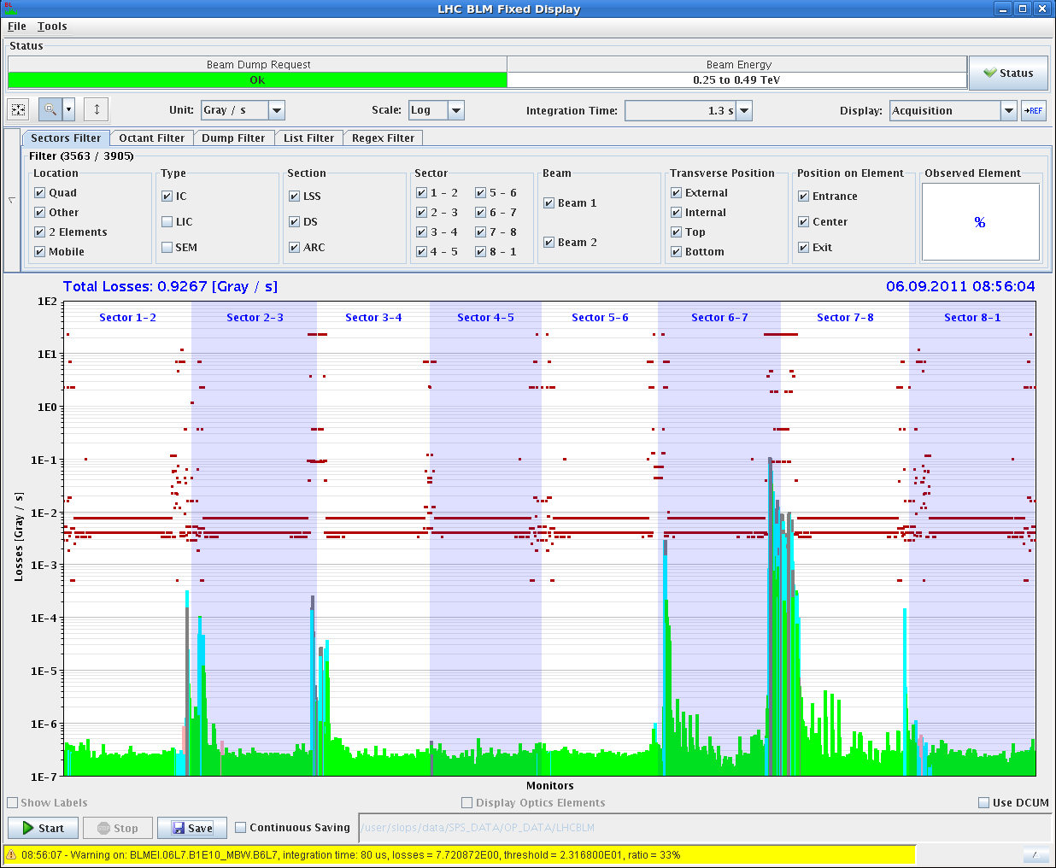
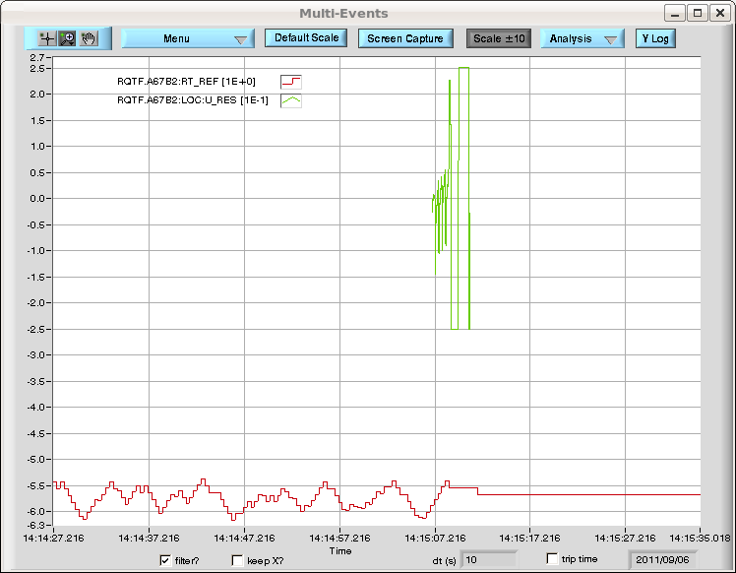
Tue Morning
Complete Loss maps at injection
Some minor (?) problems:
Dump via QPS trigger
sine like modulation from Q feedback made the U_RES of RQTF.A67.B2 add up and pass the threshold, and dump the beams at flat top with b*=1.5m

Slide 3
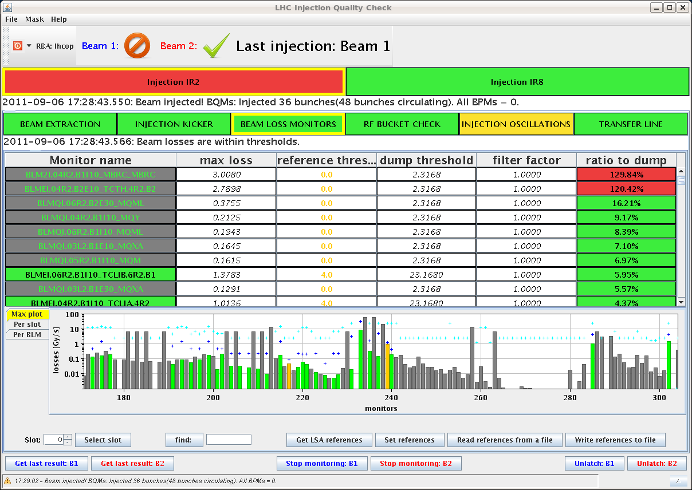
Tue Late: Injection needs TLC
Injection optimisation:
B1: recentered TCLIA.4R2
B2: we increase for TCLIA.4L8 the setting from
6.8 sig to 7.1 sig
...we cannot trim in these settings for the 36 b injection
Dump Classification: Beam Losses during injection
* Beams dumped when injecting 36 bunches in B1 (in three shifts !!)
* Brought the 36 b in with more scraping in the SPS and slightly bigger TCLIA gap
* Dumped again during 2nd injection of 36b train (103% losses)

Slide 4
Tue Late: Long Range Beam Beam
special fill 84 bunches: to investigate the long range bb situation
reminder: x-angle 120 urad, beta = 1m, collis at standard
“Lifetime evolution - incredibly flat
- try to guess when we started colliding ! “
homework
scale the expected lumi
for 1380 bunches
2721

Slide 5
validation / loss maps
✔
Loss maps injection.
Betatron H + V, off-momentum +/-, asynch dump.
Fresh beams for each test.
Swap H and V tunes for H loss map.
Loss maps at flat top (unsqueezed) – 1 fill.
Betatron H + V, asynch dump.
Loss maps end of squeeze to 1m (separated !) – 1 fill.
Betatron H + V, asynch dump.
Loss maps with collisions – 1 fill.
ALFA and TOTEM RPs in beam.
Betatron H + V, asynch dump.
Loss maps with collisions – 1 fill.
ALFA and TOTEM RPs in beam –1-2 hours (data taking test)
Off-momentum test dp/p + (RF frequency trim -500 Hz).
being done at the moment

Slide 6
Validation matrix
Injection to be done also with injection protection (betatron)
Condition | Betatron H | Betatron V | Dp/p + | Dp/p - | Dump
Injection | DONE | REPEAT | DONE | DONE | DONE
Flat top | DONE | DONE | --- | --- | REPEAT
Squeezed | DONE | DONE | --- | --- | DONE
Collisions | OK | X | X | OK | X
✔
✔
✔
✔
✔
... to be validated !

Slide 7
Part 3: intensity ramp up
Injection checkout to 12 ... 144b
Ramp up for stable beams:
264 – ≈ 5h
480 – short fill
912 – long fill
1380 – finally !!

