Slide 1
Saturday
10:00 Beam back after MKE4 reconditioning.
12:00 Ramp for TCT alignment @ 1m.
14:30 Alignment starting with separated beams.
Lost time to solve a problem of loss spikes preventing the alignment. Solved when sending of RT packets was disabled for the feedback – seems this actually inducing current changes on some converters.
16:00 Colliding, re-optimizing ATLAS & CMS.
19:00 Alignment finished.
Loss maps, asynch. dump test.
Unfortunately TCP in IR3 left at 8 sigma (instead 12 sigma).
Else looking good.

Slide 2
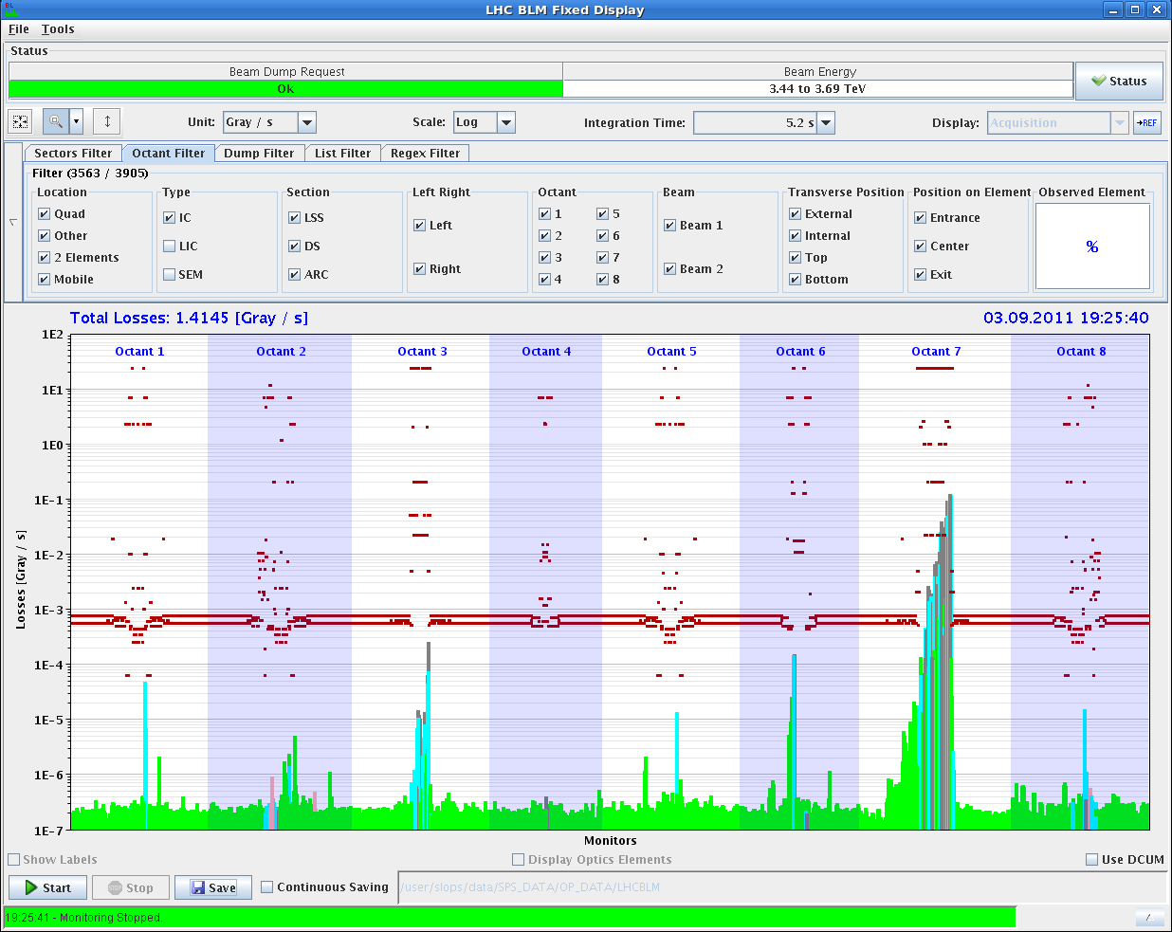
Example B2 H
No losses at BLMs behind TCTs

Slide 3
Sunday
22:00 Re-injecting. Some time lost trying to tune the probe for aperture measurements in the SPS.
Functions updated for TCTs in IR1&5.
We accidentally went “too far” to collisions, while we wanted to measure aperture at end of squeeze.
Aperture in collision (with lumi knob) – Xing plane:
IR1 (V) : 14.8-15.3 sigma
IR5 (H) : 15.3-15.8 sigma
Loss maps with TCTs at 13.8 sigma – look OK.

Slide 4
Sunday
04:00: Refill for second aperture check.
Aperture measured in separation plane (with separated beams) - more difficult to find.
IR1 H: > 16 sigma.
IR5 V : >16 sigma.
07:30: Loss maps with TCTs at collision setting + 2 sigma (11.8 + 2 sigma).
Look good at first sight.
Some losses at Q10 in IR1 to be checked.
Prel. conclusion:
Aperture confirmed at 1 m – we have enough aperture for 1m & 120 urad Xing angles, with around 2 sigma add. margin,

Slide 5
TS feed-downs
No HW problems so far – best recovery.
Lot’s of “small” controls issues with LSA (interference with INCA SW), FIDEL, sequencer, XPOC, DB publication (affects Handshakes), machine DIP-CMW servers etc.
Made a few SW rollbacks.
Some of the problems are not understood. To be looked at on Monday…

Slide 6
Tentative plan
Day/afternoon:
Start with ALICE reversal.
Schedule such that we make a test ramp before the night – may shift the protection validation to Monday.
Night:
Aperture with separated beams in Xing plane – systematic.
Loss maps.

Slide 7
Block A : aperture check
Fill 1: 1 probe/beam, checkout cycle.
b* 1 m and Xing angle 120 μrad.
Standard collimator settings IR6+7.
TCTs IR1/5 to be adapted to 120 μrad (setup on 100 μrad).
Fill 2: 2 nominals/beam, TCT alignment, orbit.
TCTs IR1/5 alignment on 120 μrad, separated and in collision.
Collision (re-)optimization with 120 μrad, reference orbit.
End with loss map (H+V) and asynch dump. TCTs at 11.8σ.
Fill 3: 1 probe/beam, aperture check @ 1 m.
Repeat aperture measurement at 1 m.
End with a loss map H, TCTs at 14σ.
Fill 4: 1 probe/beam, aperture check with loss map.
Loss map with TCTs at Xσ, X = 13…14.
4h
DONE
6h
~DONE
8h
~DONE
(repeat parts)
5h

Slide 8
Block A: long range BB check
Fill 5: 84b with highly asymmetric BB filling pattern (also used for 1 m with 100 μrad).
Bring the beam up to collisions.
Verify stability and beam-beam effects.
6h

Slide 9
Block B : ALICE polarity
Step 1: adjust injection, reference.
ALICE on ‘old’ polarity.
Injection steering with 12b, then copy to probe and check it.
Step 2: revert ALICE polarity.
Check/correct orbit.
Check/steer injection oscillations with probe, repeat with nominal.
Step 2’: re-steer TI2 if necessary.
TDI coarse
TL setup, TCDI alignment and verification.
Step 3: TDI/TCLI alignment.
TDI/TCLI alignment with 1 nominal b.
Check TDI,TCLI setup.
Check injection 12b.
2h
4h
12h
If required, ‘alternate’ with TCT alignment (steps 4-6)
8h

Slide 10
Block B : ALICE polarity continued
Step 4: TCTs IR2 at injection.
Setup TCTs in IR2 at injection.
Step 5: Checkout cycle, 2 probes/beam.
Check Xing angle IR2 along the cycle.
Correct orbit if necessary.
TCTs IR2 ‘open’.
Step 6: TCT IR2 alignment cycle, 2 nominal b/beam.
TCT alignment on flat top and in collision.
Collision orbit, reference.
Loss map H+V and asynch. dump.
(Step 7: TCT IR2 functions, positions and interlocks )
2h
4h
6h

Slide 11
Block C
Validations (loss maps, asynch dump checks) – to be confirmed with collimation team (Dp/p)
Condition | Betatron H | Betatron V | Dp/p + | Dp/p - | Dump
Injection | X | X | X | X | X
Flat top | X | X | X | X | X
Squeezed | X | X | X | X | X
Collisions | X | X | X | X | X

Slide 12
Block D: Intensity ramp up
Proposed ramp up for stable beams:
48b – short fill
264 – short fill
480 – short fill
912 – long fill
1380 – finally !!

