Slide 1
Technical Stop #4 29th August - 2nd September 2011
Day 4
Julie Coupard
Schedule and Coordination

Slide 2
Summary after Day 3
Cryogenics
Done Intervention on oil pipes @Pt6 on surface
Cabling
Done BLM @Pt3
Done NG18 replacement @Pt3
Done Thermo-switch @Pt1&2
Done Monitoring cryo @Pt4
Beam Instrumentation
Done BLM: Direct beam dump connection to dump system
?? BPM: New firmware and SW to increase IIR filter order
Kickers
Done Change of generator pos K @Pt6 – revalidation tests ongoing
Done Change of generator HV switch @Pt2 – revalidation tests ongoing
Machine Protection
Done Adjustment of 600 A Energy Extraction Switches
DQEMC.UA63.RQTD.A56B1 – test performed - OK
DQEMC.UA43.RCS.A34B1 – test performed - OK

Slide 3
Issue
CRYO
Stop of the Compressor @Pt8 THU afternoon
Powering Test
See with the EIC

Slide 4
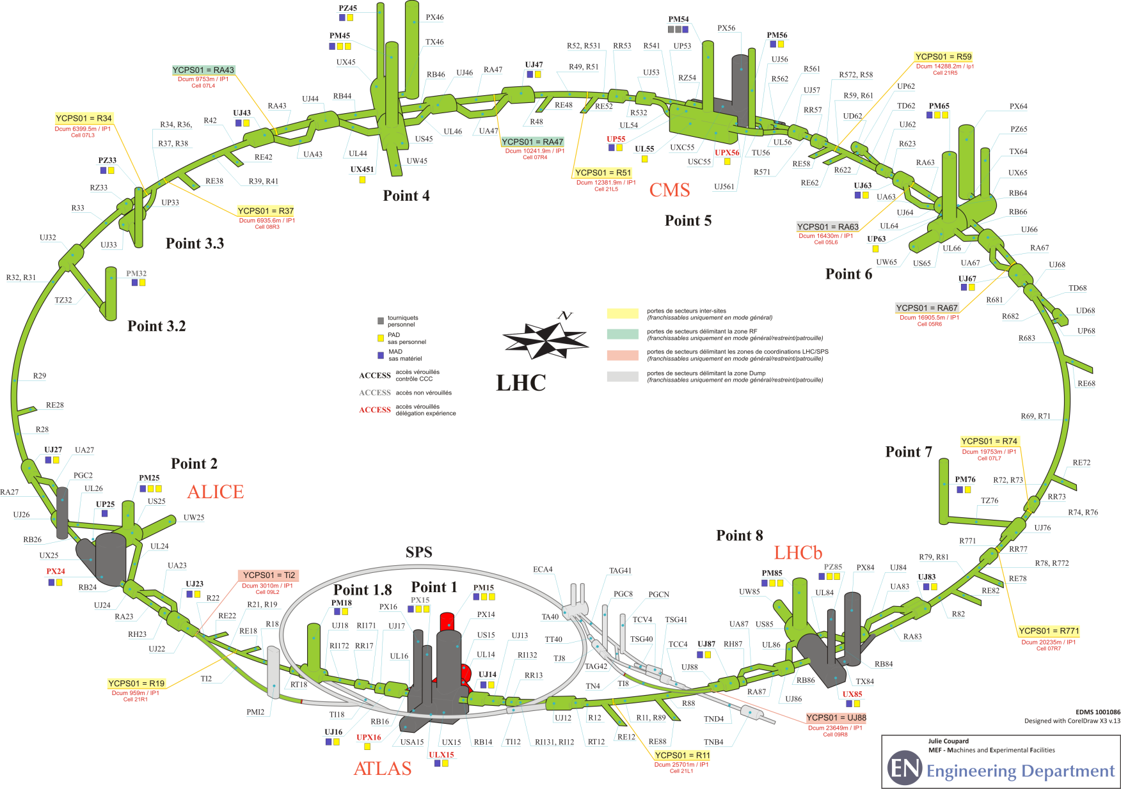
Status of patrol
Pt1
Friday 17h

Slide 5
Program for Friday
Deconsignation of injection lines (Ti2, Ti8) on Friday afternoon
Steve Hutchins will take the SPS keys for LHC extraction so the LHC will remain safe during the Patrols on Friday evening
Pt3 and P7 CLOSED for 15:00
All LHC machine CLOSED for 16:00
Last patrols at 17h (earlier if possible)
Point 1
End of the Technical Stop around 18h30 (if no more patrols)
People in CCC to give the green light for beam : S.Hutchins
EIC : L.Ponce

