Slide 1
Summary of Week 34
Machine Coordinators: G. Arduini, R. Assmann
MD Coordinators: R. Assmann, F. Zimmermann
Main aims:
Luminosity production
90 m optics run
MDs ➔ see Frank’s presentation

Slide 2
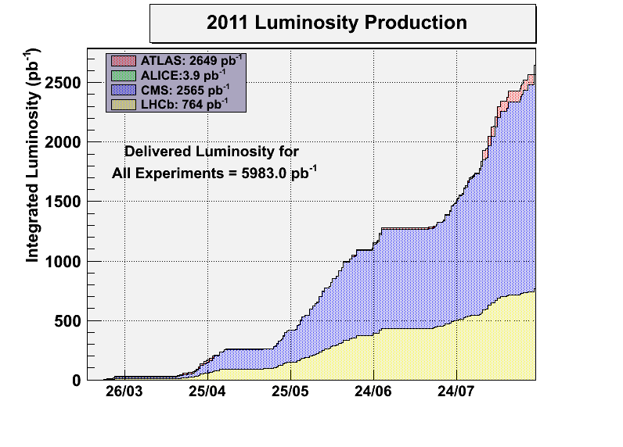
Statistics
Summary of Week 30
Fill | Phase | Peak L [10³³ cm⁻²s⁻¹] | Length [h] | Int. L [pb⁻¹] | Dump cause
2040 | STABLE | 2.11 | 17.6 | 83.3 | Programmed dump

Slide 3
Statistics
Major stops:
Cryogenics Sector 23 (27 hours) ➔ trip of 3.3 kV due to earth fault detection on cryo equipment ➔ no earth fault found
Thunderstorms ➔ trip of Q8/Q9/Q10 circuits twice (9.5 hours)
Current lead temperature gauge on RQTL9.R7B1 (twice – one in the shadow of Sector 23 recovery) (6 hours). Running with the current lead cryo valve blocked open at 43% (value required for high current)
Unsuccessful transverse feedback firmware update (4 hours)
In total ~50 hours of time recorded as fault. Time to recover not included!!
Significant perturbations to the programme of the week

Slide 4
90m Run for TOTEM/ALFA
Tue 23/8 09:00 to Wed 24/8 05:00 (stopped prematurely by EDF glitch leading to trip of ALICE and LHCb compensators):
Mostly set-up of TOTEM (alignment of vertical roman pots). ALFA alignment not possible due to PXI problem
No TOTEM/ALFA data taking due to the premature end
Difficulties encountered:
Filling scheme with bunches of different intensity due to limitations in the quality of the orbit reading ➔ to be followed-up
Bug in the LSA software undetected so far leading to power converter functions with too large acceleration rates and consequent trips of the 600 A triplet orbit correctors ➔ understood

Slide 5
90m Run for TOTEM/ALFA
If 90 m physics run is to take place more efficient to schedule a period of 2-3 days as for low energy run to complete the full programme. Piecewise setting-up proved not to be very efficient.
Beam characteristics to be agreed by experiments beforehand ➔ agreed upon written specification would be very useful

