Slide 1
LHC Status Tue Morning 16-Aug
Bernhard Holzer, Jan Uythoven
Tentative Planning:
Tue Morning cryo ok expected in the complete machine at 14:00h
last sector 81 switching on power converters, preparing restart
Tue 15:00h precycle, injection & ramp for luminosity
Meanwhile: access for
Blowing fibres in preparation of TS (points 7 & 8)
Access UA for RF, RF noise problem on 4B2
Access BI
SPS Machine studies:
11:00 – 14:00 TI2 tests – Q20 optics extraction
✔
... ?
✔
✔

Slide 2
Tentative Planning: Tue / Wed
Tuesday late: Restart, 1380 bunches, N_{p} ≈ 1.2*10^{11,}
establish stable conditions, check & optimise beam parameters
(vacuum, background rates etc etc)
TOTEM & ALFA moving in during stable beams in second half of
the fill
second fill: 1380 bunches, N_{p} ≈ 1.2*10¹¹, LHCb polarity changed
check & optimise beam parameters
(vacuum, background rates)
next fills increase bunch intensity N_{p} ≈ 1.35*10¹¹
end of fill studies: tight colli settings

Slide 3
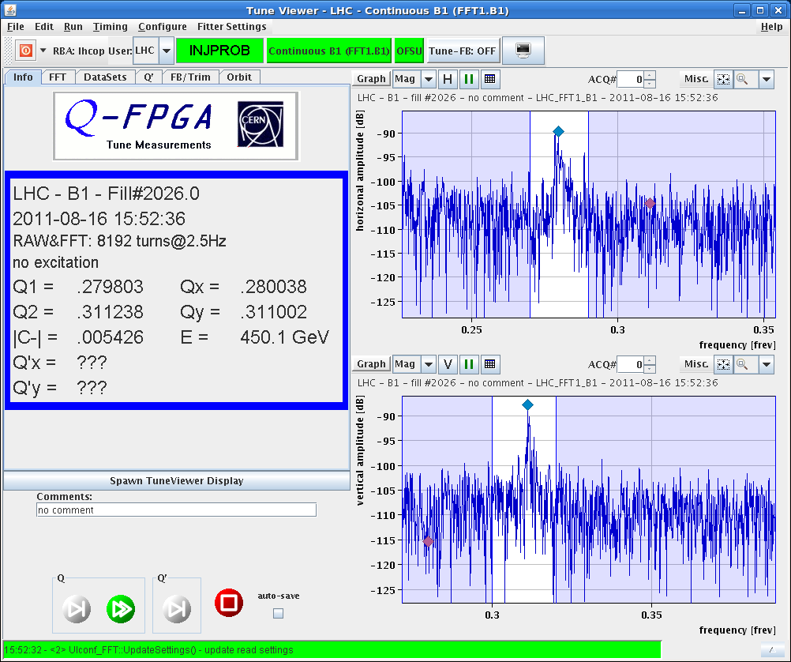
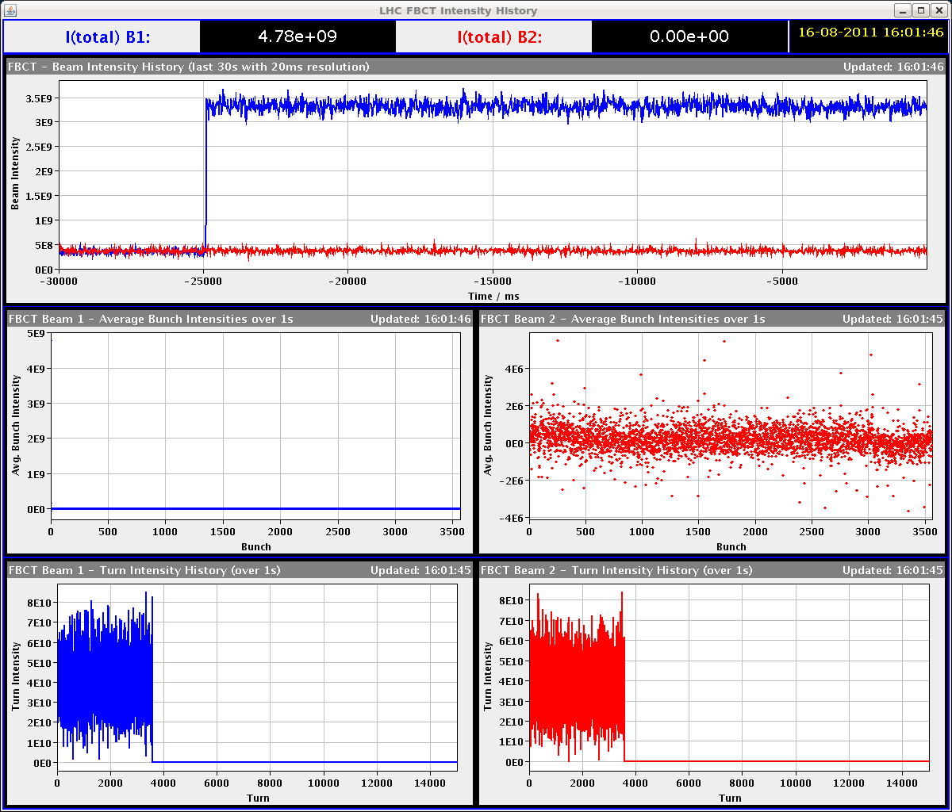
Tue late 16-Aug-2011
15:52h injection beam 1
optimising beam parameters
strong losses at SPS / Transferline
injection oscillations in LHC
“At the SPS, they found problems of injection oscillation.”

Slide 4
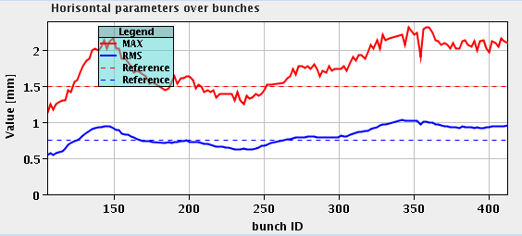
Tue late 16-Aug-2011
15:52h injection beam2
bunch by bunch oscillations ??
“Etienne C. is going to
check the kicker pulses.”
18:06h
Beam Dump by the OP switch while injecting for physics: bad inj osc for B2 requiring re-steering.
News from Etienne: he sees no problem with the SPS extraction kicker. the wave form is the same every time.

Slide 5
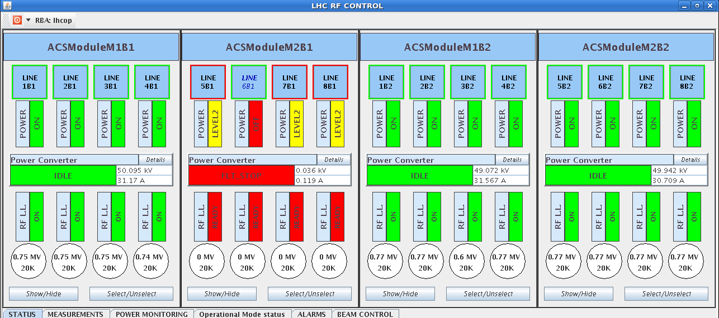
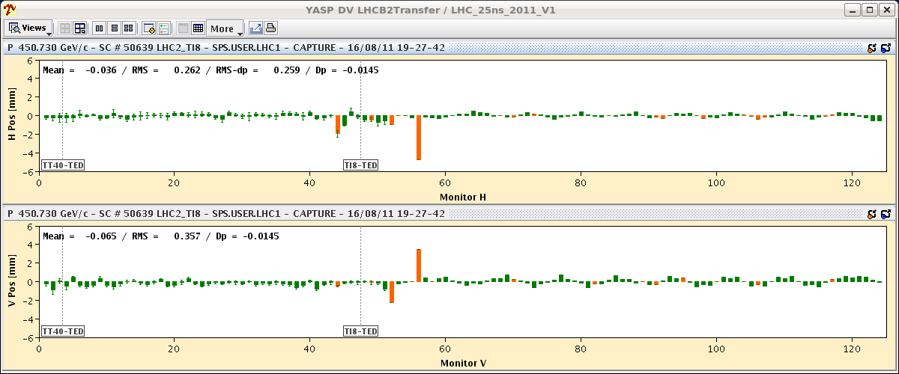
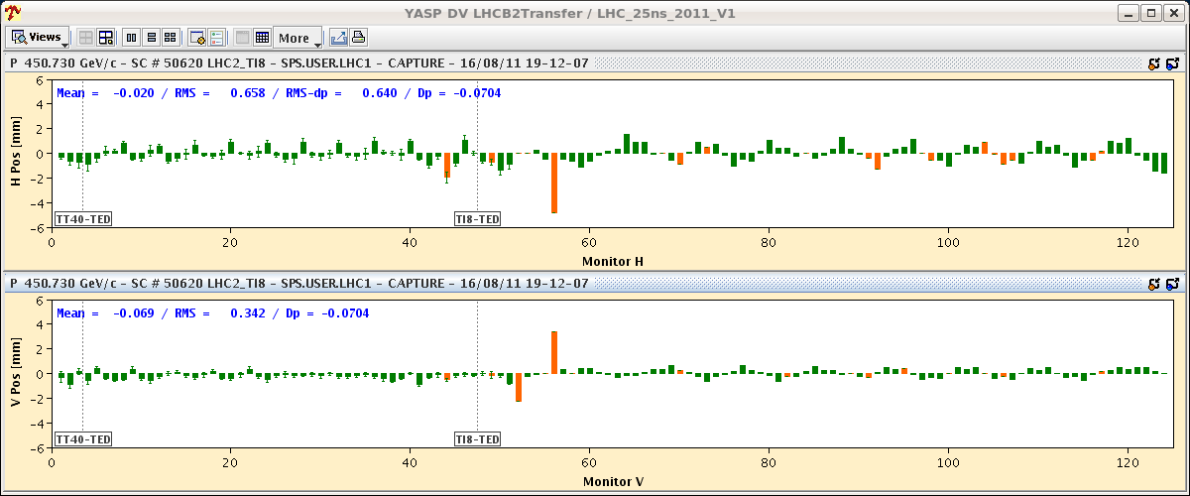
Tue late 16-Aug-2011
18:19h RF trip
The RF problem requires an access.
There is a problem with a power supply
of a B1 klystron focusing system.
Inj Optimisation / study ongoing
Etienne checked the MKE4 waveforms in BA4: for him all pulses are rock stable and the injection oscillations don't seem to be related to MKE4 waveform changed.

Slide 6
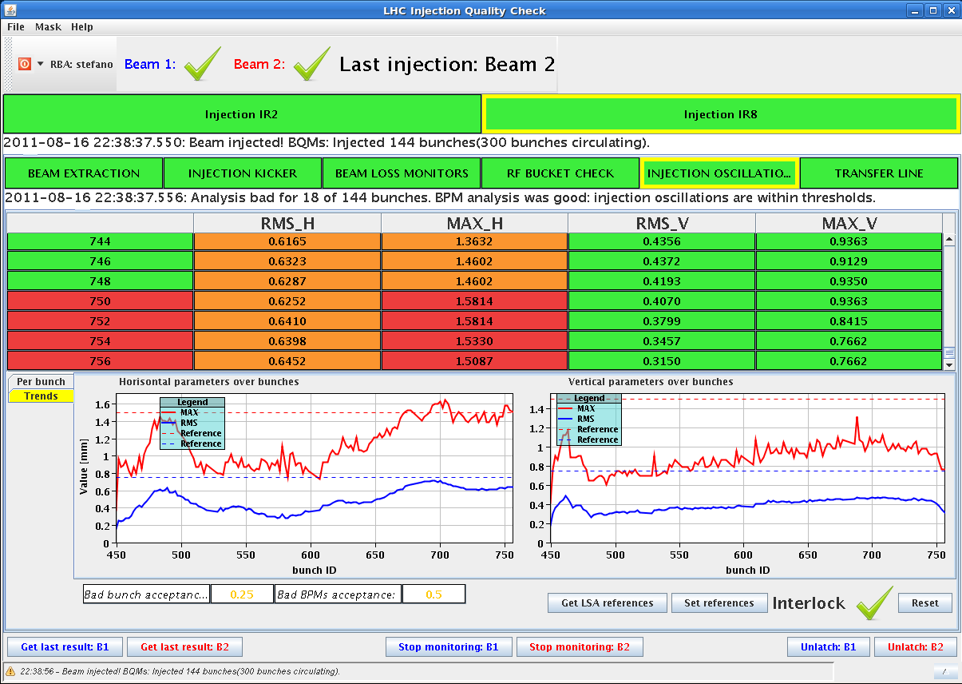
Tue late 16-Aug-2011
20:20h RF problem solved, injection for physics
still losses above warning in the ring
... in both beams
23:52h Luminosity
we are back in business !!

Slide 7
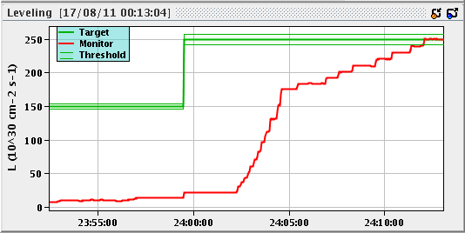
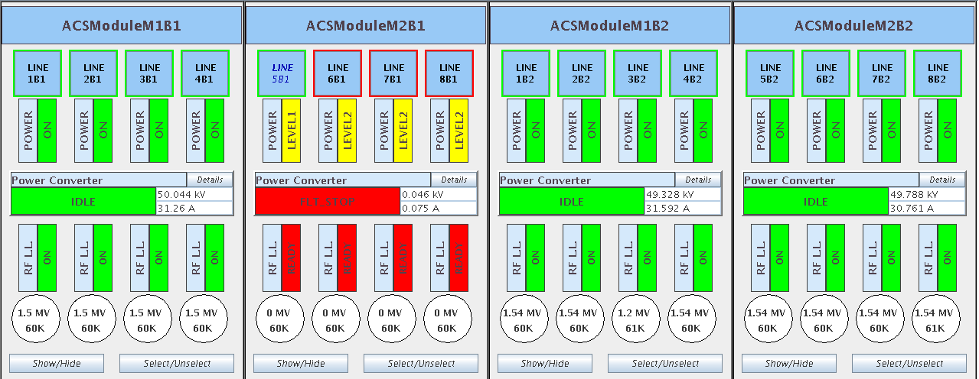
Tue night 16/17-Aug-2011
00:05h LHC-b on target lumi
02:04h Dump: Dump Classification: RF fault
(klystron filament current, possibly
bad contact according to piquet)
03:59h Injection probe beam
04:28h Injection for physics

Slide 8
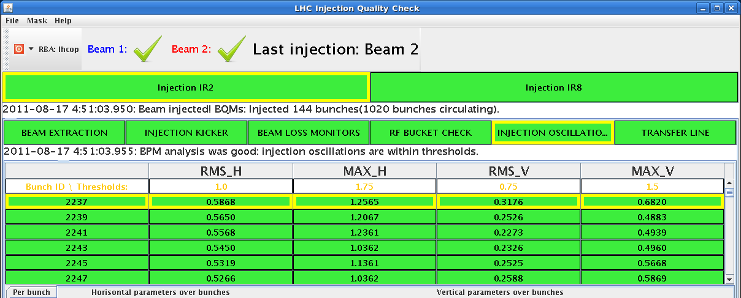
Tue night 16/17-Aug-2011
injection oscillations better now
05:45h Lumi

Slide 9
Tentative Planning: Tue / Wed
Tuesday late: Restart, 1380 bunches, N_{p} ≈ 1.2*10^{11,}
TOTEM & ALFA moving in
second fill: 1380 bunches, N_{p} ≈ 1.2*10¹¹, LHCb polarity changed
next fills increase bunch intensity N_{p} ≈ 1.35*10¹¹

