Slide 1
Thursday
Access, access, interventions.
RF investigations – localized the problem.
MKIs.
Optical fibers IR7 monitoring (fibers for LHC access system !).
Cryo interventions (auto-resets Pt 5/7, compressor config, etc).
WPS/HLS in Pt5.
CV Pt5.
QHPS in S12.
ATLAS, ALICE, CMS.
SIS fix for RF voltage, MKI temperature intlk now independent for 2 & 8.
Master thresholds for 10 TCSGs IR7.

Slide 2
Thursday evening
Dry ramp and squeeze to 1.5 m, followed by squeeze test to 1.0 and 0.55 m.
RF interlock in SIS good again.
1 m OK, 0.55 m → trip of all RQ6’s. Seems to come from B2.
Beta* information not correct below 1.5 m. New conversion tables I to beta* checked. They will be updated during the TS.

Slide 3
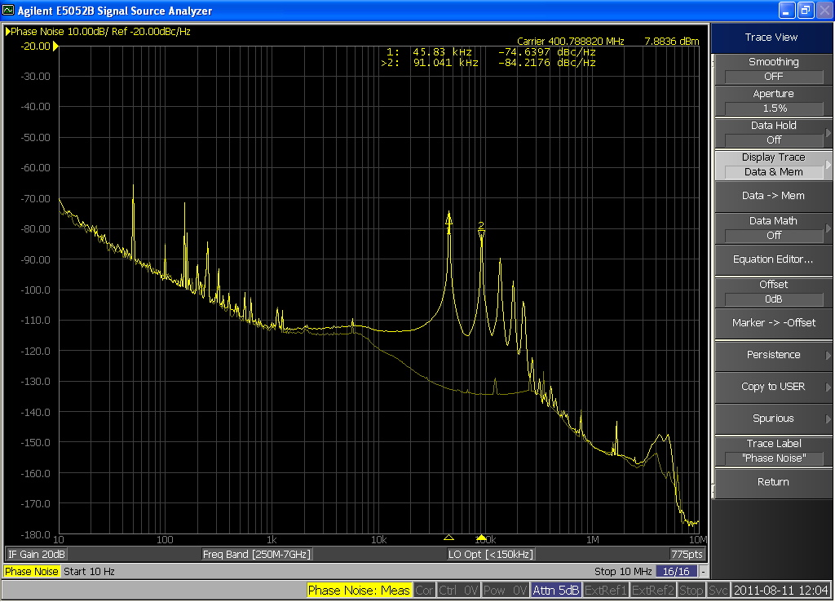
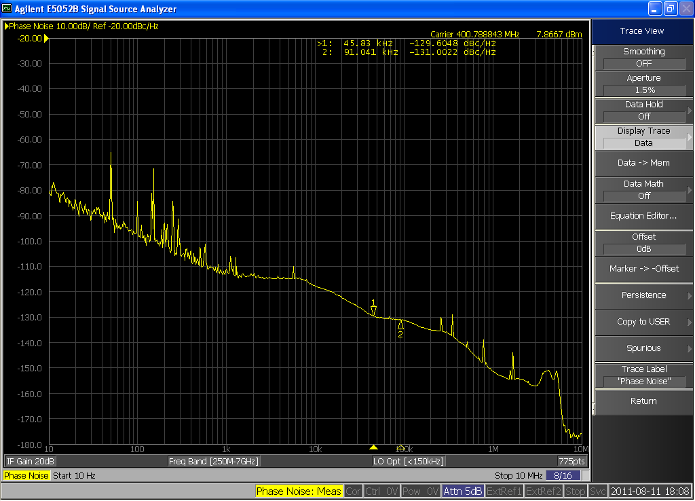
RF on beam1
Philippe BAUDRENGHIEN:
Without beam, Cav4B1 at injection settings had a large phase noise, locked at 4x frev. Cured by cold reset of the firmware.
Similar issue found on Cav4B2 – with lower amplitude. Not solved by reset. Gain reduced on loop for the moment.
All cavities checked.
Cav4B1
Cav4B1
after reset

Slide 4
SPS
Magnet in place and ready for pumping ~17:00.
First beam ~21:30.
Conditioning of the local vacuum with 50 ns beam.
4 batches at 450 GeV at 23:05, conditioning…
Extractions slightly readjusted in H.
00:00 LHC closed – last RF access finished.
01:40 Beam back in the LHC.
Injection oscillation corrections with 12b.
Filling a bit rocky.
Interrupted by a reboot of the timing FEC (mastership issues).

Slide 5
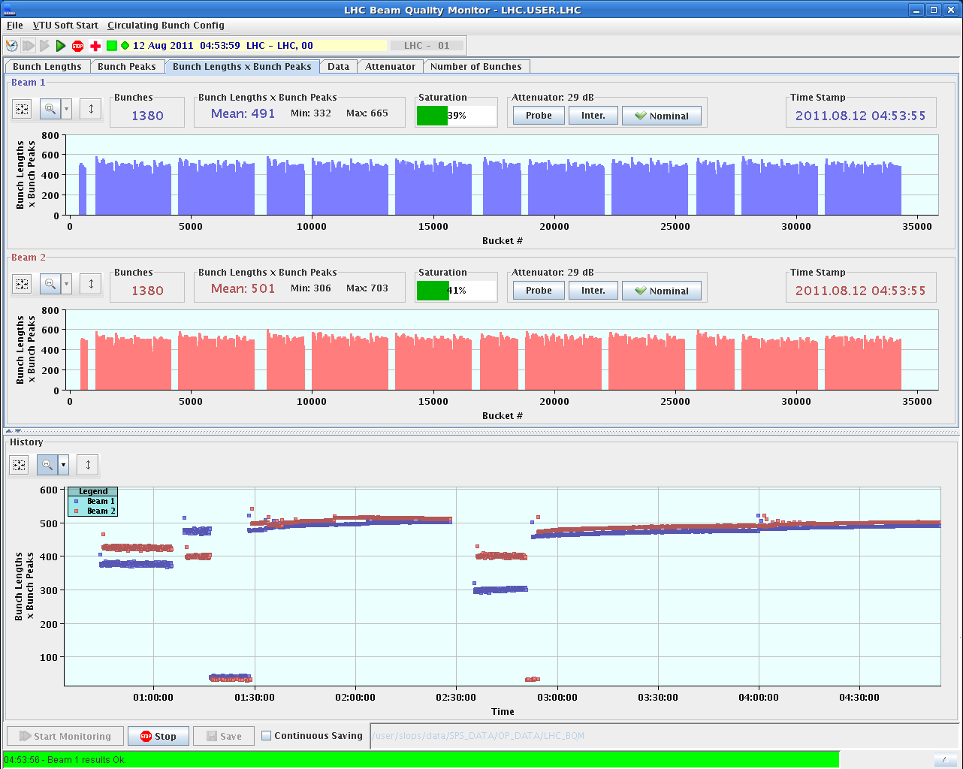
Bunch lenths

Slide 6
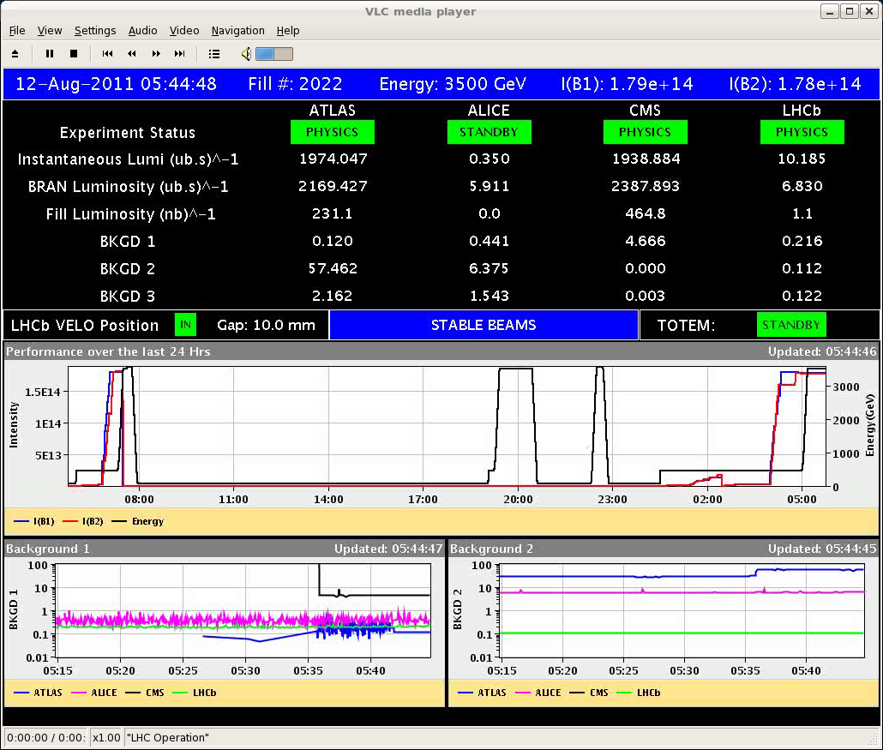
Vacuum activity at MKI in the ramp.
Stable – ‘modest’ Lumi given the intensity of almost 1.3E11/b.

Slide 7
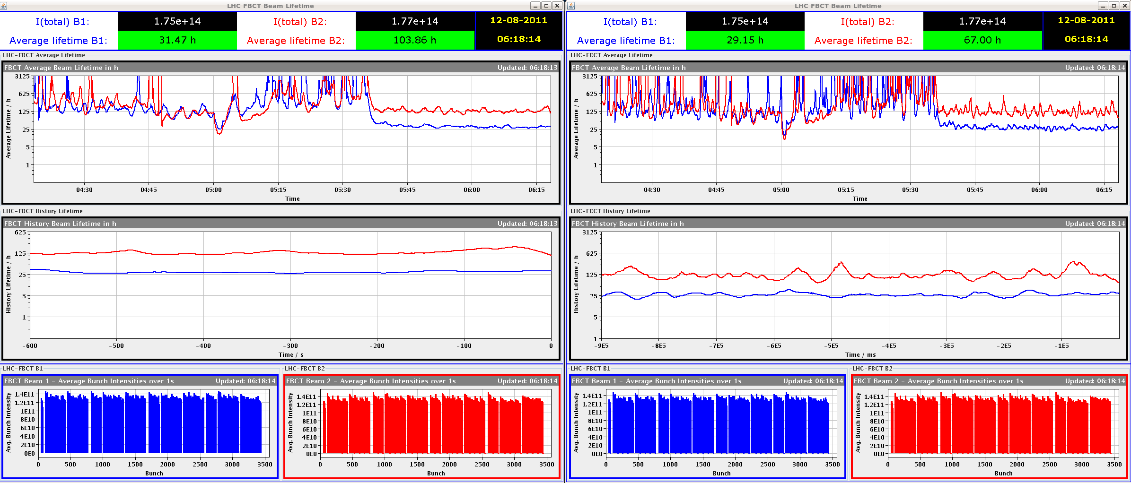
B1 lifetime low, but no dip when colliding..

Slide 8
Today
Physics.
Loss maps in collisions, probe+2b – slotted in when it fits (daytime).

Slide 9
Fill Overview
Fill | Phase | Peak L [10³³ cm⁻²s⁻¹] | Length [h] | Int. L [pb⁻¹] | Dump cause
2009 | STABLE | 2.1 | 15.3 | 76 | Sector 81 trip (QPS quadrupoles)
2010 | STABLE | 2.05 | 18.8 | 85 | RQT12.R7B1 (QPS-SEU?)
2011 | STABLE | 2.1 | 8.5 | 45 | SIS interlock (comm. To RF FEC)

