Slide 1
Wednesday
14:30 Fill 2011 dumped.
SIS interlock due to loss of communication with RF FEC.
45 pb-1 in 8.5 hours.
Investigations of RF problems at injection with beam1.
Problems during injection of fill 2011 due to RF problems.

Slide 2
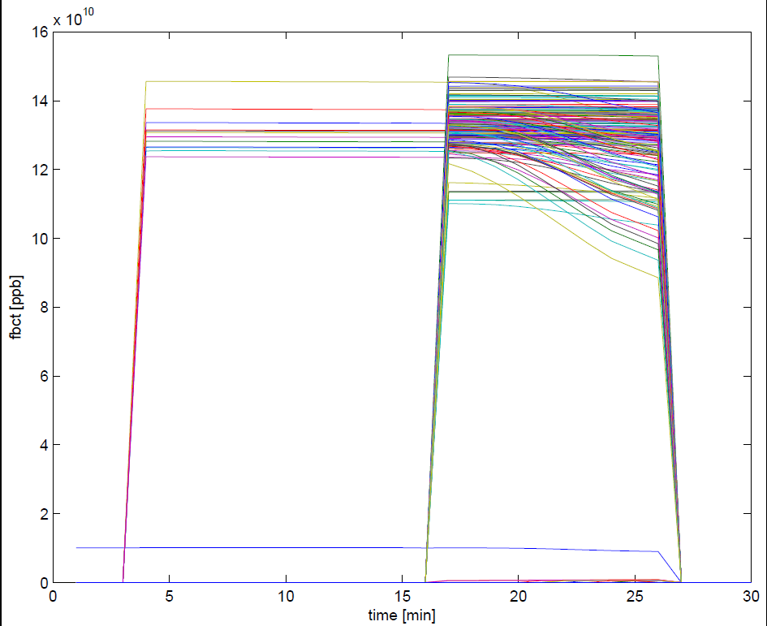
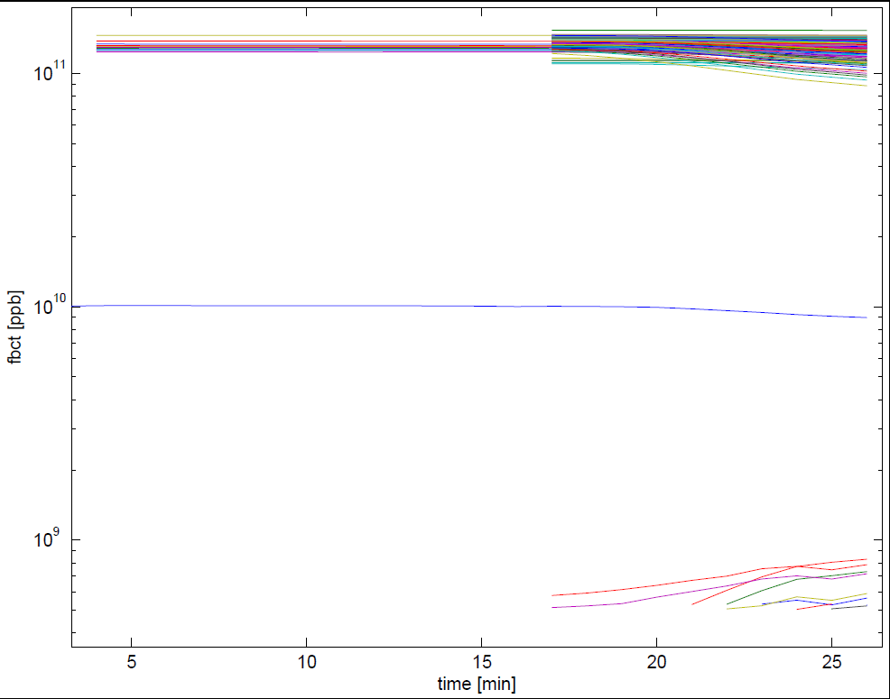
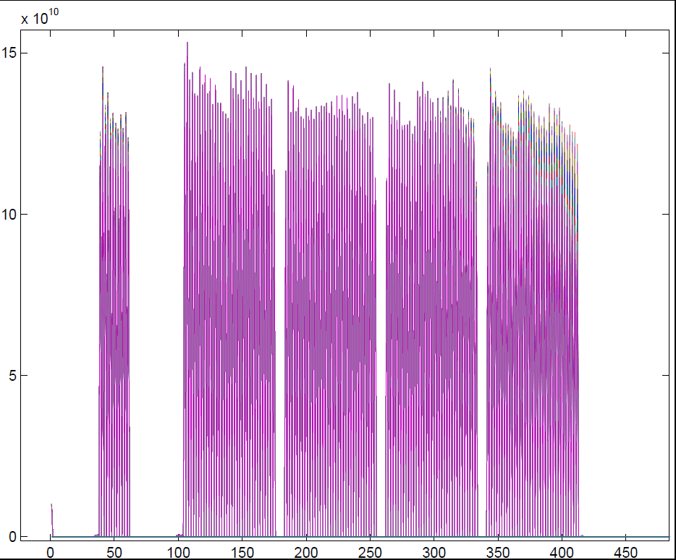
Beam dump at Wed 03:00:50.750
The first 144 train of B1 was badly captured and beam was escaping the bucket particularly in the last part of the train
G. Papotti

Slide 3
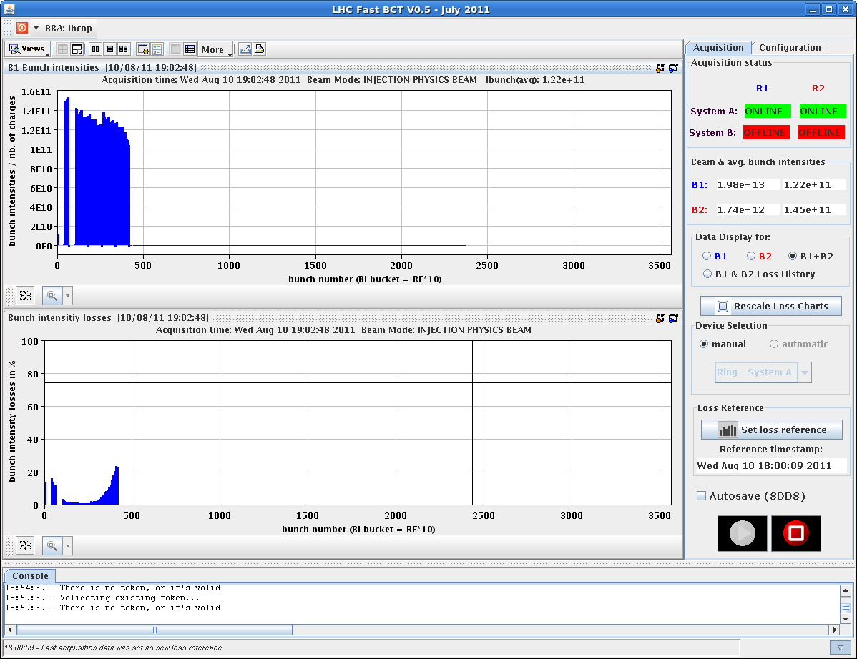
RF at injection
Beam 1 losses at injection of 144b

Slide 4
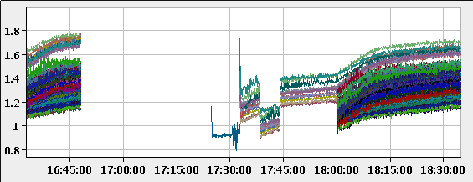
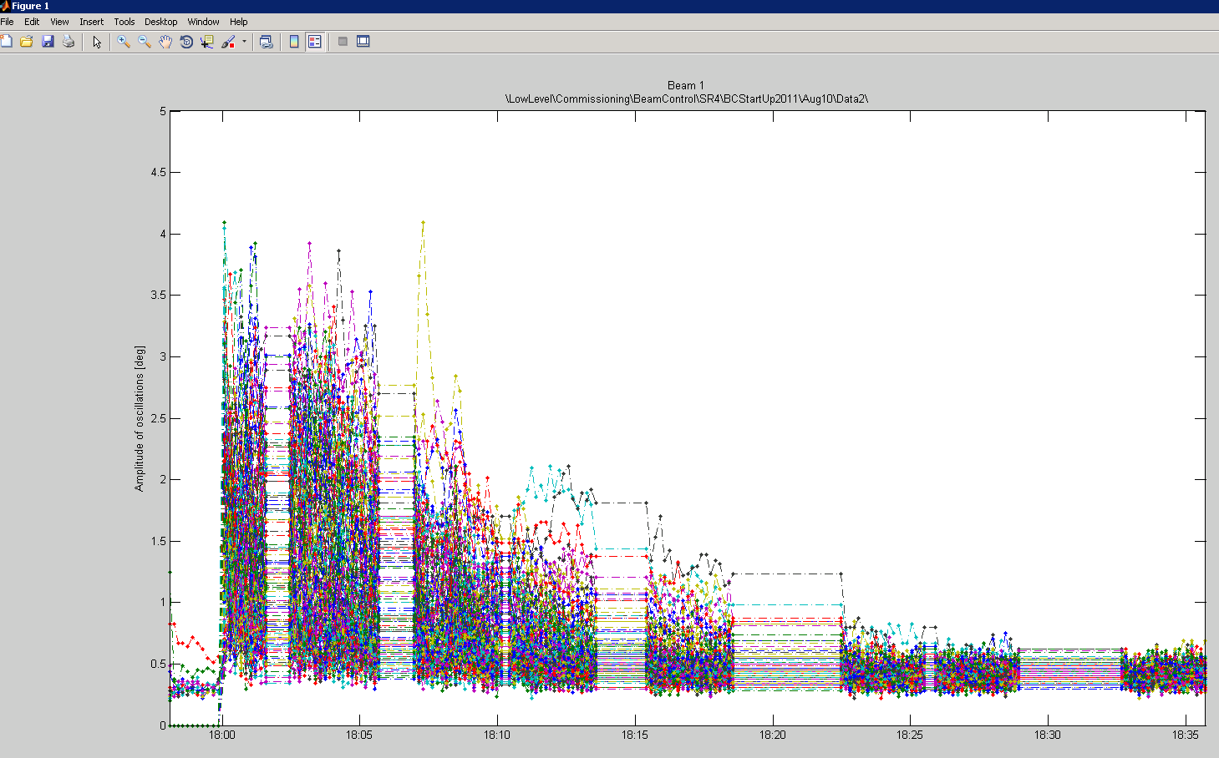
RF at injection
Beam 1 bunch length
Beam 1 phase oscillations last 20 minutes…

Slide 5
Mis(t)ery
The problem on beam1 could be reproduced.
The last bunches of the 144 bunch start losing beam out of the bucket quickly if the intensities by bunch are on average > 1.3e+11. The bunch lengths of the 12 b and the 144b grow rapidly.
Changing gains in the RF LL did not help.
The situation improves when the distance between 12b and 144b is increased.
For long waiting times after the first 144 bunch injections the beam is dumped on the next injection.
If the second 144 bunches is injected quickly, the situation is stabilized >> inject quickly beam1 – no interleaving during the first injections

Slide 6
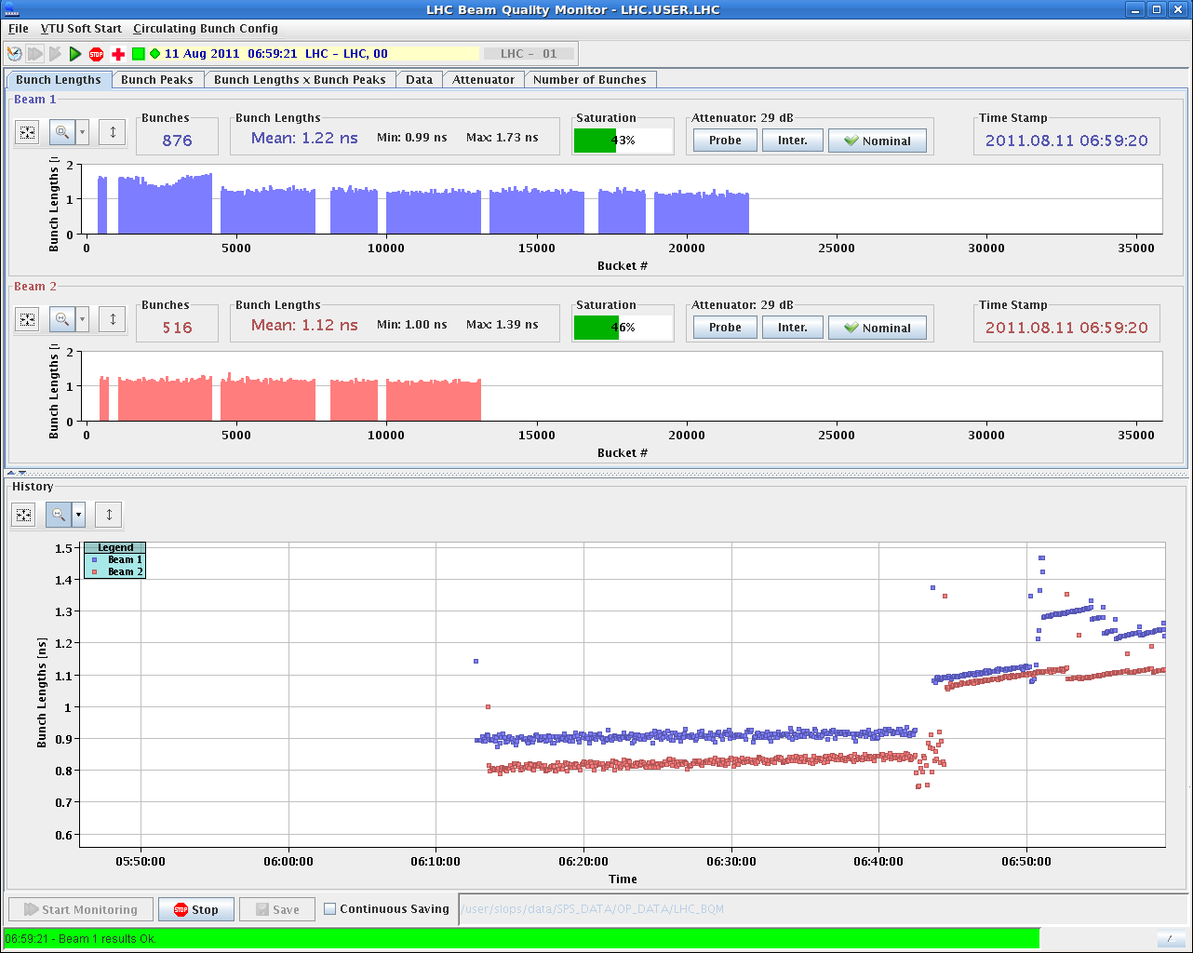

Slide 7
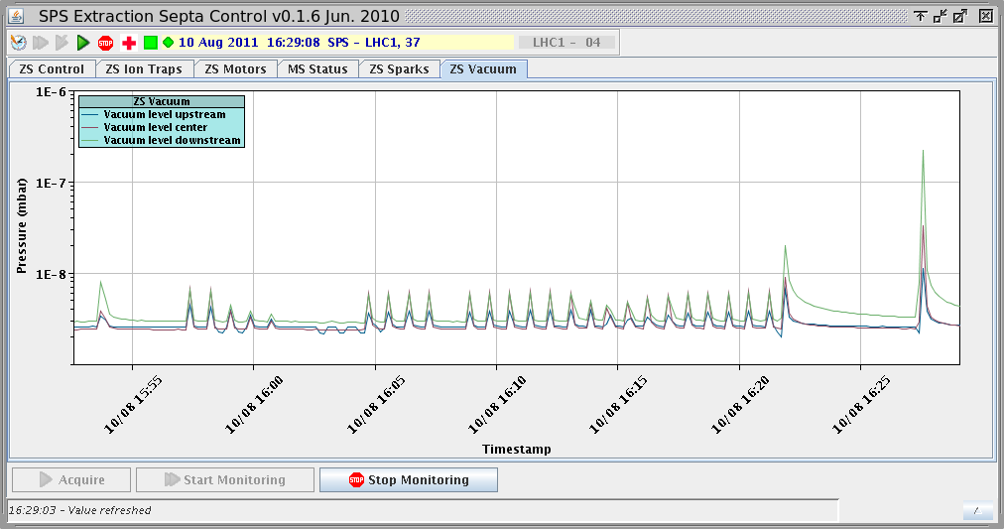
Higher bunch intensities - SPS
When pushing towards/above 1.3E11 p/bunch problems appeared on the SPS electrostatic septum for slow extraction (ZS).
Vacuum activity increasing.
Ion trap trips during LHC cycle, even with reduced voltage.
And sparking on certain cycles.

Slide 8
Night
02:00 Loss maps at injection finished.
Both B2H and B1H look suspicious. TBC. Compare with previous measurements…
03:00 Filling – sort of OK.
03:45 Beam dumped in the ramp, trip of RCBXH2.L2.
Fast Access for EPC to change power module – very fast reaction – thanks !

Slide 9
Night
05:04 MKI8 kicker faulty – need reset by expert.
06:40 Filling again for physics – 1.8E14 / beam
Vacuum high in MKIs at the end.
07:45 Dump at 3.4 TeV – total voltage interlock in SIS
Voltage sum reading (A.U.) : 17500 (B1) – 17200 (B2)
Interlock levels : 19450 - 18800
Normal values : > 22000
Correct reaction of SIS – why did the voltage sum change since yesterday ??

Slide 10
Today
SPS dipole replacement (MBA 52050) ~ 20 hours.
Access:
Auto reset for cryo-valves in IR5/7 (3 hours – no access)
Swap Board A➔B for nQPS QF/QD Sector 81
Oil leak warm compressor point 4 – require reconfiguration of point 4 (2-3 hours stop)
MKI2 (access – 2 hours)
RF
HLS in Pt5??

Slide 11
Fill Overview
Fill | Phase | Peak L [10³³ cm⁻²s⁻¹] | Length [h] | Int. L [pb⁻¹] | Dump cause
2009 | STABLE | 2.1 | 15.3 | 76 | Sector 81 trip (QPS quadrupoles)
2010 | STABLE | 2.05 | 18.8 | 85 | RQT12.R7B1 (QPS-SEU?)
2011 | STABLE | 2.1 | 8.5 | 45 | SIS interlock (comm. To RF FEC)

