Slide 1
Summary of Week 30
G. Arduini, J. Wenninger
Main aims:
“Adiabatically” increase peak luminosity by emittance reduction
Luminosity production

Slide 2
Fill Overview
Summary of Week 30
G. Arduini, J. Wenninger
Main aims:
Adiabatic increase of peak luminosity by emittance reduction
Luminosity production
Fill | Phase | Peak L [10³³ cm⁻²s⁻¹] | Length [h] | Int. L [pb⁻¹] | Dump cause
1975 | STABLE | 1.6 | 2.5 | 13 | Cryo valve PROFIBUS (UJ76) (SEU)
1976 | ADJUST | 1.6 | - | - | BLM TCSG.L7
1977 | SQUEEZE | - | - | - | RF trip: crowbar - spurious
1979 | STABLE | 1.3 | 6 | 23.3 | QPS RCO
1980 | RAMP | - | - | - | QPS RQTL7
1982 | STABLE | 1.7 | 2.5 | 13.4 | EL. perturbation
1984 | SQUEEZE | - | - | - | Vacuum R2
1985 | STABLE | 1.75 | 11 | 49.8 | El. perturbation
1986 | STABLE | 1.85 | 2.5 | 14.3 | RF klystron vacuum
1990 | STABLE | 1.92 | 7.5 | 40.9 | QPS trigger RCBXV3.R1 (SEU)
1991 | STABLE | 1.88 | 5 | 27.2 | Cryo valve PROFIBUS (UJ16) (SEU)
1992 | STABLE | 2.00 | 0.9 | 6.1 | Collimator control power supply (UJ16)
1993 | STABLE | 2.03 | 0.9 | 6.2 | UFO (31.L8)
1994 | STABLE | 2.04 | 0.75 | 5.3 | HOM on RF Line 2 B2 (spurious)
1995 | ADJUST | >2 |  |  | μUFO (Q3.L1)(ATLAS BCM)
1996 | STABLE | 1.92 | 1.2 | 6.9 | CRYO Pt.8 (PLC)

Slide 3
Main achievements (c/o ATLAS)
Peak Stable Luminosity Delivered | 2.03x10³³ | Fill 1993 | 11/07/30, 22:53
Maximum Luminosity Delivered in one day | 63.7 pb⁻¹ | Friday 29 July, 2011
Maximum Average Events per Bunch Crossing | 9.79 | Fill 1993 | 11/07/30, 22:53
Maximum Luminosity Delivered in 7 days | 276.15 pb⁻¹ | Saturday 23 July, 2011 - Friday 29 July, 2011
206.4 pb⁻¹ Delivered during week 30
Emittances now at the minimum achievable by the injectors and consistently below 2 μm in collision at the LHC
Bunch population ranging from 1.12 to 1.2x10¹¹ p
Beam-beam tune shifts close to 0.007/IP

Slide 4
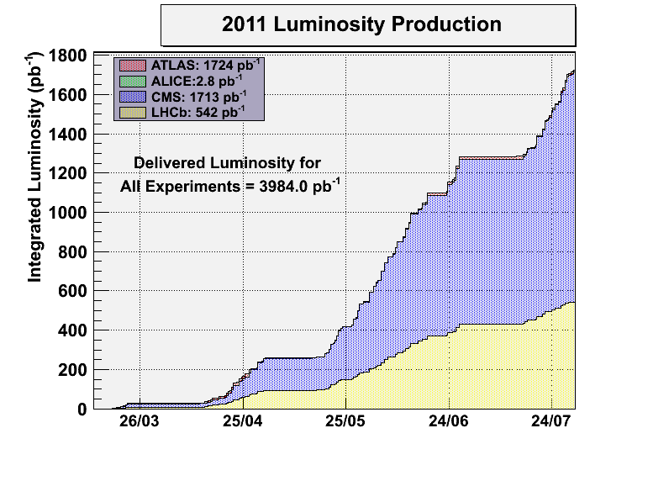
Statistics
24.1 % of the time in stable beams

Slide 5
Major stops
Injection kicker MKI2 untriggered turn-ons (Thu, Friday and Saturday)
Cryogenics in point 8 (Sunday, ongoing). PLC problem (this was relocated during the last technical stop)
Access for QPS, RF, LBDS (Tuesday 09:00 to 21:00) to fix a series of problems encountered during the previous days
Other issues:
  Vacuum activity in point 2 and 8
  UFOs
  Power glitches

Slide 6
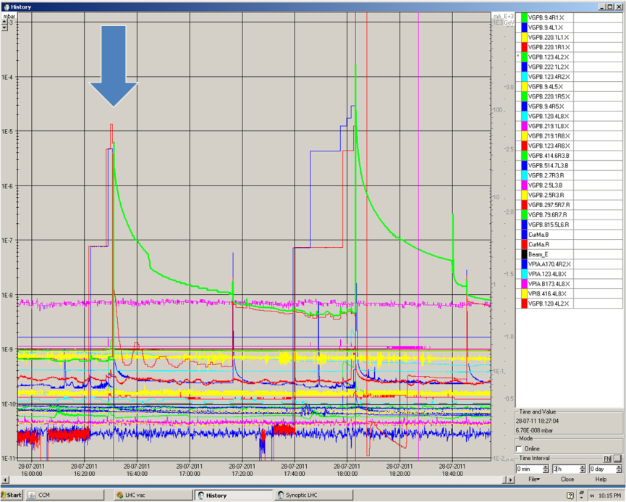
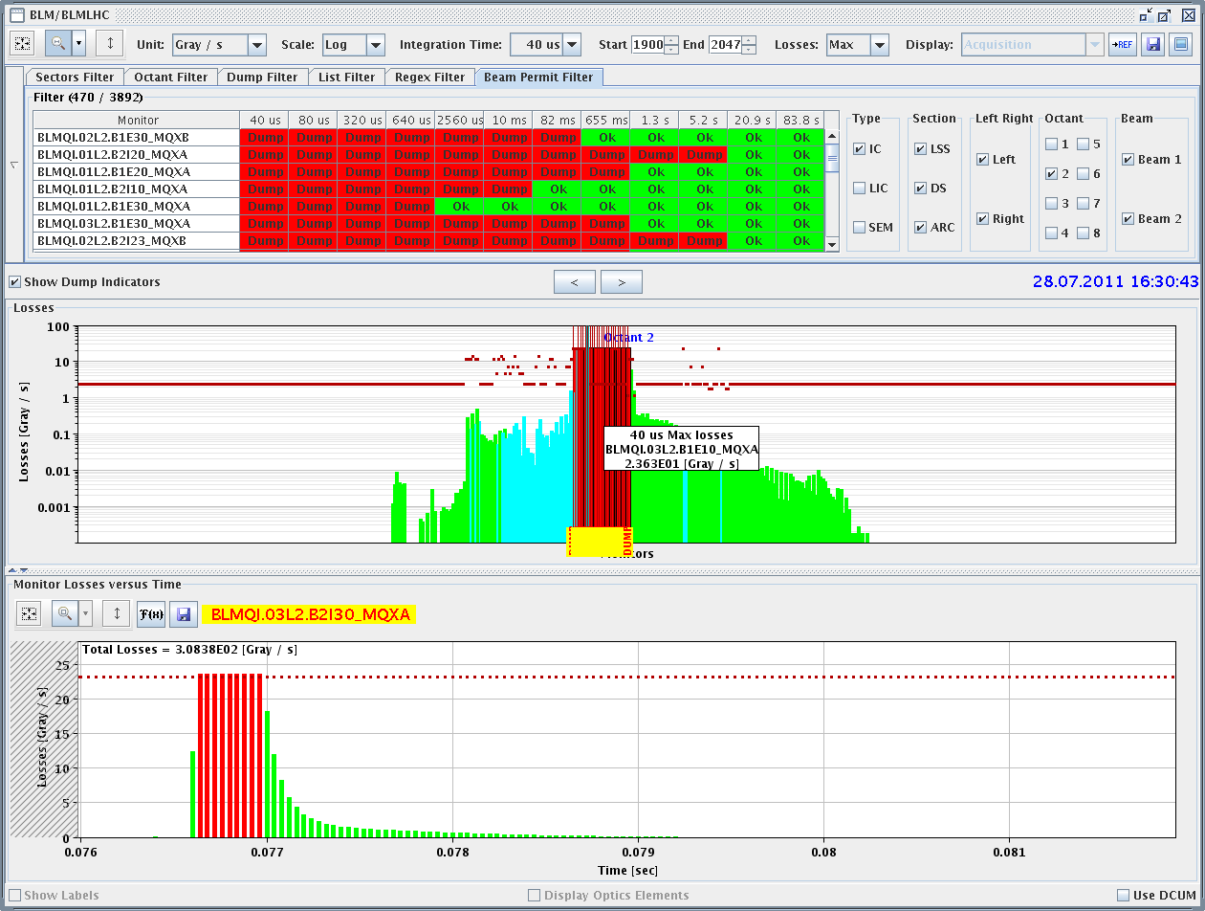
MKI2 event no. 1 (Thu 28/7)
16:30 Injected beam of 144b dumped on TDI in IR2.
  Main switch erratic on PFN C.
  Injected beam was not kicked, erratic was too late to prevent the extraction.
  Circulating beam was not hit.
  Heavy losses in IR2, but NO quench.
  Vacuum spike, valves closed.

Slide 7
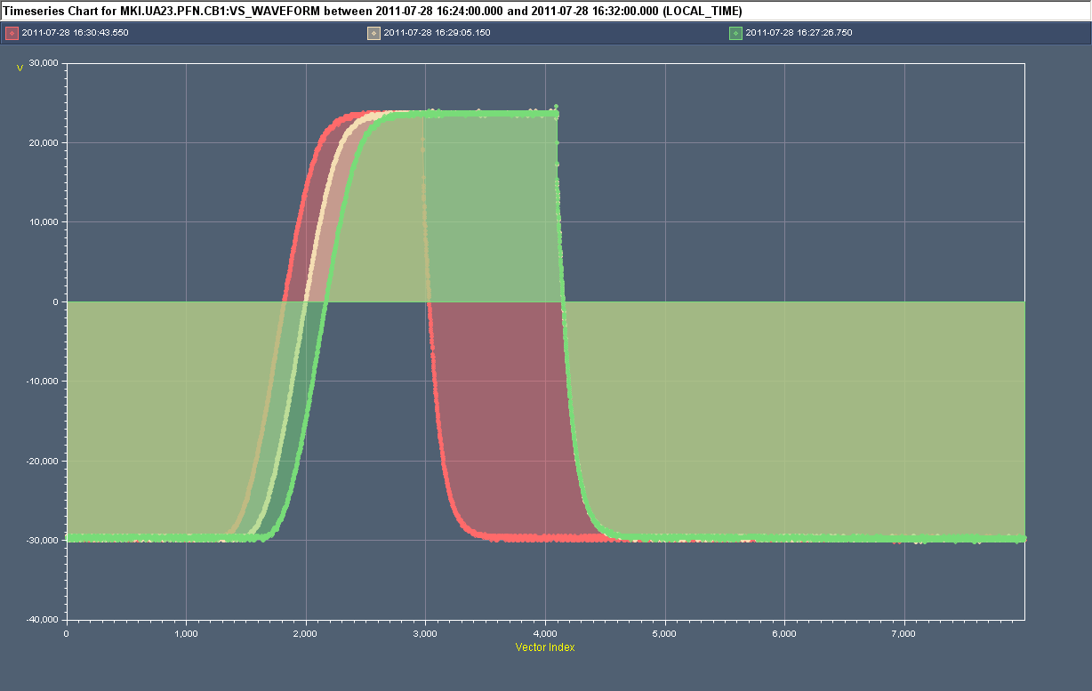
MKI2 event no. 1 (Thu 28/7)
Normal (triggered) turn-on
Erratic (untriggered) turn-on of MKI2 MS3
Interlocks detected erratic. Control (machine protection) philosophy is to trigger all MS and DS of system (within a delay of 1µs). Hence all 4 kicker magnets pulsed for up to 4.5µs.
Circulating beam was not hit by the kick.
Batch was extracted from SPS but saw no kick at MKI and went straight into the TDI.
Note: this MS was put in place during last TS and has since made 5 erratics (only last 2 effected beam).
M. Barnes

Slide 8
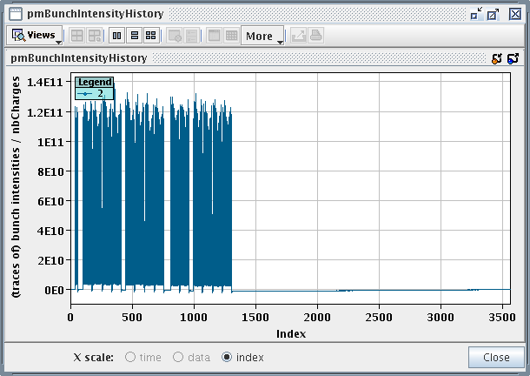
MKI2 event no. 2 (Thu 28/7)
17:00 Following investigations by expert resumed filling for physics.
18:02 Requesting 4th injection from 36b SPS cycle : 144b.
  Circulating B1: 12+2x144+72+144 ~500b, 6E13 p.
Massive beam loss during injection
  Main switch erratic on PFN C
  D1.L2, triplet L2, D2.R2 quenched.
  Massive losses in IR2.
  Vacuum spike and valves closed again.
  ALICE hit (again).

Slide 9
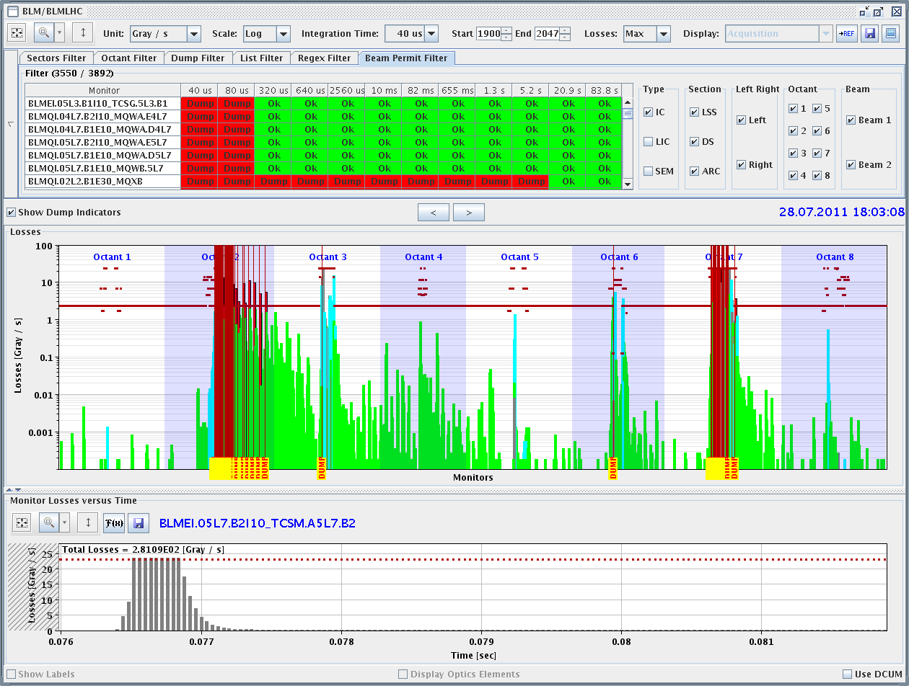
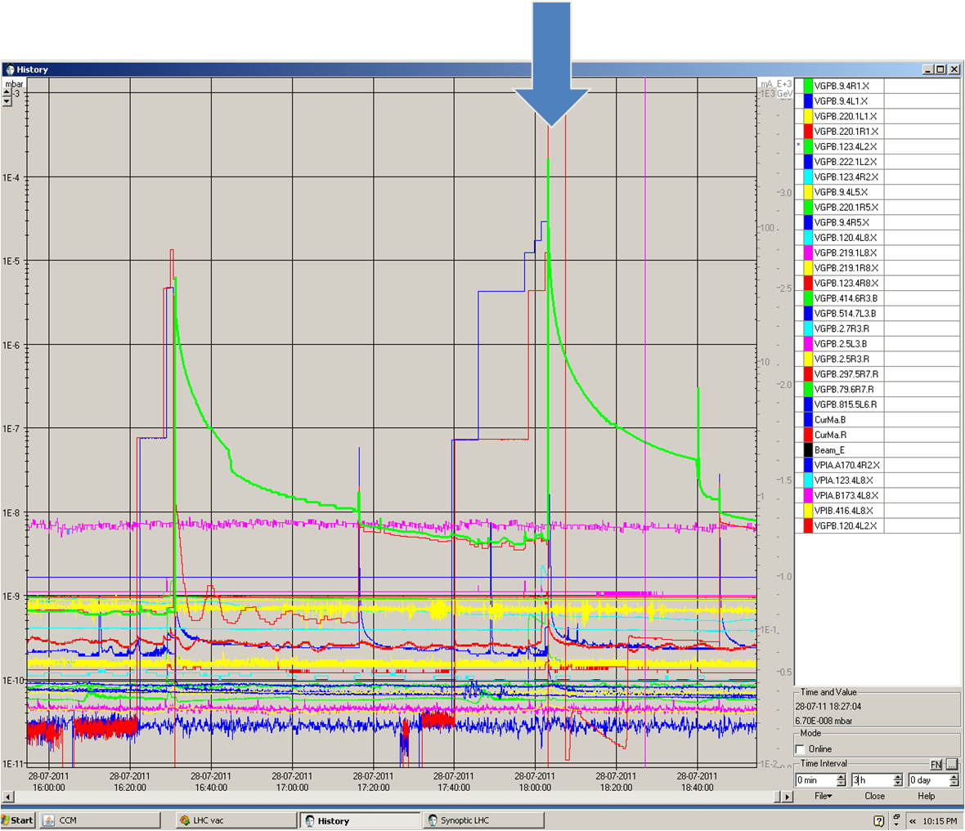
MKI2 event no. 2
BLMs: important leakage to S23 (but no quench) and IR7.

Slide 10
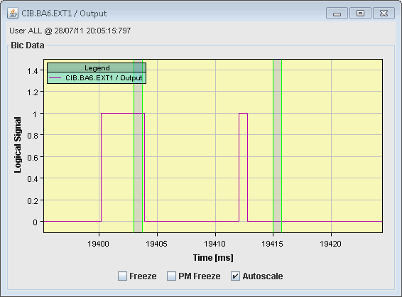
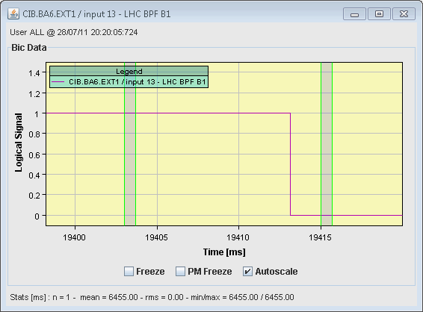
MKI2 event no. 2 – SPS extraction analysis
Extraction conclusion:
  Event occurred ~2 ms before extraction.
  144b were not extracted from the SPS – the losses are coming from badly kicked circulating LHC beam.
    Also confirmed by TI2 BCTs and BPMs – saw no beam.
MKE6 PFN charging
Extraction
Extraction
Extraction permit
LHC BPF

Slide 11
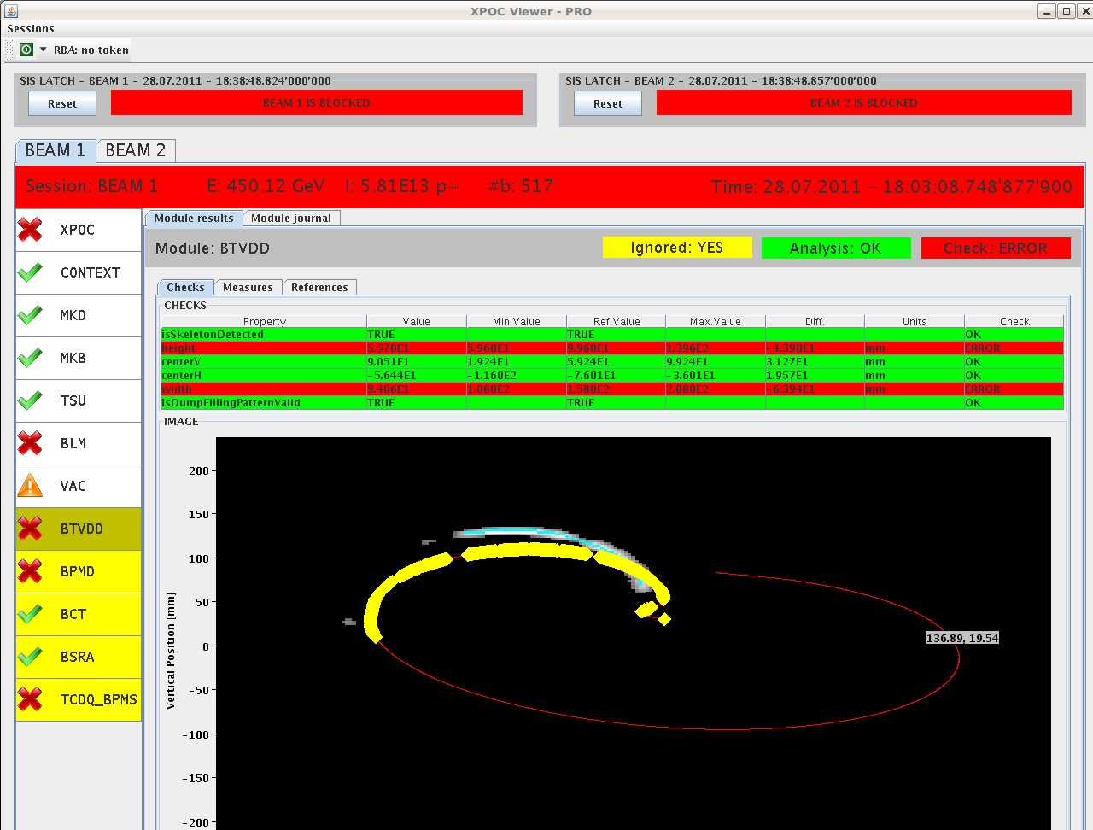
MKI2 event no. 2 – dumped beam
BTVDD and dump line BCTs indicate that ~ 200 bunches of the circulating were not dumped → to TDI.
Beam kicked to TDI

Slide 12
MKI2 event no. 2 (Thu 28/7)
M. Barnes
PFNs 1 & 2 at normal voltage (~50kV)
PFNs 4 at low voltage (~33kV) because of PFN3 switch erratic
Erratic (untriggered) turn-on of MKI2 MS3
Erratic during resonant charging and before SPS extraction. SPS beam was not extracted.
Interlocks did NOT detect erratic of MS3 (at 33kV). PFNs discharged via the DS after 4ms (no further magnet current);
The circulating beam which was swept over the aperture and protection elements (~17% of normal kick) for ~9µs. Bunches grazing on TDI quenched D1.L2, triplet L2 and D2.R2 and hit ALICE.

Slide 13
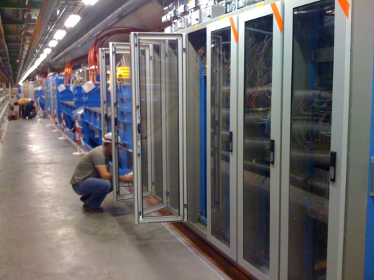
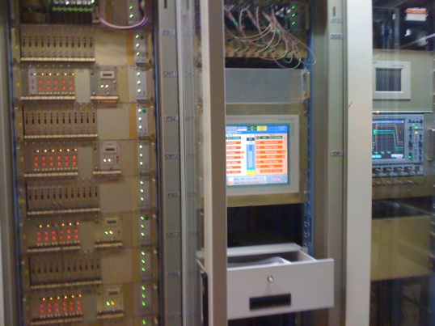
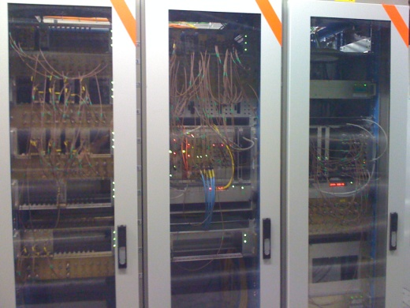
MKI2
Intervention on morning of 29/7/2011:
MS3 exchanged for spare
All 6 erratic detection cards, for MS3 replaced.
Cards used to retrigger MSs replaced;
Some 50 ohm LEMO terminations, on the retriggering chain, replaced.
Local operation, SoftStarts and Inject and Dump did not result in any further erratics.

Slide 14
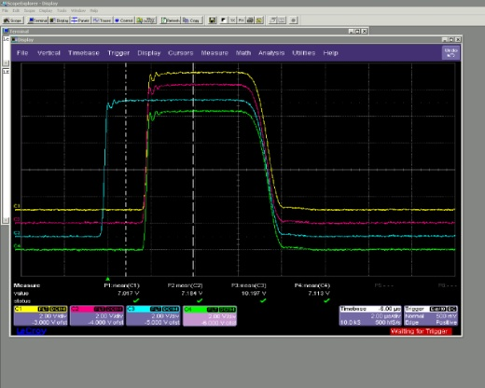
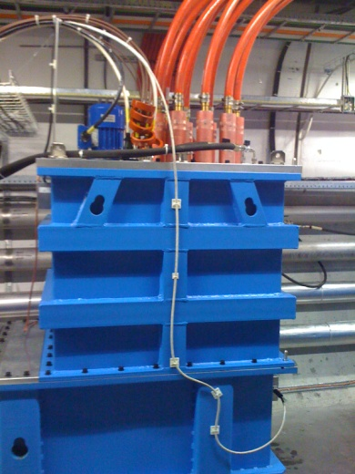
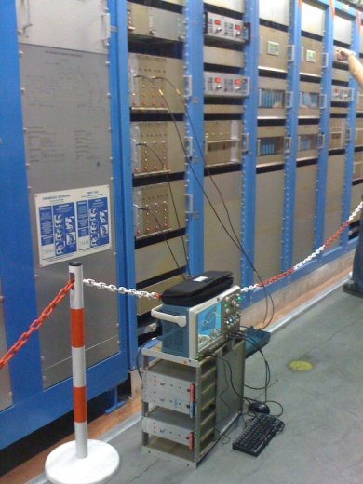
MKI2 events no. 3-4 (w/o beam – Sat 30/7)
MS3 erratic during SoftStart @ ~04:30hrs, at 51.6kV (2kV above nominal). Erratic was correctly detected, resulting in the turn-on of all 4 MS.
MS3 erratic, during SoftStart @ ~15:06hrs, at 50.4kV (0.8kV above nominal). Erratic was correctly detected, resulting in the turn-on of all 4 MS.
Intervention on afternoon of 30/7/2011:
Magnetic cores added to trigger inputs of MS3
Trigger units for MS3 replaced.
Power supply and crate for MS3 heater/reservoir replaced.
Diagnostics added
M. Barnes

Slide 15
MKI2 status
No additional erratics since Saturday afternoon
Carry out some checks on trigger cables for MS3 this morning.
Diagnostics in place in case of other events
Spares available in point 8 and laboratory

Slide 16
Vacuum spikes in L8
Solenoids off at injection to verify the possible correlation with e-cloud ➔ No correlation of vacuum pressure with solenoid current for L8 (but for R8). e-cloud not responsible for pressure spikes
Improvement of beam lifetime and B1/B2 lifetime asymmetry and reduction of the vacuum/loss activity in IP8 after LHCb polarity switch but in particular after reduction of the emittance and working point optimization
Not totally understood

Slide 17
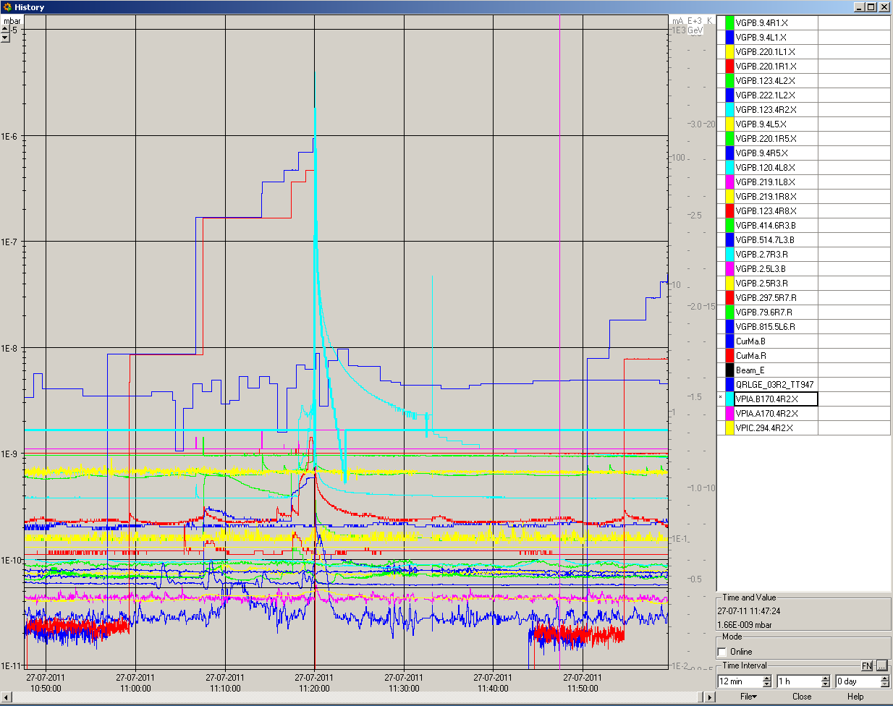
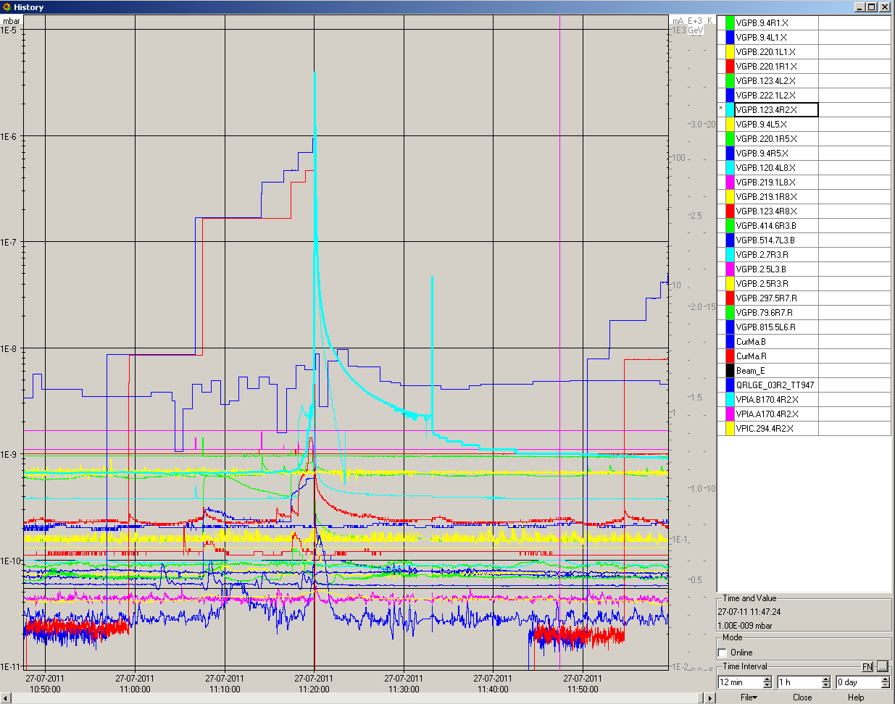
Vacuum spikes in R2
Possible explanation (V. Baglin) is the outgassing of an ion pump when the discharge is starting from time to time. Increase the interlock level on the nearby vacuum gauge temporarily to allow cleaning

Slide 18
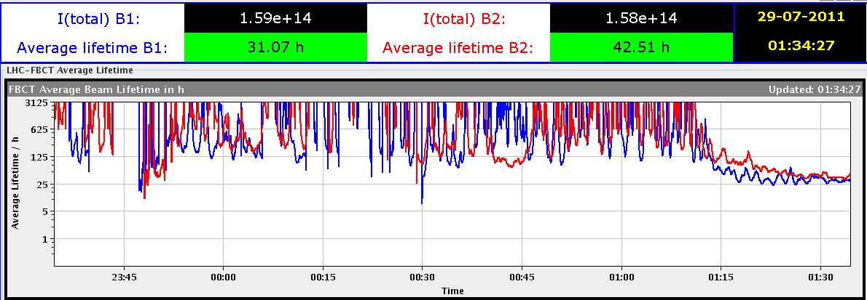
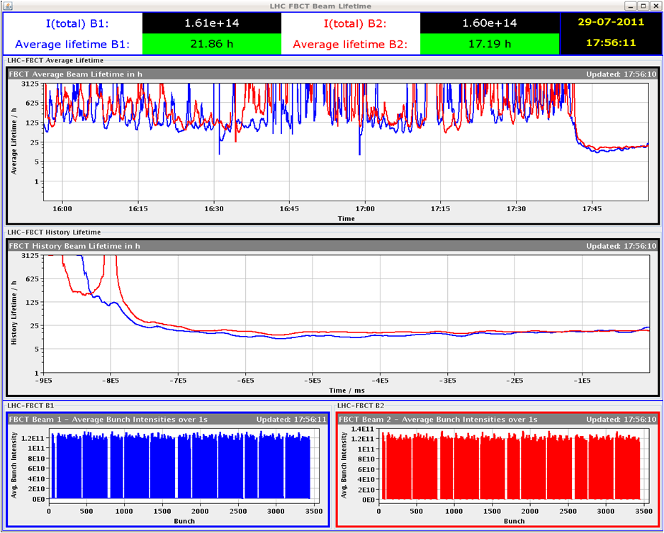
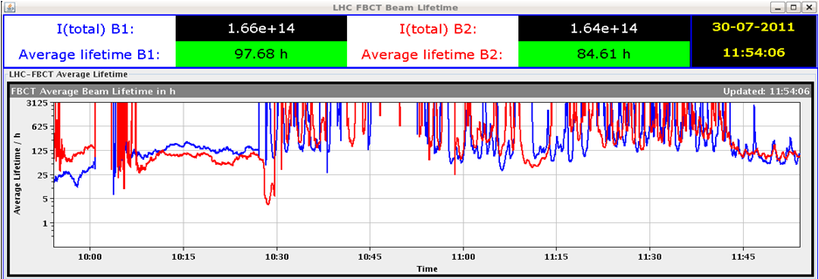
Working point optimization
Fill 1990 – 0.31/0.32
Fill 1991 - 0.308/0.318
Fill 1992 - 0.312/0.322

Slide 19
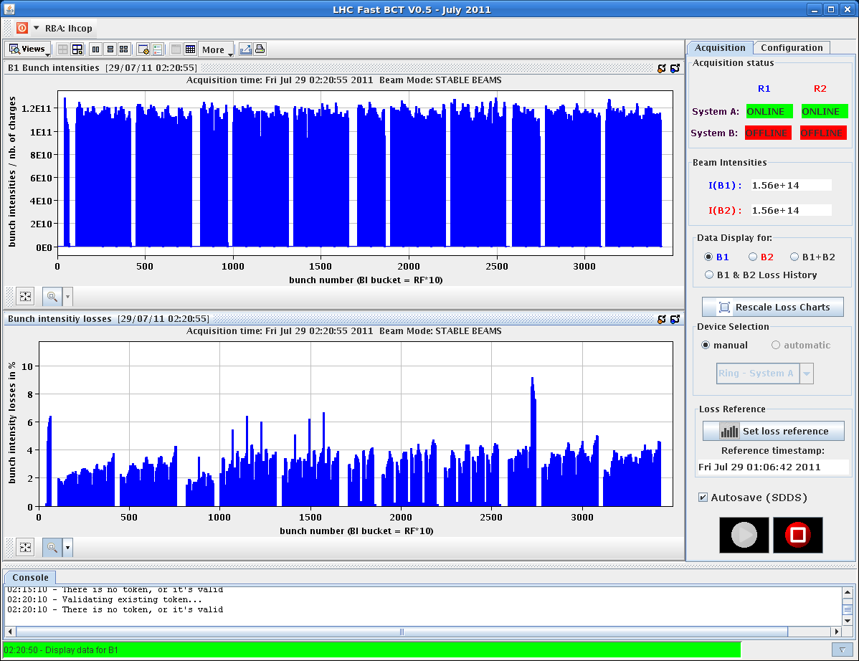
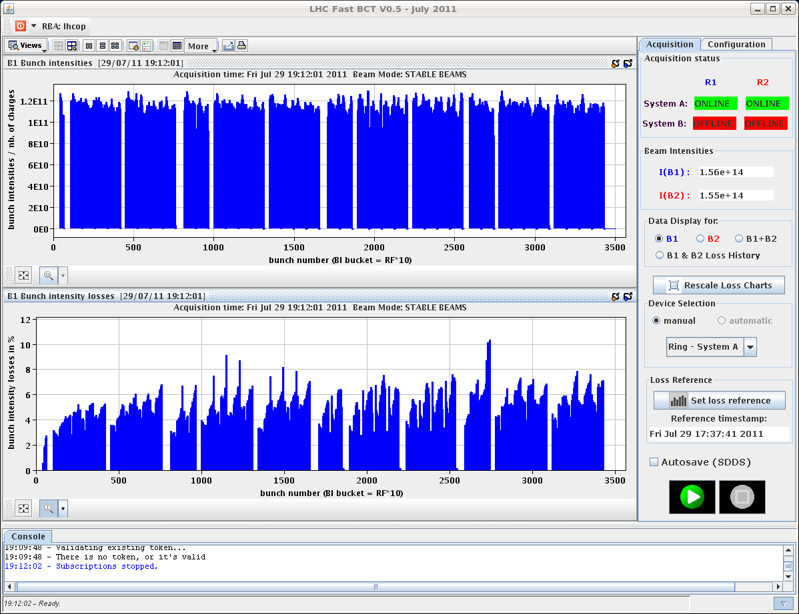
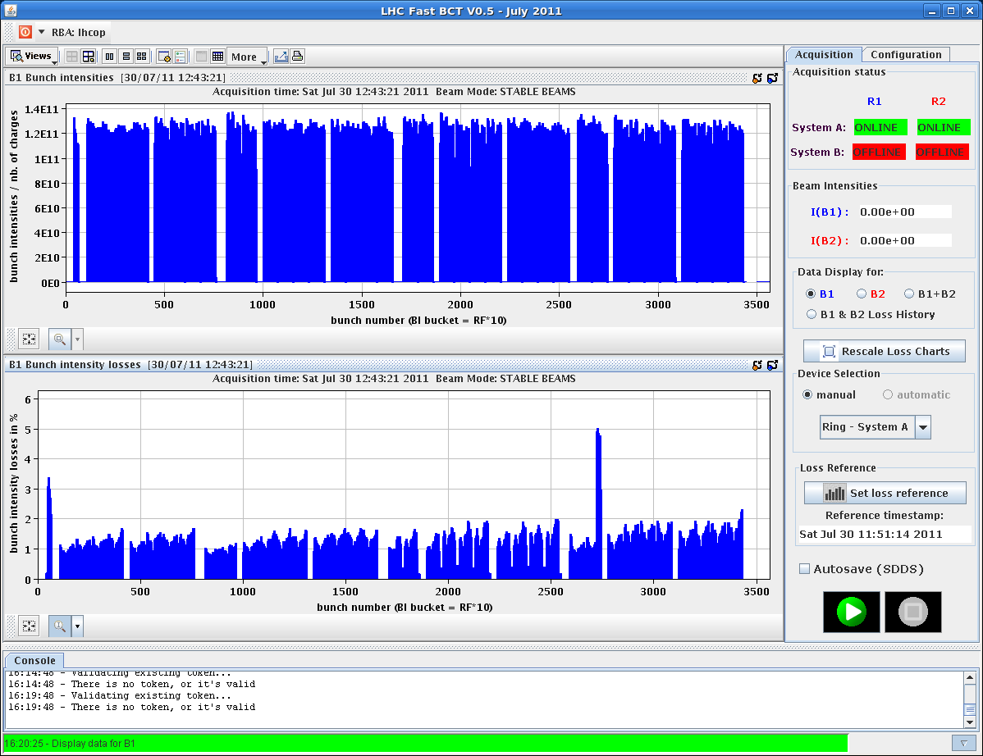
Working point optimization
Fill 1990 after ~1h
Fill 1991 after ~1.2h
1-2-5-8
1-2-5-8
Fill 1992 after ~0.9h

Slide 20
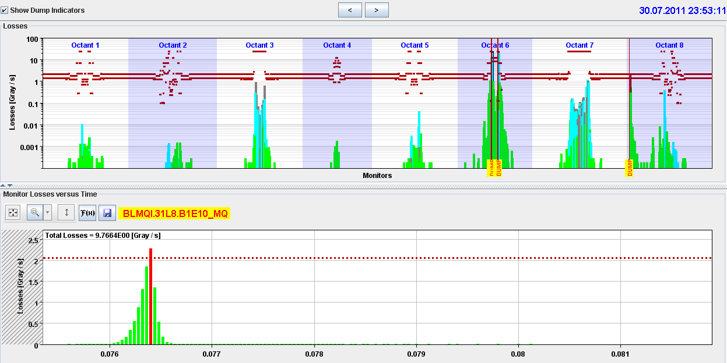
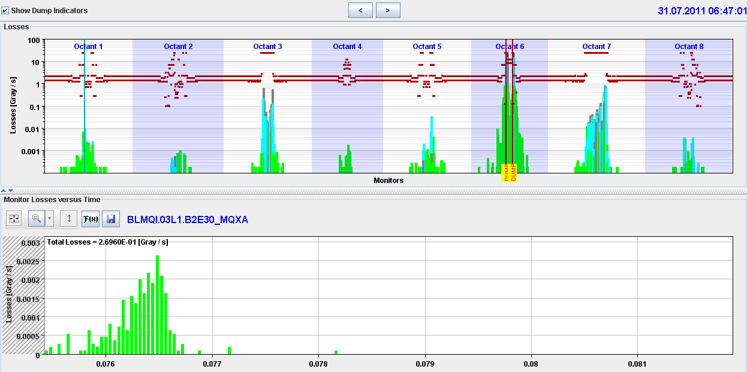
UFO are back…
30/7 - 23:45 - arc UFO – 31L8
  Fast and strong.
31/7 07:00
  μUFO Q3-Q4.L1. ATLAS BCM dumped

Slide 21
Summary
We can keep the very small emittances delivered by the injectors now at their minimum
These small beams can be brought in collision with almost no visible lifetime dip ➔ working point (to be continued..)
Vacuum spikes seem to become weaker but not totally understood
Quite a number of stops ➔ not really seen the effect of the increase in peak performance. Particularly penalizing for LHCb.
<50 % of dumps due to high intensity/luminosity effects.
In spite of the number/length of stops managed to produce a good integrated luminosity

Slide 22
Plans
Day: Cryo recovery
Evening: Physics
Week 31 Coordinators: Bernhard and Mike

