Slide 1
Thursday 20th July - morning
08:10 Cryo intervention at point 1 is over.
DFB valves back in service.
Precycle etc.
11:30 injection
2 microns from SPS
1.09e11 per bunch
12:50 Stable beams #1961
> 1.4e33 cm-2s-1
tune-shift ~0.019
14:58 Beams dumped
Lost sector 81 - QPS

Slide 2
Thursday 20th July - morning
Access for QPS
Atlas & CMS also in
QPS intervention
16:28 WorldFIP repeater replaced but problem not solved.
18:37 The QPS experts have identified the problem in S81. It was a blown fuse of a WorldFIP repeater, but not on the one which was exchanged.
QPS also lost communication for RQT13.L6B1/B2 and RCO.A56B1/2 during ramp-down
M.Zerlauth called back concerning the trip of RCO.A56B1
He suspects a problem on the QPS card and suggests to replace it if another trip occurs.

Slide 3
Wednesday evening
19:30 pre-cycling
21:50 Ramp started
22:30 Stable beams #1962
masking the BLM HV in 7 signal was not necessary
Initial luminosity: ~1.29e33 cm-2s-1
Total intensity: 1.56e14
Average bunch current: 1.13e11
Bigger emittances - SPS
Clear drop of the life-time and reached 50 % of dump threshold on 2 collimators in IR7 (running sum 83 s) when bringing LHCb into offset collisions
ditto #1961
bringing LHCb in from fairly large separation to 1 – 2 sigma – beam-beam

Slide 4
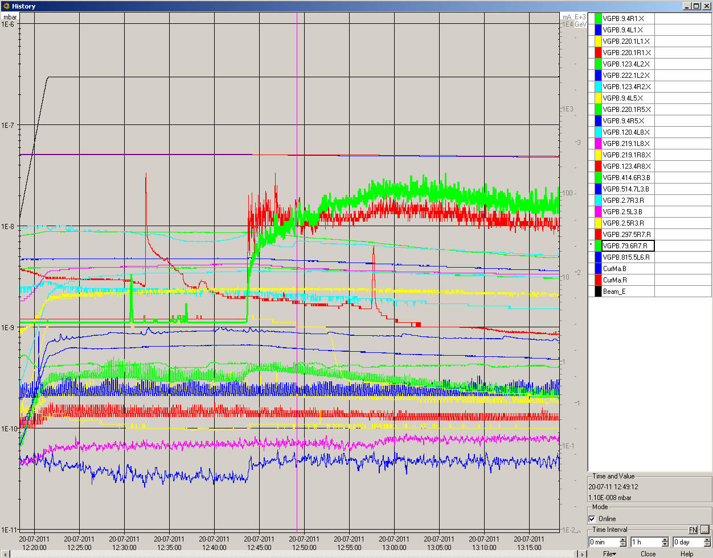
Vacuum #1961

Slide 5
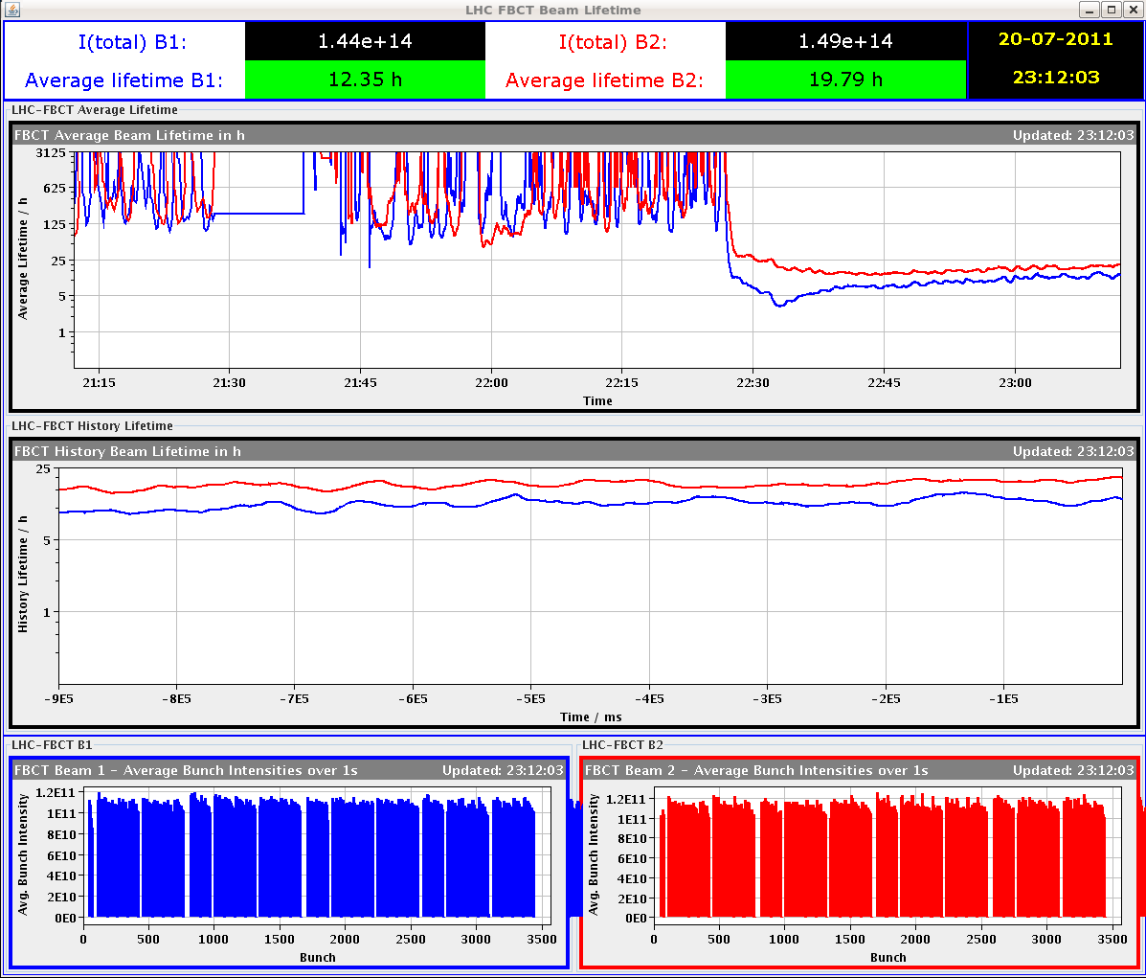
Lifetimes #1962

Slide 6
Today
Luminosity production
bunch intensity of 12b drifting low…
LACS Database intervention – no access 09:30 – 12:00

