Slide 1
Friday morning
06:32 Beam lost just after collisions (840 bunches)
software interlock on the voltage of a BLM card.
Re-injection interrupted to allow for an access in ATLAS
RF also in to repair L2B1 klystron.
Cryo point 6
The RF team got stuck underground because the PZ45 lift was blocked.
The piquet has been called to repair the lift, team came out from the PM but their material left down.
Precycled the machine while waiting for piquet.

Slide 2
Friday afternoon
14:00 lost the cryo maintain in MSR7 t0wards the end of the precycle.
faulty temperature sensor on RQTL9.R7B2 – see over
Access required
RF back in PZ45 to pick the stuff they had left behind due to the lift outage (the lift is functioning now).
Atlas also in shadow
17:20 Access over
Pre-cycle
19:20 Probes in

Slide 3
Faulty temperature sensor on RQTL9.R7B2
Le canal redevient operationel lorsque la chaine de mesure est temporairement ouverte à n’importe quelle niveau du cablage et pas exclusivementau niveau C50: d’ou nous suspectons un probleme capacitif?
Le probleme n’etant pas reproductible, nous avons decide de switcher les cables* des amenées 1 à 6(C50_2) avec celles de 7 à 12(C50_3) tout en corrigeant les adressages sur le systeme de controle afin d’être transparent au niveau de la supervision.
Cette operation nous aidera à diagnostiquer plus précisement la source du probleme: sonde, electronique ou cablage.
Nicolas Vauthier; Richard Mompo

Slide 4
Friday to Saturday
21:13 Ramp started
Note vacuum activity
21:39 Beams dumped in squeeze
Trip of RQTF.A23B2
QPS on tune feedback RT trims (an infrequent again)
Noisy tune signal horizontal plane
23:15 Filling again
00:55 Colliding
Beams dumped by UFO on the MKI.D5L2.B1

Slide 5
Saturday morning
Back at 450 GeV problems with the orbit in the injection region. Cannot correct it and also the FB is not able to correct.
Tweak trajectory. Dump and re-fill…
Same problem with BPMWI.4L2.B1 and BPMSX.4L2.B1 and had to introduce a local orbit correction.
05:49 Colliding again
beams dumped by an UFO again during optimization
The instantaneous luminosity for the previous fill went up to 1.11e33 Hz/ub The intensity per bunch was adjusted in the SPS to the nominal and the emittance was around 2.3-2.6, as measured in the SPS on the 36b.
Next time we wait 30 minutes at 450 GeV after finishing injection

Slide 6
Saturday morning
08:00 Re-injecting some phase control issues in SPS
Cured by Daniel jumping up and down in Faraday cage
08:45 Lost sector 81
RB81 quench loop opened..
Recovery ongoing

Slide 7
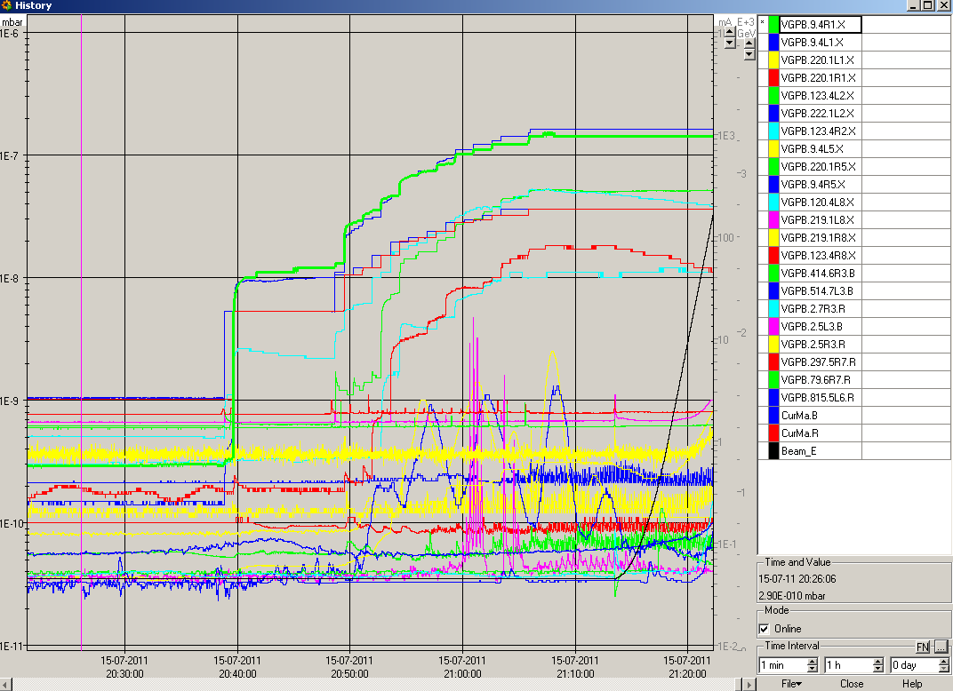
Vacuum

Slide 8
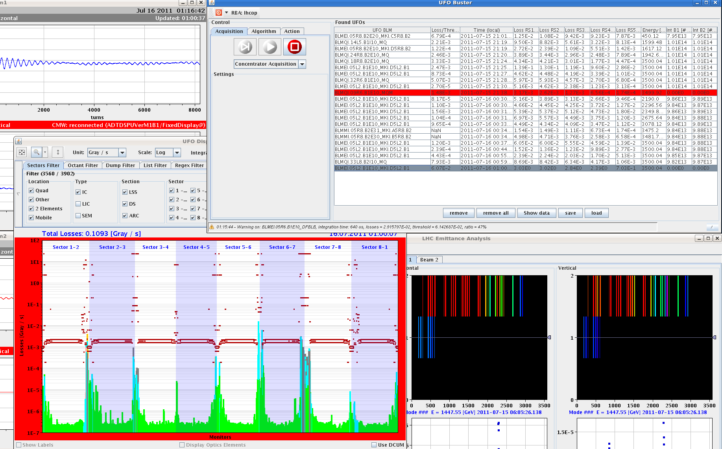
UFO 1

Slide 9
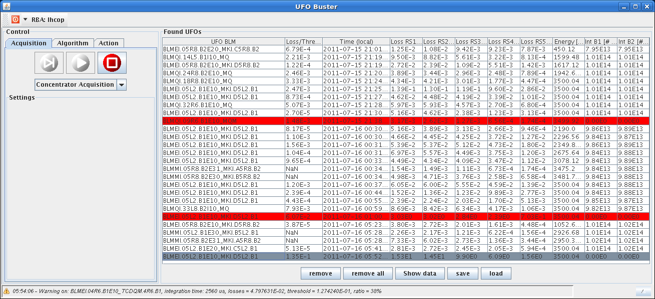
UFO 2

Slide 10
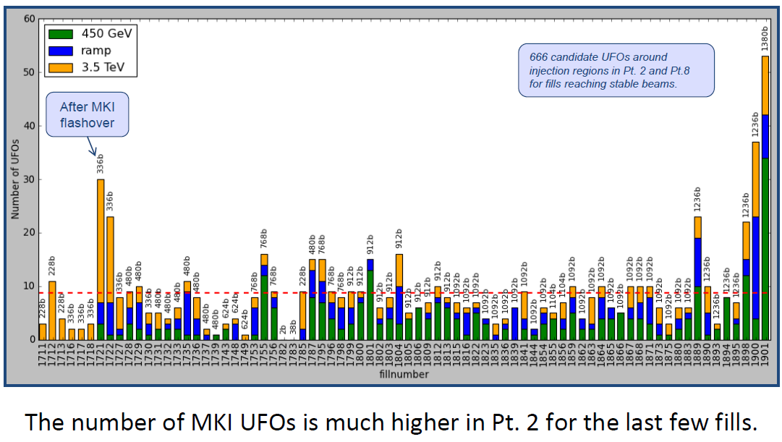
UFOs MKI
Tobias Baer

Slide 11
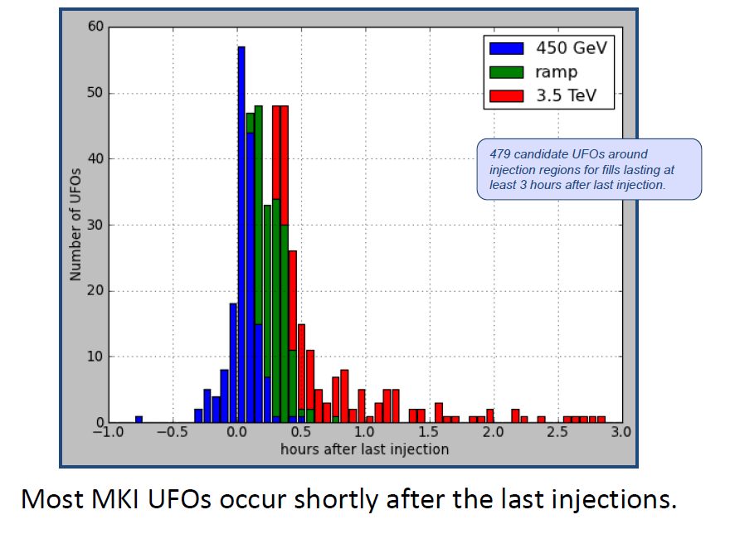
MKI UFOs
Tobias Baer

