Slide 1
Week 27
Monday 4th to Friday 8th Technical stop
Coordination: Katy Foraz
Machine back to Operations Friday evening on schedule
Major cryogenics intervention point 8 during technical stop
See Serge Claudet’s presentation last Friday

Slide 3
Saturday
7:00 – 9:13 Access Point 8 for QPS RQD A78
7:24 MKB (dilution kickers) in fault B1 & B2 → reset by piquet
SIS positioning wire on IR8 triplet out of tolerance (why?) → changed WPS limits
8:05 cryogenics is back
Critical settings check on MKD settings failed, hardware setting off (not by much)
changed LSA values to be able to continue; need 3 hour access to update hardware setting.

Slide 4
Saturday cont.
12:22 MKI B1 tripped during soft-start (MKISS)
was reconditioned by several soft-starts at 14:22 (M. Barnes: probably insufficient conditioning of a new switch)
A modified soft-start procedure would have been desirable (more gradual change), but not possible due to absence of experts
Access for Alice and CMS
16:10 Access finished
16:52 update of LBDS energy tracking tables
Notes:
Shift summary: *) Cryo conditions were recovered at 8:05am. *) In the meantime we were in access in S78 for an energy extraction problem on RQD/F S78. The remaining HWC tests on the 60 A circuits in 78 could only be done after the intervention due to the global protection mechanism. Access was finished at about 9:10. Otherwise: *)Survey wires at triplet R8 were out of tolerance. Updated the interlock threshold. Did not investigate whether they triplet had been really moved. *) The hardware settings for two MKD generators of beam 2 are not correct. Can run like this for the time being. Needs to be modified at some point however. Access of 2-3h. *) The switch change at the MKI B1 caused the kickers to trip during the softstart. After a couple of trials it was decided with the piquet to access and change the new switch again. Access was prepared. It turned out however later on that the switch probably just needed more conditioning via more softstarts or an extended softstart. It seems to be OK now. *) CMS and ALICE profited from the access. *) Precycle started.

Slide 5
Saturday evening
17:30 pilot injection:
Optimization at 450 GeV (orbit, tune, chromaticity, RF phasing)
Instrumentation: BPM calibration (phasing-in); Set-up of BSRT and abort gap (injection energy) F. Roncarolo
Temporary injection line steering (SPS orbit to be corrected)
19:40 Trip of RQ10.L1B2
Dry ramp for testing before access → which verified that the new LBDS energy tracking tables are OK
access afterwards: 22:21 water flow increased RQ10, reset OK
Water flow generally too low for quadrupoles?
MKI thresholds for IQC updated
first iteration - Etienne Carlier
21:36 RQ6.L8B1 and RQ6.L8B2
(same fault as the RQ10: “EXTERNAL DC CABLE WATER FLOW”) → reset ok

Slide 6
Night
22:42 UJ14 patrol lost: problem with access doors
1:00 machine closed
1:37 pilot injection - ramp
2:24 Beams dumped at top energy, RQ4.R6B2 tripped: again the “external DC cable water flow”
Injection test for MKI - IQC limits (inject and dump 10 times)
Ramp – squeeze – collide with pilots
Software issues but OK

Slide 7
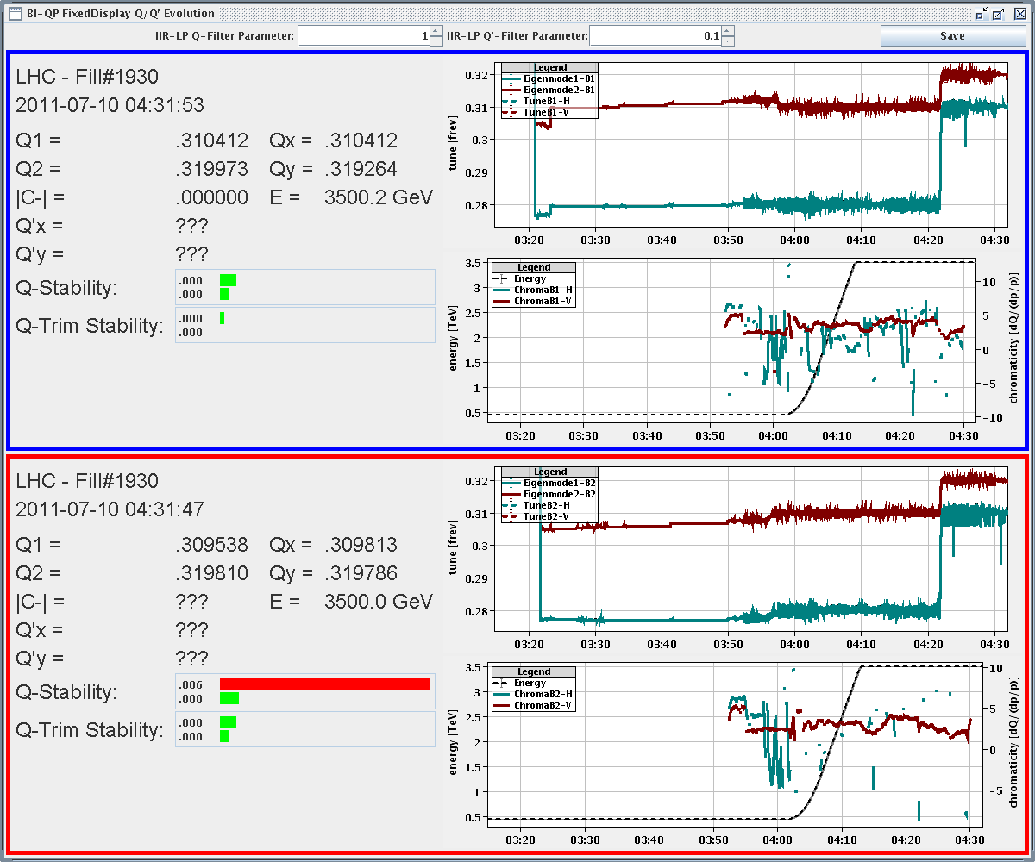
Tune and Chromaticity during ramp

Slide 8
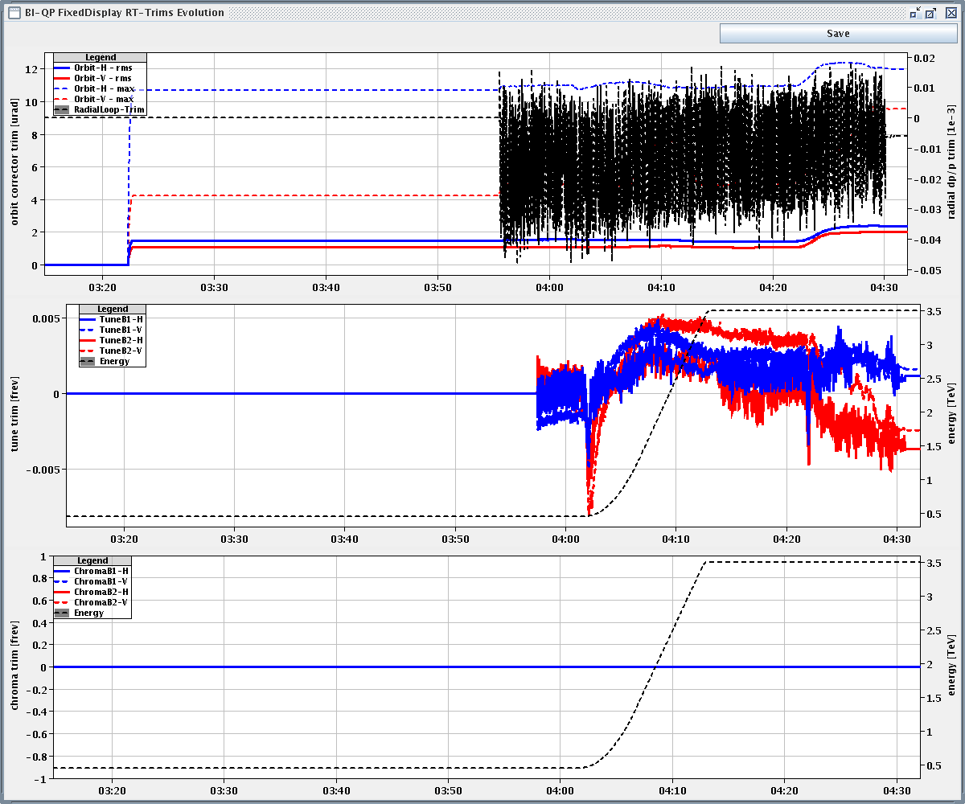
Second ramp: tune and orbit feedback trims

Slide 9
Sunday morning
Carried out a TCDQ-TCSG consistency check with defining a clear beam edge with the TCP and then bumping the beam on to the TCSG and TCDQ.
The obtained results do not comply with a retraction of 1 sigma between TCSG and TCDQ.
More tests have to be carried to study the offsets at the TCDQ after the intervention in the TS.

Slide 10
Sunday
11:11 Lost sector 81
11:35 Major CERN wide electric perturbation -
A series of unfortunate events…. LHC 18 kV loop down for a sustained period
RF, ADT, MKIs and beam dump tripped, fault-off.
Collimators
BI Access chain for LHC and TI2 lost. Patrol lost in points 2, 3
All vacuum valves closed. No communication
Technical network in a bad shape
Cryogenics conditions lost sectors 23, 34, 45, 78, 81.
Experiments and injections hit hard

Slide 11
Recovery
Mass mobilization
EL, TI/OP, Cryo, cooling, ventilation, vacuum, controls, collimators, radiation protection…
Several accesses in the tunnel
Fire brigades – false ODH alarms
Mainly related to EL and cryo.
Experiments, VAC, cooling…

Slide 12
Recovery
Several BLM crates were down: tried reboots and contacted experts. They will need to follow this up tomorrow.
Collimators went in autoretraction due to the power cut. This requires an important work to recover the settings because in some cases also the UPS were lost (recalibration might be needed).
Various kickers tested by E. Carlier: no problem found
Various communication problems for the access systems around P3. Needs urgent follow-up by access team.

Slide 13
Recovery
VAC: affected by communication problems. One real interlock in P4 due to pumps that stopped. Needs follow-up Monday.
Tried to recover some FGC's of the RF system without success: needs follow-up Monday.
Rebooted various BPM servers. Further checks by BI are needed.
EPC: experts checked the systems around the ring and found no issue, but recommend to reset and switch on asap to check.

Slide 14
List of required accesses known so far,
VAC: P4 (pumps not working)
VAC: S12, S67, S81
Access team: intervention for PZ33
BLM team: at least 4 accesses: P2-right, P5-right, P4-left, P8
TCDQ: verification of survey to check suspected position errors.
Collimator: power of one rack in SR2 could not be recovered and required manual intervention.
UX451: EL team requested an access.
To be confirmed

Slide 15
Lost patrols
PZ33 (access system controls down)
UJ27 (cause by problem in PZ33)
UJ43 (cause by problem in PZ33)
UP55 (lost at the moment of the electrical power cut)
PM56 (lost during today's accesses)

Slide 16
Today
Accesses as required
Patrols as required
Cryogenics
Status – Serge Claudet
PS recovery – still down with PFW problem
Tests and dry run
SVC back on around LHC
Atlas and CMS magnets not before Thursday
Will continued with beam commissioning and bunch number ramp up… minimal luminosity loss.

Slide 17
Incoming after recovery
Verification tests:
TCDQ and TCSG relative position → follow-up required
beam presence flag intensity limit
Beam Dump (inject and dump mode)
Asynchronous dump 450 GeV B2 (pilot or 1-2 nominal bunches)
loss maps at injection
Pilot + 2 nominal bunches
1 hour in stable beams
loss maps at 3.5 TeV
48 bunches per beam - stable beams for 3-4 hours
Default is to continue with the satellite collision scheme 264b, 840b…

