Slide 1
1900: the fill they couldn’t kill
Nice long fill despite:
MKI UFO storm
Going to beam mode = beam dump by mistake
Vacuum spiking to 1e-6 point 4
LSA server crash
Keep fill a little longer than planned – Booster extraction septum power converter problem
Beams eventually dumped 22:23
Integrated lumi ~ 61/pb

Slide 2
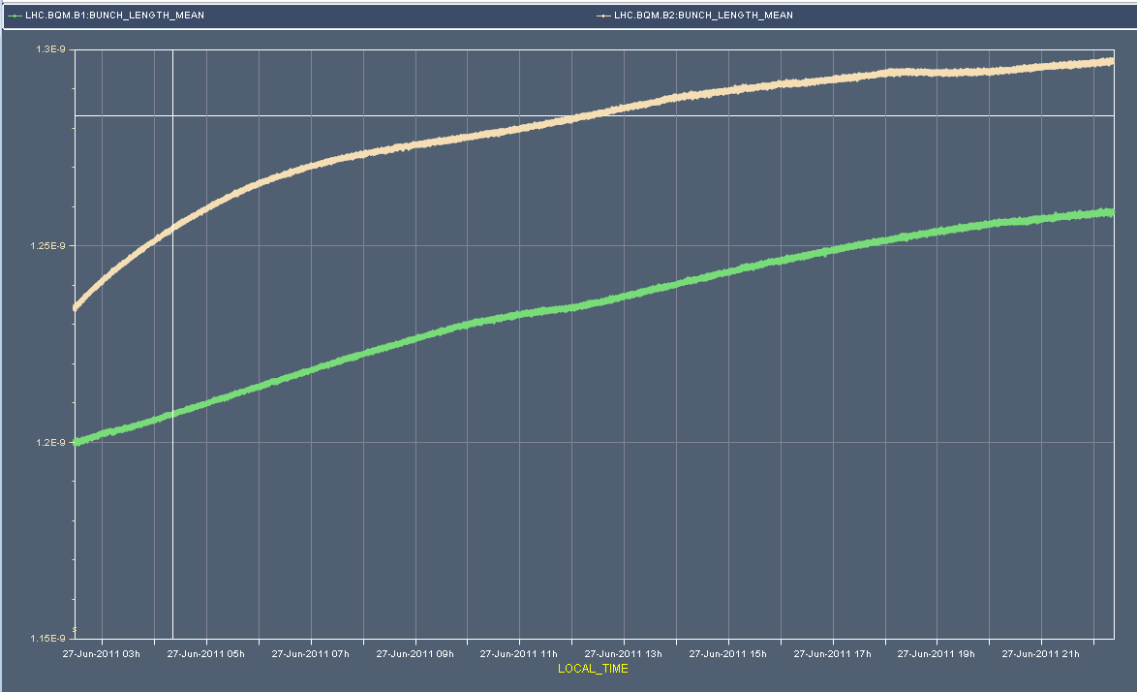
Bunch length

Slide 3
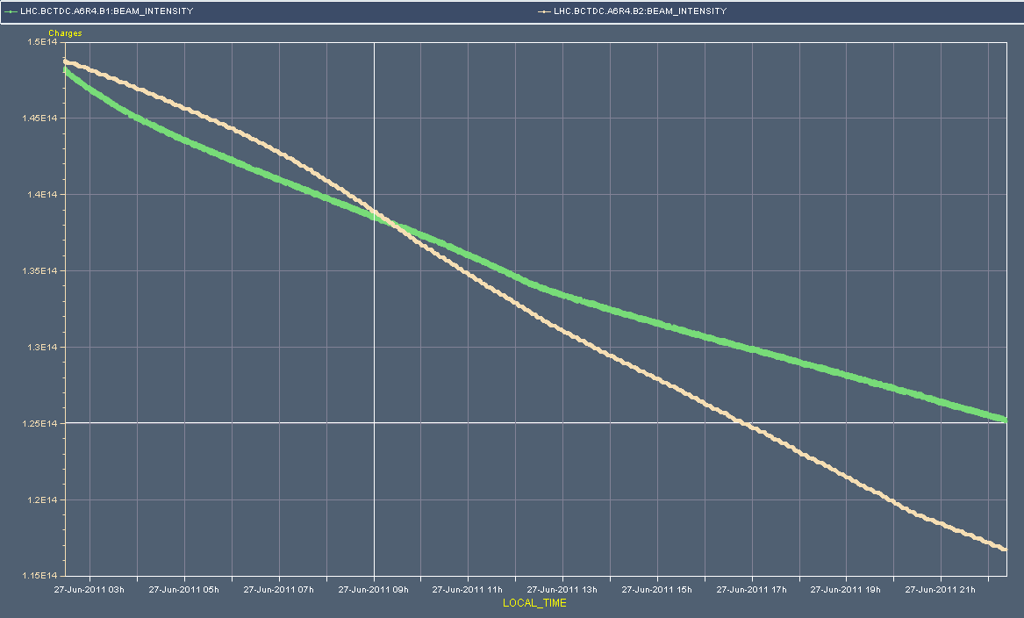
Beam intensity

Slide 4
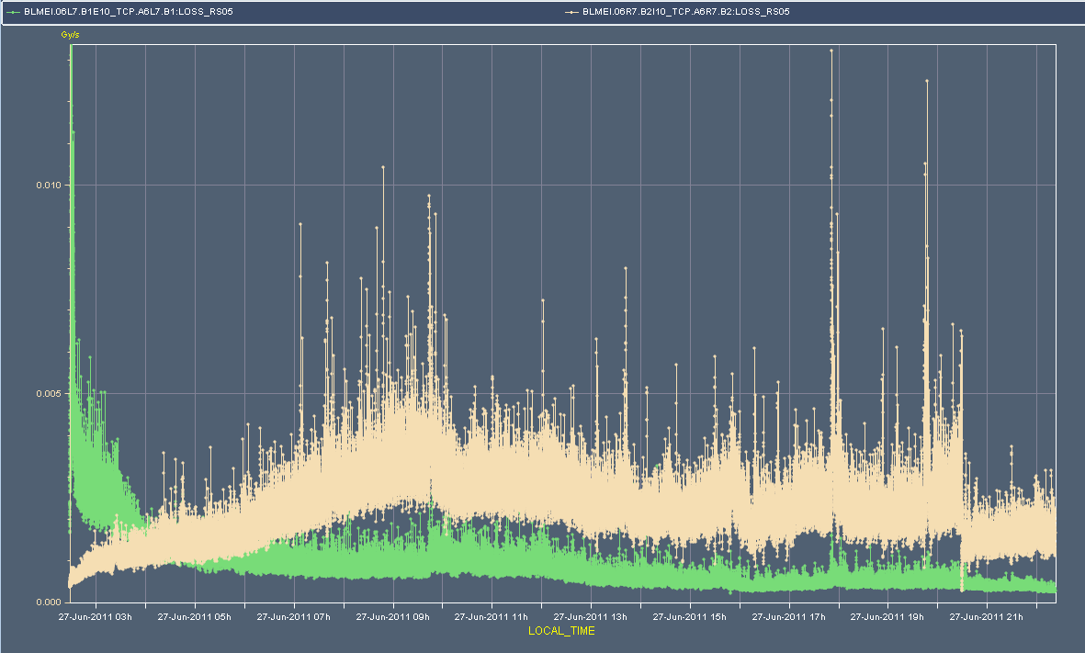
Beam loss at TCP

Slide 5
Records

Slide 6
Fill 1901
23:23 Beam in
Large Q’ swings – record flat top length
Bit of a wrestling with beam from SPS
High losses on both lines. Trajectories look OK.
Checked interlocked BPM with new filling pattern
02:17 Stable beams – 1901 – 1380 bunches
~1.15e11 per bunch (low-ish on the back of Booster problems)
Initial luminosity ~1.25e33 cm⁻²s⁻¹
UFO activity at injection at the MKI - it calmed down afterwards.
Pressure spike in 5R4 before collisions, would have been above the old dump threshold.
Alice's had to optimize lumi/background rates and started taking data only after about 3 hours into stable beams.

Slide 7
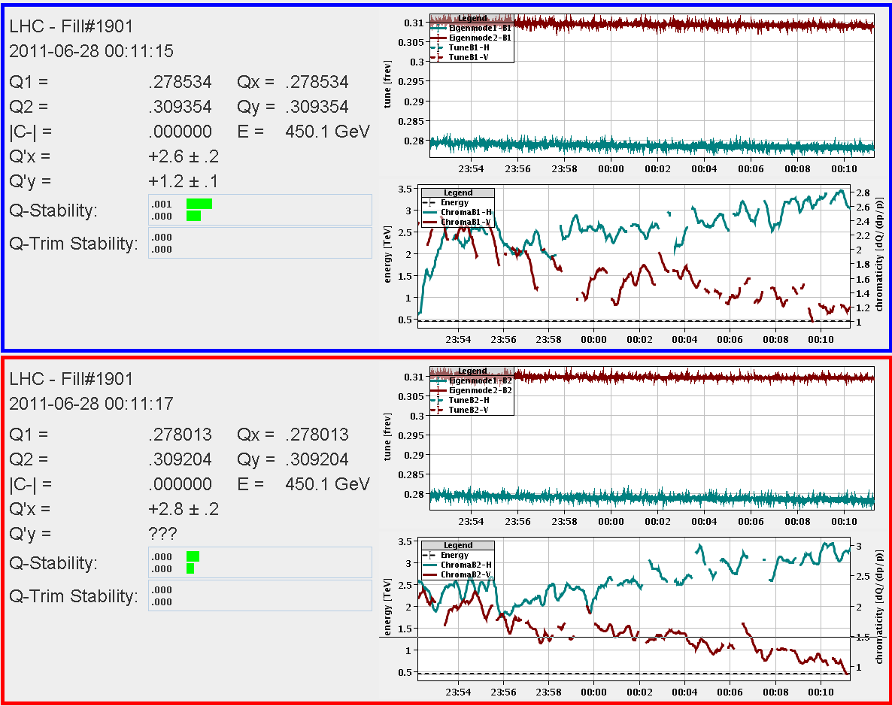
Q’drifts after long flat top

Slide 8
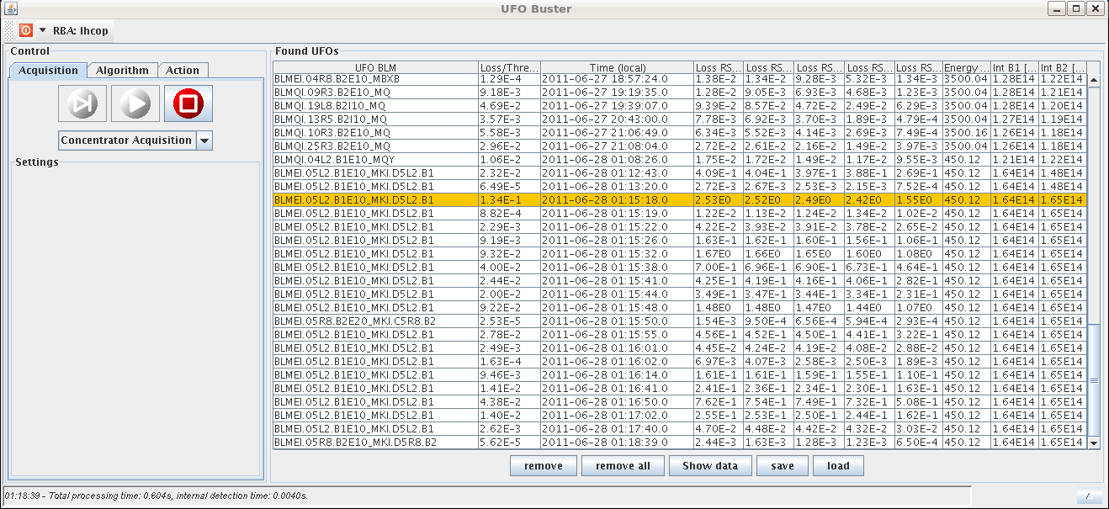
Snowing UFOs MKI.D5L2.B1
At 450 GeV after injection

Slide 9
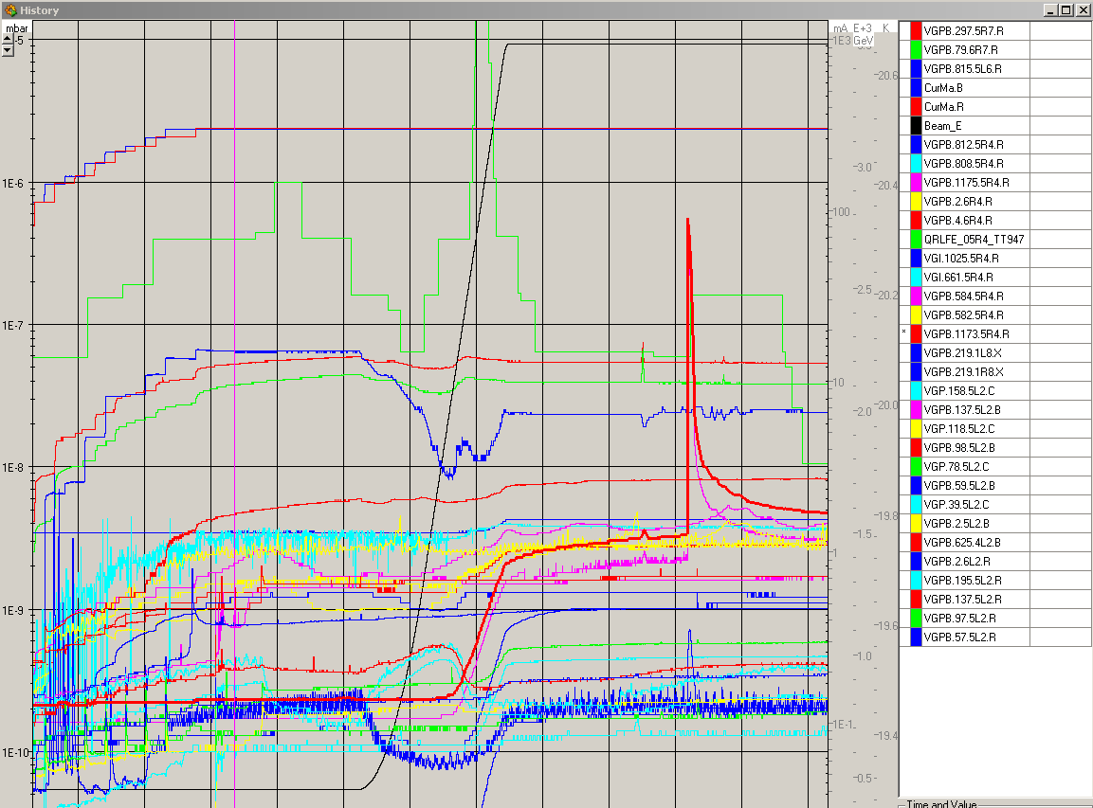
Vacuum still spiky 5R4 B2

Slide 10
Incoming – 90 m
18:00 - 20:00 cycling the machine 20:00 - 22:00 injection, checks, interlocks, ramp 22:00 - 23:00 flat top - prepare for un-squeeze 23:00 - 00:30 un-squeeze in steps to 90 m 00:30 - 02:00 check out parallel bumps to adjust separation and optics measurements 2:00 - 03:00 optics correction and remeasure 3:00 - 04:00 adjust collisions and leave beams in collisions The time at 90 m was discussed with Rogelio who estimates that he needs 2.5 hours for the optics work at 90 m. Beams: single bunch 1 in beam 1 and beam 2. The bunch intensity is limited to 2.5e10 to allow for optics measurements with the AC dipole. Priority is on bumps/optics.
Helmut Burkhardt

