Slide 1
Summary of Week 26
G. Arduini, B. Holzer, M. Lamont
MD Coordinator: R. Assmann
Main aims:
Luminosity production
1380 bunches
MDs ➔ see Ralph’s presentation

Slide 2
Main achievements (c/o ATLAS)
Peak Stable Luminosity Delivered | 1.26x10³³ | Fill 1889 | 11/06/24, 07:31
Maximum Luminosity Delivered in one fill | 62.1 pb⁻¹ | Fill 1900 | 11/06/26, 22:08
Maximum Luminosity Delivered in one day | 62.1 pb⁻¹ | Monday 27 June, 2011
Maximum Colliding Bunches | 1318 | Fill 1901
Longest Time in Stable Beams for one fill | 19.2 hours | Fill 1900 | 11/06/27, 01:09
Longest Time in Stable Beams for one day | 19.2 hours (82.9%) | Monday 27 June, 2011
2 consecutive long fills (19.2 and 13.7 h) dumped by OP – A primer!
Total integrated luminosity: 107 pb⁻¹ in 2 days!
Turn around ~4 hours (Losses at injection, LSS6 BPM check)

Slide 3
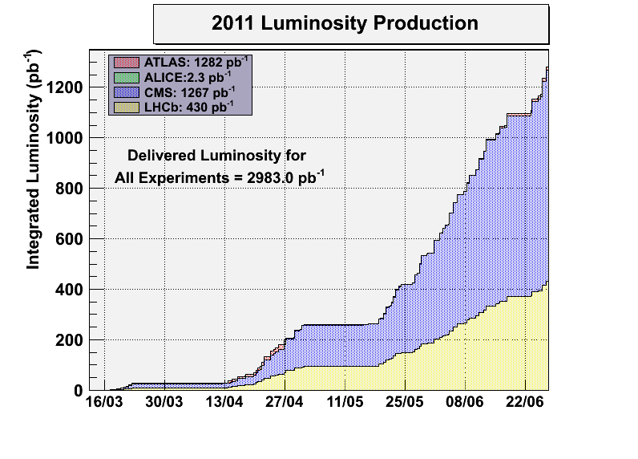
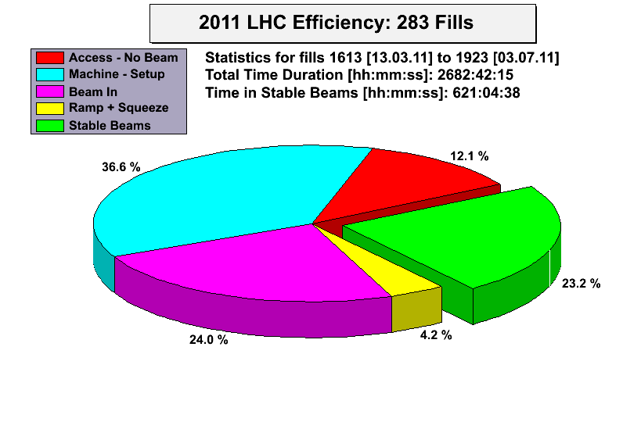
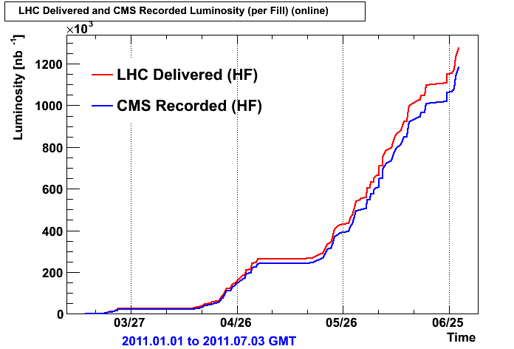
Statistics
Thanks CMS!
The statistics data refer to all fills (including MD, scrubbing, etc). If only scheduled physics time is considered ~32% of stable beams.

Slide 4
Fill 1901
~1/2 nominal intensity and ¼ of the nominal stored energy

Slide 5
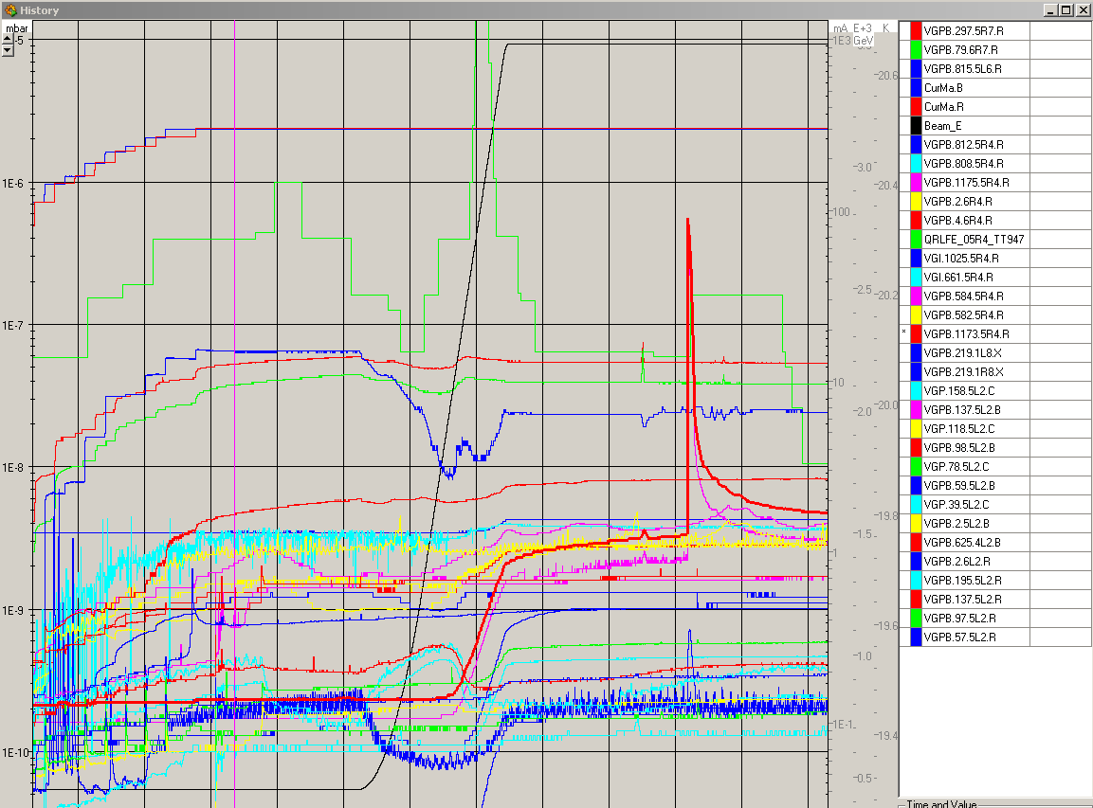
Fill 1901
Q’ drift after long flat-top
UFO activity at injection at the MKI2- it calmed down afterwards.
Pressure spike in 5R4 before collisions, would have been above the old dump threshold.

Slide 6
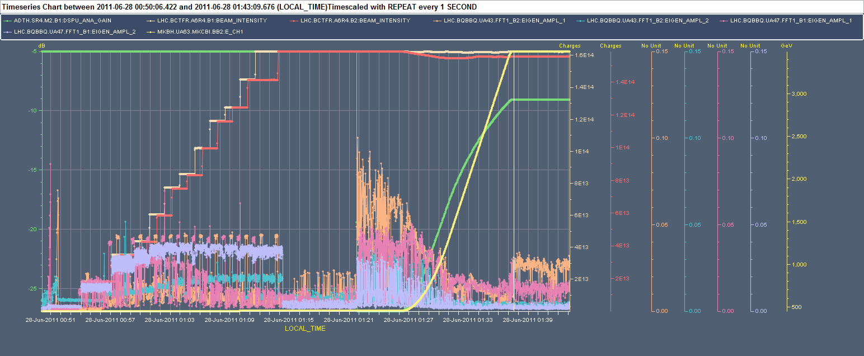
Why lower luminosity?
Fill 1901 – 1380 bunches – R. Giachino
Activity in the H-plane (both beams) when the damper gain is reduced before starting the ramp and at 3.5 TeV ➔ need to revisit when back from technical stop

Slide 7
90 m optics setting-up (H. Burkhardt et al.)
Unsqueeze OK (feed-forward from previous test)
Ramped the collimators in IP3, 6 and 7 to the nominal ramp settings. TCT at coarse protection settings.
Orbit/coupling corrections through the squeeze.
At 90m, we tested all the knobs for parallel separation and for lumi scans in IP1/5. They worked as expected.
AC dipole not working ➔ only k-modulation in IR1/5 before and after applying the global optics corrections determined in the first 90m MD ➔ being analyzed.
30 mins data taking for ALFA and TOTEM.

Slide 8
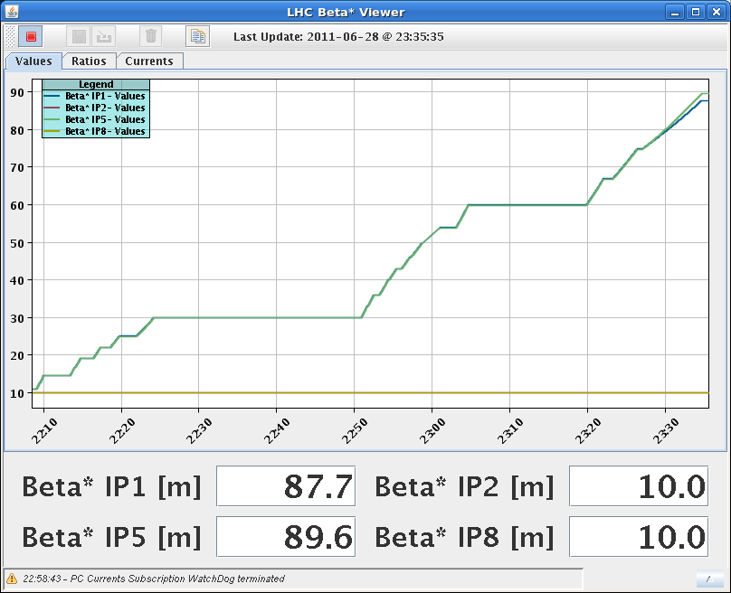
90 m optics setting-up (H. Burkhardt et al.)

