Slide 1
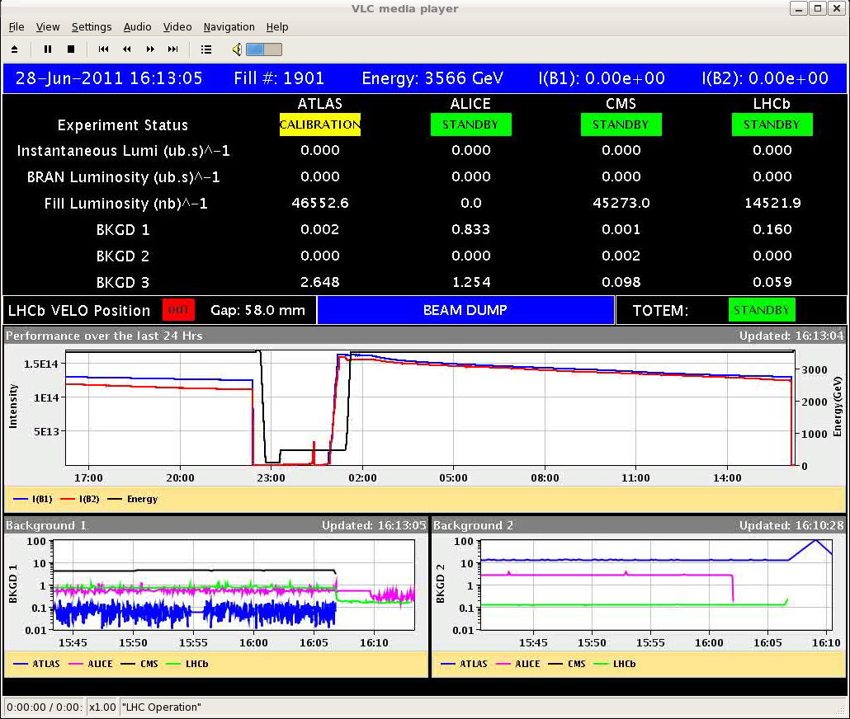
Another Immortal Fill….
OP dump after 13.7 hours to prepare for 90 m optics setting-up

Slide 2
Another Immortal Fill….
~1/2 nominal intensity and ¼ of the nominal stored energy

Slide 3
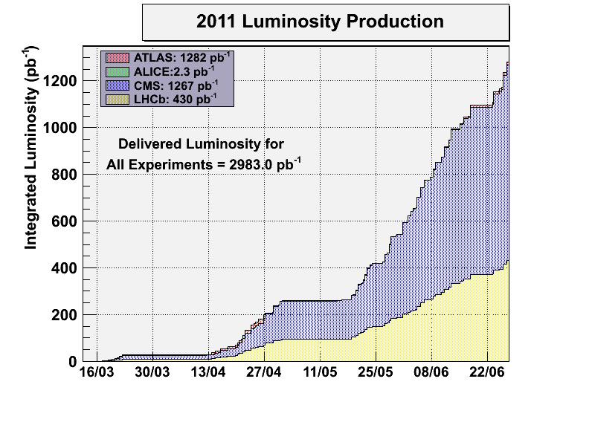
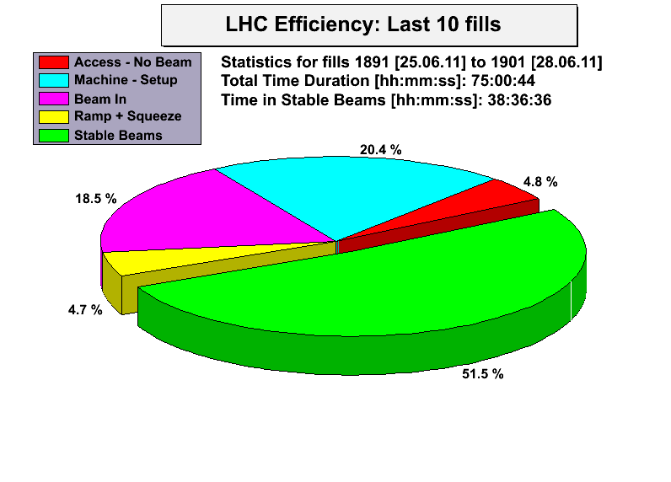
Stats

Slide 4
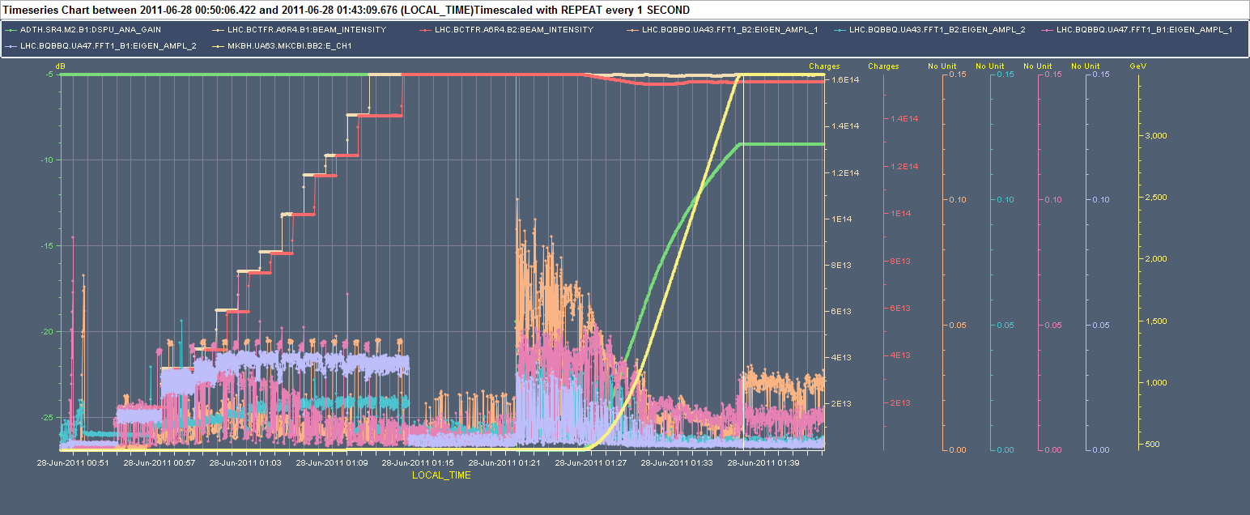
Why lower luminosity?
Fill 1901 – 1380 bunches – R. Giachino
Activity in the H-plane (both beams) when the damper gain is reduced before starting the ramp ➔ need to revisit when back from technical stop

Slide 5
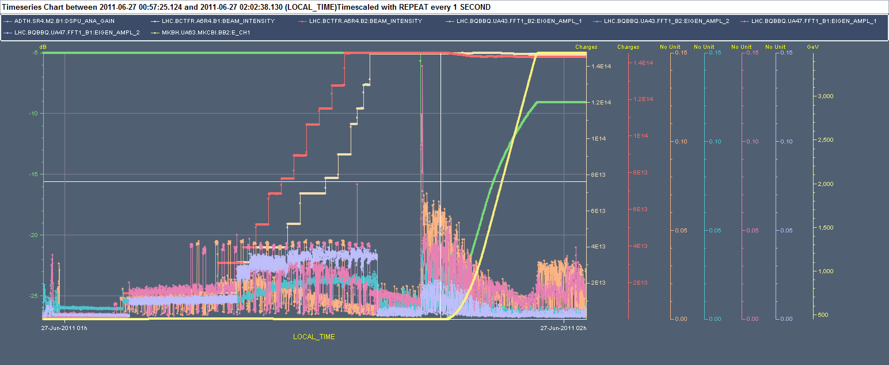
Why lower luminosity?
Fill 1900 – 1236 bunches – R. Giachino
Already visible with 1236 bunches

Slide 6
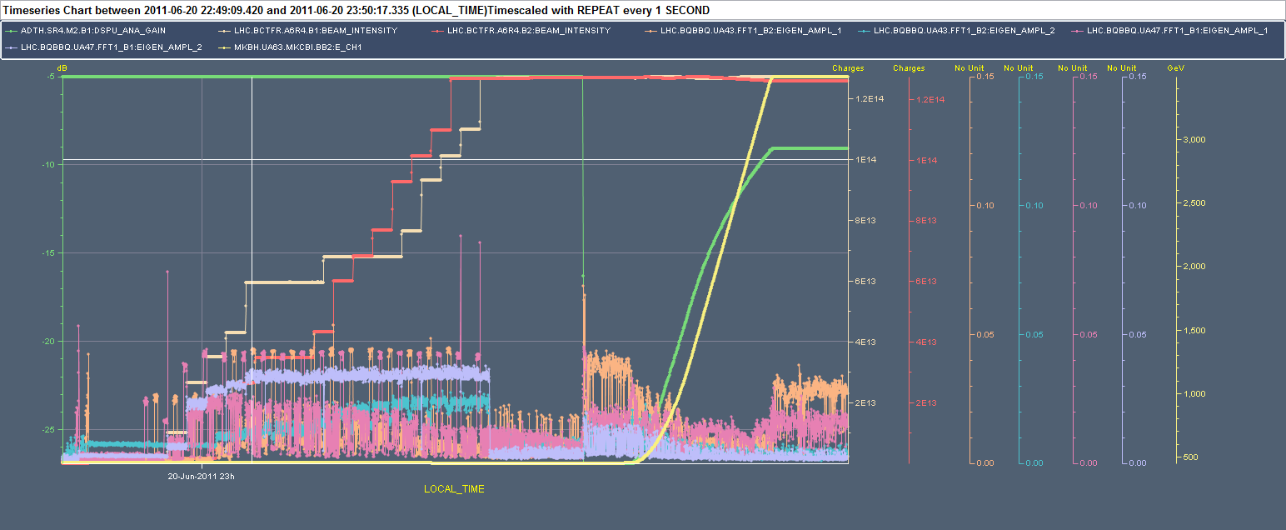
Why lower luminosity?
Fill 1883 – 1092 bunches – R. Giachino
…and a tiny bit with 1092. This could explain why the increase in luminosity was marginal.

Slide 7
Why lower luminosity?
Some differences in the emittance of the PSB rings (ring 4 has larger emittance) ➔ could also be the effect of mis-steering at PS injection

Slide 8
Tue 28/6- Wed 29/6
16:00-19:20 Ramp down - Access for BI. Loading of 90 m optics hyper-cycle. Cleaning of the water cooling filters for cryo in point 2 in the shadow
19:20 start injection for 90 m optics

Slide 9
90 m optics setting-up (H. Burkhardt et al.)
Feed-forward of simulated tune errors during the squeeze (S. Redaelli)

Slide 10
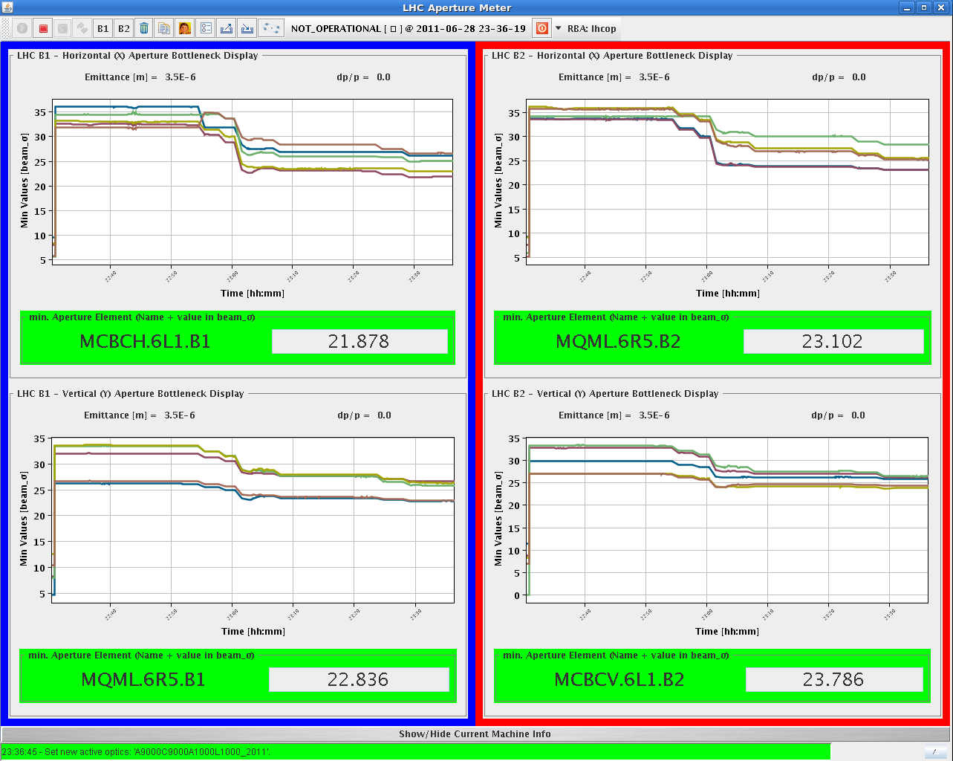
90 m optics setting-up (H. Burkhardt et al.)

Slide 11
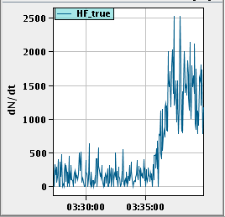
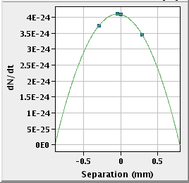
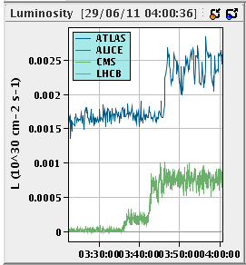
90 m optics setting-up (H. Burkhardt et al.)
IP5 lumi scan
IP1 lumi scan

Slide 12
90 m optics setting-up (H. Burkhardt et al.)
The beam tests were performed with one fat pilot of ~2.0e10p per beam to have collisions in IP1 and 5 and one pilot. The unsqueeze went well without any significant loss. Feed-forward of tune corrections (from simulations and measurements) was applied and worked well.
Compared to the initial commissioning test, this time we ramped the collimators in IP3, 6 and 7 to the nominal ramp settings. TCT are set at coarse protection settings. ADT and longitudinal blow-up were not active during the ramp (to be followed up for higher intensities).
Orbit corrections were performed at 30m and coupling corrections at 60m. Both were incorporated into the unsqueeze functions for the next commissioning test. We also used dynamic changes of the OFB reference orbit. The analysis of the response requires some off-line analysis.
At 90m, we tested all the knobs for parallel separation and for lumi scans in IP1/5. They worked as expected.

Slide 13
90 m optics setting-up (H. Burkhardt et al.)
The next step was optics measurements and corrections. It turned out that the AC dipole required for the precise optics measurements was not available and would require an access to get it working. The detailed global optics measurements could not be done. Local beta* measurements using k-modulation were done instead in IP1 and IP5.
We then applied the global optics corrections determined in the first 90m MD and redid the local beta measurements with k-modulation.
At 3:10, we collapsed the separation bumps and started to look for collisions. The counting rates were very low and required a combination of manual trims and optimization scans to center collisions. Both ALFA and TOTEM moved the vertical roman pots to 10 sigma and recorded some collisions in the last 30 minutes of the study.

Slide 14
Draft MD Planning Wed – Thu (29. – 30.6.)
Day | Time | MD | MP
Wed | 04:00 | Ramp down, cycle
 | 06:00 | No beam: ATS optics checks w/o beam
 | 08:00 | Ramp down, cycle.
 | 10:00 | 450 GeV: Injection 25ns – different SPS parameters, first look, transverse damper first look (no detailed setup for 25ns) | B
 | 16:00 | 450 GeV: RF setup for high bunch intensity | A
 | 22:00 | 450 GeV: 450 GeV → 3.5 TeV: Beam instrumentation – high bunch intensity, … | B/C
Thu | 06:00 | Ramp down, cycle.
 | 08:00 | 450 GeV: Head-on beam-beam limit – up to 3e11p per bunch, coherent modes. BI parasitically. | A
 | 16:00 | 450 GeV: Injecting nominal emittances, MKI & UFO’s – 50ns, blow-up in SPS, SPS scraping and losses, injection into LHC, nominal emittance. | B

Slide 15
Experimental magnets
ATLAS and CMS ramping down this morning
ALICE and LHCb: we switch them off this morning

Slide 16
Draft MD Planning Fri – Sat (1. – 2.7.)
Day | Time | MD | MP
Fri | 01:00 | Switch back to operational injection settings. Verification.
 | 03:00 | 450 GeV → 3.5 TeV: RF – longitudinal beam stability. | B
 | 16:00 | Ramp down, cycle.
 | 18:00 | 450 GeV → 3.5 TeV: Long-range beam-beam limit – lifetime, emittance versus beam-beam separation. Collimation with changing crossing angle. | C
Sat | 02:00 | Ramp down, cycle.
 | 04:00 | 450 GeV: Non-linear dynamics – Dynamic aperture, non-linear chromaticity and frequency map. | A
 | 12:00 | If needed: Precycle.
 | 14:00 | 3.5 TeV: Collimation – combined cleaning, faster setup. | A
 | 22:00 | Ramp down, cycle.

Slide 17
Draft MD Planning Sun – Mon (3. – 4.7.)
Day | Time | MD | MP
Sun | 00:00 | 3.5 TeV: ATS – correction & pre-squeeze. | A
 | 08:00 | Ramp down, cycle.
 | 10:00 | 450 GeV: Beam distribution in LHC – scraping, halo, tails, BLM limits, … (high intensity) | B
 | 14:00 | 450 GeV: Quench margin at injection – observation with special QPS instrumentation, losses from TCLIB collimator, TCDQ checks in parallel | C
 | 22:00 | 450 GeV: R2E – slow controlled losses (1e13p on Q14.R2.B1). | A
Mon | 06:00 | Technical Stop
Needs from experiments:
30.6., 08:00 to 16:00 – Luminometers on in ATLAS and CMS
01.7., 18:00 to 02:00 – Luminometers on in ATLAS and CMS

