Slide 1
LHC Status Sat Morning 18-June
Bernhard Holzer, Gianluigi Arduini et al
Tentative Planning:
Luminosity 1092 x 1092
Access: installing low pass filter at RF couplers
test & 1092 again
Luminosity 1236 x 1236
instead ... a lot of trouble

Slide 2
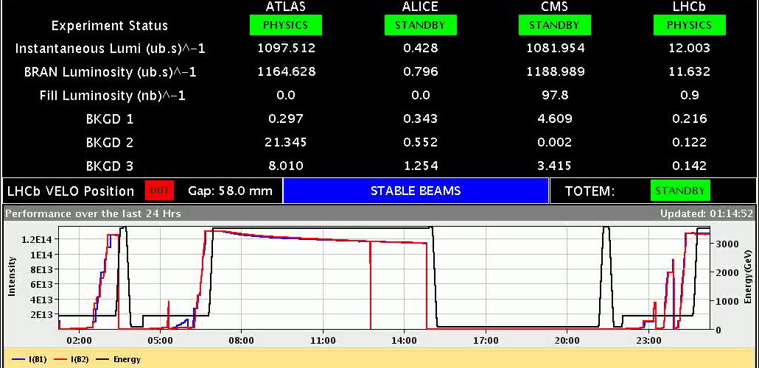
Thu Night / Fri Morning
17. June
02:06h dump triggered by BLM on Q4.L6, could be a UFO, but signature not clear
+ This dump most likely came from the BIS.
+ a glitch propagated UA87-SR7-TZ76-UA67 in the A permit loop
+ the glitch was long enough to cause the generator A to switch off. Random glitches occur, at the same time. It’s the first time we’ve observed a glitch long enough to cause us to stop like this, it could be an indication of degradation of an optical component in SR7 or UA87 (Ben)

Slide 3
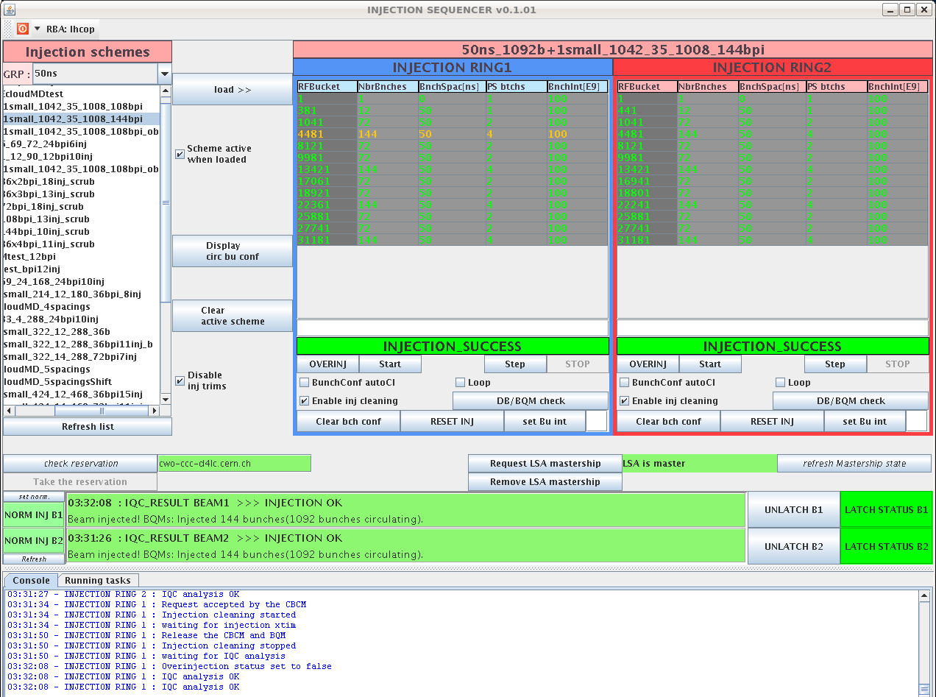
17. June
Thu Night / Fri Morning
03:32h injections finished. We have a good quality, almost
all injections green on IQC!
03:57h trip of RQTF.A78B1 when changing tune ref in the
beginning of the squeeze
06:15h stable beams
08:31h start preparation of VdM scan in IP5 ... ± 3 σ
14:04h Beam Dump: SIS dumped because the beam position at the TCDQ was out
of tolerance for BOTH redundant BPMs.
the event on the orbit starts about 1 second before the dump (50 samples @
20 ms)
The undulator tripped approximately 1.3 seconds before the dump by SIS, it
is possible that during the current decay, some imbalance in the undulator
lead to the H orbit excursion.
G-J Coelingh: it seems as if the power of the QPS
was lost for few msec

Slide 4
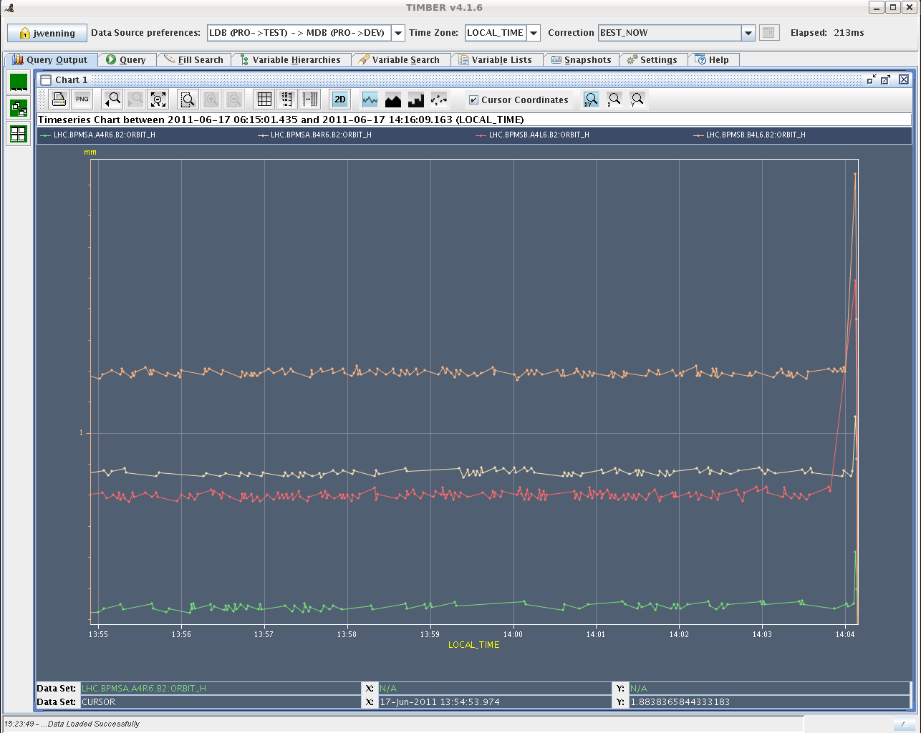
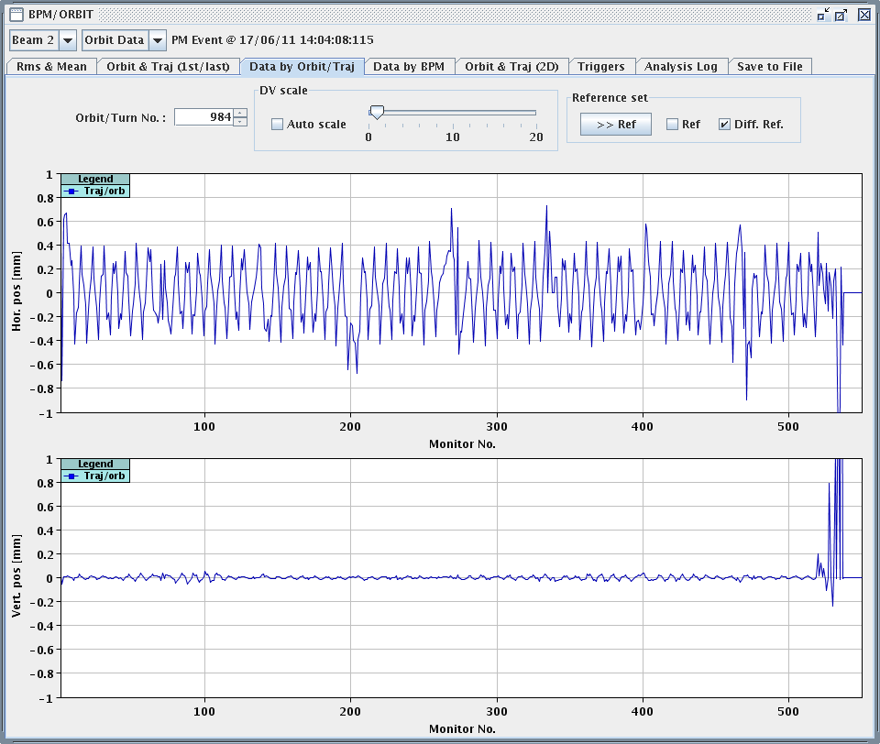
17. June
Fri Morning
14:04h SIS dump
BPM.b4l6.B2
BPM.a4l6.B2
14:06h Lost cryo conditions in the matching section L4
following the trip of the undulator.
14:18h lost 60A converters in S12. It seems that the
reason is the lost of the cryo PP for 10 seconds.
No clear reason for that.
At 13:40 (24min. before the dump) we lost 4 ADT
modules on vacuum interlocks.

Slide 5
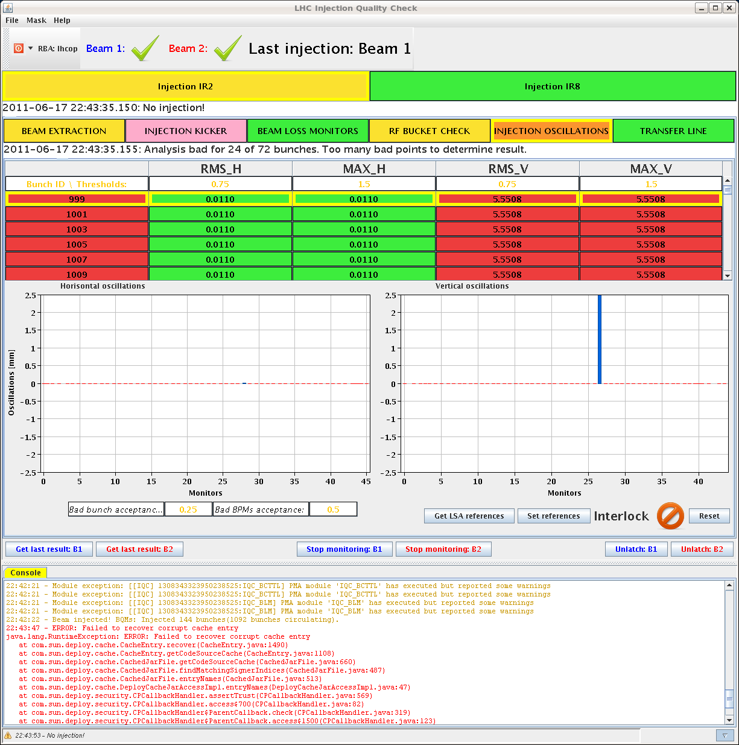
Fri Afternoon
17. June
15:20 h Short access needed for RF (coupler window
interlock), and for QPS (to check the QPS control
unit of the undulator)
18:16 h RF interlock test: An RF External Veto interlock was
provoked on each of the 16 cavities. A beam
interlock was correctly observed in each case.
19:02 h Restart the machine:
problem with H1B2 of ADT. Gate Control failure on
HV power supply. Needs piquet intervention at SR4
20:13 h Restart the machine:
20:49 h Dual power supply in TT60 is down
22:00 h Injection for physics ... but
IQC cash appears to be
corrupted.

Slide 6
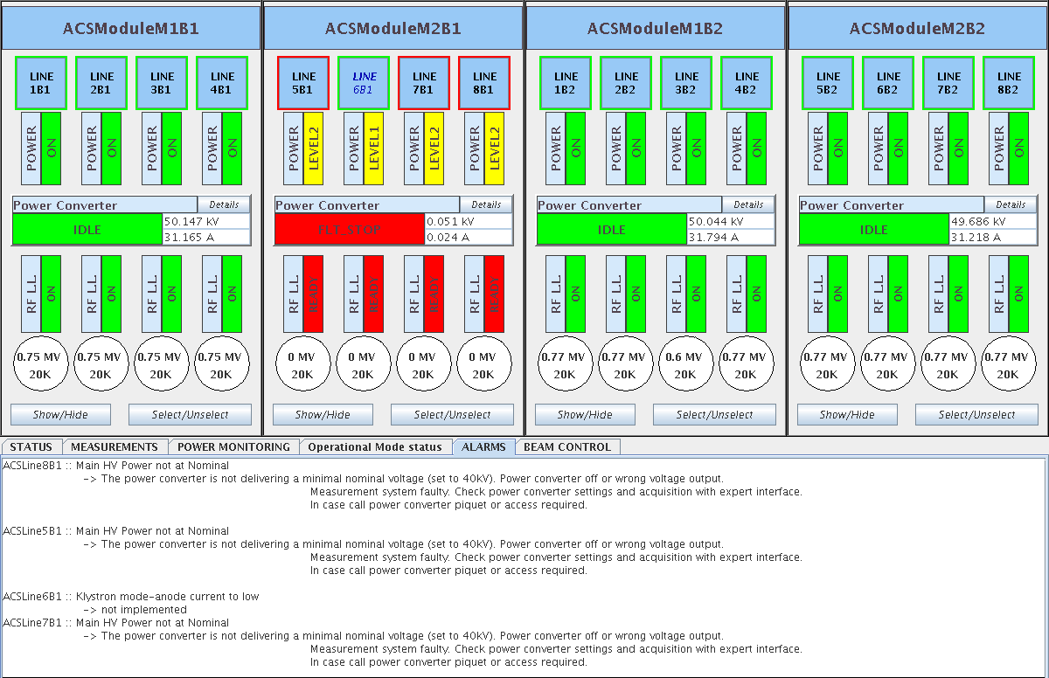
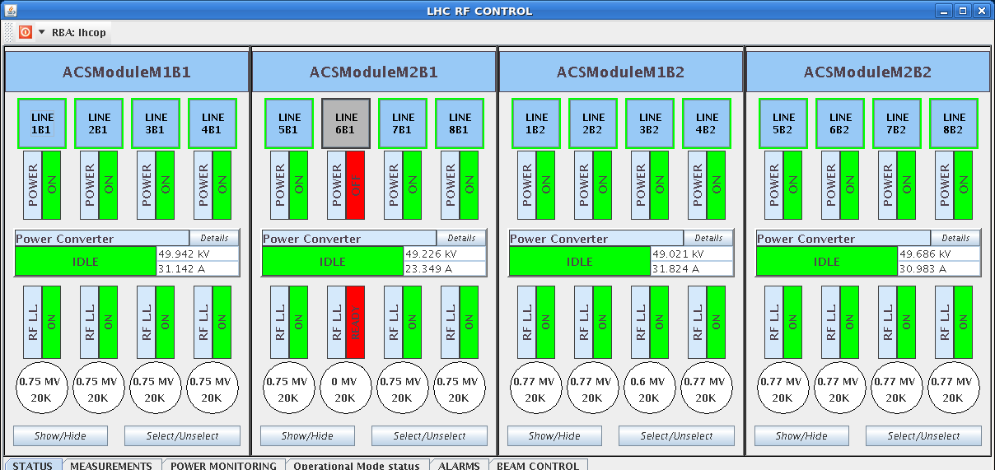
Fri Night
17. June
23:00 h Injection for physics
00:02 h Dump Classification: RF power fault module ACSM2B1
Calling RF power piquet
... It looks like a problem
on the electronics rather than
the klystron itself.
Phillip: We have switched 6B1 off, detuned the cavity
and keept the coupler at low (20k) loaded Q in physics.

Slide 7
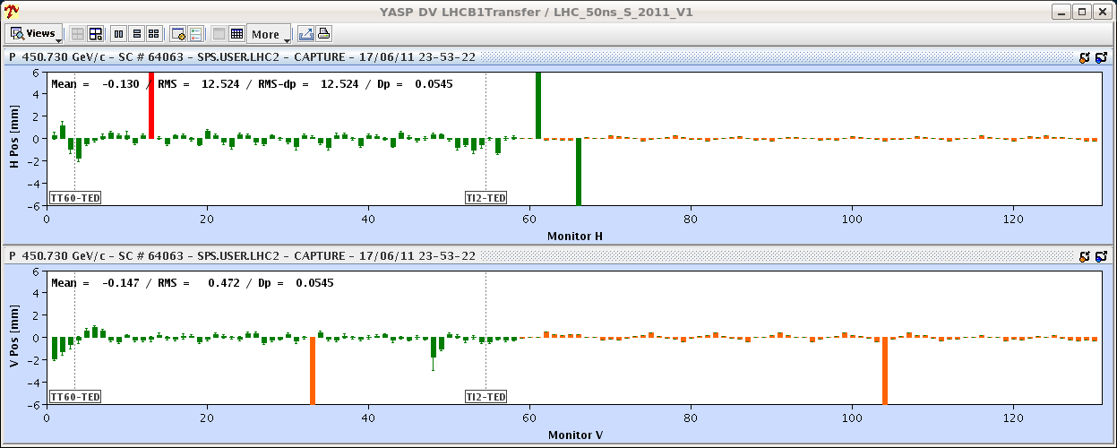
Fri Night
in addition to all this ...
00:02 h Inj oscillations b1...
Problem: we have no data for the ring..
??? wrong settings left from pre- MD studies ???
??? problems with unstable orbit correctors in the TL ???
01:22 h Alarm for ADT. In fact, looking back at the afternoon
logbook, it is the same module that tripped then.
05:02 h After a lengthy and tedious optimisation
injection completed, BEAM MODE > Prepare Ramp

Slide 8
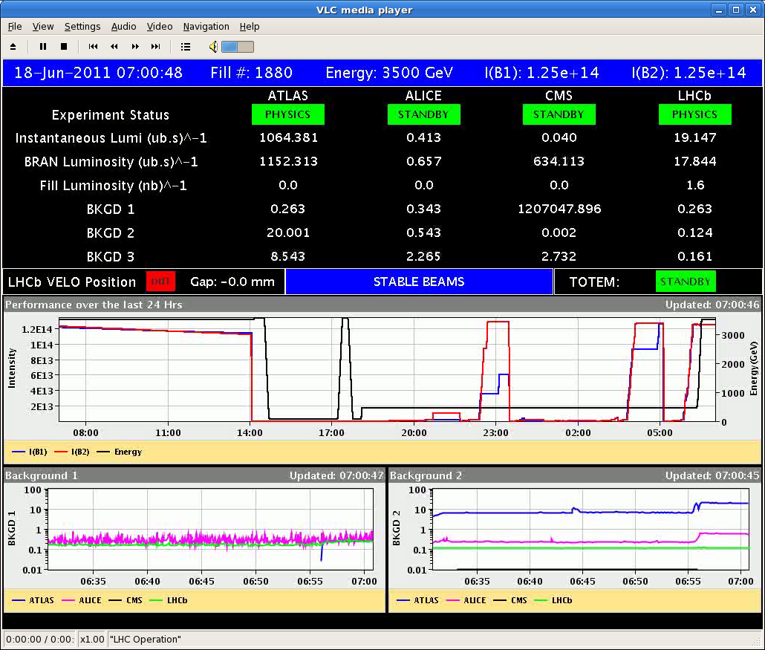
Fri Night
05:07h Dump, reason unknown, similar to LBDS self trigger
... but no hardware faults
05:26h BEAM MODE > Injection Probe Beam
05:26h BEAM MODE > Injection Physics Beam
07:00h ramp, squeeze, lumi
undulator / beam orbit
RF power
unknown

Slide 9
Sat Morning
07:48h DUMP ... unknown reason
Resume:
RF-Klystron / Electronics ... to be fixed now
Injection Oscillations ... ?
spontaneous loss of BIC / LBDS ... to be checked now
Restart:
1236 x 1236 Bunches

