Slide 1
Tue 14/6 – Wed 15/6
07:30 STABLE BEAMS 1868
22:37 Trip of sector 81 due to 400V problem in RR13 resulting in stop of the current lead heaters. End of fill #1868 after 15 h (~47 pb⁻¹)
Access for:
400 V repair(UJ14)
QPS card replacements (lost communication) in Sector 67 (Old QPS 8L7 QF/QD) and Sector 23 (Old QPS 21R2 QF/QD)
02:30: end of access
BIW in point 5 not OK (SR5) ➔ changed relay
05:00: Machine closed ➔ Start injection
06:15: Beam dump at injection B1
07:00 Still high losses at injection ➔ checking injection

Slide 2
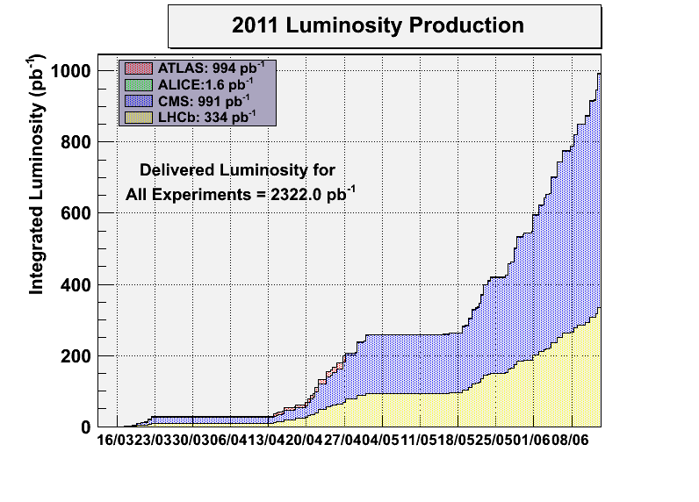
We are getting there... (2011 – 3.5 TeV)

Slide 3
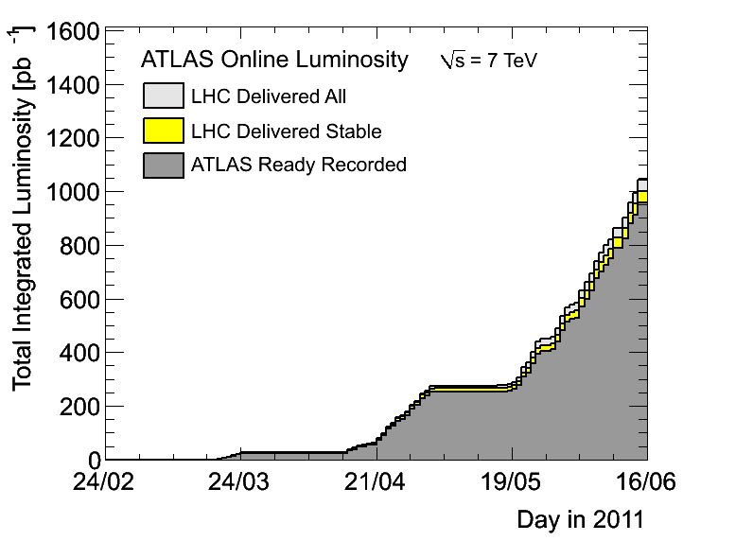
We are getting there... (2011 – 3.5 TeV)

Slide 4
Plan
Physics with 1092 bunches
If beam stop during working hours:
intervention on arc detector electronics for RF waveguides
Intervention on cryo valve controller (bad contact) in RE76
BLM enable in TD62

Slide 5
Pending
Increase to 1236 bunches (RF strategy to be discussed at LMC this afternoon)
Van der Meer scan in IP5 in stable beams (being prepared)

