Slide 1
RF observation from Saturday morning
Observation of beam induced voltage/power following the two klystron trips:
03:18 3B1 just at end ramp, 1.26E14 p total, 1.19 ns, we observed 0.94 MV beam induced and 153 kW. Abort gap population not measurable.
07:15 2B1 after 4 hours physics, 1.19E14 total, 1.23 ns, we observed 0.8 MV induced and 118 kW. Abort gap population peaks at 5E9
Now extrapolating to 1236b, 1.2E11 per bunch, we will get ~ 212 kW (using 3B1 data) and 183 kW (using 2B1 data) beam induced power. MAXIMUM until we condition the couplers further.
Philippe Baudrenghien

Slide 2
Recent intensities

Slide 3
Saturday 11th June - morning
03:40 Stable beams fill #1863.
Initial lumi 1.1e33
13:17 Beam dumped due to cryo conditions MSL1,
controls problem on valves regulation L1 (possible single event - cryo PLC.)
Integrated luminosity 30 pb⁻¹
In the meantime at 8:30 vacuum valves in the PS in, leak on fast wire scanner
leak detection, replacement of wire scanner mechanism, pump down
pump down a lot faster than originally foreseen, beam back in PS around 21:00

Slide 4
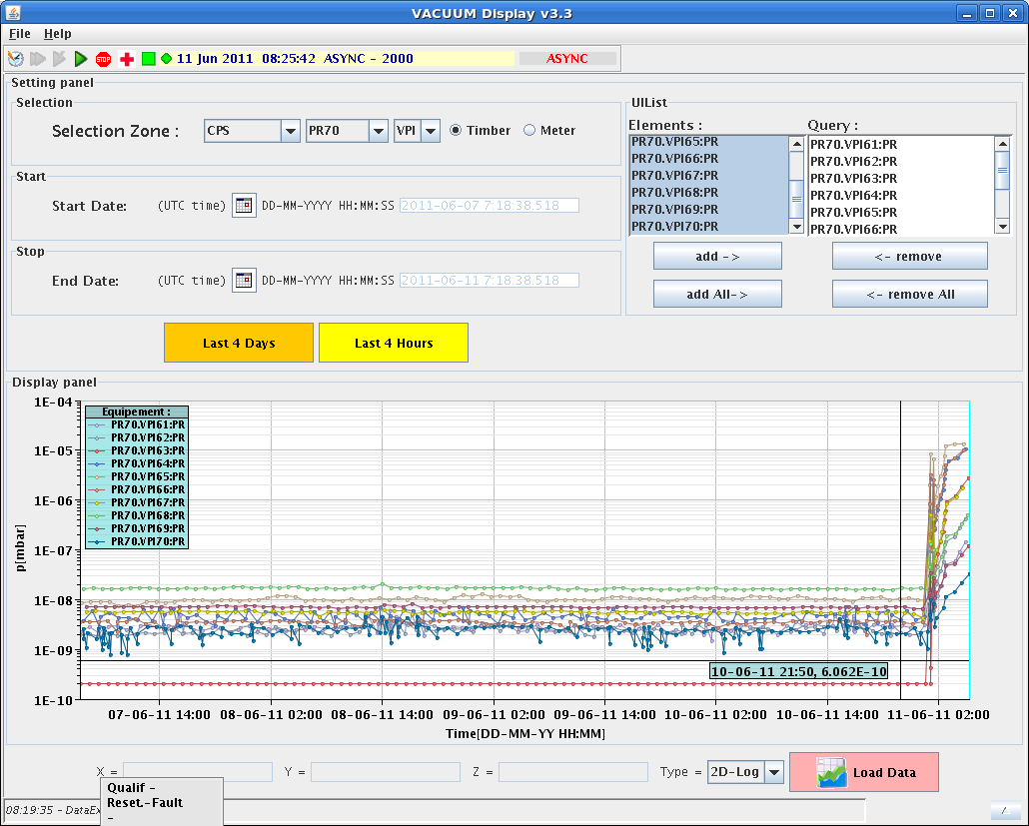
PS vacuum

Slide 5
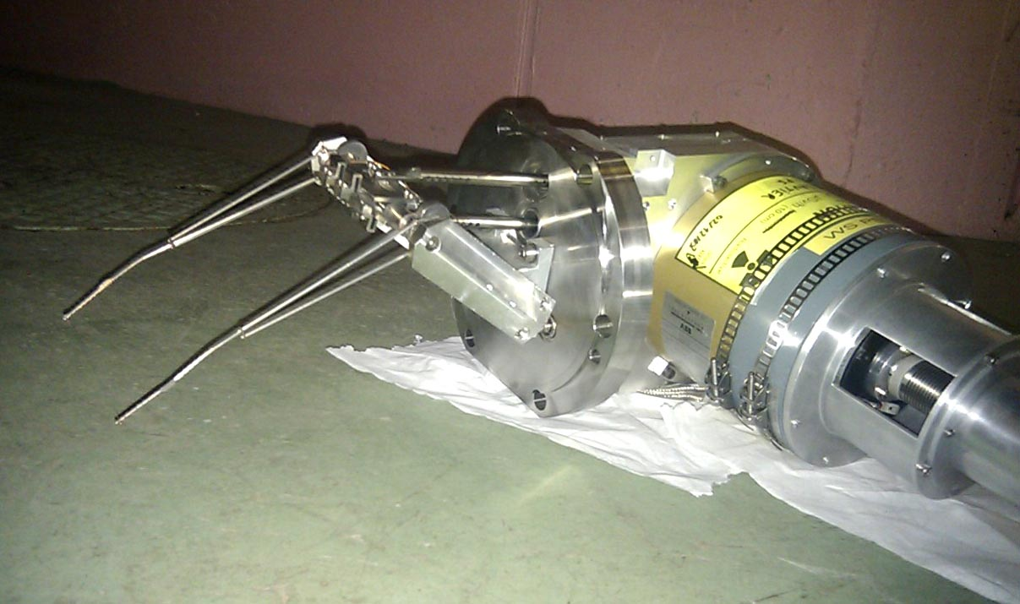
PS wire scanner
Spot the wire

Slide 6
In the shadow
UPS ESS22/85
RF conditioning
17:15 RB81 – thyristor bridge cooling problem again
discharge request on main circuit (PC Field: TRG|BRIDGE A COOLING)
Access for EPC and CV
Problem fixed definitely – to be checked

Slide 7
Sunday 12th June
Beam back in LHC ~23:30
(delay because of recovery from RB.A81 intervention)
00:29 Stable beams #1864 (23 pb⁻¹)
07:17 beam dumped by trip of RD2.L1
Vacuum valves in
Looks like a bus-bar quench
Cooling problem on the link some time before
Incoming:
physics 1092 x 1092 bunches, trains 144 bunches

