Slide 1
Thursday 9th June - morning
05:04 Site wide electrical glitch tripped the beam, caught by FMCM
Int. lumi 13.3 pb⁻¹
QPS not ok for RB.A56 (new QPS) and RB.A81 (old QPS)
07:45 Start pre-cycle
09:50 measure filamentation time with and without octupoles
See Wolfgang Hofle’s presentation
OF & ODs now on at 6.5 A at 450 GeV - both de-focusing
13:40 Stable beams #1862
Afternoon shift in the logbook: (Walter & Rossano)
CMS re-optimized on request
New optimization requested by CMS
Stable beams

Slide 2
Friday 10th
00:51 Beams dumped (~33/11 pb⁻¹)
triggered by a trip of RQSX3.L1
slow losses at Pt 7
Access required for repair RQSX3.L1 converter
03:07
power module replaced ... seemed to be a problem with the 400v distribution on the module - Greg Hudson
Problem with QPS controller (old) MQ.24.R5
Need access – point 6
& several power resets to crank it back to life
Pre-cycle required
IPOC error coming from the MKB
Access required

Slide 3
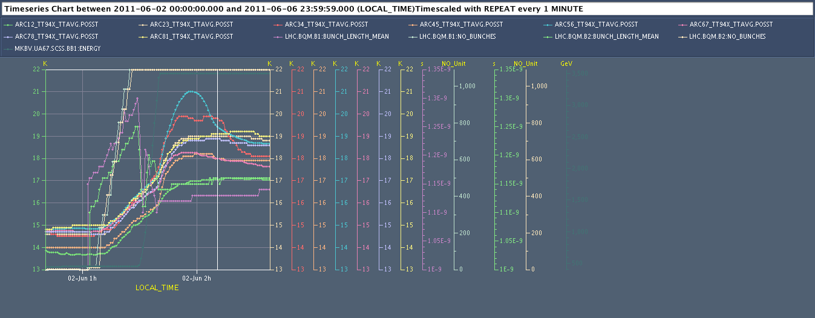
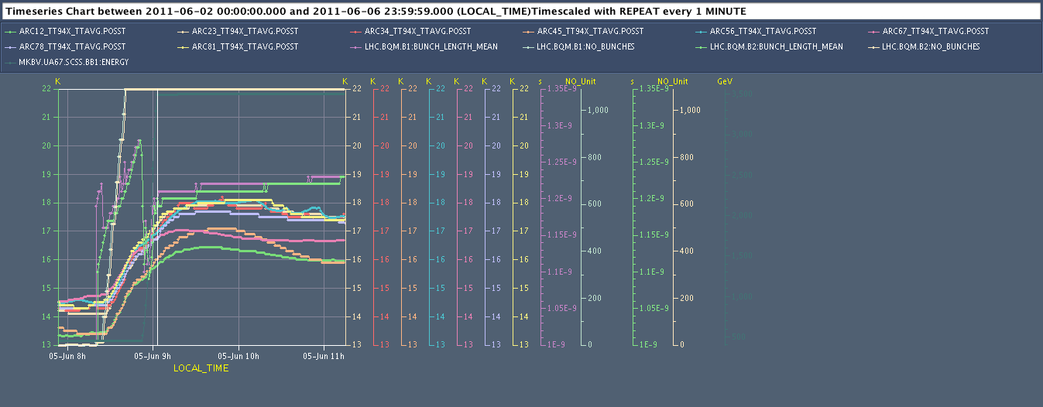
Too low bunch length => direct impact on image current heat loads!
Injection
18K
Bunch L B1
Ramp
ARCs 34 & 56 mostly penalised
Injection
Longer bunch length => lower heat loads
18K
Very homogeneous behaviour of all arcs
Ramp

Slide 4
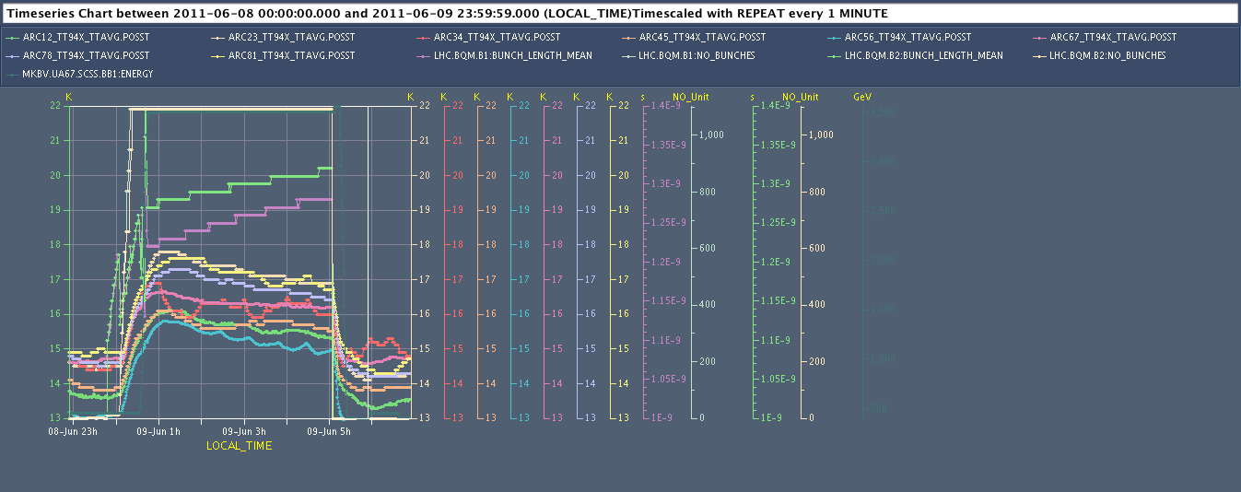
Cryogenics – beam screen heat load
Injection
Longer bunch length on purpose => lower heat loads confirmed
18K
∆T
Appreciated as well by collimators and kickers !!!
Ramp
Temperature increase (Peak - before injection) for 1092 bunchs:
Maxi: +4.5K (1836, 1.12ns-1.14ns)
Avg: +3.6 K
Mini: + 2.6K (1859, 1.22ns-1.27ns)
(always about 2.0K for injection, rest for ramp effect)
Serge Claudet

Slide 5
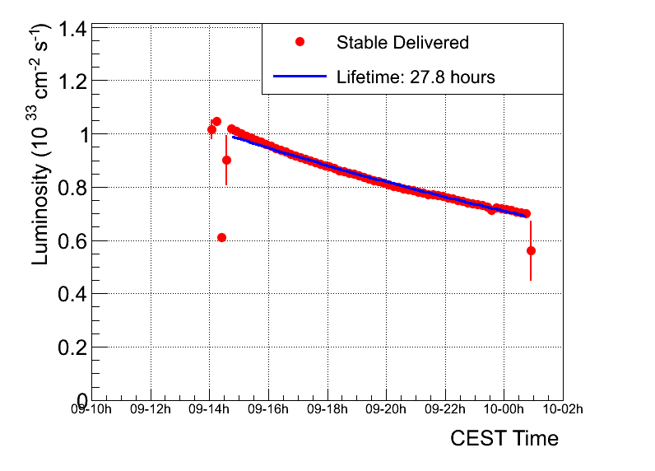
1826
~826 pb⁻¹ total for the year

Slide 6
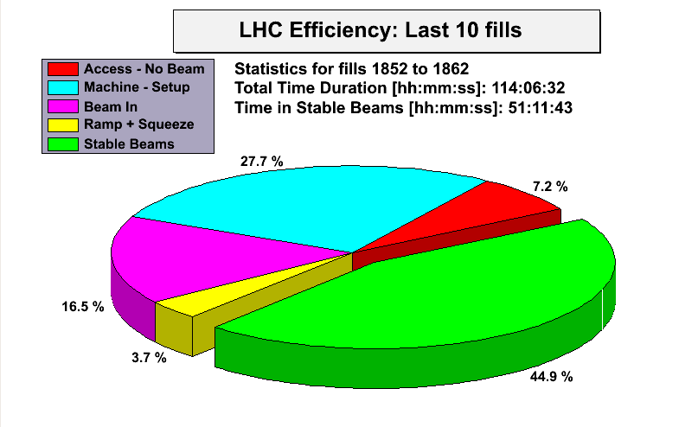
Alick

Slide 7
Incoming
Access – 2 hours now
beam dump
BLMs end of dump line…
Q’’ & then physics
Checklist to allow for the transition from 1092 to 1236 bunches
Outstanding
End of fill: TCL adjustment
Q’ decay following long fill

Slide 8
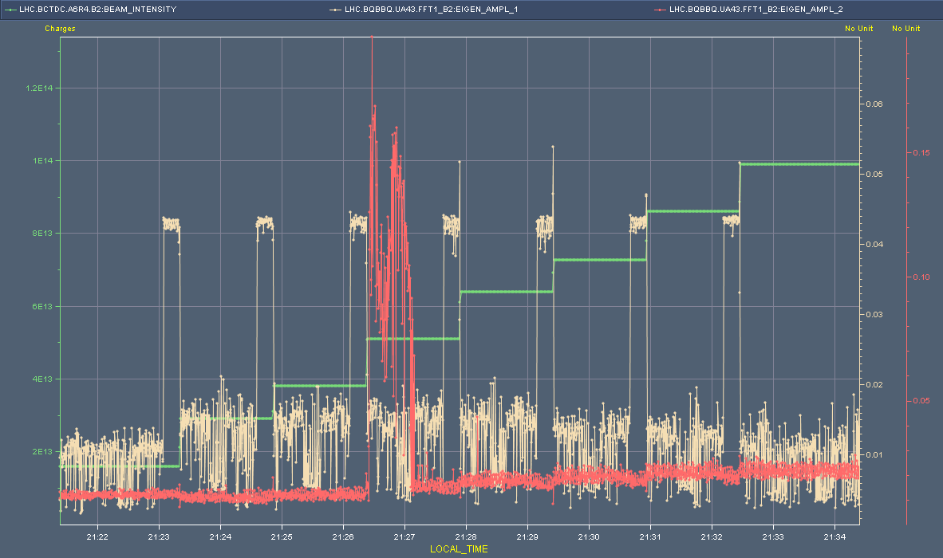
Beam 2

Slide 9
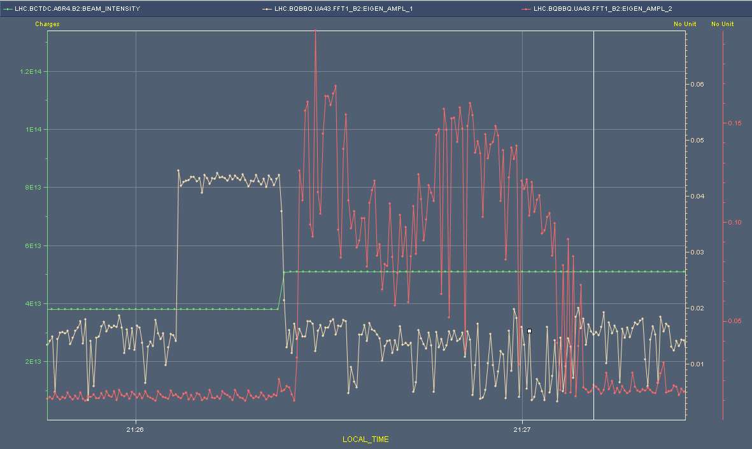
B2 - zoom

Slide 10
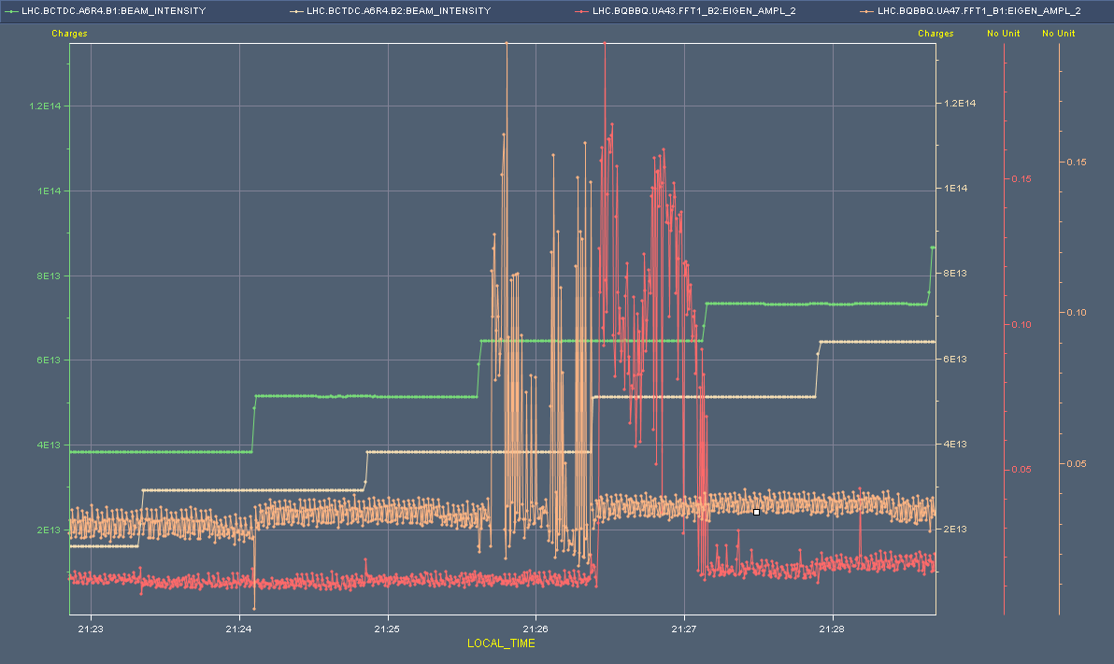
Beam 1 then beam 2

Slide 11
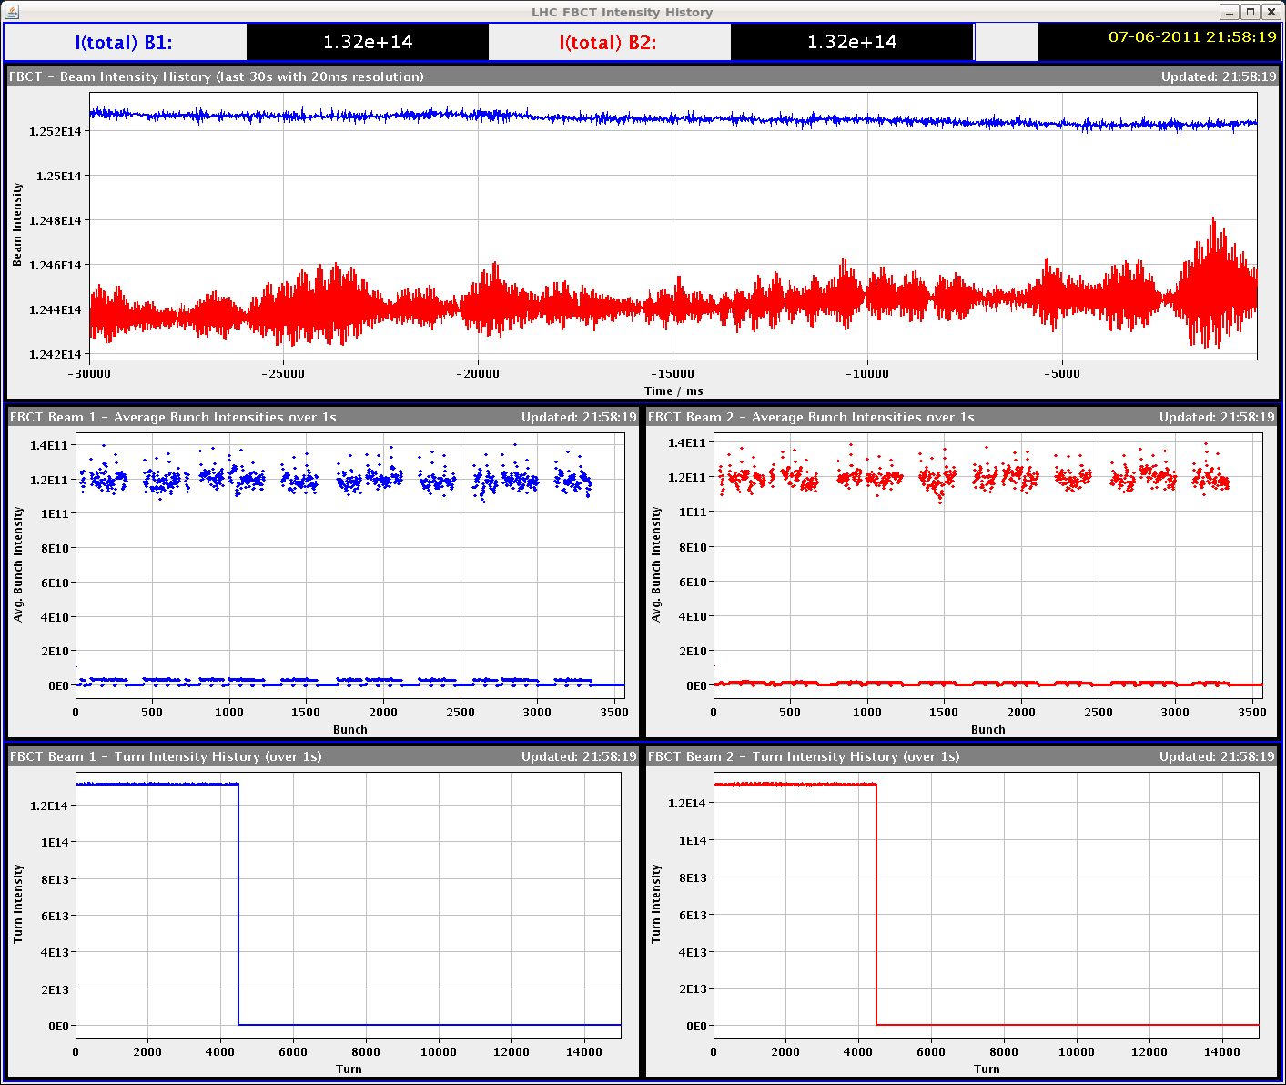

Slide 12
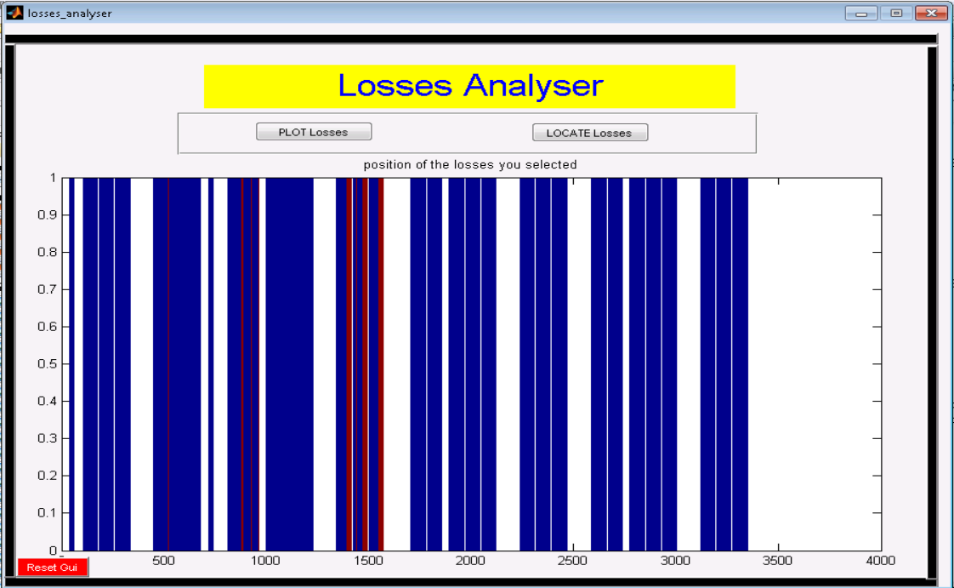
Beam 1 losses in physics
Georges Trad

Slide 13
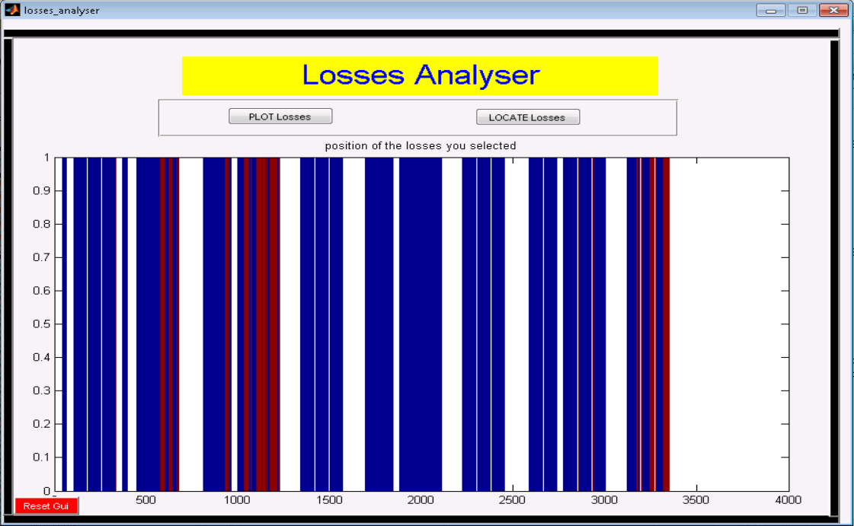
Beam 2 losses
Georges Trad

