Slide 1
Sunday 12th
00:29 Stable beam fill #1864. Initial lumi 1.1e33
07:17 beam dumped by trip of RD2.L1
Integrated lumi 23 pb-1
10:30 Cryo maintain back
11:30 Injecting - some injection steering
13:56 Stable beam fill #1865. Initial lumi 1.1e33
03:22 Beams dumped, collimator interlock
Integrated lumi 42 pb-1
05:00 Access for change of power converter
07:13 Injecting probe beam

Slide 2
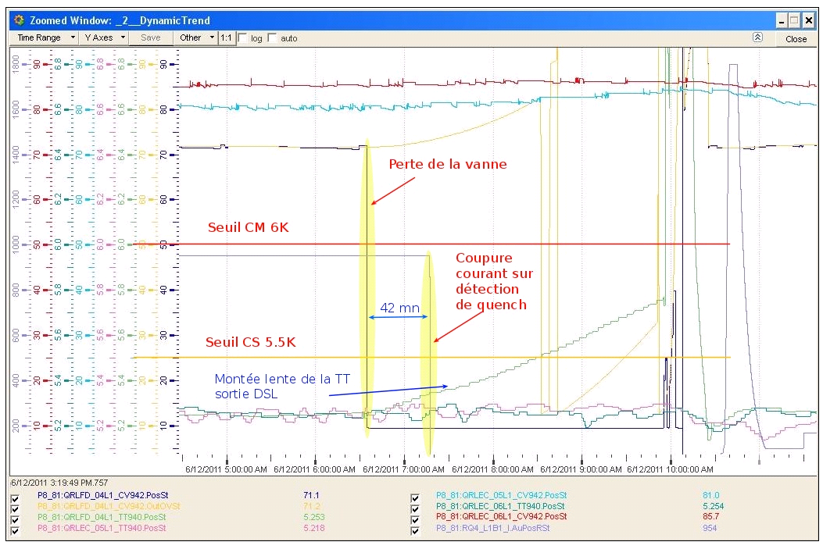
Trip of RD2.L1
Bus-bar quench, following cryo valve control problem
Heaters fired, quenched RD2.L1
Vacuum valves in around RD2.L1 following vacuum spike, 2.1 s after dump request by PIC
Michel Combe

Slide 3
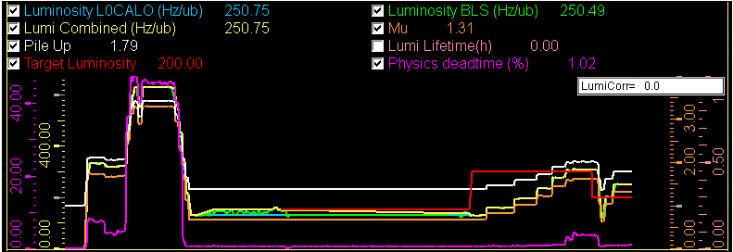
Fill #1865 – LHCb levelling problem
We went for too high with the optimize all routine for LHCb which went up to 600 (ub.s)^-1! It looks like we were heads on in Vertical and completely OFF in Horizontal. The Optimize All (in H plane) put us too much in collisions. We tripped LHCb.
Put manually LHCb to 250 (ub.s)^-1 on request of LHCb, with levelling OFF
Smoothly restarted the leveling 1/2 hour later @ 300 (ub.s)^-1
Short term improvements to prevent this in the future
Richard Jacobsson

Slide 4
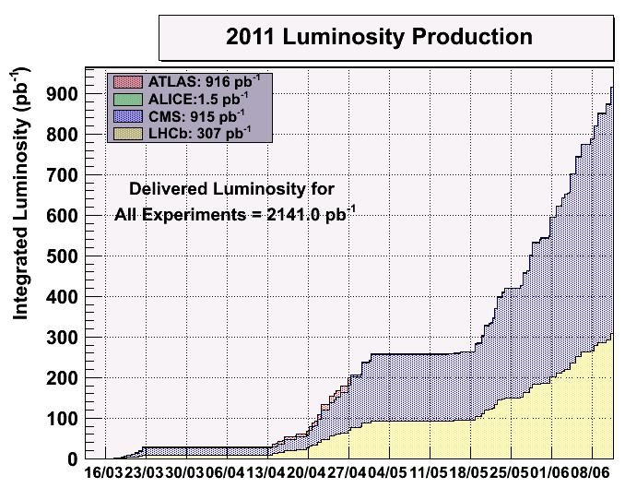
Including fill #1865: @ 915 pb-1

Slide 5
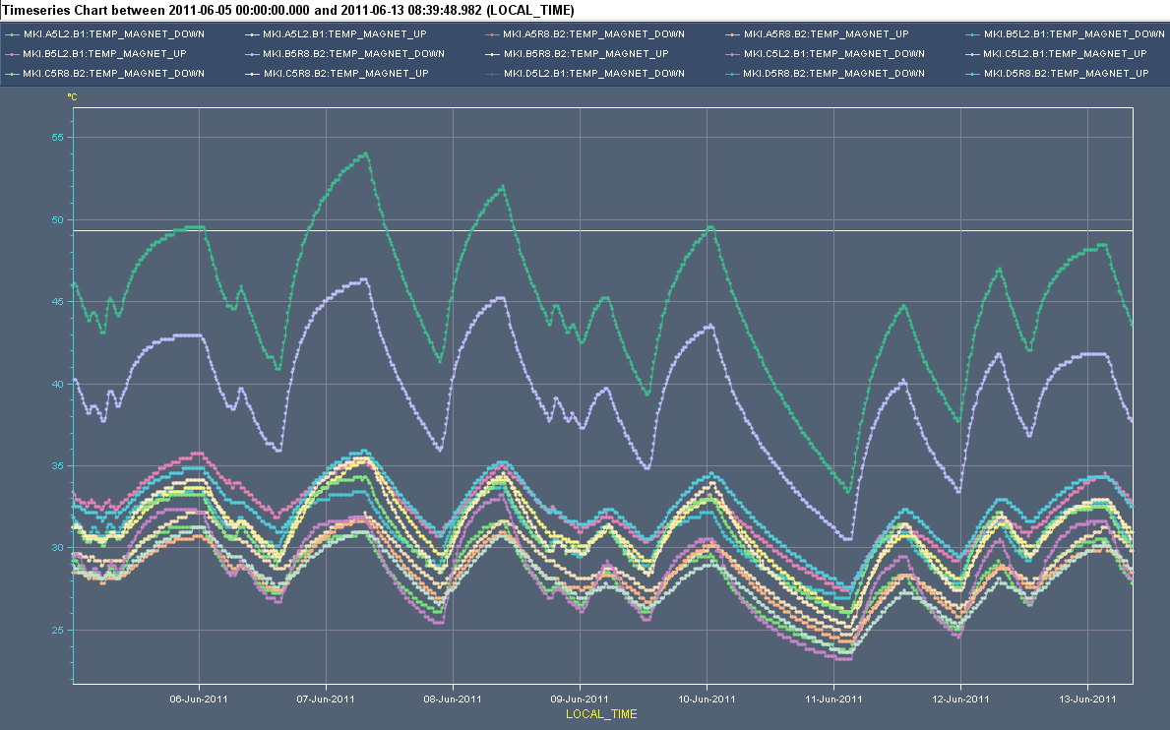
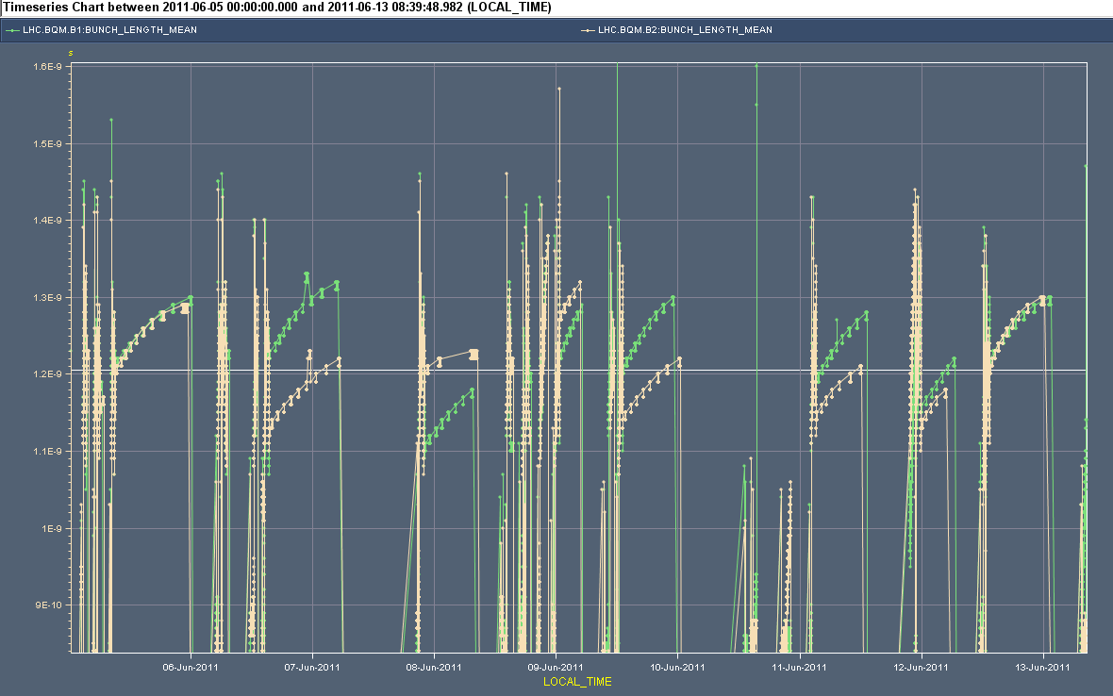
Integrated efficiency indicator
MKI profiting from the longer bunch lengths
Like cryo, collimators,....
Temperatures
Bunch length

Slide 6
Plan
Physics 1092 x 1092 bunches, trains 144 bunches
Not for today
Physics 1236 x 1236 bunches, trains 144 bunches
rMPP approval procedure OK
After RF main power coupler conditioning, which would otherwise be at the limit
Outstanding
End of fill: TCL adjustment
Q’ decay following long fill

