Slide 1
Wednesday 8th (I)
09:22 Fill #1855. Beams dumped by Alice dipole trip Stable beams for 10.5 hours; int. lumi 31 pb-1
After investigation EPC could not find an explanation for the fault
BLM problems
14:00 Inject for test ramp longitudinal blow-up
15:30 Test ramp dumped
BPM calibration problem
It seems this is due to the fact that the telegram is not sent out….
17:30 Some injection steering with 12 bunches on B1
17:45 Injecting for physics fill #1858 – trains of 144 bunches
No difference seen compared to trains of 108 bunches
B2 some vertical blow-up at injection
19:00 Luminosities around 1.1e33, but did not declare yet stable beams
19:04 Beam dump fill #1858 due to Big UFO IP2

Slide 2
Wednesday 8th (II) & Thursday 9th
20:04 Injecting probes fill #1859
21:07 SPS extraction problem for B1; TI2 power converter problem
Use waiting time to change chromaticity on B2 (1094 bunches) and study BBQ amplitude signals – no obvious conclusion
22:20 SPS back but problems with “beam dump”
XPOC time stamp from ring FBCT – works again later without any action
IPOC server down – ok after server reset
23:14 injecting probes fill #1859
01:09 Stable beams, lumi 1.05e13
Small beam currents, but no blow-up
05:04 Site wide electrical glitch tripped the beam, caught by FMCM
Int. lumi 13.3 pb-1
QPS not ok for RB.A56 (new QPS) and RB.A81 (old QPS)
07:45 Start pre-cycle

Slide 3
BLM problem
09:50 BLM sanity check is failing
10:20 « The intervention on the BLM might be longer than expected »
12:50 BLM problem “solved”:
Sanity check was failing due to 6 monitors out of limits. These monitors have been excluded from the sanity check, since they are not critical (not connected to BIS): but there is a reason that they are there!
They have been masked from the XPOC as well, as they are towards the end the dump line (last 6 monitors on TD62): new release of XPOC limits
To be fixed as soon as possible – needs 2 to 3 hours intervention

Slide 4
New longitudinal blow-up
We have tried with 12 bunches an improved longitudinal blow-up, with a target-length that is increased at the beginning of the ramp (1.35 ns), then linearly reduced to reach 1.25 ns at start flat top. The results are mixed:
We do not under-shoot anymore (good!)
but we still have ~ 100 ps dispersion in results. We got to 1.1 ns on B1 and 1.2 ns on B2 (see attached).
We keep observing fast 150 ps "jumps". These are not related to the blow-up method and are investigated in parallel.
We leave this "new" blow-up operational for next physics fill.
Philippe B.

Slide 5
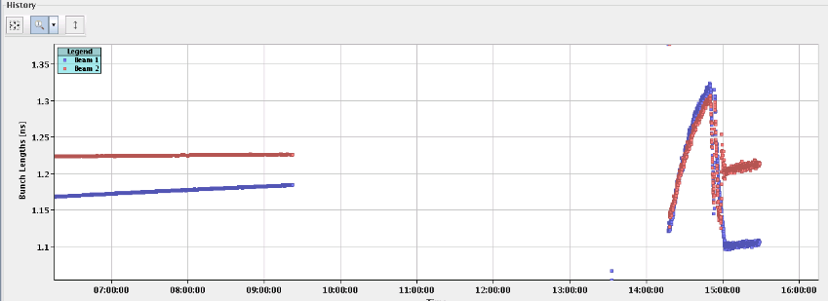
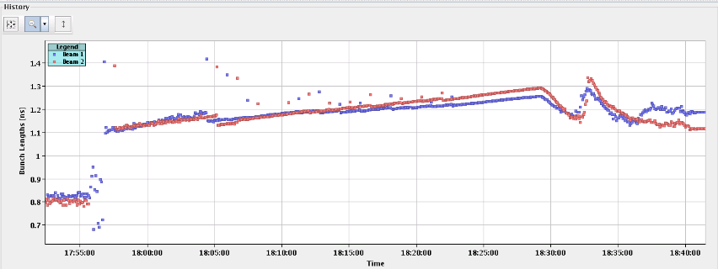
Bunch length with new blow-up
Test ramp with 12 bunches
Both ramps finishing with 1.1 – 1.2 ns end of ramp
Physics ramp 1094 bunches
“I have made the excitation a bit more aggressive for next ramp. I will keep checking.” This gave 1.2 and 1.3 ns bunch length after the ramp of the night

Slide 6
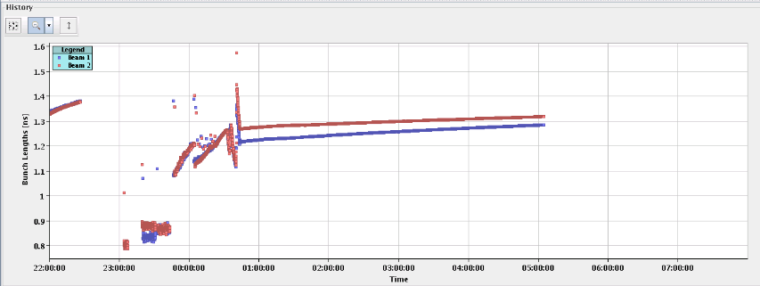
Longitudinal Blow-up
Ramp of last night with “the excitation a bit more aggressive”

Slide 7
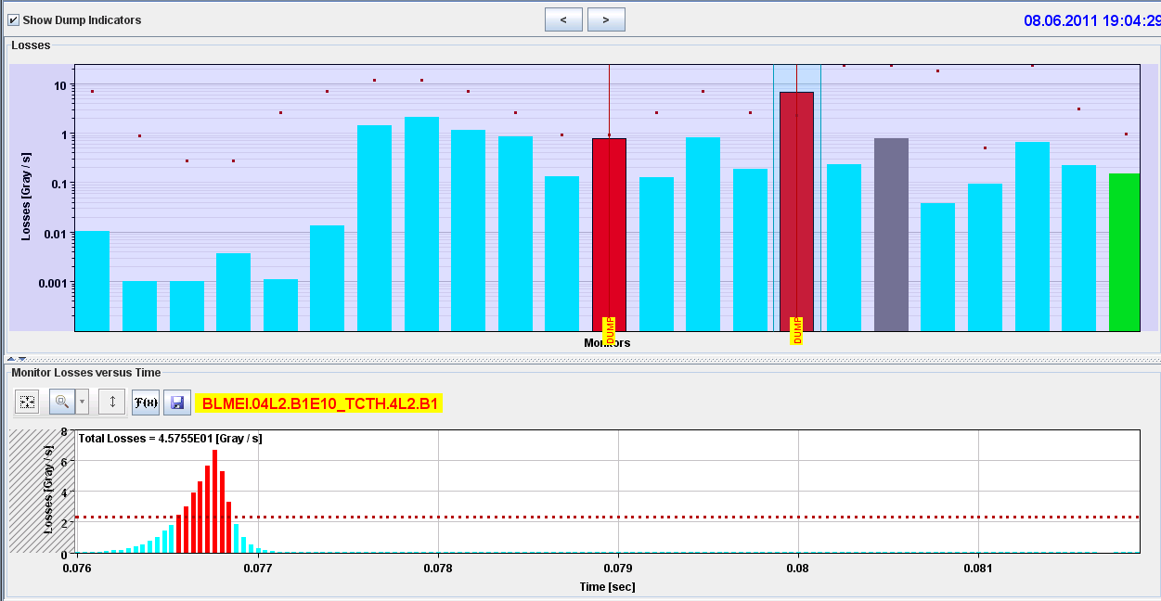
19:04 Beam dump fill #1858 due to Big UFO IP2
TCT
MKI-C
Q4
MKI-D

Slide 8
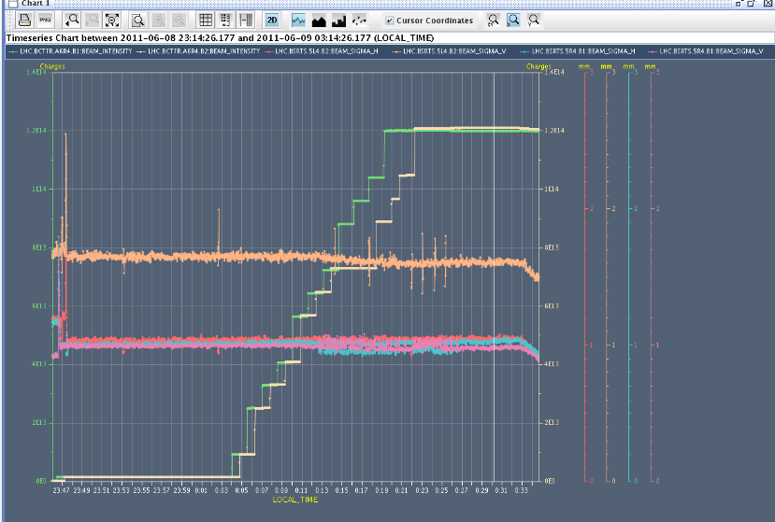
Fill during night: no blow-up (BSRT sigma’s)

Slide 9
Plan
Physics 1092 x 1092 bunches, trains 144 bunches
If a good couple of fills: +144 bunches
Outstanding
End of fill: TCL adjustment
Q’’
Q’ decay following long fill

