Slide 1
Sunday/Monday 05.06. & 06.06.
06:30 Stable beams. Fill #1851.
06:56 Dump: Ufo MKI pt 2. Length stable beams: 0h26.
08:30 injection for physics
09:26 Stable beams. Fill #1852. Lumi ~1.1e33.
00:31 Beam dump: QPS trigger on RQTL11.R7B1. Length stable beams: 15h05.
07:30 Stable beams. Fill #1854.
07:39 PC failure of RQ6L2. Length stable beams: 00h09.

Slide 2
Week Summary (R. Assmann & B. Holzer)
Goal: 250 pb⁻¹
Weeks results:
Highest luminosity per fill: 46.5 pb-1 (new record)
Production in week: 200 pb-1 (new record)
Average bunch intensity: 1.2e11 (slightly lowered)
Typical luminosity: 1.1e33 (slightly lowered)
Number of bunches/beam: 1092 (from week 21)
Number of stable beams: 14
Average length stable beams: 4.2 h (mostly short fills)
Bunch length blow-up: 1.25 ns (plus 50 ps)
Average turn around: 5.5 h (2.5 h best)
144b injection: fully commissioned & tested
TOTEM/ALFA: RP settings qualified for physics
Nice week but could have been even nicer…

Slide 3
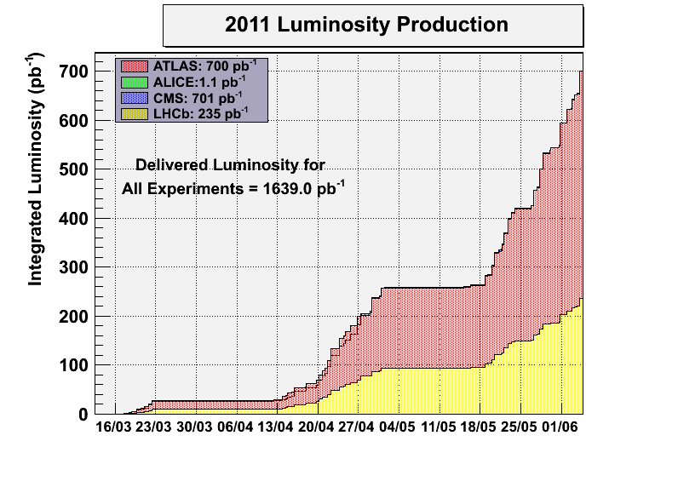
Luminosity Production

Slide 4
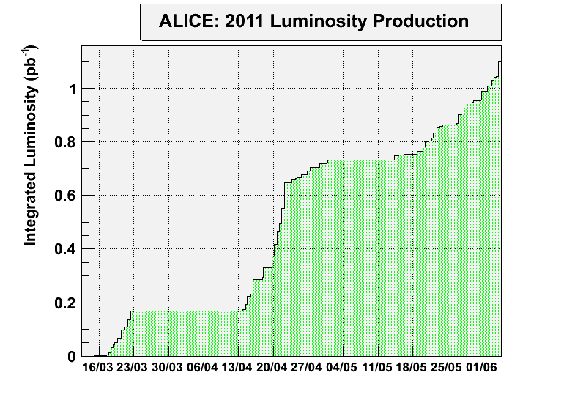
Luminosity Production

Slide 5
Performance (ATLAS figures)
Maximum Luminosity Delivered in one fill | 46.61 pb⁻¹ | Fill 1836 | 11/06/01, 18:49
Maximum Luminosity Delivered in one day | 46.84 pb⁻¹ | Thursday 02 June, 2011
Maximum Luminosity Delivered in 7 days | 201.05 pb⁻¹ | Monday 30 May, 2011 - Sunday 05 June, 2011

Slide 6
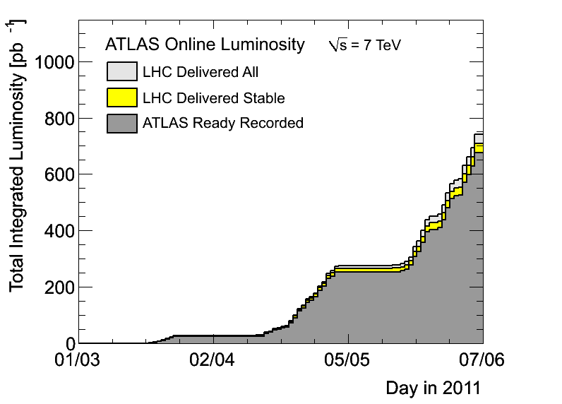
Integrated Lumi (ATLAS)

Slide 7
Turn-around Time: Dump SB → SB
Number | Length | Total
1 | 03h03 | 3.05
2 | 05h26 | 5.43
3 | 04h48 | 4.80
4 | 08h05 | 8.08
5 | 07h24 | 7.40
6 | 04h59 | 4.98
7 | 05h28 | 5.47
8 | 07h10 | 7.17
9 | 06h15 | 6.25
10 | 02h30 | 2.50
Average |  | 5.51
Average turn-around time: 5.5 h

Slide 8
Beam Dumps at > 450 GeV – I
Date | Time | State | Reason
30/05 | 11h08 | Stable beams | QPS trigger circuit detector of RCBXH2.L1. SEU?
 | 15h43 | Adjust | New RF interlock not masked
 | 20h20 | Adjust | FMCM. Electrical glitch
31/05 | 06h22 | Stable beams | UFO IR2L
 | 10h38 | Stable beams | Communication with DFBAJ. SEU?
 | 22h20 | Squeeze | UFO IR2L
01/06 | 02h10 | Squeeze | QPS trigger (Quench of Q9R5 ?)
 | 06h53 | Adjust | RF trip (radiation-induced arc detector signal?)
 | 09h17 | Ramp | Collimator temperature
 | 20h37 | Stable beams | Collimation crate IR5R failure (PRS)
02/06 | 16h58 | Beam dump | EIC
 | 21h50 | Stable beams | UFO IR8
03/06 | 00h28 | Squeeze | Trip of RQTF.A23B2
 | 13h30 | Stable beams | Loss of I_meas reading
 | 18h24 | Squeeze | UFO in IR8R
 | 21h17 | Stable beams | Trip undulator IR4.

Slide 9
Beam Dumps at > 450 GeV – II
Date | Time | State | Reason
04/06 | 07:56 | Stable beams | QPS FIP communication lost, close to IR1. S12 tripped.
 | 16:19 | Stable beams | Power converter fault.
 | 20:20 | Flat top | UFO IR2L
05/06 | 00:15 | Stable beams | RF trip
 | 03:48 | Adjust | LHCb magnet trip
 | 06:56 | Stable beams | UFO IR2L
06/06 | 00:31 | Stable beams | QPS trigger on RQTL11.R7B1.
 | 07:39 | Stable beams | PC failure of RQ6L2.
Increase of BLM dump threshold
for Q4 (MQY) at MKI’s by factor 2
24 beam dumps at > 450 GeV, only one dumped by OP.

Slide 10
Length Stable Beams: 14 this week so far
Fill | Length | Total
1816 | 09h00
1822 | 00h27
1823 | 01h13
1835 | 01h06
1836 | 14h55
1839 | 00h04
1841 | 07h35
1844 | 00h23
1845 | 05h40 | 40h23
1846 | 02h55
1848 | 00h46
1851 | 00h26 | 44h30
1852 | 15h05
1854 | 00h09 | 59h44
Average length stable beams: 4.2 h

Slide 11
Tuesday to Wednesday
Injection preparation for 144b
Collimator temperature
QPS noise → quench
Cryo S56
Cryo S34
UFO IR2
RF arc

Slide 12
Wed Night / Thu Morning
2. June
00:31h BEAM MODE > Injection Probe Beam
02:03h BEAM MODE changed to STABLE BEAMS, Luminosity
15 hours run

Slide 13
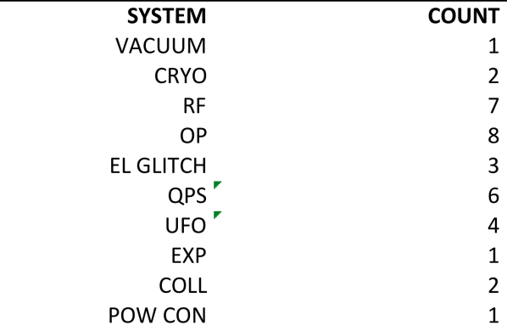
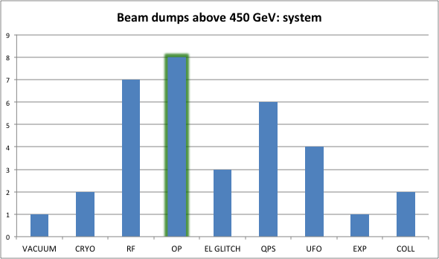
System
Mike L.

Slide 14
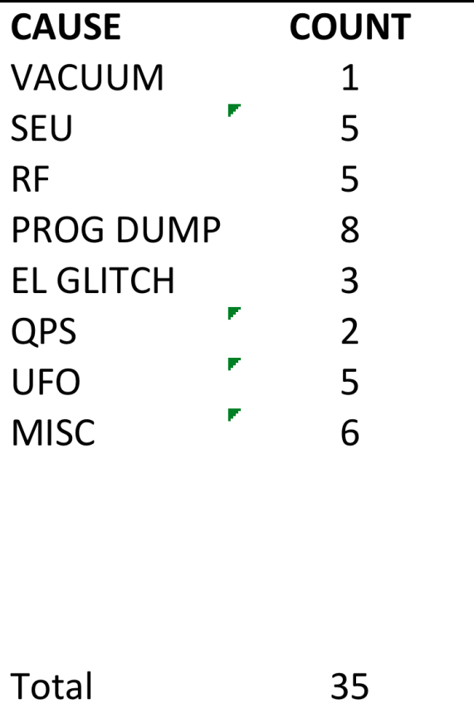
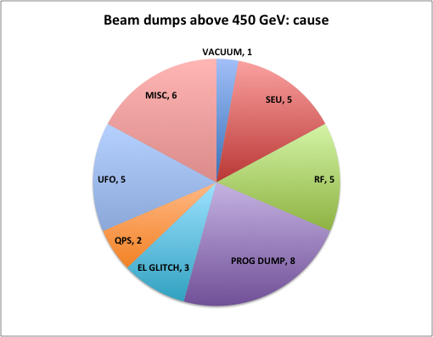
Cause
Mike L.

Slide 15
Ongoing injection problems
Consistent problems after long fills:
First filling attempts after long fills hit by strong emittance blow-up: ~100%.
Blow-up happens mostly a few seconds after injection.
Seen as beam instability.
Not all batches affected. Some good, some bad.
Seeing drifts in chromaticity at flat bottom after long fills.
Not understood. Possible actions:
Update Fidel model to take into account better long powering history.
Full pre-cycle after long fill.
Check for the hump. Is it back?
Tails beneficial for Landau damping → less scraping in SPS? Last fill with larger emittances (less scraping) went without problem, but also benfited from earlier short fills.

Slide 16
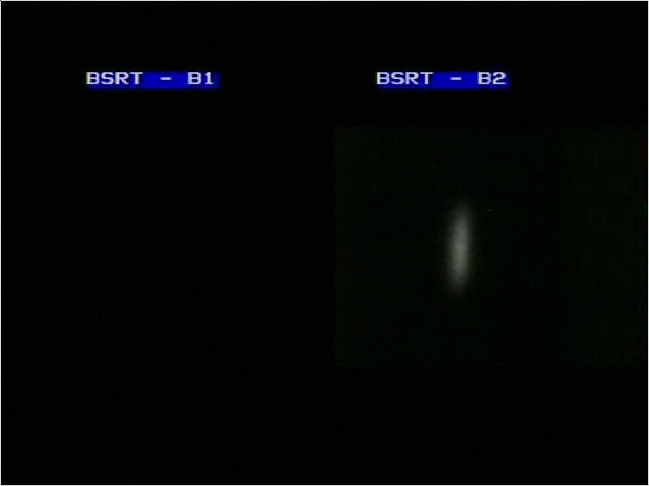
Vertical Blow-up B2

Slide 17
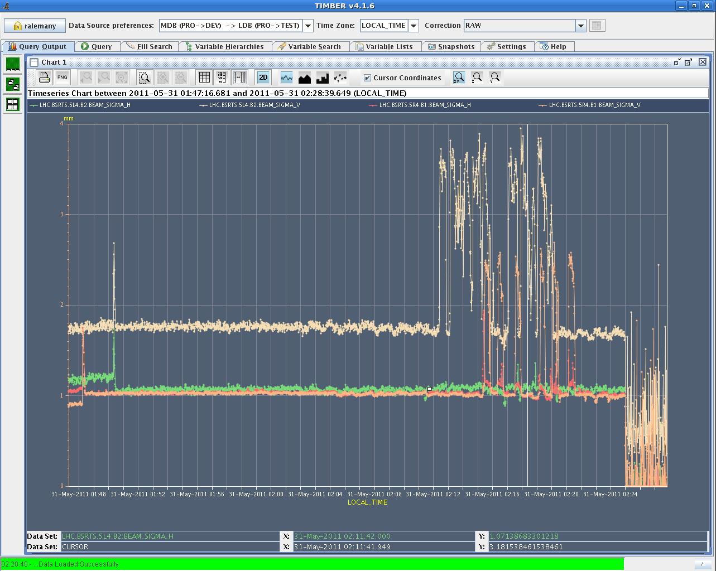
Emittance Blowup B1/B2 V
To be understood…
Real 100% emittance growth
or instrumental effect?

Slide 18
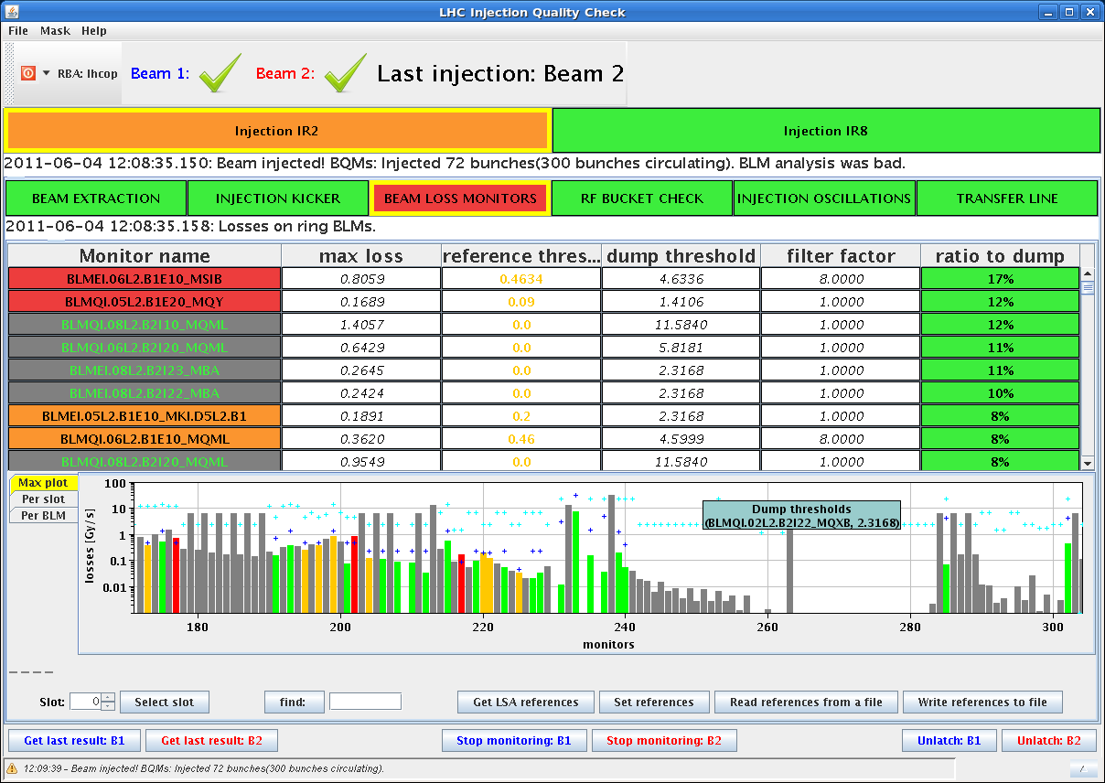
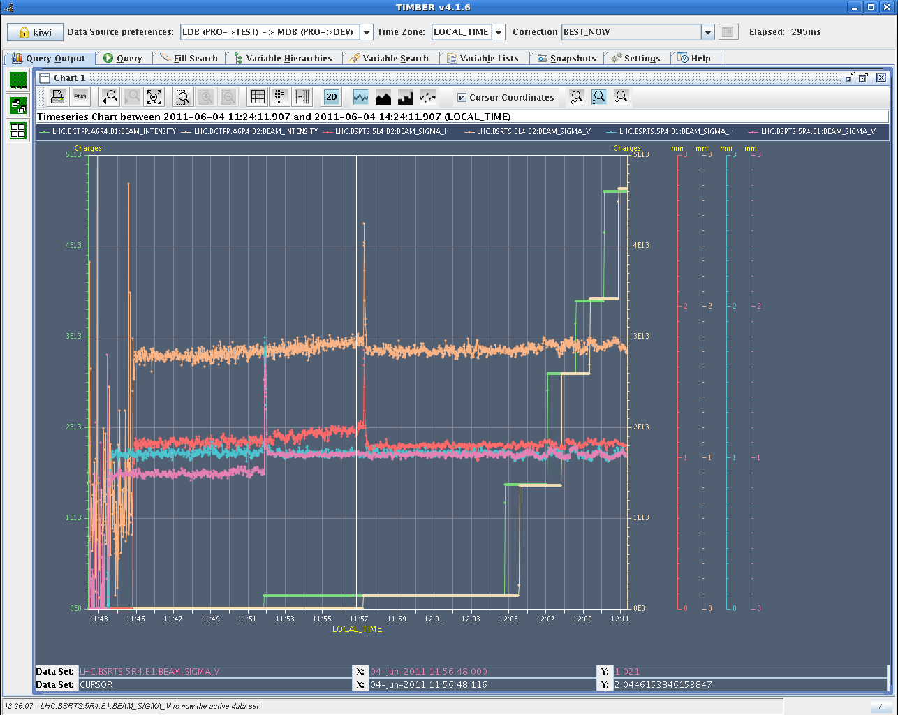
Sat morning
4. June
11:26h Injection for physics
... as decided: single bunch intensity
limited to ≈ 1.2*10¹¹
Emittances ok
beam 2 v
beam 2 h
beam 1 h
beam 1 v

Slide 19
Sat Morning
4. June
13:24h Ramp, Squeeze, Lumi
beam quality: One b2 108b injection suffered more than the rest.
That 7th injection had bunches blown up in V
intensities
emittance
!! here !!

Slide 20
UFO’s 2.6.
5 MKI R8
1 MKI L2

Slide 21
UFO’s 3.6.
3 MKI L2
4 MKI R8

Slide 22
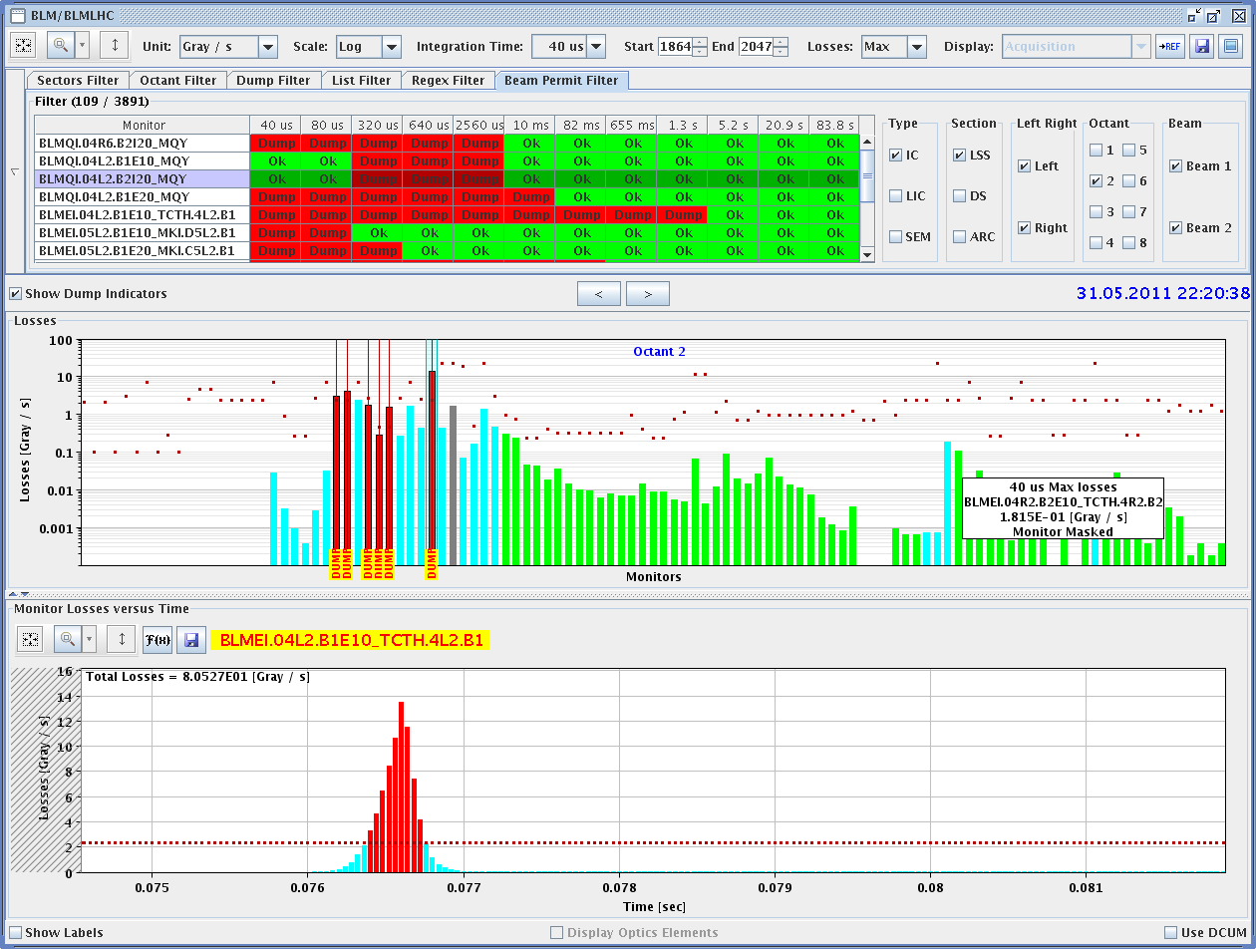
Tue Late
22:20 h Ramp, squeeze, Ufo
close to the MKI (the same
as this morning)
21:51h and once again ... much better now injections were very clean
from losses point of view.no sign of emittance growth,

Slide 23
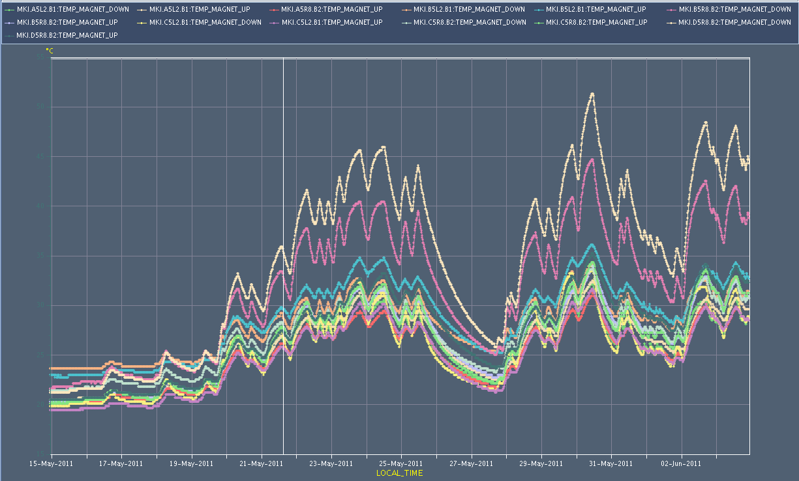
Injection Kicker Temperatures

Slide 24
Collimator Heating by EM fields
Bunch Length
25 deg.
0.5 ns
Collimator
temperature

Slide 25
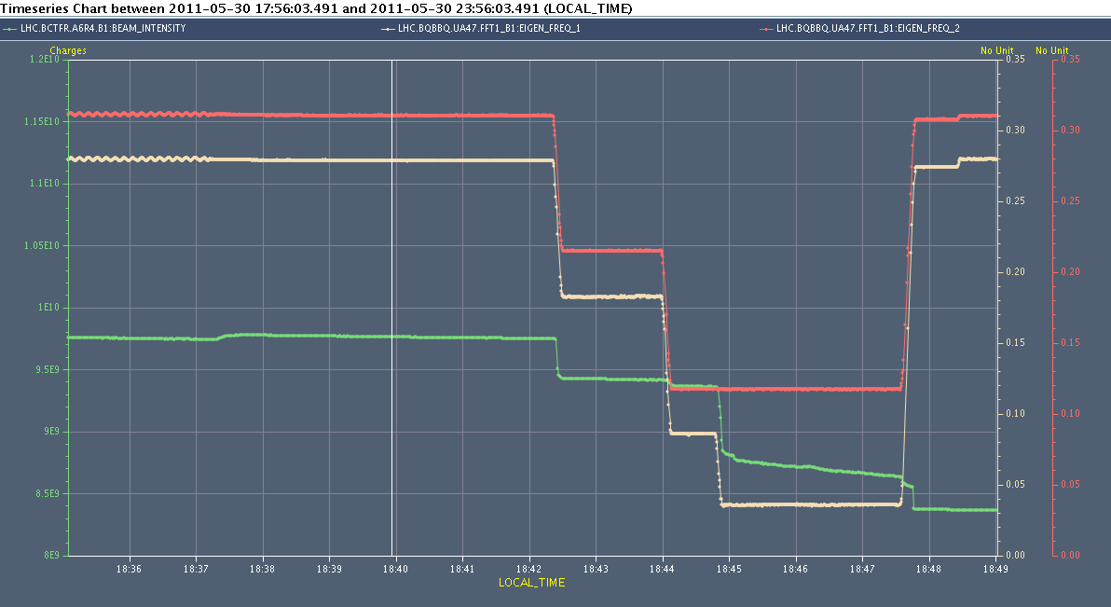
Parasitic MD: Integer Resonance
QV
QH
Beam Intensity
➔ Integer resonance is very narrow!

Slide 26
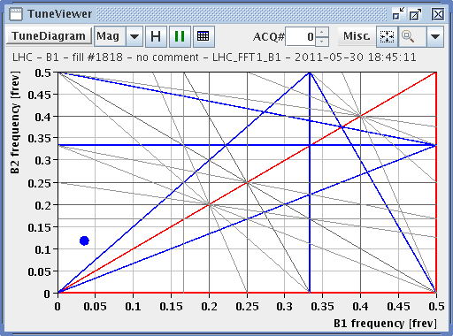
Parasitic MD: Integer Resonance

Slide 27
Ahead
Physics fills continued (1092 x 1092 bunches, 108b injections).
Average bunch intensity: ~ 1.2e11 p
End of fills (if any):
Try to reduce DS losses with TCL collimators (open now)
RF cavity switch off test
There is a chance to reach 1 fb-1 end of this week or beginning next week…
This week coordination: Mike Lamont and Jan Uythoven

