Slide 1
LHC Status Wed Morning 1-June
Bernhard Holzer, Ralph Assmann et al
Tentative Planning
Tuesday am | Physics with 1092 bunches per beam In shadow: SPS intervention End of fill: Move in physics debris collimators (TCL)
Tuesday pm | Test of 144b injection? Injectors being set up, then decide...
Tuesday night – Wednesday | Luminosity production
...
Goal: Produce > 250 pb-1 in one week (- 9 min)

Slide 2
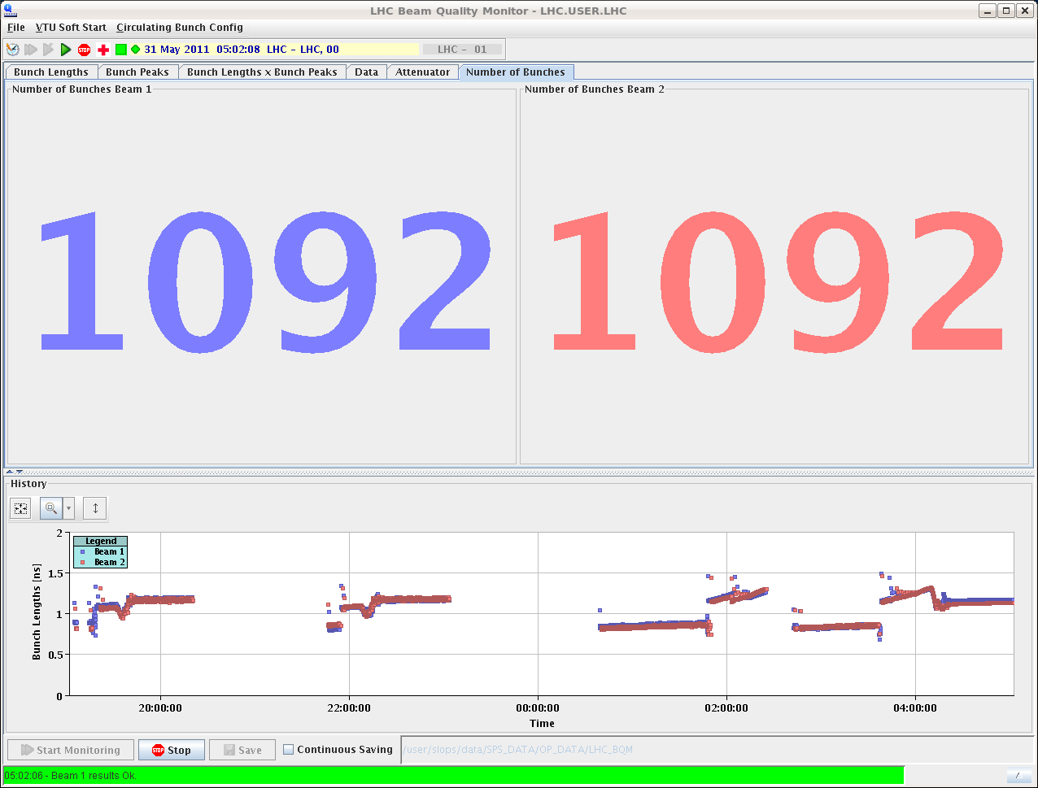
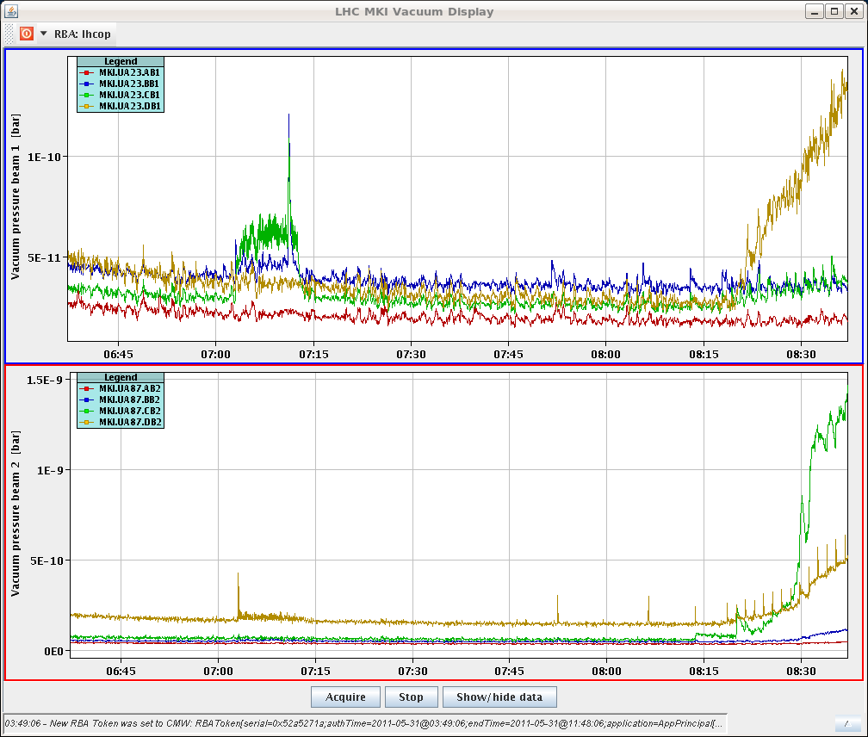
Tue morning
07:20h Machine ready for injection
Vacuum: the usual
... “being close to the limit”

Slide 3
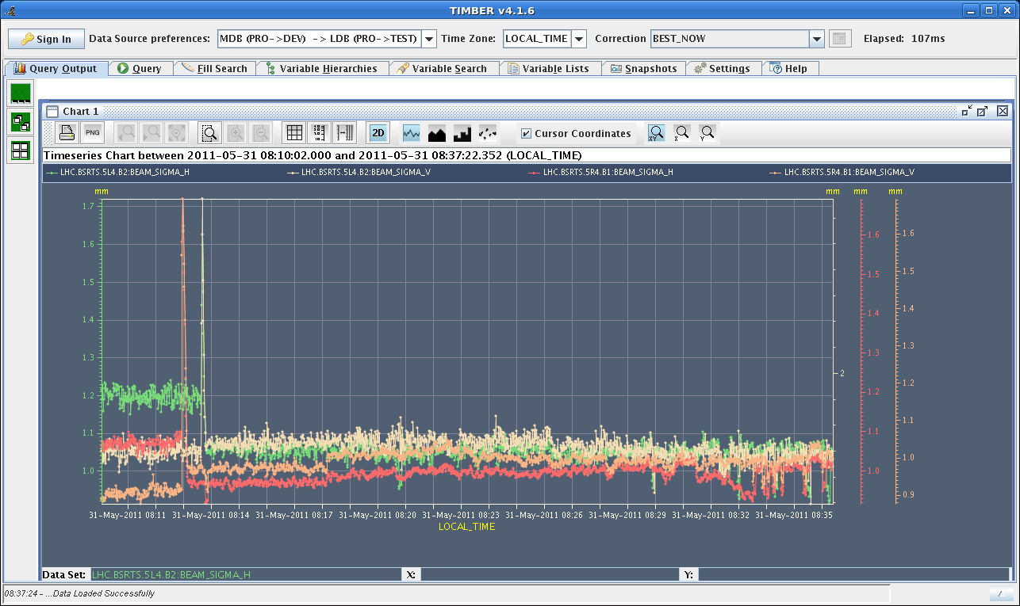
Tue morning
Beam sigma from BSRT, during filling.
No blowup for any bunches in the trains injected so far.
and nice bunch intensity
distribution

Slide 4
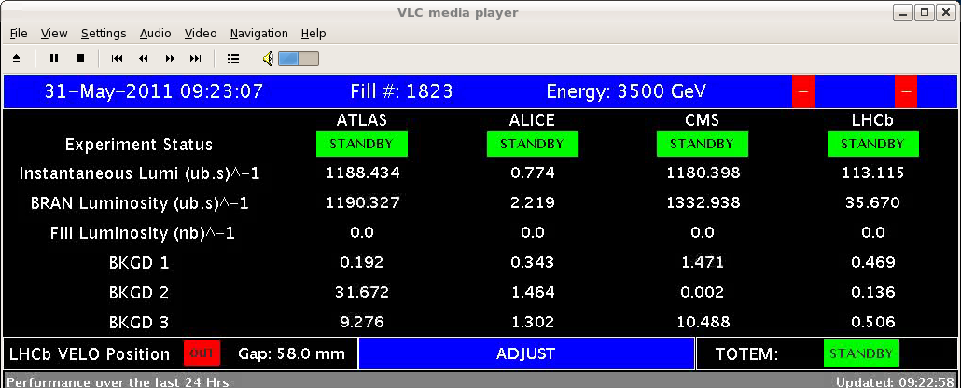
Tue morning
07:44h Lumi after optimising IP1/5/8
Lumi not as good as before. Apparently the last batches were blown up.

Slide 5
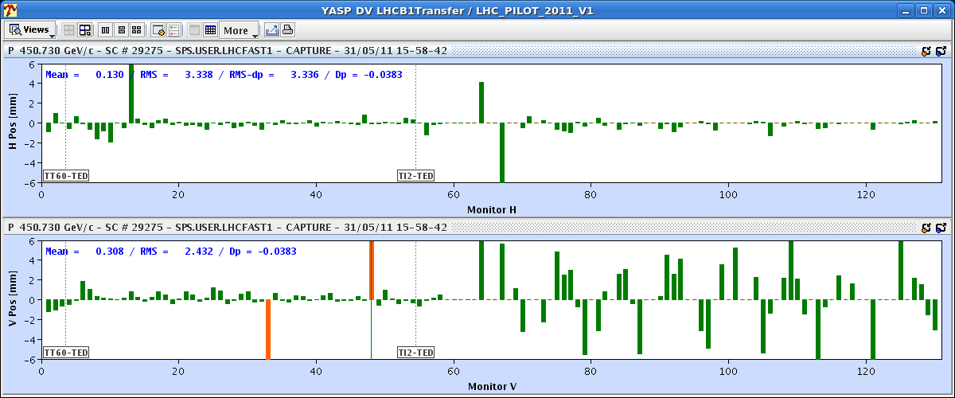
Tue Morning
10:38h
Lost cryo-maintain for arc S56.
Cryo lost communication with DFBAJ, high and
low current. Could be SEU again according to them.
10:59h Access required to reset cryo crate.
12:25h ...access for point 5 finished.
But as usual we lost the patrol.
15:29h Tests / Optimisation for 144 bunch transfer
Opened TCLIb beam 1 to 8.3 sigma.
and applying orbit
oscillations to check
collimator settings

Slide 6
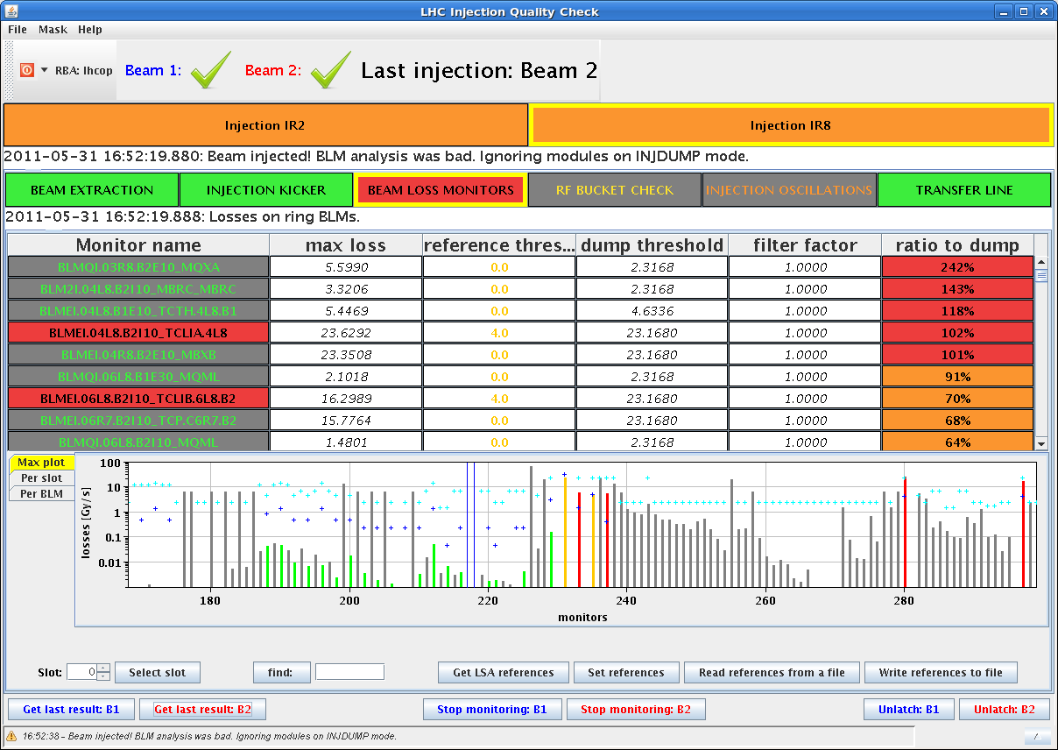
Tue late
Tests / Optimisation for 144 bunch transfer
We carried out qualification measurements for slightly more opened TCLIb settings simulating MKI failures with various
angles. ...to be analysed
before applying
Loss map with injection
protection in and new
TCLIb settings to be made
before proceeding with
these settings.
Orbit oscillation created
in both beams, +/- 12 σ
17:17 h Cryo maintain lost in AMR3 Sector 34 tripped. We have to wait for the cryo to come back and we have to precycle

Slide 7
Tue Late
19:23 h Injection Physics Beam ...
... very bad injection on beam 2, we dump and re-inject
bunch intensity
21:51h and once again ... much better now injections were very clean
from losses point of view.no sign of emittance growth,

Slide 8
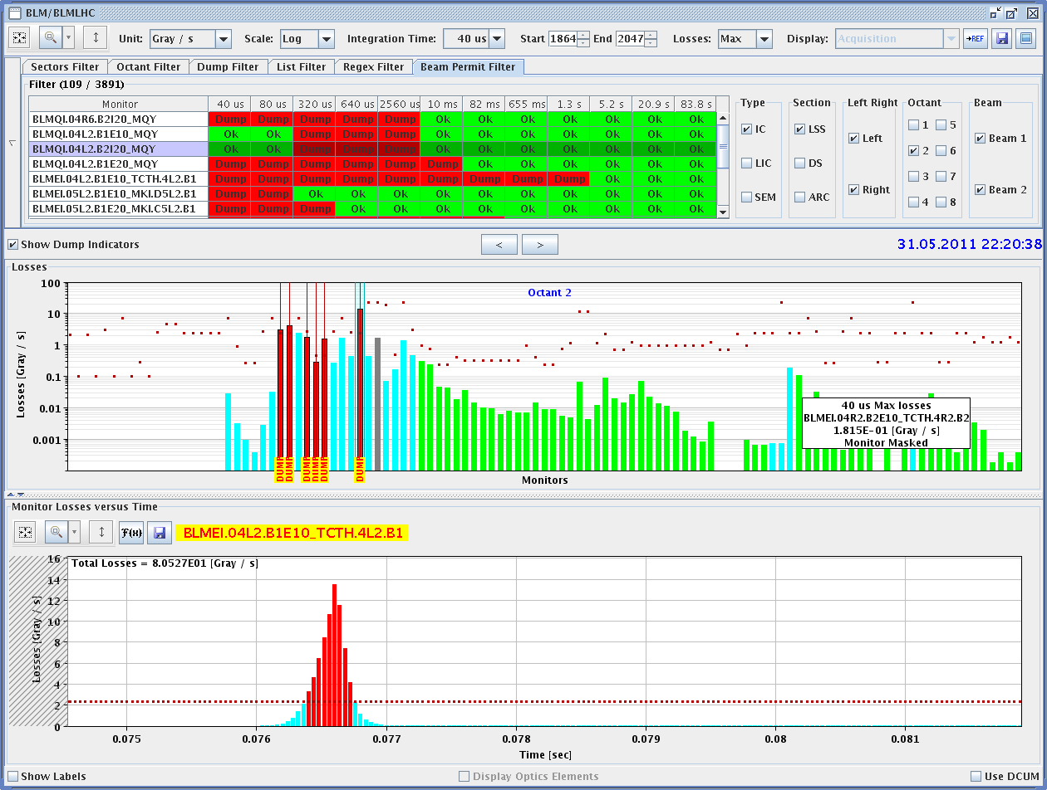
Tue Late
22:20 h Ramp, squeeze, Ufo
close to the MKI (the same
as this morning)
21:51h and once again ... much better now injections were very clean
from losses point of view.no sign of emittance growth,

Slide 9
Tue Night / Wed morning
00:41 h NJECTION PHYSICS BEAM
Emittance from the BSRT. No indication of blow-up.
02:10h ramp, squeeze, Dump: QPS trigger, Noise on QPS triggered the quench heaters on the Q9R5

Slide 10
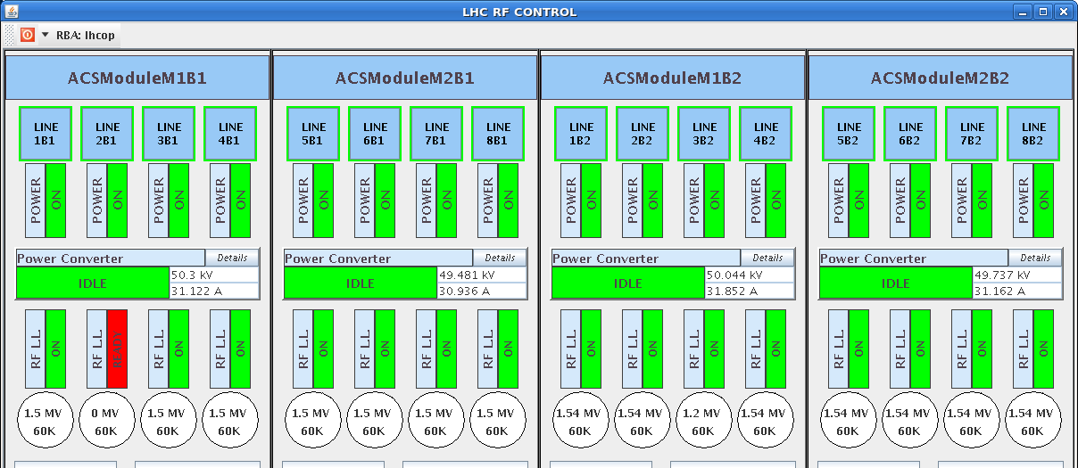
Tue Night / Wed morning
06:17 h INJECTION PHYSICS BEAM
ramp, squeeze, ... ?
06:53 h Dumped by the RF interlock. One module ONLY tripped.

Slide 11
LHC Status Wed Morning 1-June
Bernhard Holzer, Ralph Assmann et al
Tentative Planning
Tuesday am | Physics with 1092 bunches per beam In shadow: SPS intervention End of fill: Move in physics debris collimators (TCL)
Tuesday pm | Check TCLIB setting, Test of 144b injection? Injectors being set up, then decide...
Tuesday night – Wednesday | Luminosity production
...
✔
to be done
✔ ... needs further test
to be done
to be done

